Slide 1
HTML
Today’s Topics
Intro Webpack
List, Keys, Fragments
React – Props
Prop Validation
By Urvashi

Slide 2
PROPS
Props are basically properties passed as an argument in React Component.
This simply is shorthand for properties.
Props are how components talk/communicates to each other.
Props flow downwards from the parent component.
They are passed via HTML Attribute.
Props are immutable(not changing)

Slide 3
HTML
STATE VS PROPS
State
Props
They are mutable.
Collection data that resides inside your component.
States are the objects which determine components rendering and behaviour.
They are accessed via this.state
They are immutable.
Medium through which components talk/communicates to each other.
Props flow downwards from the parent component.
They are passed via HTML Attribute.

Slide 4
HTML
TYPECHECKING
As your app grows, you can catch a lot of bugs with typechecking. React has some built-in typechecking abilities.
PropTypes
Default Prop Values

Slide 5
HTML
PROPS VALIDATION
It check the types of the properties that we pass to the component.
Properties validation is a useful way to force the correct usage of the components. This will help during development to avoid future bugs and problems, once the app becomes larger. It also makes the code more readable.
propTypes is used for props Validation. If some of the props aren't using the correct type that we assigned, we will get a console warning.
Install: npm install --save prop-types

Slide 6
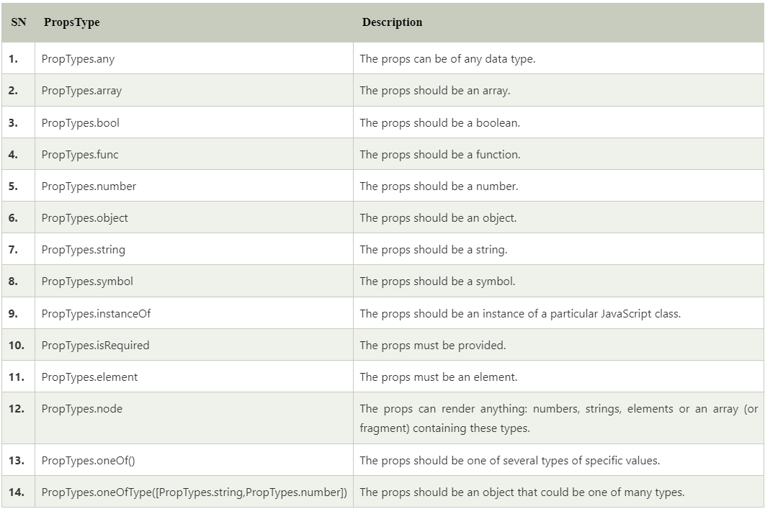
HTML
PROPS VALIDATION

Slide 7
HTML
Why not use Create React App Tool?
Create React App comes with its disadvantages. Specifically, using Create React App makes it difficult to add custom build configurations. We could eject the application (stop hiding what is installed under the hood), but that defeats the point of Create React App. Create React App also adds a lot of abstraction and it is important to understand what is required to create/run a React application. Create React App (CRA) ships with webpack already under the hood, but usually, we would need to add more configurations as our app grows. Luckily for us, we can create a webpack. config. js file and put our webpack configurations in there

Slide 8
HTML
What is Webpack?
Webpack takes files of different types such as JavaScript and front-end asset files (HTML, CSS, images, etc.) and packages them into a group of smaller files. Webpack also creates a dependency graph to import modules that are dependent on one another in the correct order. We could use alternatives such as Browserify or Gulp but webpack is the most widely used module bundler for React.

Slide 9
Setup Webpack
Please refer wepack-setup and webpack-setup-explanation files.

Slide 10
HTML
Webpack Loaders
Loaders are what webpack uses to handle and process different file types. Loaders dictate how certain file types should be preprocessed as they are imported/loaded.
babel-loader transpiles JavaScript code, sass-loader compiles SASS files to CSS, style-loader adds CSS to the DOM using style tags, etc.
Read more on: https://dev.to/riyanegi/setting-up-webpack-5-with-react-and-babel-from-scratch-2021-271l

Slide 11
LIST, KEYS, FRAGMENTS
List:
Lists are used to display data in an ordered format.
Key:
A key is a unique identifier. In React, it is used to identify which items have changed, updated, or deleted from the Lists. It is useful when we dynamically create components or when the users alter the lists. It also helps to determine which components in a collection needs to be re-rendered instead of re-rendering the entire set of components every time.
Fragment:
Fragments allow you to group a list of children without adding extra nodes to the DOM. It makes the execution of code faster as compared to the div tag. It takes less memory. Key is the only attributes that can be passed with the Fragments.

Slide 12
HTML
Q & A

Slide 13
HTML
Thank You!

