Slide 1

Welcome to
New age upskilling platform for high growth careers
By Urvshi Singla

Slide 2
Session Agenda
Lifecycle component Methods
useEffect

Slide 3
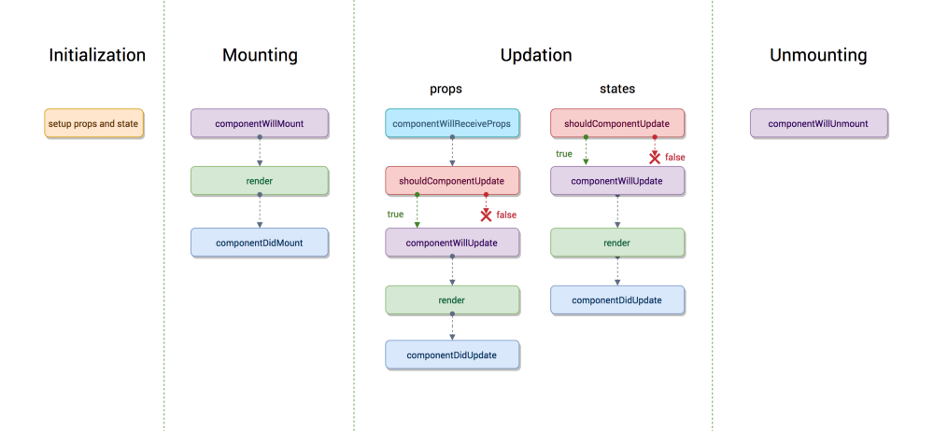

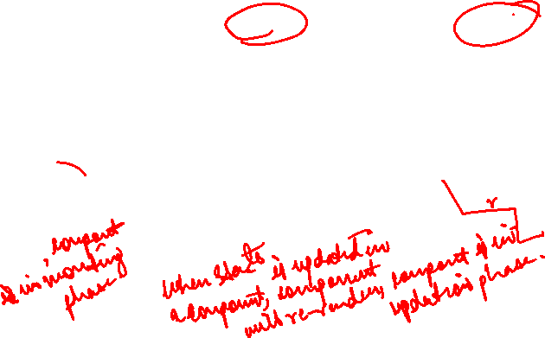

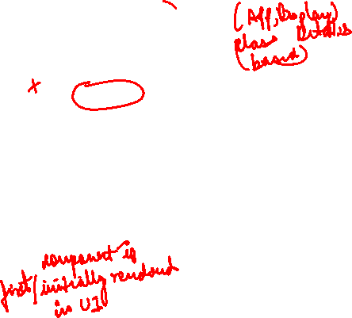

LIFECYCLE OF COMPONENT

Slide 4
Each component in React has a lifecycle which you can monitor and manipulate during its three main phases. The three phases are: Mounting, Updating, and Unmounting.
Mounting
These methods are called in the following order when an instance of a component is being created and inserted into the DOM:
constructor()
static getDerivedStateFromProps()
render()
componentDidMount()

Slide 5
Updating
An update can be caused by changes to props or state. These methods are called in the following order when a component is being re-rendered:
static getDerivedStateFromProps()
shouldComponentUpdate()
render()
getSnapshotBeforeUpdate()
componentDidUpdate()
Unmounting
This method is called when a component is being removed from the DOM:
componentWillUnmount()

Slide 6


LIFECYCLE OF COMPONENT
MOUNT
UPDATE
static getDerivedStateFromProps()
shouldComponentUpdate()
render()
getSnapshotBeforeUpdate(prevProps,
prevState)
componentDidUpdate(prevProps,
prevState,snapshot)
constructor()
static getDerivedStateFromProps(props, state)
render()
componentDidMount()

Slide 7
HTML
Uses of Lifecycle component
componentWillMount()
  This is called once on the server side, if server side rendering is present, and once the client side.
  You can use it to do api calls which do not have direct effect on the components, for example getting oAuth tokens
componentDidMount()
  This function is mostly used for calling API's.
  Components state initializations which are based on the props passed by parents.
shouldComponentUpdate(nextProps, nextState)
  This method is invoked before the render happens when new props or states are received. Here we can return false if the re-render is not required.
  We can see this as a performance optimisation tool. In case of frequent re-rendering of parent component this method should be used to avoid unnecessary update to current component

Slide 8
HTML
Uses of Lifecycle component
componentWillUpdate(nextProps,nextState)
  this function is called every time a component is updated, it is not called when component mounts
  Carry out any data processing here. For example, when a api fetch returns data, modelling the raw data into props to be passed to children
  this.setState() is not allowed in this function , it is to be done in componentWillReceiveProps or componentDidUpdate
componentDidUpdate(prevProps,prevState)
  Invoked right after the changes are pushed to the DOM
  We can use it whenever the required data is not at the first render (waiting for api call to come through) and DOM requires to be changed based on the data received
  Example, based on the age received show the user if he is eligible for application for an event
componentWillUnmount()
  As the official docs mentions, any event listeners or timers used in the component to be cleaned here.

Slide 9
HTML
Uses of Lifecycle component
static getDerivedStateFromProps is a new React lifecycle method as of React 17 designed to replace componentWillReceiveProps.
  Its main function is to ensure that the state and props are in sync for when it’s required.
  static getDerivedStateFromProps(props, state) {
  return { name: ‘alina’}
  }
  static getDerivedStateFromProps(props, state) {
  return null;
  }

Slide 10
HTML
HOOKS - useEffect
We don’t have lifecycle component in Function component. UseEffect is replacement of Lifecyle method for Function component.
useeffect means manage the side effects. Side effect is whenever you do something with state of a component.
useEffect is the replacement of ComponentDidMount, ComponentDidUpdate, ComponentWillUnmount.
Command to install axios: npm install --save axios.

Slide 11
Q & A

Slide 12
Thank You

