Slide 1

Welcome to
New age upskilling platform for high growth careers
By Urvshi Singla

Slide 2
Session Agenda
JavaScript - Data Types, Objects, Arrays

Slide 3
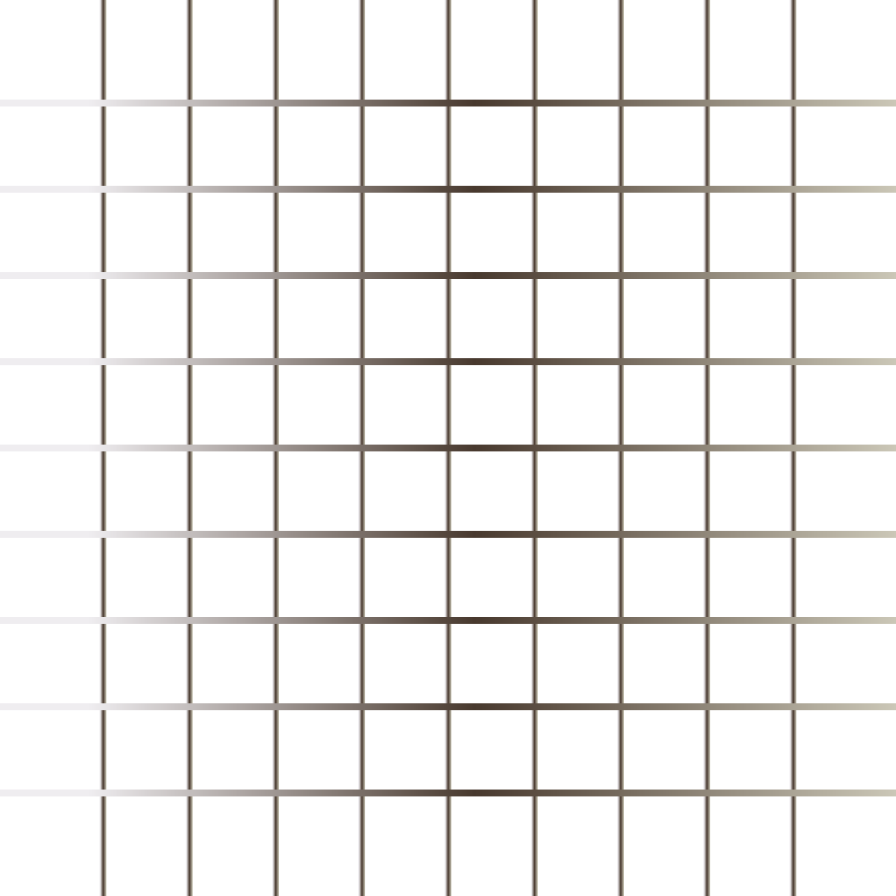
ARRAYS
Arrays: JavaScript arrays are used to store multiple values in a single variable.
An array is a special variable, which can hold more than one value at a time.
Arrays doesn’t support named indices.
Arrays are basically special kind of object with numbered index.
Return type of array and object is object.

Slide 4
OBJECTS
Object definition rules:
var person = {
firstName : “alina”,
Age: 30
};

Slide 5
Q & A

Slide 6
Thank You

