Slide 1

Welcome to
New age upskilling platform for high growth careers
By Urvshi Singla

Slide 2
Session Agenda
JavaScript- Function

Slide 3
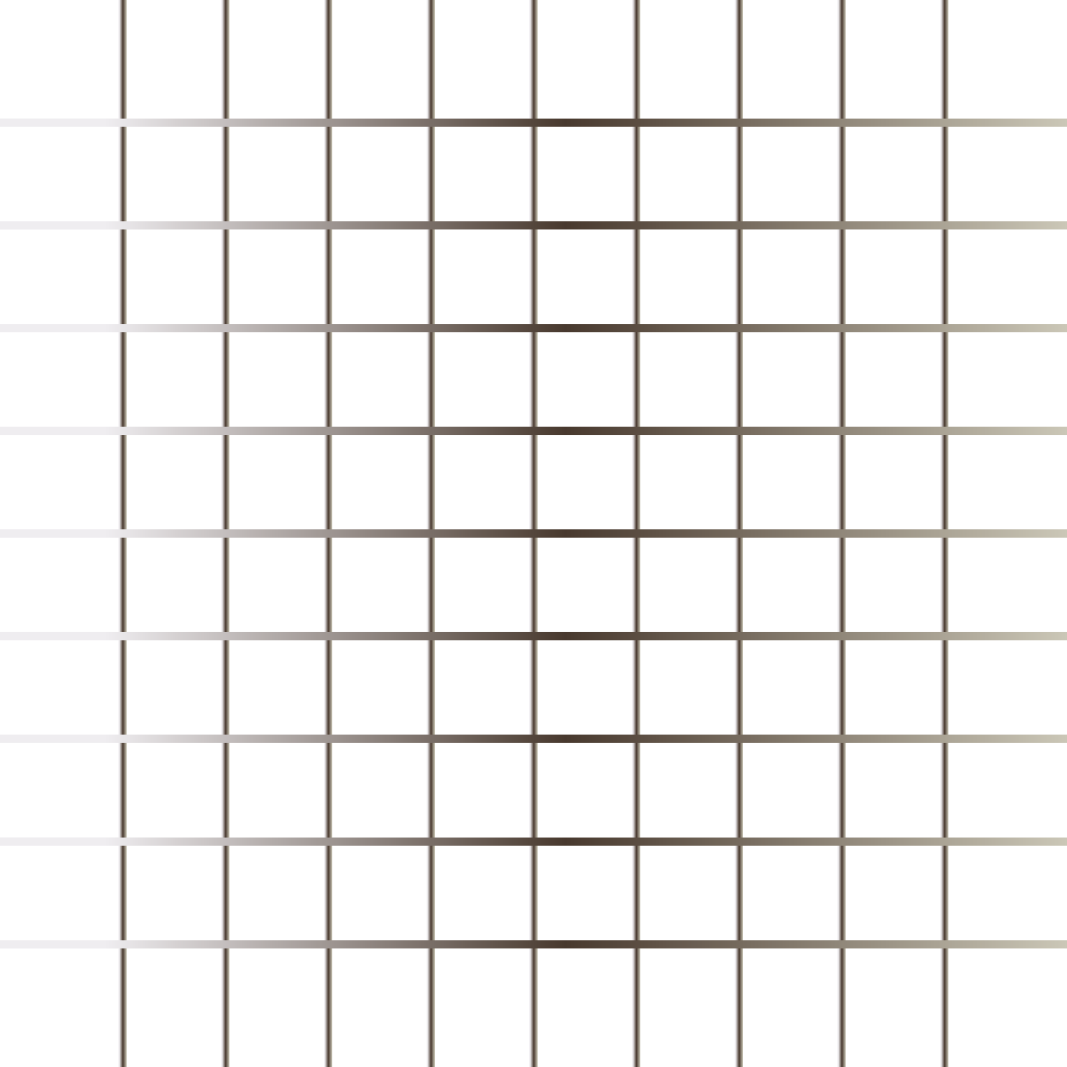
JavaScript - Functions
Function: A JavaScript function is a block of code designed to do something or perform a task. A JavaScript function is executed when it is invoked(called).
Function names can contain letters, underscores, and dollar signs (same rules as variables).

Slide 4
JavaScript - Functions
Function Calling:
When an event occurs (when a user clicks a button)
When it is invoked (called) from JavaScript code
Automatically (self invoked)
Code Reusability.
You can use the same code many times with different arguments, to produce different results.

Slide 5
JavaScript Math Object
Math Object: The JavaScript Math object allows you to perform mathematical tasks on numbers.
We have pre-defined methods and properties in Math objects.

Slide 6
Q & A

Slide 7
Thank You

