Slide 1

Welcome to
New age upskilling platform for high growth careers
By Urvshi Singla

Slide 2
Session Agenda
JavaScript - Introduction, Language basics
JavaScript – Variables
JavaScript - Data Types

Slide 3
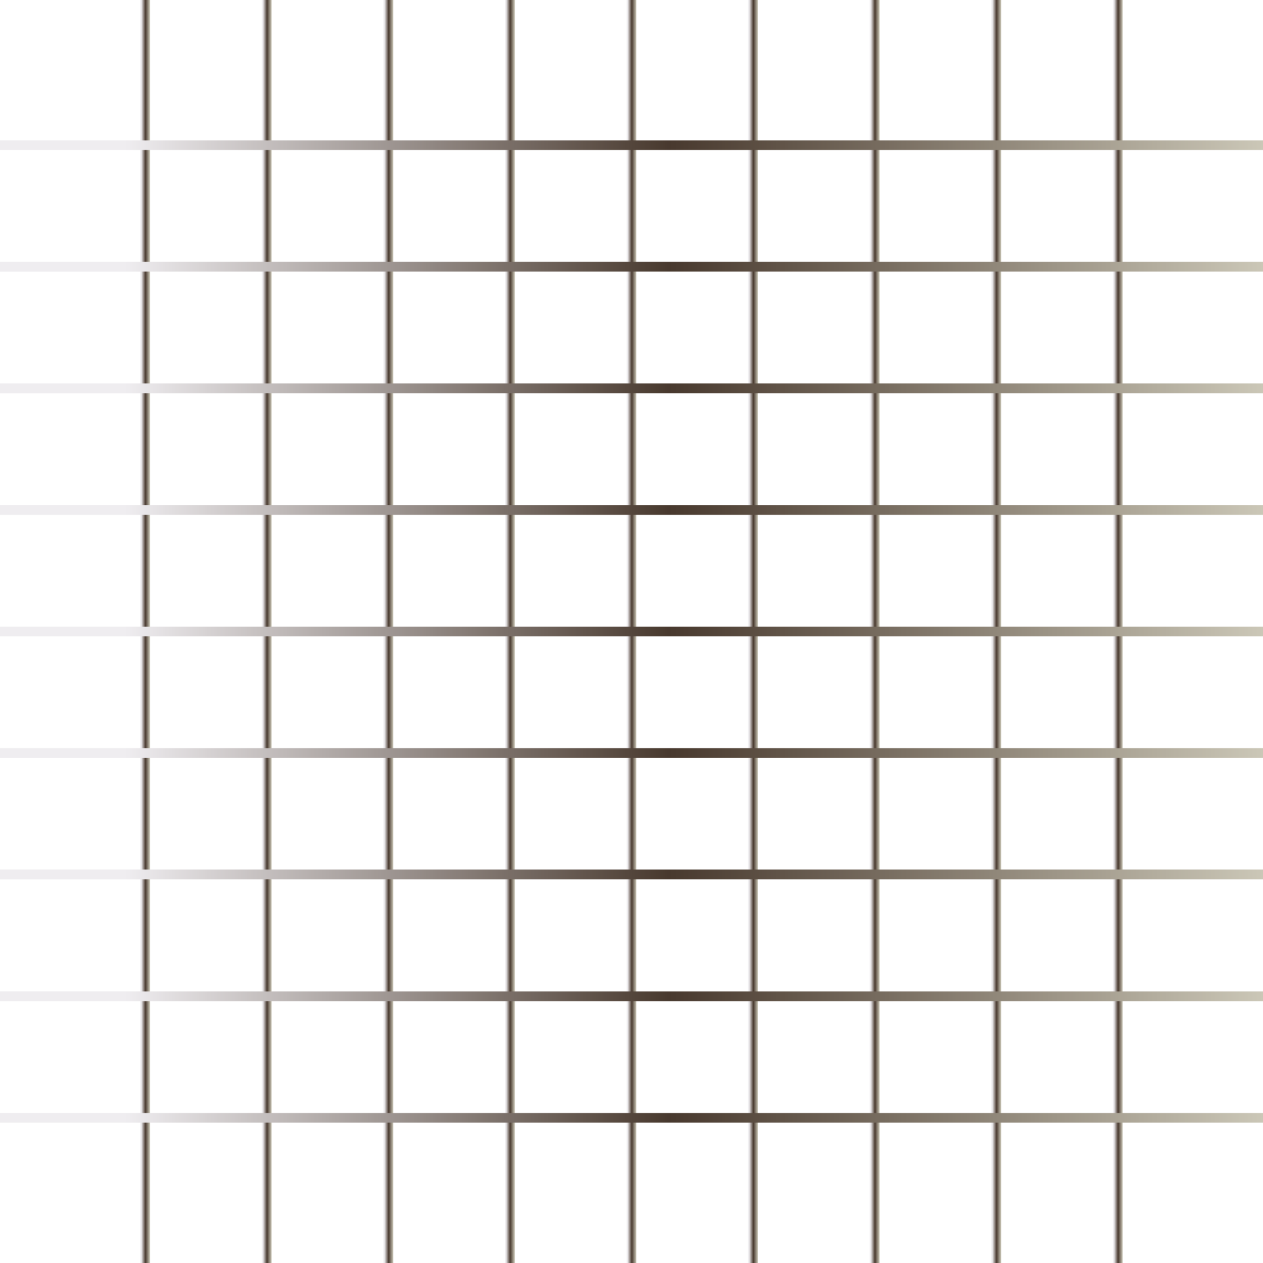
WHAT IS JAVASCRIPT?
It is an interactive glue between html and CSS. JavaScript is the programming language of the Web.
It is used to make your website dynamic and interactive.
It is the only programming language that a browser can understand. All advance tech like Reactjs, Expressjs, Nodejs written over the top of js.
JavaScript Can Change HTML Content, HTML Attribute Values, Elements, HTML Styles.
Without javaScript there would be no games, no dynamic html forms, no interactive maps, no Gmail, no Youtube, no Netflix.

Slide 4

HISTORY
It was created by Brendan Eich In 1995.
Towards the end of 1996, It was standardized by Ecma as the Ecmascript.
Java or Javascript?

Slide 5
ENGINE & RUNTINE
What is Js Runtime and Engine?
JavaScript is already running in your browser on your computer, on your tablet, and on your smart-phone.
Types of Js Runtime engine.
e.g. Chrome: V8 engine
Mozilla: SpiderMonkey

Slide 6
VARIABLES
JavaScript variables are containers for storing data values.
JavaScript uses the var keyword to declare variables
An equal sign is used to assign values to variables.
All JavaScript variables must be identified with unique names.

Slide 7
NAMING CONVENTION
It is a Case Sensitive Language.
e.g. var firstName;
var FirstName;
Use camel case for naming variable e.g. firstName.
Names Can Contain Letters, Digits, Underscores, Dollar Signs.
You Can Declare Variable Name Starting With _ And $.
Reserved Key Words Can’t Be Used As Variable Name.
Include space around operator.
e.g. var x = “hello”;
var x=“hello” ;

Slide 8
Control Flow & Folder Structure
JavaScript is a synchronous and a single threaded Programming and scripting language.
It is a case sensitive language.
The control flow is the order in which the computer executes statements in a script.

Slide 9
JAVASCRIPT - DATA TYPES
JavaScript variables can hold many data types: numbers, strings, objects, etc.
Js datatypes are of two types:
Primitive Non-Primitive String Function
Numbers Objects and Arrays
Boolean
Undefined
null

Slide 10
Q & A

Slide 11
Thank You

