Slide 1

Welcome to
New age upskilling platform for high growth careers
By Urvshi Singla

Slide 2
Session Agenda
Introduction to DBMS & Backend Development
Types of Databases
3 Tier Architecture
Database Languages

Slide 3
Workflow
Front-end
Database
GET /api/somedata
Mobile App
Server
Other Websites

Slide 4
Databases
Oracle
SQL Server
Postgress SQL
Cassandra
MongoDB
Types
Relational
NoSQL
OODBMS
Hierarchical – parent child
Network DBMS

Slide 5
Database Languages
Data Definition Language (DDL)
Data Manipulation Language (DML)
Data Control Language (DCL)
Transactional Control Language (TCL)

Slide 6
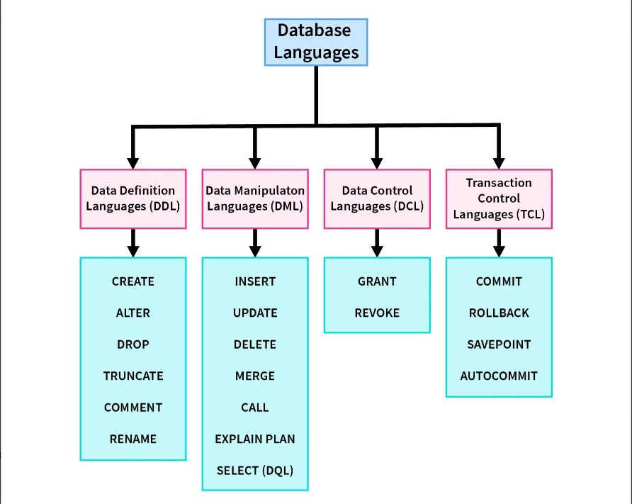
Database Languages

Slide 7
Q & A

Slide 8
Thank You

