Slide 1

Welcome to
New age upskilling platform for high growth careers
By Urvshi Singla

Slide 2
Session Agenda
NoSql
MongoDb Setup

Slide 3
NoSql
Schema Flexibility -> No schema structure
Horizontal Scalability -> One server in RDBMS (Vertical scaling)
High performance
Types > MongoDB, cosmosDB, CassandraDB, DynamoDB

Slide 4
Types of NoSql Database
Key-valur pair -> DynamoDB, Redis
Document -> MongoDB, CosmoDB
Graph database -> Neo4j
Column wide database -> CassandraDB

Slide 5
MongoDB
MongoDB stores data in flexible, JSON-like documents, meaning fields can vary from document to document and data structure can be changed over time.
Use it anytime you want to use data and persist it in your app.
The document model maps to the objects in your application code, making data easy to work with
Mongo is the ‘M’ in MERN
Database -> Collection -> Document -> BSON(similar to json)
Store Geospatial data(coordinates data) | mapbox

Slide 6
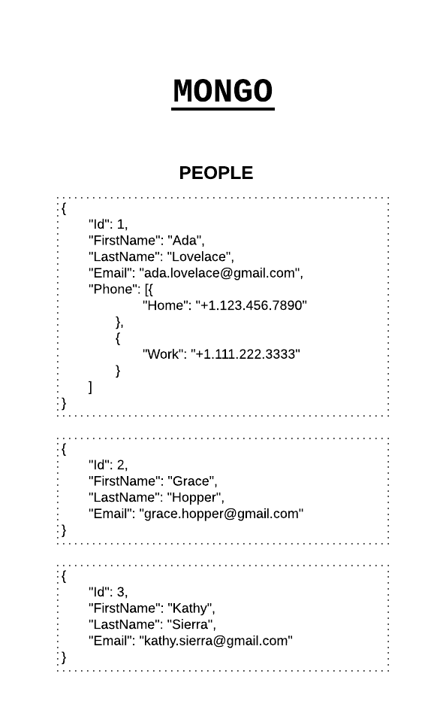
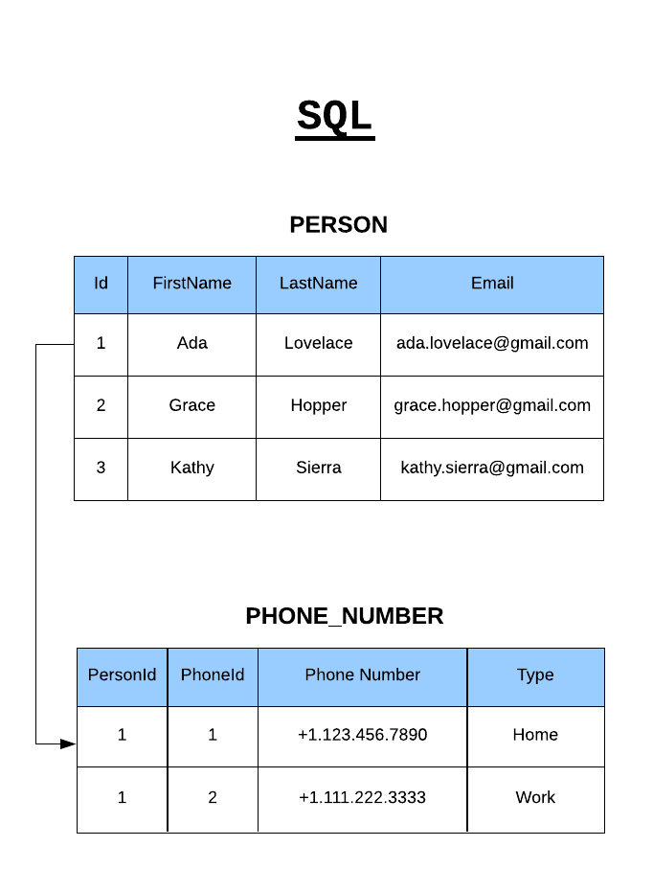
NoSQL vs SQL

Slide 7
Setup
Install server -> https://www.mongodb.com/try/download/community
Install Mongodb compass(local) -> https://www.mongodb.com/products/tools/compass
Install mongodb atlas(cloud) -> https://www.mongodb.com/cloud/atlas/register
Install mongodb shell (mongoosh) -> https://www.mongodb.com/try/download/shell

Slide 8
Terminologies
Collection - ‘Collections’ in Mongo are equivalent to tables in relational databases. They can hold multiple JSON documents.
Documents - ‘Documents’ are equivalent to records or rows of data in SQL. While a SQL row can reference data in other tables, Mongo documents usually combine that in a document.
Fields- ‘Fields’ or attributes are similar to columns in a SQL table.
Schema- A Mongoose ‘schema’ is a document data structure (or shape of the document) that is enforced via the application layer.
Models- ‘Models’ are higher-order constructors that take a schema and create an instance of a document equivalent to records in a relational database.

Slide 9
Q & A

Slide 10
Thank You

