Slide 1


Interactive Smart Moocs
By Urvi Awasthi and Anupam Ojha

Slide 2
About the platform
This intelligent platform aspires to make the content more intelligent for the user. Instead of going through the entire lecture video the user could directly jump to the topic of choice based on the number of topics inputted by the author and the corresponding segments created by the platform.

Slide 3

Installation steps
Clone
Clone the git repo
https://github.com/urviawasthi/CourseProject.git
Change
Change the directory to CS410-UI using cd CS410-UI command on the CLI.
Install
Please install the dependencies , gensim, LDA, webvtt-py and simplejson for the program to run successfully.
Run
Run the ./test.py and if the system prompts to install any dependencies other than the ones mentioned here, please do so using the pip command. For example, pip install gensim, pip install lda, pip install etc
Open
Open the server link that shows up in the terminal i.e. http://localhost:8080 like below:

Slide 4
Simple use case
with screen transitions

Slide 5
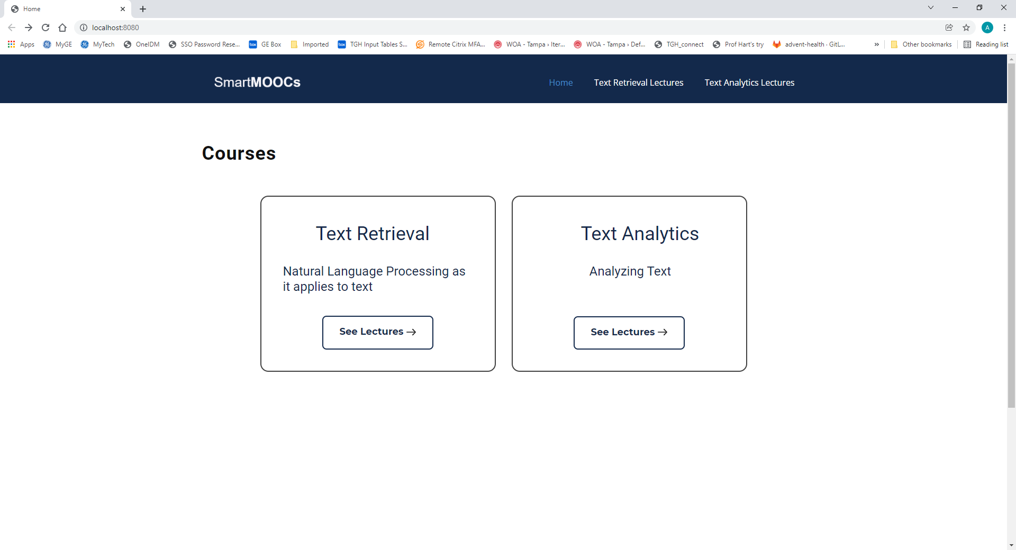

Slide 6
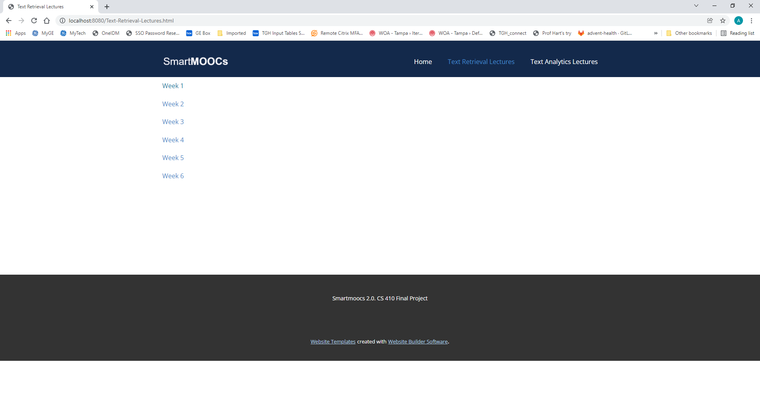

Slide 7
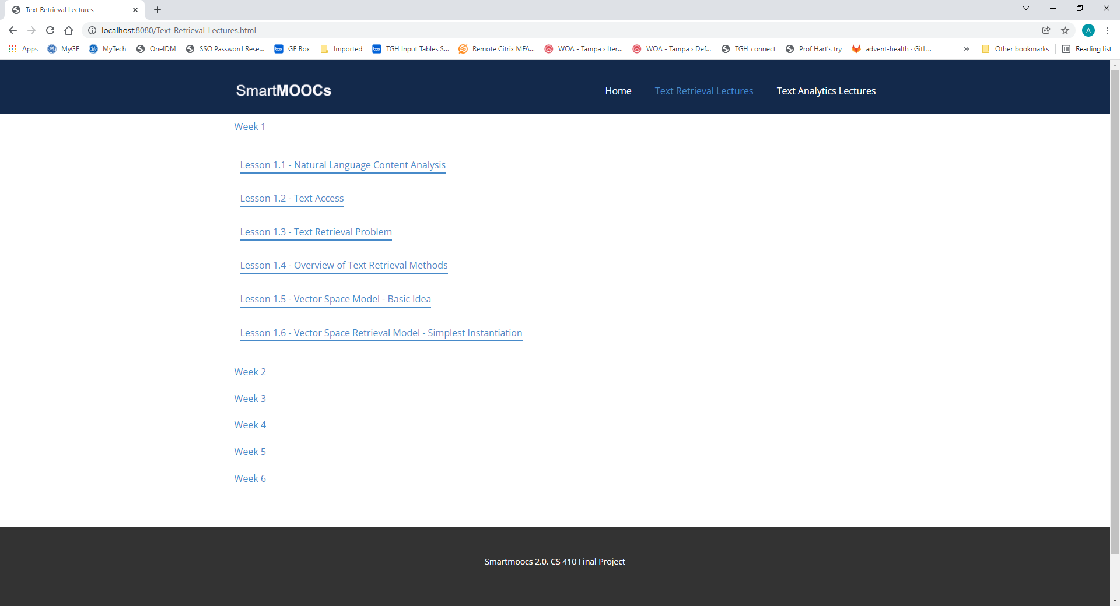

Slide 8
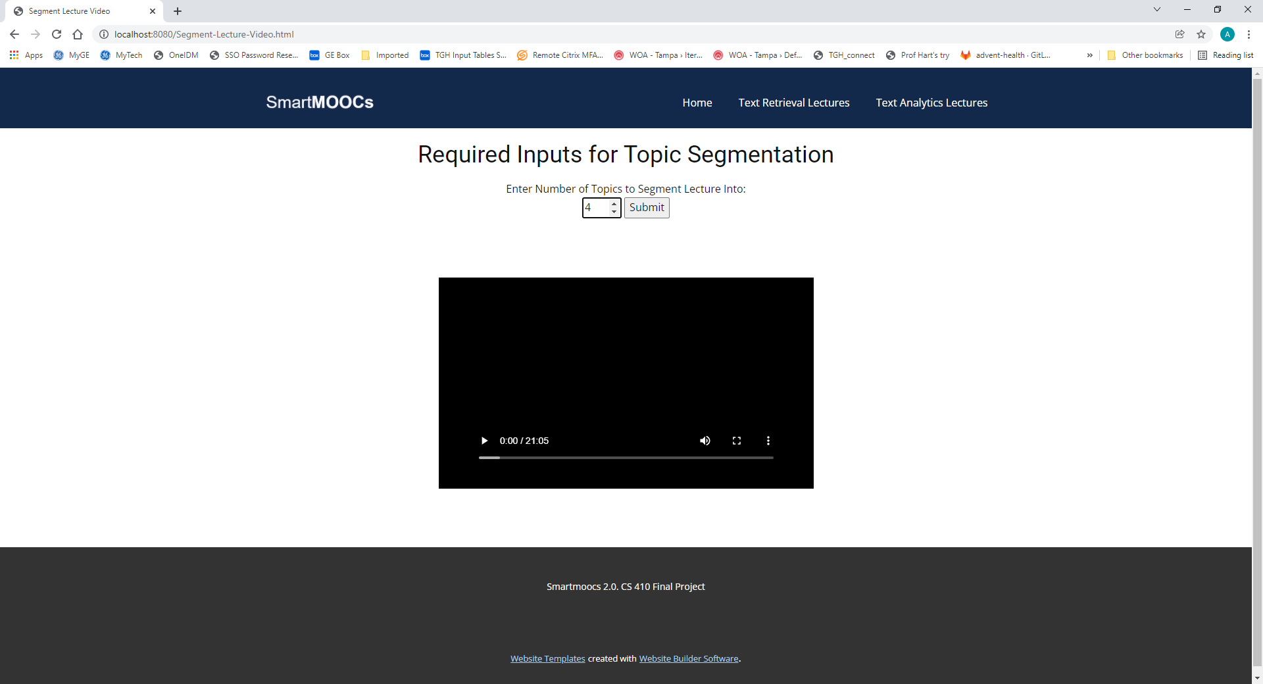

Slide 9
Wait for program to finish running topic segmentation and LDA algorithms
About 1 minute

Slide 10
