Slide 1
HISTOPATHOLOGY CAPSTONE / REVIEW GUIDE
Can biological preferences improve segmentation?
A plain-language guide to the experiments so far
PanNuke nuclei • BCSS tissue regions • WCSP refinement
The new test: learn neighbor costs from 200 GT patches, then compare one fixed pixel WCSP against raw TP argmax on 20 different patches.
1 | Historical records are context; the new experiment has one fixed beta
Notes:
Sources: /Users/kashvi/Desktop/CSCI401/csci-401-capstone-histopathology/deliverables/deliverable_3.md; /Users/kashvi/Desktop/CSCI401/csci-401-capstone-histopathology/experiments/pannuke_pixel_learned_costs/frozen_config.json
Historical runs were read only, not rerun. Different baselines and aggregation methods are not controlled comparisons.

Slide 2
HISTOPATHOLOGY CAPSTONE / REVIEW GUIDE
The basic vocabulary
Model probability: how plausible each class is at one pixel.
Unary cost: penalize labels the model considers unlikely.
Pairwise cost: penalize combinations of nearby pixel labels.
Beta: controls neighbor influence. New experiment: fixed 0.30.
ICM: update one pixel at a time while reducing total cost.
2 | Historical records are context; the new experiment has one fixed beta
Notes:
Sources: /Users/kashvi/Desktop/CSCI401/csci-401-capstone-histopathology/experiments/pannuke_pixel_learned_costs/README.md
Historical runs were read only, not rerun. Different baselines and aggregation methods are not controlled comparisons.

Slide 3
HISTOPATHOLOGY CAPSTONE / REVIEW GUIDE
Baselines and attempts to reduce variables
Experiment | Recorded result / lesson
PanNuke HoVer-Net, all Fold 2 | Detection F1 0.833; multi-class PQ 0.437
Nucleus clustering, 10 patches | 55 nuclei → 47 variables with DBSCAN / Ward
K-means nucleus clustering | 55 → 21 variables; 9 mixed predicted-class groups
BCSS Phikon-v2 / U-Net | Linear probe mIoU 0.652; pretrained U-Net 0.649
BCSS region methods | Phikon, SLIC, Quickshift, RAG, Felzenszwalb, N-cut
Oracle region scores use GT to label regions: they measure potential, not a deployed classifier. Baselines use different grids and tasks.
3 | Historical records are context; the new experiment has one fixed beta
Notes:
Sources: /Users/kashvi/Desktop/CSCI401/csci-401-capstone-histopathology/deliverables/deliverable_3.md
Historical runs were read only, not rerun. Different baselines and aggregation methods are not controlled comparisons.

Slide 4
HISTOPATHOLOGY CAPSTONE / REVIEW GUIDE
Early WCSP checks: correct solving ≠ better biology
Check | What happened
PanNuke 3 × 3 crop | 8 active pixels; all 390,625 assignments checked
Strong fidelity / weak fidelity | No changes / 3 changes; no GT accuracy claim
BCSS: 500 validation tiles | U-Net mIoU 0.6414 → WCSP 0.6428
BCSS uncertainty | ROI-bootstrap Δ CI +0.0003 to +0.0023
BCSS labels tissue regions; PanNuke labels nuclei. The small BCSS gain does not establish that the same rules help PanNuke.
4 | Historical records are context; the new experiment has one fixed beta
Notes:
Sources: /Users/kashvi/Desktop/CSCI401/csci-401-capstone-histopathology/deliverables/deliverable_4.md; /Users/kashvi/Desktop/CSCI401/csci-401-capstone-histopathology/experiments/pannuke_d4/pannuke_task2/results.json
Historical runs were read only, not rerun. Different baselines and aggregation methods are not controlled comparisons.

Slide 5
HISTOPATHOLOGY CAPSTONE / REVIEW GUIDE
BCSS: later table learning and solver comparisons
Recorded validation method: 2,124 tiles | mIoU
U-Net baseline | 0.6489
WCSP, handwritten costs, lambda 8 | 0.6507
WCSP, data-derived costs, lambda 8 | 0.6506
Time-limited toulbar2, lambda 4 | 0.6492
Handwritten-table gain CI: +0.0010 to +0.0027. Most gain was in the mixed BCSS “other” class. This is not the PanNuke Non-Neoplastic class.
5 | Historical records are context; the new experiment has one fixed beta
Notes:
Sources: /Users/kashvi/Desktop/CSCI401/csci-401-capstone-histopathology/deliverables/deliverable_5.md
Historical runs were read only, not rerun. Different baselines and aggregation methods are not controlled comparisons.

Slide 6
HISTOPATHOLOGY CAPSTONE / REVIEW GUIDE
BCSS: image terms and search limits
Image-color term on 185 dev tiles: no image term mIoU 0.7097; beta 1 gives 0.7092. No improvement over the same dev reference.
Saved record marks image-term validation as still running. No completed validation result is invented here.
At lambda 4: ICM used about 12 s/tile; toulbar2 about 87 s/tile with 20-second block limits.
An exact-search algorithm with a time limit does not certify a global optimum. Lower energy is also not a guarantee of better GT accuracy.
6 | Historical records are context; the new experiment has one fixed beta
Notes:
Sources: /Users/kashvi/Desktop/CSCI401/csci-401-capstone-histopathology/deliverables/deliverable_5.md
Historical runs were read only, not rerun. Different baselines and aggregation methods are not controlled comparisons.

Slide 7
HISTOPATHOLOGY CAPSTONE / REVIEW GUIDE
PanNuke: active pixels and flat change penalties
Initial 20-patch run: only 2 pixels changed; 0 fixes, 2 breaks.
No patch improved; one worsened; 19 were unchanged.
Earlier development lambda sweep: lowering fidelity still produced more breaks than fixes. At lambda 0: 2 fixes vs 61 breaks.
Lesson: hard-label costs and disconnected active pixels offered little useful correction.
7 | Historical records are context; the new experiment has one fixed beta
Notes:
Sources: /Users/kashvi/Desktop/CSCI401/csci-401-capstone-histopathology/deliverables/deliverable_5_pannuke_multipatch.md
Historical runs were read only, not rerun. Different baselines and aggregation methods are not controlled comparisons.

Slide 8
HISTOPATHOLOGY CAPSTONE / REVIEW GUIDE
Two-stage WCSP: mask first, then nucleus type
15-patch development method | Historical mean biological mIoU
Saved HoVer-Net | 0.474933
Stage 1 only: refine mask | 0.474896
Both stages: flat costs | 0.426603
Both stages: class-dependent unaries | 0.432511
The class-dependent version made 85 fixes and 1,961 breaks. Nucleus reconstruction and voting belong to this historical method only.
8 | Historical records are context; the new experiment has one fixed beta
Notes:
Sources: /Users/kashvi/Desktop/CSCI401/csci-401-capstone-histopathology/experiments/pannuke_d5/README_TWO_STAGE.md
Historical runs were read only, not rerun. Different baselines and aggregation methods are not controlled comparisons.

Slide 9
HISTOPATHOLOGY CAPSTONE / REVIEW GUIDE
One-stage probability costs and initialization
15-patch historical method | Mean biological mIoU
Saved postprocessed HoVer-Net | 0.474933
NP/conditional-TP probability argmax | 0.443796
Probability WCSP, saved-label initialization | 0.475899
Same plus calibrated type prior | 0.475922
Pixel-only initialization | 0.447382
These historical probabilities combine heads differently from the new raw-TP baseline. Starting labels materially affected the local solution.
9 | Historical records are context; the new experiment has one fixed beta
Notes:
Sources: /Users/kashvi/Desktop/CSCI401/csci-401-capstone-histopathology/experiments/pannuke_d5/README_FULLGRID.md
Historical runs were read only, not rerun. Different baselines and aggregation methods are not controlled comparisons.

Slide 10
HISTOPATHOLOGY CAPSTONE / REVIEW GUIDE
Raw TP and the earlier frozen evaluation
Earlier raw six-channel TP development test: mean biological mIoU 0.438640 → 0.440987; saved HoVer-Net was 0.474933.
A previous strength calibration chose unchanged HoVer-Net overall. Its frozen WCSP candidate used strength 2.
That candidate on 20 new patches: class mIoU 0.555525 → 0.559888, but binary nucleus IoU fell 0.770946 → 0.764872.
These are historical records. This task does not repeat that sweep or reuse that chosen strength.
10 | Historical records are context; the new experiment has one fixed beta
Notes:
Sources: /Users/kashvi/Desktop/CSCI401/csci-401-capstone-histopathology/experiments/pannuke_d5/README_FULLGRID.md
Historical runs were read only, not rerun. Different baselines and aggregation methods are not controlled comparisons.

Slide 11
HISTOPATHOLOGY CAPSTONE / REVIEW GUIDE
100 more patches: small gains and metric traps
Earlier 100-patch test: mean biological mIoU 0.595110 → 0.595380. Paired 95% interval: -0.007761 to +0.008223.
44 patches improved; 55 worsened; one was unchanged.
A later metric reassessment pooled six-class counts: 0.608028 → 0.636522. Most net gain came from rare Dead cells.
Patch means, GT-present-class averages, and pooled fixed-class mIoU answer different questions. Do not compare them as one scoreboard.
11 | Historical records are context; the new experiment has one fixed beta
Notes:
Sources: /Users/kashvi/Desktop/CSCI401/csci-401-capstone-histopathology/experiments/pannuke_d5/README_FULLGRID.md; /Users/kashvi/Desktop/CSCI401/csci-401-capstone-histopathology/experiments/pannuke_d5/pixel_wcsp_extended_evaluation/BACKGROUND_REASSESSMENT.md
Historical runs were read only, not rerun. Different baselines and aggregation methods are not controlled comparisons.

Slide 12
HISTOPATHOLOGY CAPSTONE / REVIEW GUIDE
The new experiment: raw TP → pixel WCSP
HoVer-Net fast PanNuke → raw TP logits → six-channel softmax.
Baseline: take the most probable type at every output pixel.
WCSP: all 164 × 164 pixels; all six classes; probability unaries.
24 spatial neighbors; cost = 0.30 × learned table / distance.
No NP confidence, HV, instance IDs, centroids, or nucleus voting.
12 | Historical records are context; the new experiment has one fixed beta
Notes:
Sources: /Users/kashvi/Desktop/CSCI401/csci-401-capstone-histopathology/experiments/pannuke_pixel_learned_costs/frozen_config.json
Historical runs were read only, not rerun. Different baselines and aggregation methods are not controlled comparisons.

Slide 13
HISTOPATHOLOGY CAPSTONE / REVIEW GUIDE
Frozen split and biological class coverage
GT class | Train pixels | Test pixels | Test patches
Background | 4,490,845 | 456,622 | 20 / 20
Neoplastic | 426,677 | 45,575 | 10 / 20
Inflammatory | 140,162 | 4,212 | 8 / 20
Connective | 211,748 | 18,105 | 15 / 20
Dead | 2,842 | 1,301 | 3 / 20
Non-Neoplastic | 106,926 | 12,105 | 5 / 20
200 training patches / 18 tissues; 20 test patches / 19 tissues. 266 prior-use IDs excluded. Patient IDs unavailable; checkpoint exposure unknown.
13 | Historical records are context; the new experiment has one fixed beta
Notes:
Sources: /Users/kashvi/Desktop/CSCI401/csci-401-capstone-histopathology/experiments/pannuke_pixel_learned_costs/coverage.json; /Users/kashvi/Desktop/CSCI401/csci-401-capstone-histopathology/experiments/pannuke_pixel_learned_costs/split.json
Historical runs were read only, not rerun. Different baselines and aggregation methods are not controlled comparisons.

Slide 14
HISTOPATHOLOGY CAPSTONE / REVIEW GUIDE
How training GT becomes a compatibility table
1. Count actual neighbor labels in training GT; add both orientations.
2. Add 1 to every count; compare joint adjacency to class prevalence.
3. Convert unexpectedly rare contacts to nonnegative costs; zero diagonal.
4. Blend 80% learned table with 20% fixed biological prior.
5. Normalize mean off-diagonal cost to 1; freeze before testing.
Rules: homophily; Dead isolation; immune infiltration preference; connective boundary preference. These are soft modeling choices.
14 | Historical records are context; the new experiment has one fixed beta
Notes:
Sources: /Users/kashvi/Desktop/CSCI401/csci-401-capstone-histopathology/experiments/pannuke_pixel_learned_costs/tables.json; /Users/kashvi/Desktop/CSCI401/csci-401-capstone-histopathology/experiments/pannuke_pixel_learned_costs/README.md
Historical runs were read only, not rerun. Different baselines and aggregation methods are not controlled comparisons.

Slide 15
HISTOPATHOLOGY CAPSTONE / REVIEW GUIDE
The final frozen table
 | BG | Neo | Immune | Stroma | Dead | Non-Neo
BG | 0.00 | 0.42 | 0.36 | 0.36 | 0.22 | 0.41
Neo | 0.42 | 0.00 | 1.04 | 0.84 | 1.29 | 2.31
Immune | 0.36 | 1.04 | 0.00 | 0.68 | 1.13 | 1.93
Stroma | 0.36 | 0.84 | 0.68 | 0.00 | 1.36 | 1.06
Dead | 0.22 | 1.29 | 1.13 | 1.36 | 0.00 | 1.60
Non-Neo | 0.41 | 2.31 | 1.93 | 1.06 | 1.60 | 0.00
Higher values discourage contact more strongly. Diagonal = 0. Background costs come from data. Beta 0.30 is applied after this table.
15 | Historical records are context; the new experiment has one fixed beta
Notes:
Sources: /Users/kashvi/Desktop/CSCI401/csci-401-capstone-histopathology/experiments/pannuke_pixel_learned_costs/tables.json
Historical runs were read only, not rerun. Different baselines and aggregation methods are not controlled comparisons.

Slide 16
HISTOPATHOLOGY CAPSTONE / REVIEW GUIDE
New results: pooled fixed-class IoU
Metric | Raw TP argmax | WCSP, beta 0.30
Biological mIoU | 0.3769 | 0.3752
Six-class mIoU | 0.4731 | 0.4718
Pixel accuracy | 0.9334 | 0.9336
Background IoU | 0.9545 | 0.9545
Neoplastic IoU | 0.6319 | 0.6338
Inflammatory IoU | 0.1604 | 0.1536
Connective IoU | 0.4130 | 0.4110
Dead IoU | 0.1554 | 0.1523
Non-Neoplastic IoU | 0.5237 | 0.5253
Δ biological mIoU -0.0017; paired 95% CI [-0.0050, 0.0080].
16 | Historical records are context; the new experiment has one fixed beta
Notes:
Sources: /Users/kashvi/Desktop/CSCI401/csci-401-capstone-histopathology/experiments/pannuke_pixel_learned_costs/results.json
Historical runs were read only, not rerun. Different baselines and aggregation methods are not controlled comparisons.

Slide 17
HISTOPATHOLOGY CAPSTONE / REVIEW GUIDE
Corrections, new errors, and changed wrong labels
1,820 changed pixels. Background is 84.9% of GT. Accuracy is dominated by background; biological mIoU weights each biological class equally.
17 | Historical records are context; the new experiment has one fixed beta
Notes:
Sources: /Users/kashvi/Desktop/CSCI401/csci-401-capstone-histopathology/experiments/pannuke_pixel_learned_costs/results.json
Historical runs were read only, not rerun. Different baselines and aggregation methods are not controlled comparisons.

Slide 18
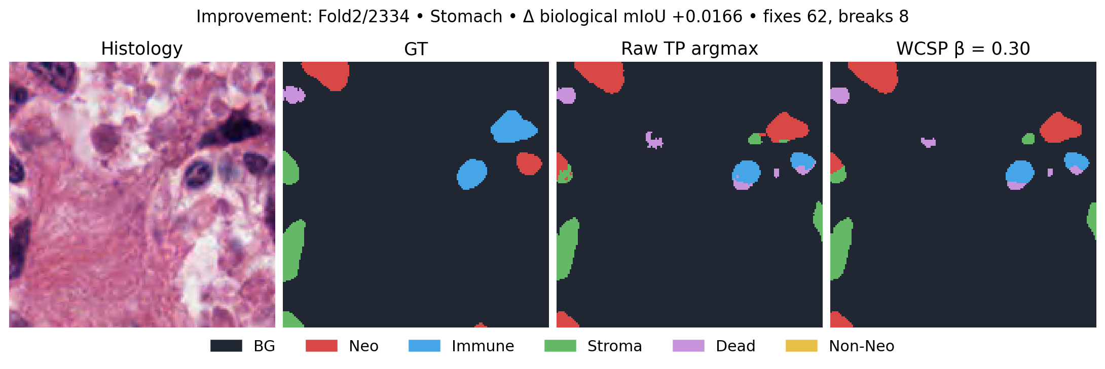
HISTOPATHOLOGY CAPSTONE / REVIEW GUIDE
Example improvement
Largest positive fixed-five-class patch mIoU change; an illustrative extreme, not a representative sample.
18 | Historical records are context; the new experiment has one fixed beta
Notes:
Sources: /Users/kashvi/Desktop/CSCI401/csci-401-capstone-histopathology/experiments/pannuke_pixel_learned_costs/selected_examples.json; /Users/kashvi/Desktop/CSCI401/csci-401-capstone-histopathology/experiments/pannuke_pixel_learned_costs/predictions
Historical runs were read only, not rerun. Different baselines and aggregation methods are not controlled comparisons.

Slide 19
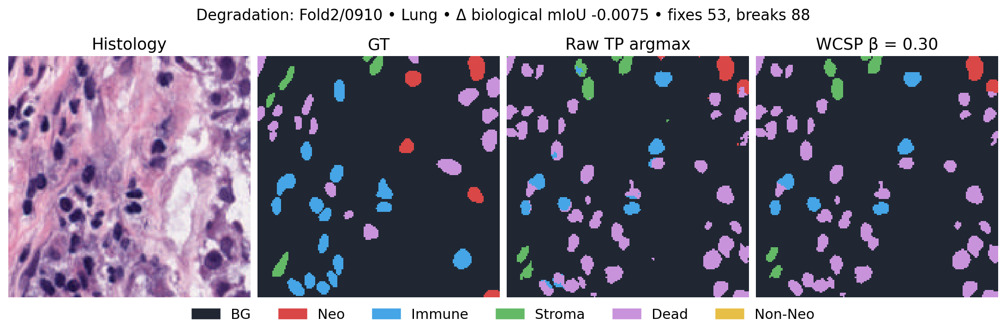
HISTOPATHOLOGY CAPSTONE / REVIEW GUIDE
Example degradation
Largest negative fixed-five-class patch mIoU change; an illustrative extreme, not a representative sample.
19 | Historical records are context; the new experiment has one fixed beta
Notes:
Sources: /Users/kashvi/Desktop/CSCI401/csci-401-capstone-histopathology/experiments/pannuke_pixel_learned_costs/selected_examples.json; /Users/kashvi/Desktop/CSCI401/csci-401-capstone-histopathology/experiments/pannuke_pixel_learned_costs/predictions
Historical runs were read only, not rerun. Different baselines and aggregation methods are not controlled comparisons.

Slide 20
HISTOPATHOLOGY CAPSTONE / REVIEW GUIDE
Interpretation, limits, and office-hours questions
No reliable improvement: the patch-bootstrap interval includes zero.
Pairwise contacts cannot literally enforce stromal barriers or detect dense immune clusters. Rare Dead cells remain fragile evidence.
All results are single-pixel local solutions, not global optima. Unknown patient clustering and pretrained-fold exposure limit claims.
Questions: Is pixel adjacency the right biological scale? Would region-level context help? What should a separately frozen follow-up test measure?
20 | Historical records are context; the new experiment has one fixed beta
Notes:
Sources: /Users/kashvi/Desktop/CSCI401/csci-401-capstone-histopathology/experiments/pannuke_pixel_learned_costs/results.json; /Users/kashvi/Desktop/CSCI401/csci-401-capstone-histopathology/experiments/pannuke_pixel_learned_costs/README.md
Historical runs were read only, not rerun. Different baselines and aggregation methods are not controlled comparisons.
Reproducibility: /Users/kashvi/Desktop/CSCI401/csci-401-capstone-histopathology/experiments/pannuke_pixel_learned_costs/README.md; frozen config SHA256 444c64b66b5724fe1451a9bf6c355c735bd920d9ab2bb54a3759950d44e0573a; checkpoint SHA256 789b2be8bdaf532627f584a009f83b3ba06e04c0e55c1635252ff12785ef57e8. Numerical tests, manifests, tables, label predictions, confusion matrices and bootstrap replicates accompany the report. No commit or push. Deliverable 5 files untouched.

