Slide 1
Introduction

Slide 2
What is an embedded system ?
An embedded system is an electronic/electro-mechanical system designed to perform a specific function and is a combination of both hardware and firmware.
Every embedded system is unique, and the hardware as well as the firmware is highly specialized to the application domain.
Embedded systems are becoming an inevitable part of any product or equipment in all fields including house appliances, telecommunications, medical equipment etc.

Slide 3
The computing revolution began with the general purpose computing requirements. Later it was realized that the general computing requirements are not sufficient for embedded computing requirements.
The embedded computing requirements demand “something special" in terms of meeting the computational deadlines, power efficiency. limited memory availability, etc.
Embedded system vs General purpose computing

Slide 4
Criteria | General Purpose Computer | Embedded System
Contents | A system which is a combination of a generic hardware and a General Purpose Operating System for executing a variety of applications. | A system which is a combination of special purpose hardware and embedded OS/firmware for executing a specific set of applications
OS | It contains a general purpose operating system (GPOS). | It may or not contain an operating system for functioning.
Alterations | Applications are alterable by the user. | Applications are not-alterable by the user.
Key factor | Performance is key factor. | Application specific requirements are key factors. (performance, power consumption, memory usage)
Power Consumption | More | Less
Response Time | Not critical | Critical for some applications
Execution | Need not be deterministic | Deterministic for certain types of ES like ‘Hard Real Time’ systems.

Slide 5
History of embedded system
Embedded systems were in existence even before the IT revolution.
In the olden days embedded systems were built around the transistor technologies, the embedded algorithm was developed in low level languages.
IT revolution gave way to the development of miniature embedded systems. The first recognized modern embedded system is the Apollo Guidance Computer (AGC) developed by the MIT Instrumentation Laboratory for the lunar expedition.
Command Module and the Lunar Excursion Module (LEM). The Command Module was designed to encircle the moon while the Lunar Module were designed to go down to the moon surface and land there safely. The Lunar Module featured a total of 18 engines including a descent engine and an ascent engine.
Around 5000 Ics were used in this design.
The first mass produced embedded system was the guidance computer for the Minuteman-I missile in 1961.

Slide 6
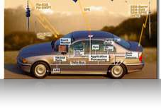
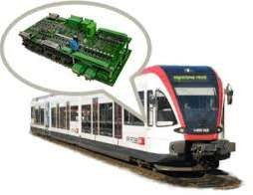
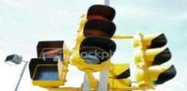
Applications of Embedded systems
9
The application areas and the products in the embedded domain are countless.
Consumer electronics: Camcorders, cameras, etc.
Household appliances: Television, DVD players, washing machine,
fridge, microwave oven, etc.
Home automation and security systems: Air conditioners, sprinklers, intruder detection alarms, closed circuit television cameras, fire alarms, etc.
Automotive industry: Anti-lock breaking systems (ABS), enginecontrol, ignition systems, automatic navigation systems, etc.
5. Telecom: Cellular
telephones, telephone switches, handset
multimedia applications, etc.

Slide 7
Classification of embedded systems
It is possible to have a multitude of classifications for embedded systems, based on different criteria. Some of the criteria used in the classification of embedded systems are:
Based on generation.
Complexity and performance requirements
Based on deterministic behavior
Based on triggering.
The application/task execution behavior for an embedded system can be either deterministic or nondeterministic.
ES which are reactive in nature can be classified based on the trigger, which can be event triggered or time triggered.

Slide 8
Classification based on generation
First generation:- The early ES were built around 8 bit microprocessors and 4 bit microcontrollers. Simple in hardware circuits with firmware developed in assembly code. Digital telephone keypads, stepper motor control units are examples of this.
Second generation:- These ES built around 16 bit microprocessors and 8 bit microcontrollers. The instruction set were much more complex and powerful. Example includes data acquisition systems- combination of h/w and s/w that allows to measure physical characteristics of some thing in real world. It consist of h/w, sensors and actuators.
Third generation :- With advances in processor technology, embedded system developers started making use of powerful 32 bit microprocessors and 16 bit microcontrollers for their design. Digital signal processors and Application specific integrated circuits came into picture. Instruction set became more powerful and complex and the concept of instruction pipelining also evolved. ES spread its ground to areas like robotics, media, networking etc.
Fourth generation:- The advent of System on Chips (SoC), reconfigurable processors and multicore processors are bringing high performance, tight integration and miniaturization into the embedded device market. The fourth generation ES are making use of high performance real time embedded operating systems for their functioning. Example includes smart phone devices.

Slide 9
Classification based on complexity & performance
Small scale ES
Es which are simple in application need and performance is not time critical.
They are built with low performance and low cost 8 or 16 bit microcontroller/microprocessor.
Eg. Electronic toy
Medium scale ES
Slightly complex in h/w and s/w requirements
Built with medium performance and low cost 16 or 32 bit microcontroller/microprocessor.
Eg. ES for functioning
Large scale ES
Highly complex
Demand high performance – mission critical systems and high cost 32 or 64 bit microcontroller/microprocessor.
Eg. ES for task scheduling, prioritization and management.

Slide 10
Purpose of ES
Each embedded system is designed to serve the purpose of any one or a combination of the following tasks:
Data collection/Storage/Representation
Data Communication
Data (signal) processing
Monitoring
Control
Application specific user interface

Slide 11
1 . Data Collection/Storage/Representation
Embedded systems designed for the purpose of data collection performs acquisition of data from the external world.
Data collection is usually done for storage, analysis, manipulation and transmission.
Data can be either analog (continuous) or digital (discrete).
Embedded systems with analog data capturing techniques collect data directly in the form of analog signal whereas embedded systems with digital data collection mechanism converts the analog signal to the digital signal using analog to digital (A/D) converters
If the data is digital, it can be directly captured without any additional interface by digital embedded systems.
A digital camera is a typical example of an embedded system with data collection/storage/representation of data.
Images are captured and the captured image may be stored within the memory of the camera. The captured image can also be presented to the user through a graphic LCD unit.

Slide 12
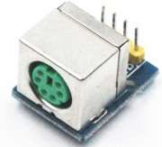
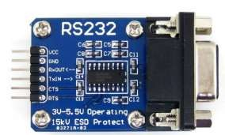
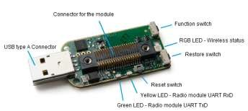
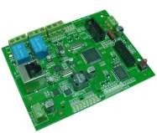
Data Communication
Embedded data communication systems are deployed in applications from complex satellite communication systems to simple home networking systems.
The transmission is achieved either by a wire-line medium or by a
wire-less medium.
Data can either be transmitted by analog means or by digital means.

Slide 13
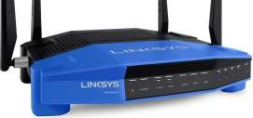
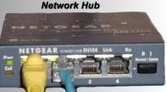

The data collecting embedded terminal itself can incorporate data communication units like Wireless modules (Bluetooth, ZigBee, Wi- Fi, EDGE, GPRS, etc.) or wire-line modules (RS-232C, USB, TCP/IP, PS2,etc).
Network hubs, routers, switches, etc. are typical examples of
dedicated data transmission embedded systems.

Slide 14
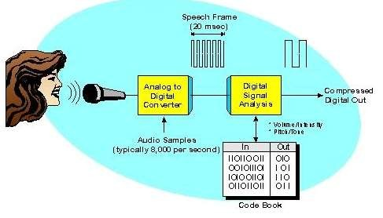
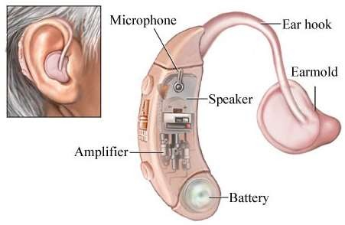
Data (Signal) Processing
Embedded systems with
signal processing functionalities are employed in applications demanding signal processing like speech coding, synthesis, audio video codec, transmission applications, etc.
A digital hearing aid is a typical example of an embedded system employing data processing.
Digital hearing aid improves the hearing capacity of hearing impaired persons.

Slide 15
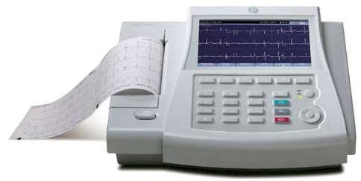
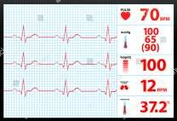
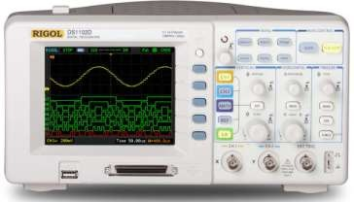
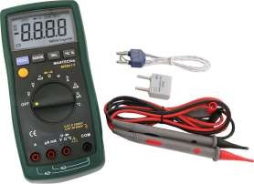
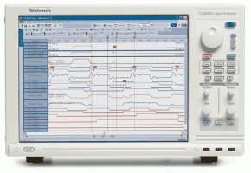
Monitoring
Almost all embedded products coming under the medical domain are with monitoring functions only.
Electro cardiogram machine (ECG) is intended to do the monitoring of the heartbeat of a patient but it cannot impose control over the heartbeat.
Other examples with monitoring function are digital CRO, digital multimeters, and logic analyzers.

Slide 16
Control
A system with control functionality contains both sensors and actuators.
Sensors are connected to the input port for capturing the changes in
environmental variable or measuring variable.
The actuators connected to the output port are controlled according to the changes in the input variable.
Air conditioner system used in our home to control the room temperature to a specified limit is a typical example for ES for CONTROL purpose.

Slide 17
Applications specific user interface
Buttons, switches, keypad, lights, speakers, display units, etc. are application-specific user interfaces.
Mobile phone is an example of application specific user interface.
In mobile phone the user interface is provided through the keypad, graphic LCD module, system speaker, vibration alert, etc.

