Slide 1

Psychology -11
Chp3 – Self Contd…
-Urvi Patel

Slide 2
Self-Regulation
Being able to control our thoughts, feelings and actions to our benefit
We are behaving according to societal norms
When we regulate ourselves, our objective is to ensure
1
2
Our relationships with others are nurtured, not destroyed due to our negative behavior
3
We do not react impulsively
Our behavior doesn’t affect our college/school environment negatively
We control/stop ourselves from immediate satisfaction of desire

Slide 3
What Does SR involve?
Monitoring our actions and reactions
We can predict the consequences
Focusing on certain parts of our life and ignoring some other part for some time
Like Abstaining from social media when Exams are approaching

Slide 4
Types Of Regulatory Focus (Higgins,1966)
Regulatory Focus
Promotion Regulatory
Achieving +ve Outcomes
Prevention Regulatory
Don’t do anything to prevent –ve outcomes

Slide 5
Some More about Regulatory Focus
People from East Asian cultures have a preventive regulatory focus
( Hamamura and Heine)
They tend to suppress their expressions to prevent a negative reaction from society
SR has crucial implication in our life
Our brains are evolved that way
Heatherton (2011) identifies important psychological components to help us stay socially connected

Slide 6
Heatherton Model (2011)
Be Aware of our Actions+ Evaluate them
Must detect any kind of threat or rejection from others
Must do something constructive to improve the situation
Must be able to predict other people’s reaction to them
Here we have control over
Our actions
Acting impulsively
And we can avoid nasty thoughts which is a bit difficult
(but Achievable)…

Slide 7
An Example to illustrate the Heatherton Model in Your life…

Slide 8
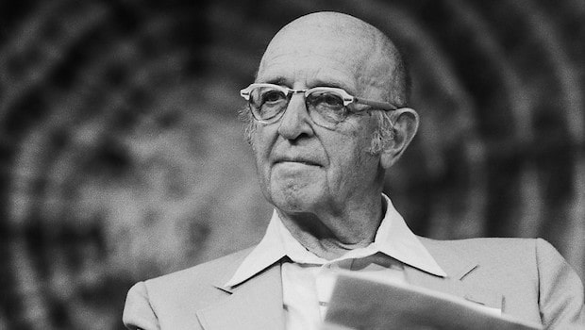
Carl Rogers Theory Of Self
A little introduction to this Icon…
He was born on Jan 8 , 1902 in Oak Park, Illinois
Was known for his client-centered approach, which is widely accepted
Is considered to be one of the founding fathers of Psychotherapy
was honored for his pioneering research with the Award for Distinguished Scientific Contributions by the APA in 1956.

Slide 9
Carl Rogers Theory Of Self
According to Rogers, every individual has a tendency to actualize herself
According to Rogers, mentally healthy individuals have congruence between their experience and their self- concept
Neurotic individuals deny awareness of their sensory and emotional experience
Ex:-
Rogers believed that incongruence has its earliest roots in childhood. When parents place conditions on their affection for their children (only expressing love if children "earn it" through certain behaviors and living up to the parents' expectations), children begin to distort the memories of experiences that leave them feeling unworthy of their parents' love. (Leading to false memories and lies)
Unconditional love, on the other hand, helps to foster congruence. Children who experience such love feel no need to continually distort their memories in order to believe that other people will love and accept them as they are.

