Slide 1



Data
View in Power BI
Last data refresh:
8/29/2022 3:05:06 PM UTC
Downloaded at:
8/29/2022 3:05:46 PM UTC

Slide 2
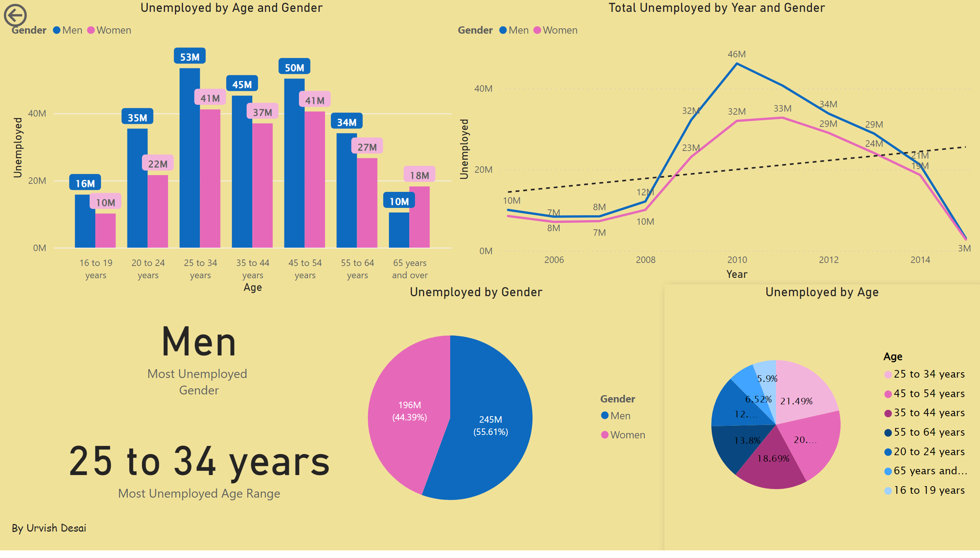
Page 1
Notes:
clusteredColumnChart
No alt text provided
actionButton
No alt text provided
pieChart
No alt text provided
pieChart
Unemployment by the Age range.
Total Unemployed by Year and Gender
No alt text provided
card
No alt text provided
card
No alt text provided
textbox
No alt text provided

