Slide 1
React.js
A JAVASCRIPT LIBRARY FOR BUILDING USER INTERFACE
Session by
Urvish Sheth

Slide 2
React Introduction
React is an open source JavaScript library in which components are defined and eventually become HTML.
It is developed by facebook and instagram
React is intended to be the view(“V”) or the user interface in MVC.
One of the benefits and goals of the React project is to make developing a large scale single page application or SPA much easier.
React is a JavaScript Library to build user interfaces for modern application.

Slide 3
Why React ?
Renders view ultra-quickly
React code is easy to understand for developers designers, and anyone with the knowledge of XML or HTML
Easy to test
It uses JSX which is clean and easy to understand syntax which can be used directly in our JS
Enforces good coding practices
Supported and developed by Facebook

Slide 4
Virtual DOM
“React abstract away the DOM from you, giving a simpler programming model and better performance”
- React
A DOM represent webpage in a tree structure. It also refers how these page elements are accessed and changed.
Updating the DOM is expensive.
Reading and writing in to DOM using DOM API are slow because they are optimized for speed.
JavaScript objects are faster than DOM objects.
React offers the virtual DOM which is pure JavaScript intermediate representation of JavaScript
React never reads from the real DOM. It only writes to real DOM if needed, so it efficiently handle DOM updates.
The Process of updating only part of the DOM structure is called “reconciliation”.

Slide 5
How virtual DOM Works
Whenever the data model state changed, the virtual DOM and React will re-render the UI to a virtual DOM representation.
React calculates the difference between the two virtual DOM representations: the previous virtual DOM representation that was computed before the data was changed and the current virtual DOM representation that was computed after the data was changed.
This difference between the two virtual DOM representation is what actually needs to be updated in the real DOM.
React updates only what needs to be updated.
DOM
React Virtual DOM
JS Logic

Slide 6
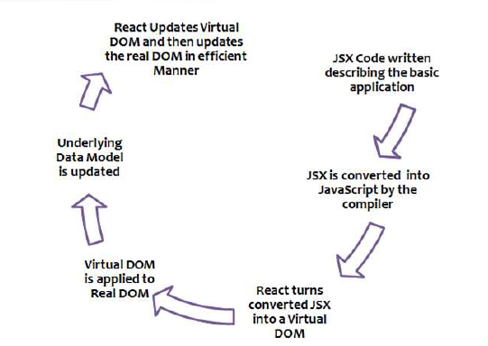
How React Renders the view ?

Slide 7
Core of React (React Top Level API)
React is entry point to the React Library.
Following are some of the important functions under React Library
React.CreateElement
ReactDOM.render
ReactDOMServer.renderToString
ReactDOMServer.renderToStaticMarkup
React.createClass
React.children.count
React.children.map
React.children.forEach

Slide 8
Top Level API
React.CreateElement
Create Element method will create new elements
Var element = React.createElement(
‘div’,
null,
‘hello’
);
ReactDOM.render
Renders a react element in the DOM in the supplied contatiner.
ReactDOM.render(element,document.getElementById(‘App’));
<div id=“App” />

Slide 9
JSX Introduction
JSX is a javascript syntax extension that looks similar to XML.
When we build our virtual DOM by constantly calling the React.CreateElement() method, it becomes quite hard to visually translate these multiple function calls into a hierarchy of HTML tags.
JSX allows us to create a virtual DOM tree without using React.CreateElement() method.
JSX can be transfomed into native javascript by using “babel” Compiler.
Babel online compiler : https://babeljs.io/repl/

Slide 10
Working with Props
The props parameter is a JavaScript object (data & event handlers) passed from parent component to a child component.
Props are supplied as attributes
Ex: <MegaMenu list={data} name=“Dhinesh”/>
Props can be accessed via props property inside a component.
this.props.name , this.props.list
Parent can read its children by accessing the special this.props.children.prop

Slide 11
Event handling
Handling events with React elements is very similar to handling events on DOM elements. There are some syntactic differences:
React events are named using camelCase, rather than lowercase.
With JSX you pass a function as the event handler, rather than a string.
var ButtonComponent = React.CreateClass({
clickHandler() {
alert(‘hi’);
},
render() {
return (<button onClick={this.clickHandler}> {this.props.children} </button>)
}
});
ReactDom.render(<ButtonComponent>Click</ButtonComponent),document.getElementById(‘app’));

Slide 12
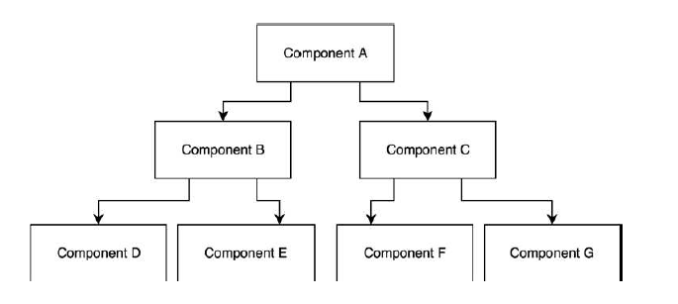
Working with state
In React state is like a local scope.
Component can be made dynamic by adding state to it.
State is used when a component need to change independently of its parent.
State component can be accessed using this.state()

Slide 13
Example :
Class MenuList extends React.Component() {
constructor(props){
super(props);
this.state = {name: ‘Dhinesh’,};
}
nameChange(e) {
this.setState({name: e.target.value});
}
render(){
<div>
<span>Name : </span>
<input type=“text” value={this.state.name} onChange={this.nameChange}/>
<span> Name : </span>
<label> {this.state.name} <label />
</div>
}
}
< MenuList role=“consultant” />

Slide 14
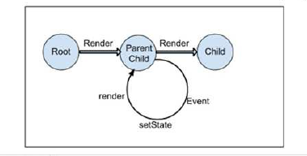
Unidirectional data flow
In React, application data flows unidirectionally via the state and props objects, as opposed to the two way data binding of libraries like angular.
Notes:
In the two way data binding the view is updated when the state changes and vice versa. For ex: when u change the model in Angular view gets update and same. It can lead to cascading updates and changing the one model may trigger many updates.
As the state can be altered(mutated) by both the model and view , sometimes dataflow is unpredictable.
React doesn’t encourage bi-directional binding to make sure you are following a clean data flow architecture. The major benefit of this approach is that data-flows throughout the app is single directional and it’s predictable and we have better control over it.

Slide 15
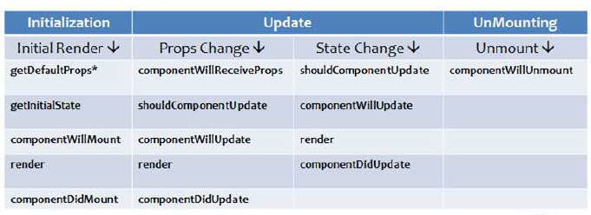
Component and Component Life cycle
Two types of component
Functional component
Class-base component
It is important to understand component lifecycle method, role it plays and the order in which it is invoked.
Component life cycle has three phases
Initialization: where the component is created
Update: where the state and props values updates
Unmounting: where the component is deleted.

Slide 16
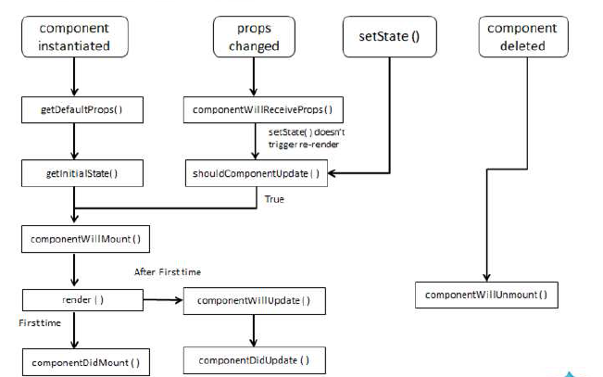
Life cycle Method and execution sequence

Slide 17
ES6 functions
Block-Scoped Constructs Let and Const
Default parameter in ES6
Multi-line strings
Template literals
Destructuring Assignment
Arrow functions
Promises
Enhanced Object Literals
Classes
Modules
import and export
Array helper function
forEach
Map
Fillter
Find
Spread Operator

Slide 18
Important links
React tutorial
React components and tutorial
React developer tool for Chrome
ES6 Example
HTML to JSX Compiler

Slide 19

Thank You

