Slide 1
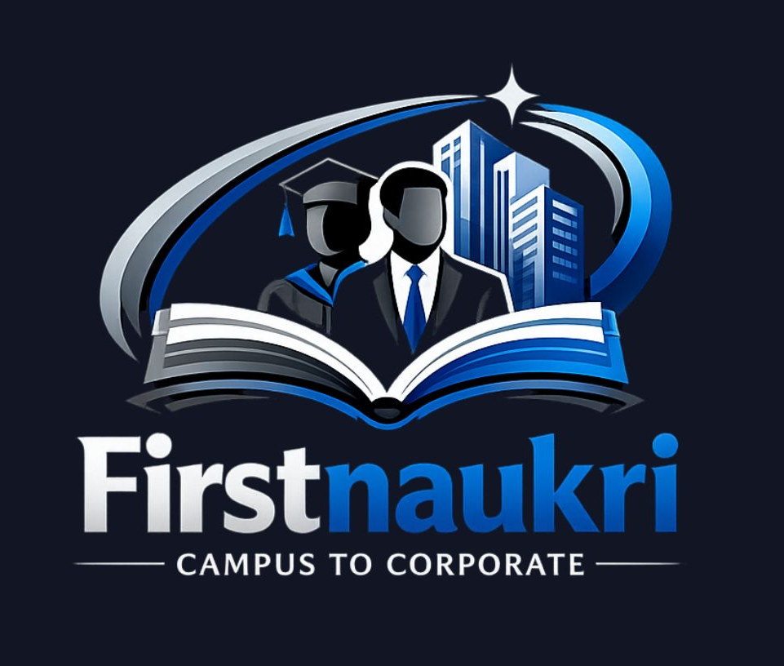
First Naukri:
From Campus to Corporate
Submitted by -
Urvi 2310997358
Vanshika Chawla 2310997319
Swastik Arora 2310997293

Slide 2
Problem Statement
Freshers Struggle
Recruiter Challenges
Generic Platforms
Entry level job seekers face difficulty finding relevant opportunities tailored to their skill level and educational background.
Employers struggle to identify and connect with qualified fresh graduates who match their specific requirements.
Existing job portals are too general and lack specialized focus on fresher recruitment and campus-to-corporate transition and resume based analysis.

Slide 3
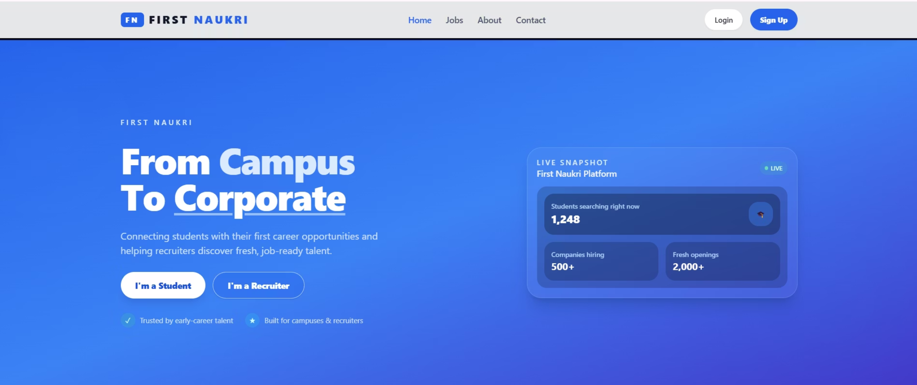
Project Overview
First Naukri is a web-based job portal designed specifically to bridge the gap between fresh graduates and entry-level opportunities
Separate login systems for students and recruiters
Centralized platform for job posting and applications.
Resume analyzer for job recommendations and better analysiis according to skills.

Slide 4




Work Done So Far
Homepage
Authentication
Clean, intuitive design with navigation menu and featured job listings displayed prominently
Complete login and signup system with role-based access control for students and recruiters
Dashboards
Database
Student and recruiter dashboards with personalized content and functionality
Basic database connectivity established with user data storage and retrieval capabilities

Slide 5
Individual Contributions
Team Member
Role
Key Responsibilities
Urvi
Login/Sign-up page and Landing page
UI design, homepage layout, login page implementation
Swastik
Recruiter dashboard
Recruiter interface, post jobs and schedule interviews
Vanshika
Student dashboard
Resume analyzer and Students can apply jobs.

Slide 6
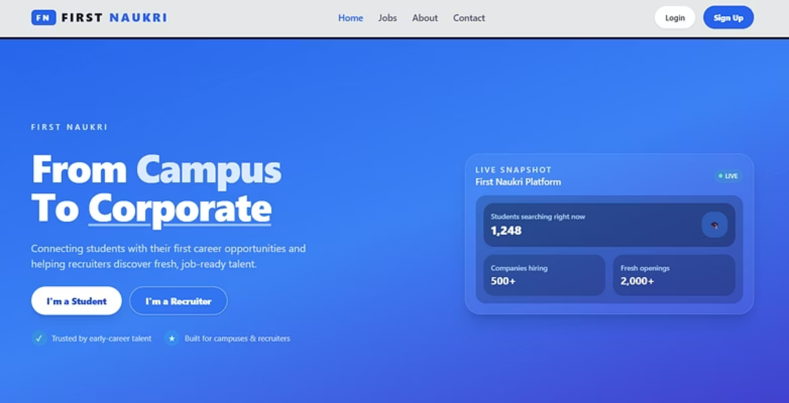
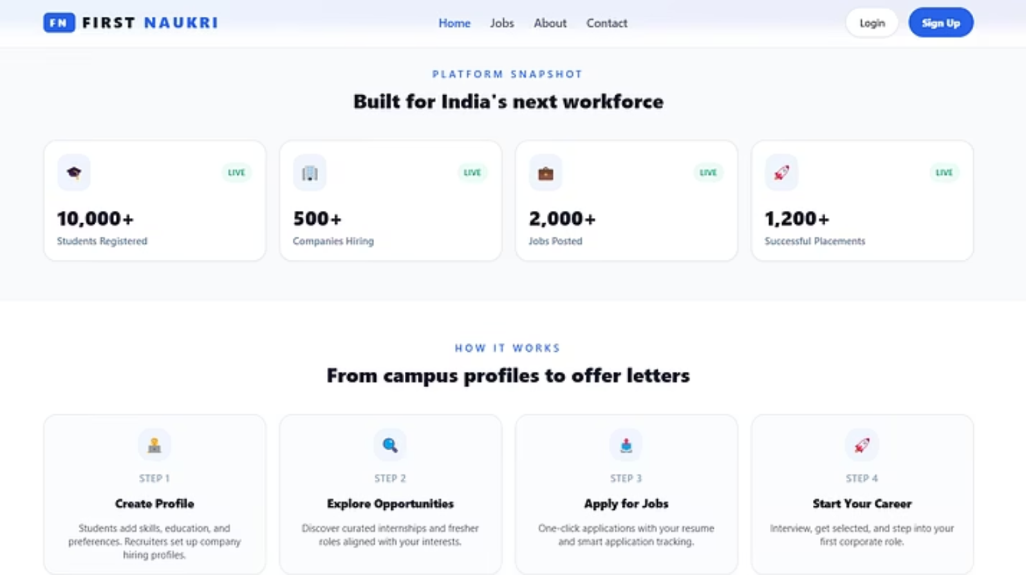
Main Landing Page

Slide 7
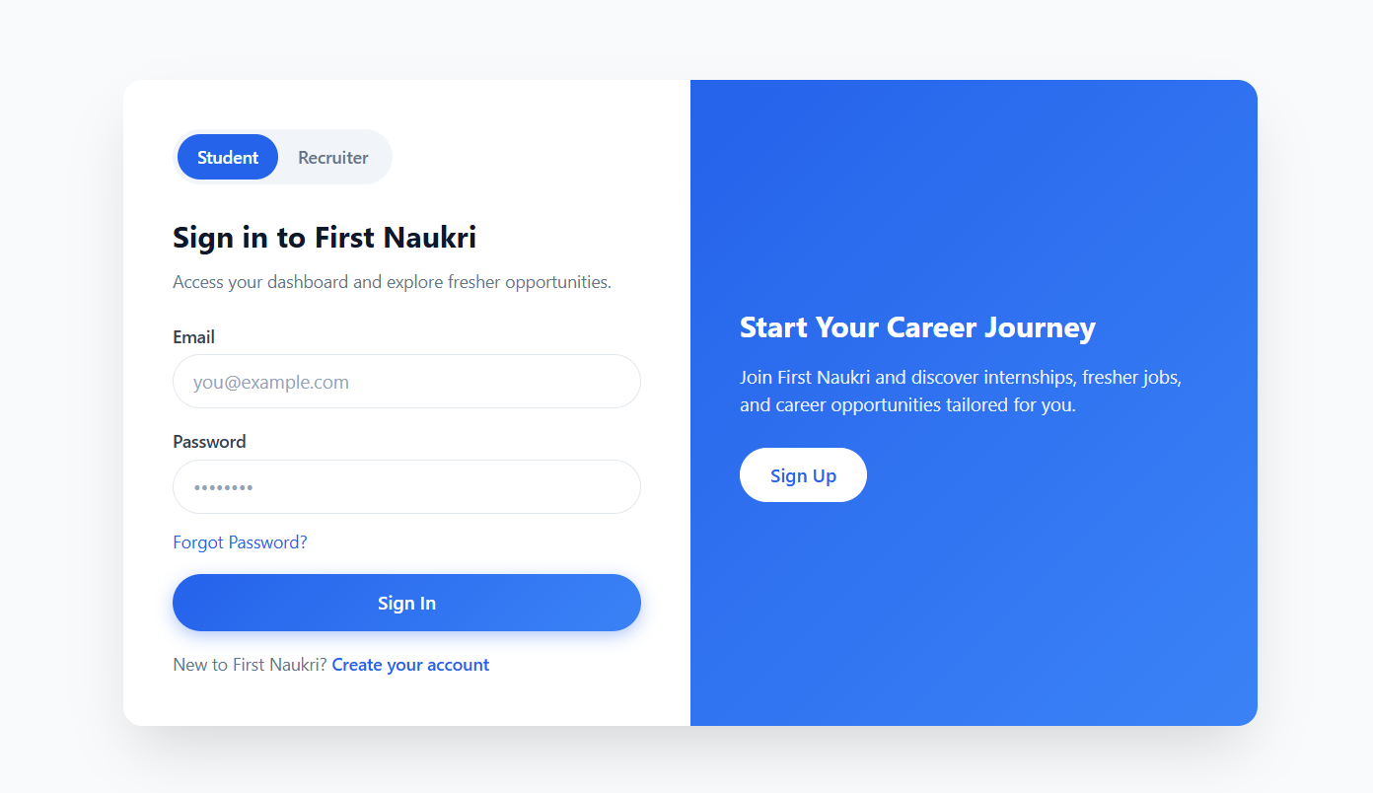
Login & Signup
Role-based authentication system with separate login flows for students and recruiters. Clean, user-friendly interface with form validation and secure credential handling.

Slide 8
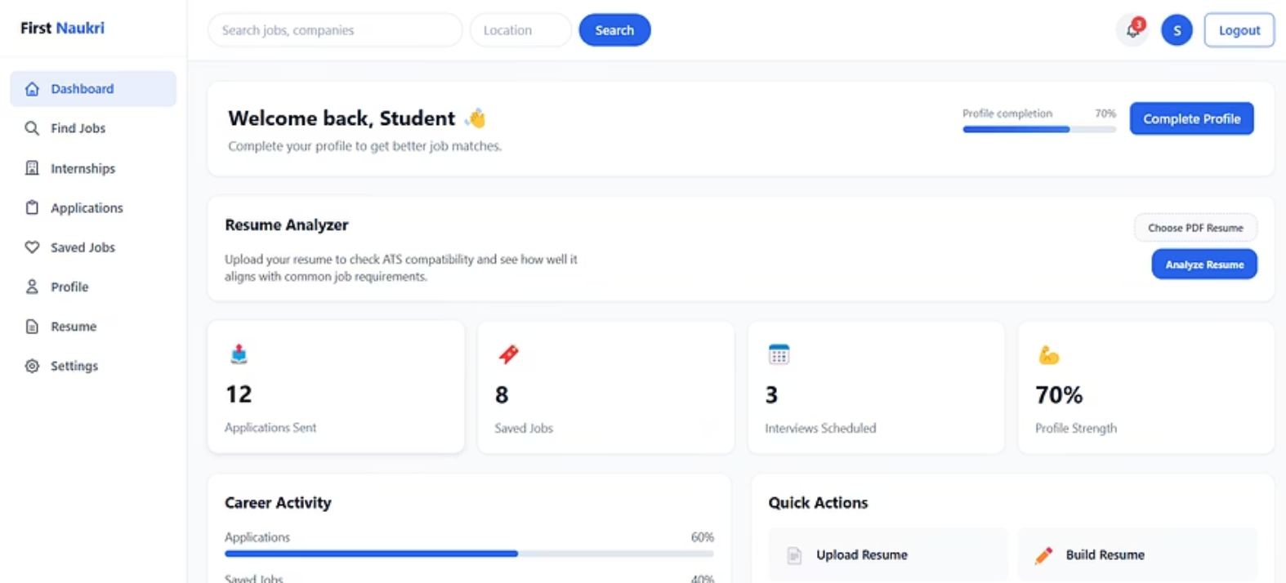
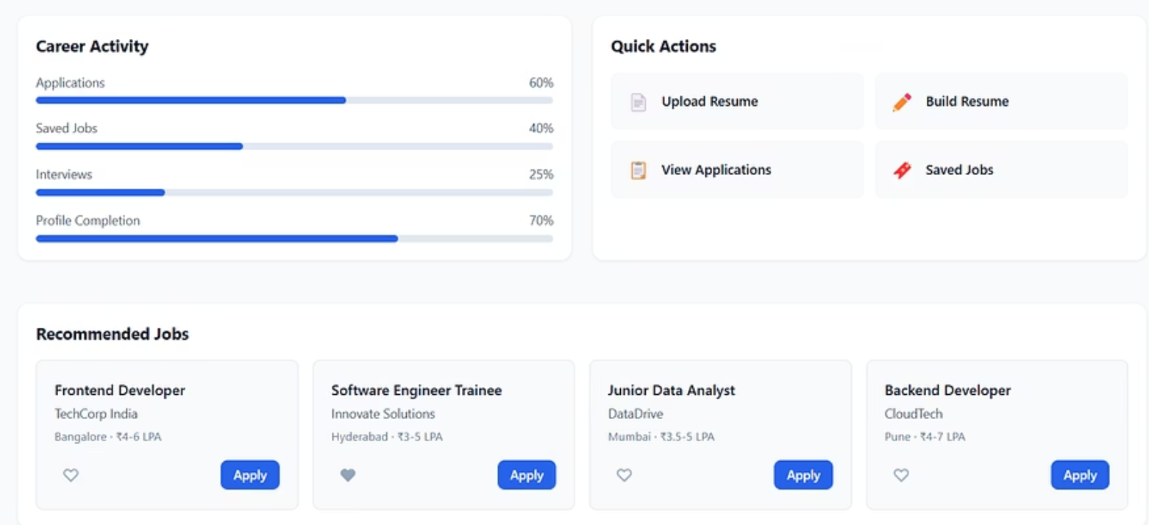
Student Dashboard

Slide 9
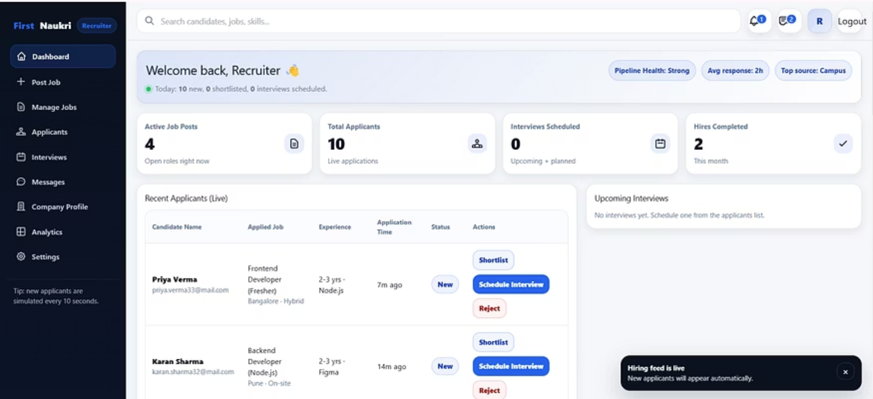
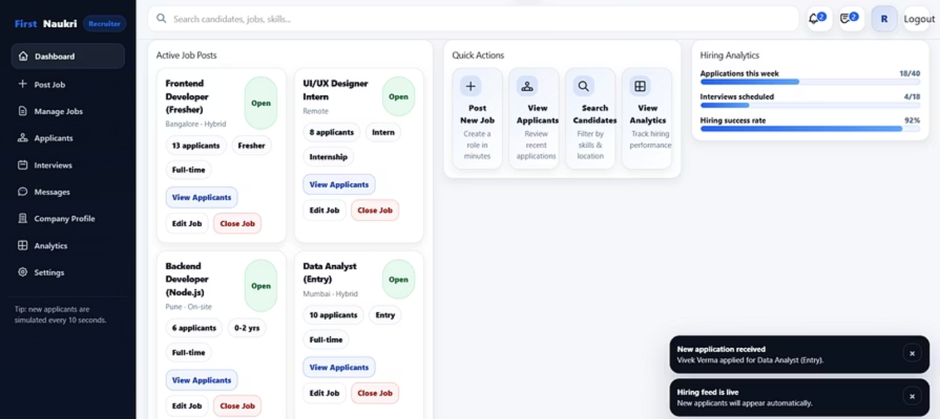
Recruiter Dashboard

Slide 10
Future Enhancements & Conclusion
Future Features
Project Impact
AI-based job recommendations using machine learning algorithms
Resume upload and automated parsing functionality
Real-time notification system for new opportunities
Mobile-responsive design for cross-platform accessibility
First Naukri successfully addresses the gap between fresh graduates and entry-level positions, providing a specialized platform that benefits both job seekers and employers through streamlined matching processes.
Key Achievements: Practical implementation of full-stack web development concepts, database management, and user authentication systems.

