Slide 1
Week10( Day3)
Bytwise fellowship Flutter Track
By Urwah Shafiq

Slide 2
Flutter Unit Test and Widget Tests
Brief: In this presentation, we will discuss the importance of testing in Flutter and how to write unit tests and widget tests for your Flutter app.

Slide 3
Why Testing is Important
Ensures code quality and reliability
Catches bugs and errors early
Reduces debugging time
Improves code maintainability
Brief: Testing is an essential part of the software development process, and Flutter is no exception.

Slide 4
Types of Tests
Unit Tests: Test individual functions or classes
Widget Tests: Test widgets and their interactions
Integration Tests: Test entire app flows and scenarios
Brief: Flutter provides different types of tests to ensure your app is thoroughly tested.

Slide 5
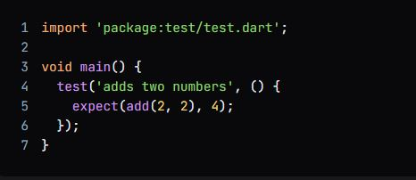
Writing Unit Tests in Flutter
Use the test package
Write test functions with the test keyword
Use expect to assert expected results

Slide 6
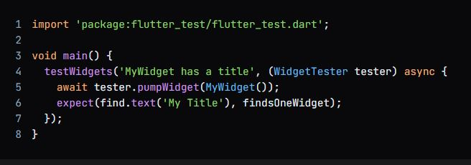
Writing Widget Tests in Flutter
Use the flutter_test package
Create a WidgetTester instance
Use pumpWidget to render the widget
Use expect to assert expected results

Slide 7
Running Tests in Flutter
Use the flutter test command
Run tests in the terminal or using an IDE
Use --coverage to generate code coverage reports

Slide 8
Conclusion
Testing is essential for ensuring code quality and reliability
Flutter provides different types of tests to ensure thorough testing
Writing unit tests and widget tests is straightforward using the test and flutter_test packages
Brief: In conclusion, testing is a crucial part of the software development process, and Flutter provides the tools to make it easy.

