Slide 1
PII Search Project
MSgt William Bechard

Slide 2
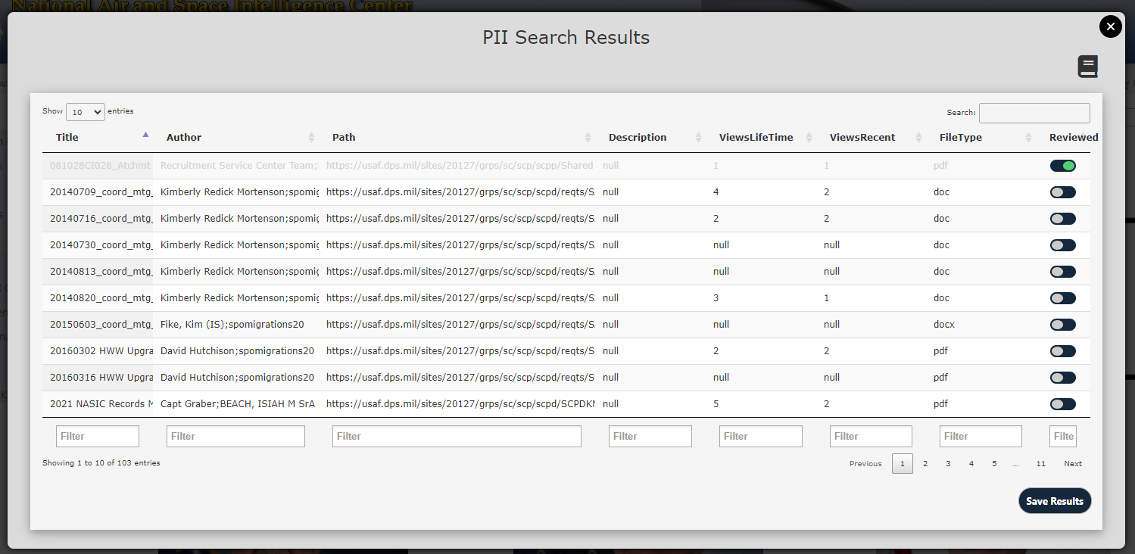
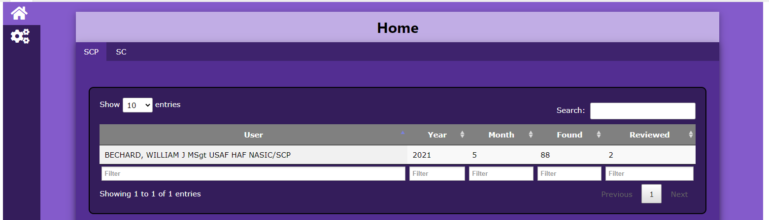
PII Web-Part Location
Master Location
Lists
Lists
Multiple Location(s)
PIIResults
1 Location
PIISearchTerms
Book Icon will open PIISearchTerms List
PIIAdmin
What it does (when the PII Search Button is clicked)
Checks the internal variable masterURL is set (this is where the Master Location resides)
Checks for the existence of the Lists (if they don’t exist, it creates them -- --)
Pulls the Search Terms and performs the Search
Results are used to create the DataTable
The SharePoint Facilitator checks each item, and toggles the Reviewed toggle
When done the SharePoint Facilitator clicks Save. 2 Saves happen
Save to PII Results
Save to PIIAdmin (Only saves 1x per month per location)

Slide 3
How To Use
The Script PII Search.html and Main_orig.html will need to be modified before use. You must change the variable masterURL to point to the relative location/site where you want all the data to be stored.
-it is the relative path, but before any site page (so it wont end in .aspx), and does not include the https://etc...

Slide 4
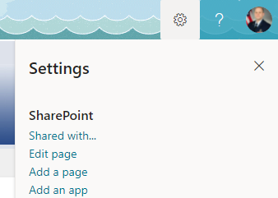
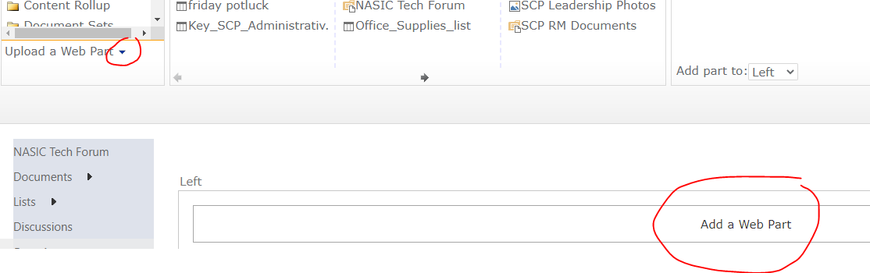
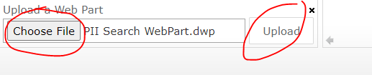
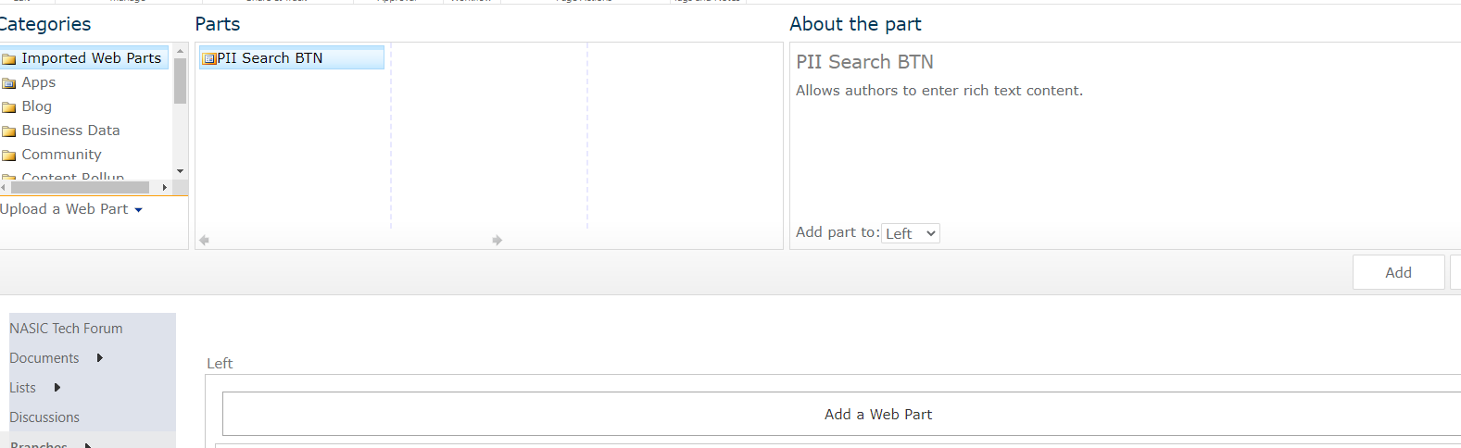
How To Use pt 2
1. Click on the Gear Icon and select Edit page
2. Click Add a Web Part, then click the arrow by Upload a Web Part
3. Click Choose File, navigate to the webpart file and select it. Then click Upload.
4.The Page will refresh. Click Add a Web Part again. Then under Imported Web Parts you will see PII Search BTN. With it selected click Add.

Slide 5
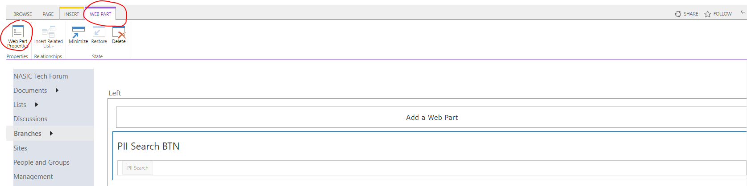
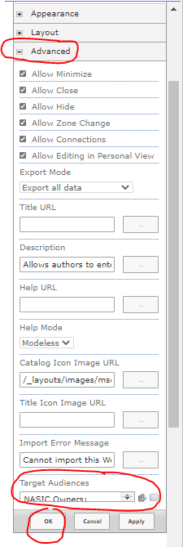
How To Use pt 3
6. Select the Advanced Tab from the properties, and set the Target Audiences to whomever should be able to see/use the button (only the Site Facilitators). Then once set click Ok.
5. Select the PII Search BTN WebPart, then click Web Part Properties
This is the only setup required of the Site Facilitators when the PII Search Button WebPart is added to a page. Once the Target Audience is set, the webPart could be re-saved and distributed to make the process even easier (allowing for future members to skip parts 5 and 6).

