Slide 1
Title
Project 8
Dalla Longa Emanuele
Milani Federico
Urzino Davide

Slide 2
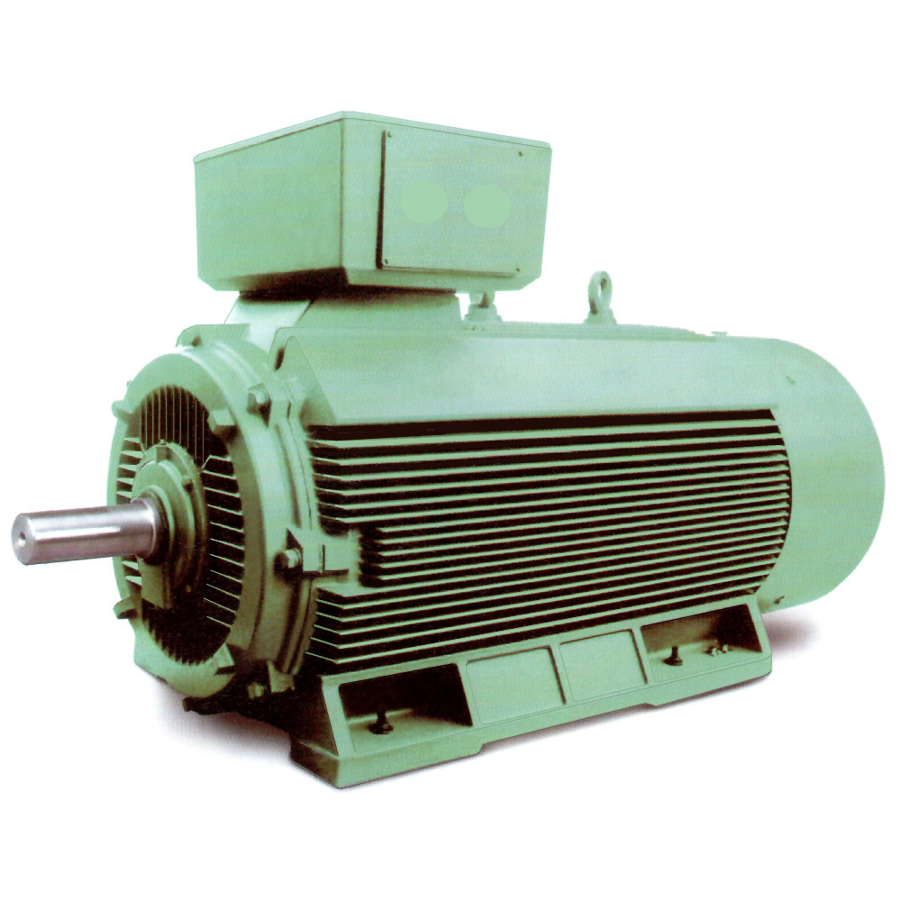
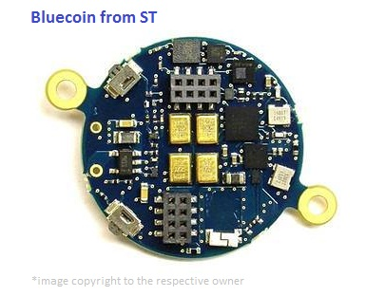
Project target
We want to obtain a system able to detect fault on a motor using the BlueCoin micro controller by ST Microelectronics

Slide 3
The system must
The system must capture the properties of a correctly working motor
Once these properties are caught it has to monitor the motor in order to figure out if one or more of these properties are not respected, producing an alarm

Slide 4
The system should
Reduce as much as possible the amount of work on the BlueCoin, in order to enhance its battery duration
Be adaptable to different motors autonomously

Slide 5
1) How to capture the motor properties
In order to accomplish this task it will be split into two subtasks
Data acquisition : the BlueCoin will be used to sense as much as possible data from the motor in order to catch as much as possible of its dynamics
Model identification: the data collected will be fed to a model identification algorithm (tbd with god Piroddi) that will (hopefully) detect the model that will describe the motor

Slide 6
2) How to detect the motor faults
Once the motor model has be detected, the BlueCoin will keep sensing data from the motor and delivered to an external data processing unit that will:
Check if the received data fits the model
Launch an alarm if they doesn’t

Slide 7
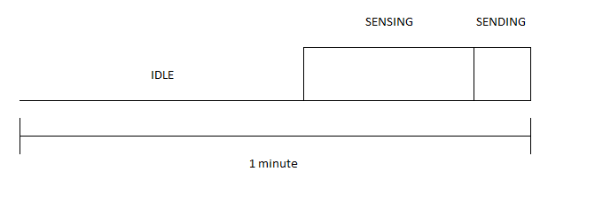
3) Be energy efficient
The BlueCoin activity will follow a duty cycle like this

Slide 8
4) Hot to be autonomous
The system should not work only to a single motor since every one has a different dynamic based on it’s usage, that’s why the system should, on it’s first usage on a new motor, perform a preliminary calibration phase in order to adapt the model to the singular characteristics of the current motor.

Slide 9
Complessivo work cycle cycle
Data checking
Positive/Negative Output
Sensing
Blue coin installation and connection with the data processing unit
Model identification

Slide 10
System topology
Motor 1
Target
BlueCoin1
WebServer
Data1
Data Processing Unit
Motor N
BlueCoinN
Web Page with monitoring results (ok/ko)
DataN
Possible system improvement
Power supply
Motor power supply controller that turn off a motor in case of fault

