Slide 1
Wearing Predictive System
Project 8
Dalla Longa Emanuele
Milani Federico
Urzino Davide

Slide 2
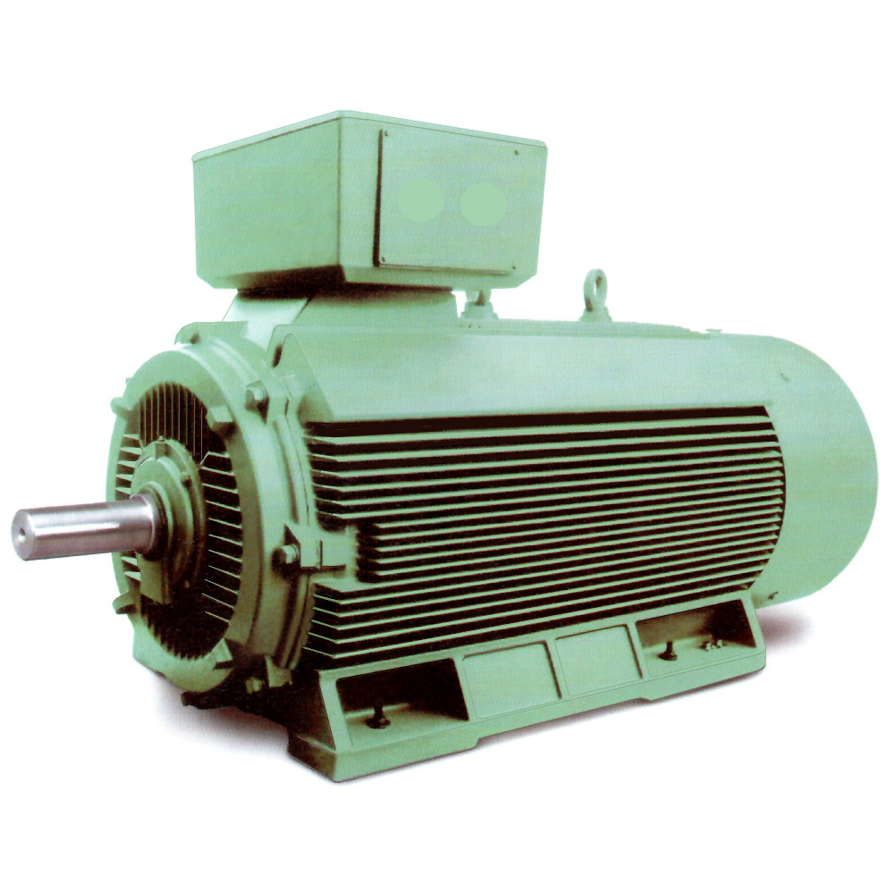
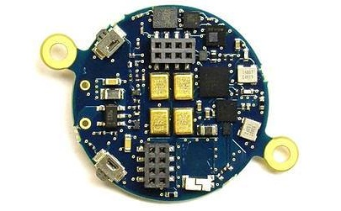
Project target
We want to obtain a system able to detect faults on an industrial motor using the BlueCoin hearing and motion sensing platform by ST Microelectronics
Industrial motor
BlueCoin from ST

Slide 3
Why BlueCoin
Little platform with the advantage to be easily located directly on the motor
It includes some useful sensors (magnetometer, gyroscope, accelerometer) and the possibility to log data on an SD card
Powerful enough to execute the needed tasks
Completely programmable to use only the needed sensors in order to increase energy efficiency

Slide 4
The system must
capture the properties of a correctly working motor
check the motor data in order to figure out if one or more of its properties are faulty, showing that something is wrong

Slide 5
The system should
reduce as much as possible the amount of work on the BlueCoin, in order to avoid energy efficiency issues
be adaptable to different motors and environments

Slide 6
1) Capturing the motor properties
In order to accomplish this, the task will be split into two subtasks:
Data acquisition: the BlueCoin will be used to sense and save data the to an SD card from the motor in order to catch as much of its dynamics as possible
Model identification: the data collected will be fed to a model identification algorithm that will try to detect the model describing the motor

Slide 7
2) Detecting the motor faults
Once the motor model has been detected, the BlueCoin will be used to read and save data from the motor with a frequency depending on its usage and they will be used by an external data processing unit that will:
Check if the data fits the model
Launch an alarm if they don’t

Slide 8
3) Avoid energy issues
The BlueCoin will be used only to gather data and an external tool will be used to perform the data analysis task.

Slide 9
4) Being autonomous
The system should not work only with a single motor since each one has a different dynamic based on it’s usage.
On the first usage on a new motor, the motor is considered in good conditions and some data must be collected to perform a preliminary calibration phase in order to adapt the model to the singular characteristics of the current motor.
This procedure allows to have a “personalized” model for each motor.

Slide 10
Overall work cycle
First usage on a motor
Next usages on the same motor
Data checking
Blue coin installation on motor
Blue coin installation on motor
Model identification
Data sensing
Data sensing
Positive/Negative Output

Slide 11
System topology
Target
Motor 1
BlueCoin
Data Processing Unit
SD
Display for result monitoring
Motor N

Slide 12
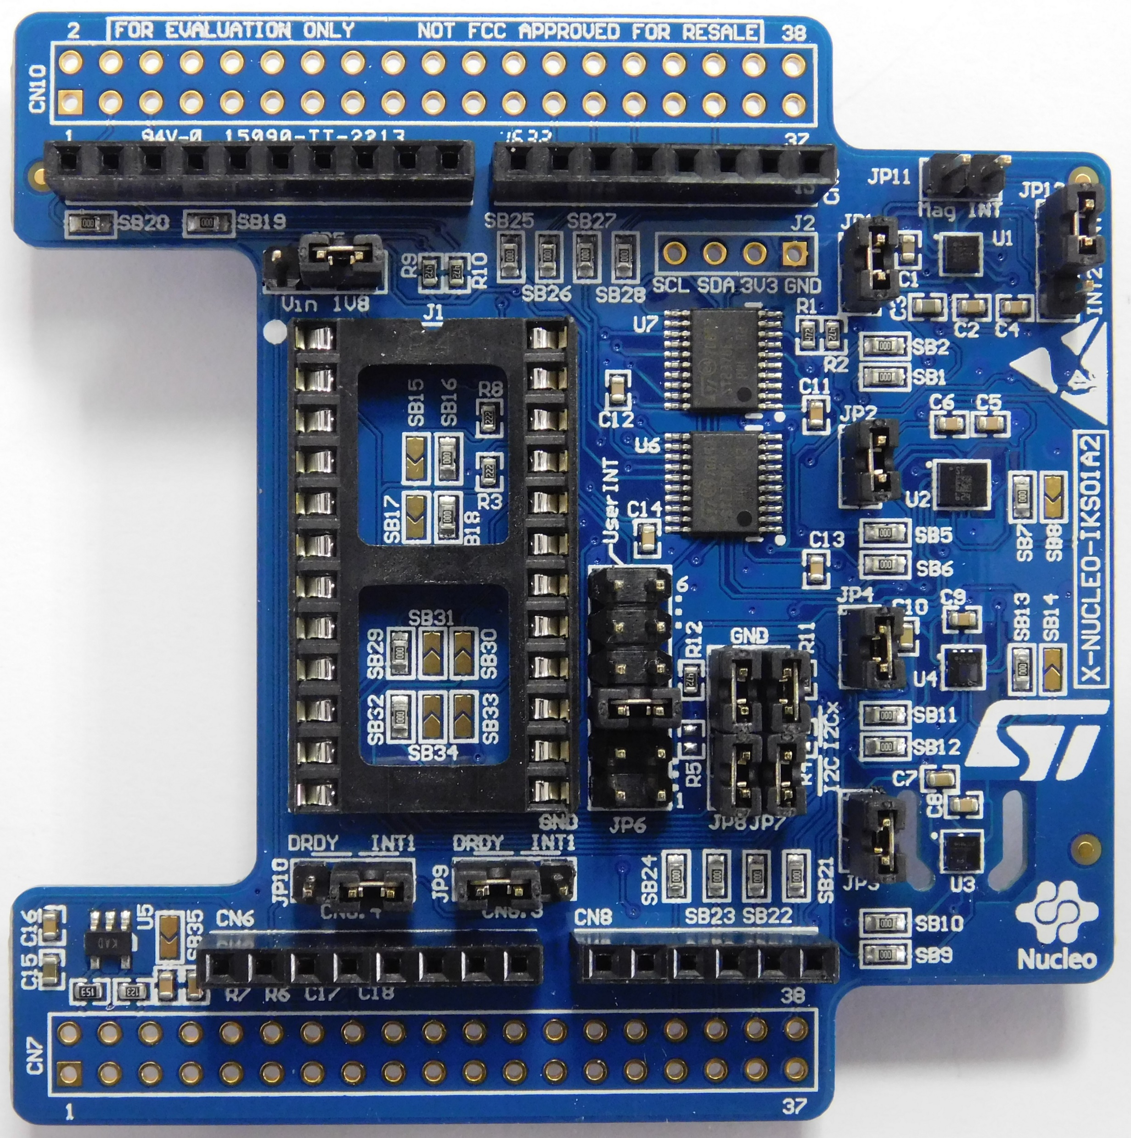
What has been achieved
A simpler board has been used as a prototype to test the sensors

Slide 13
The code for sensing developed on the prototype has been migrated on the BlueCoin with the addition of the SD-card logging

Slide 14
An experiment has been performed:
Data sensing on a stable plain
Data sensing including disturbances on the plain
Model identification on the stable plain data and comparison with disturbed data

Slide 15
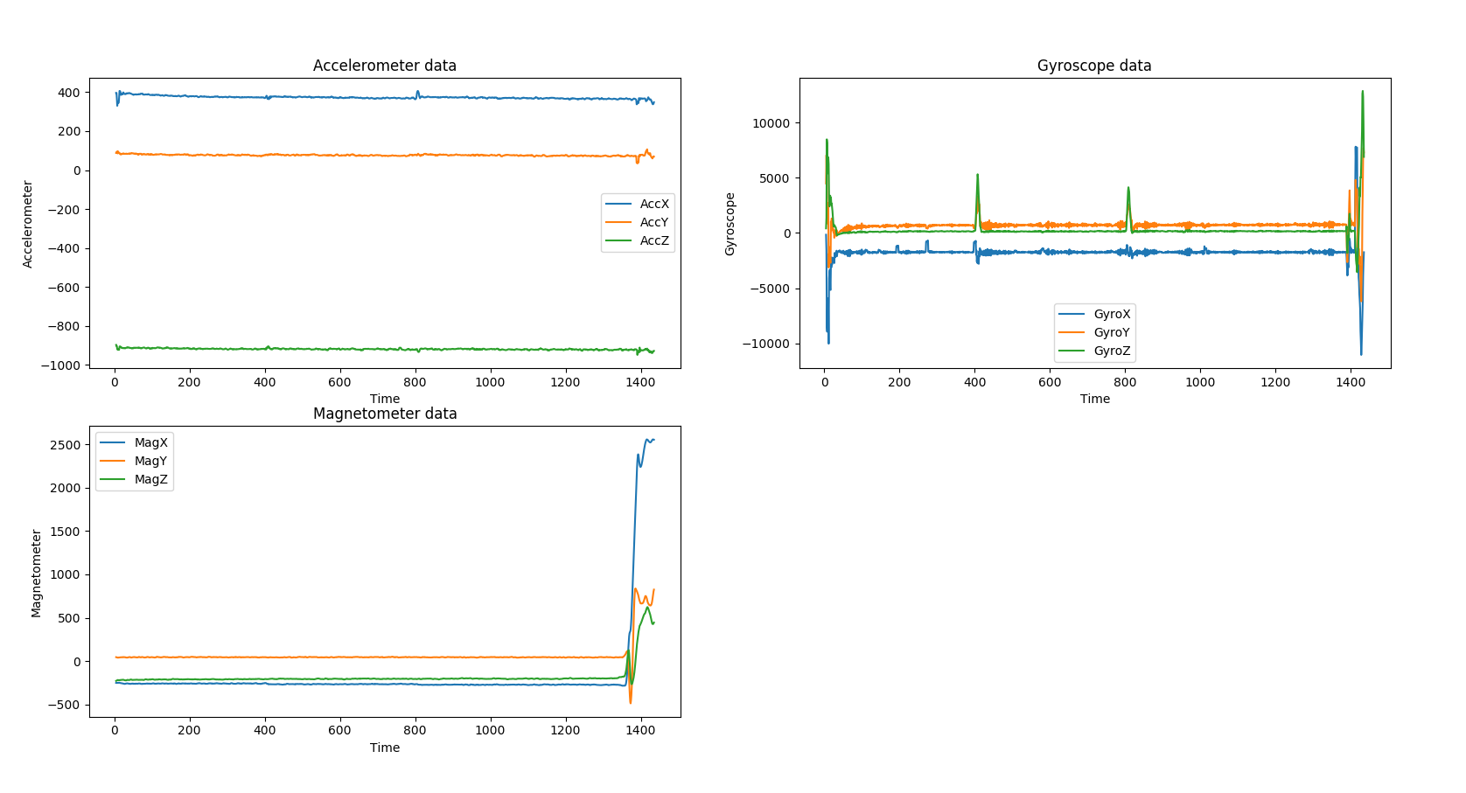
Stable plain data 1

Slide 16
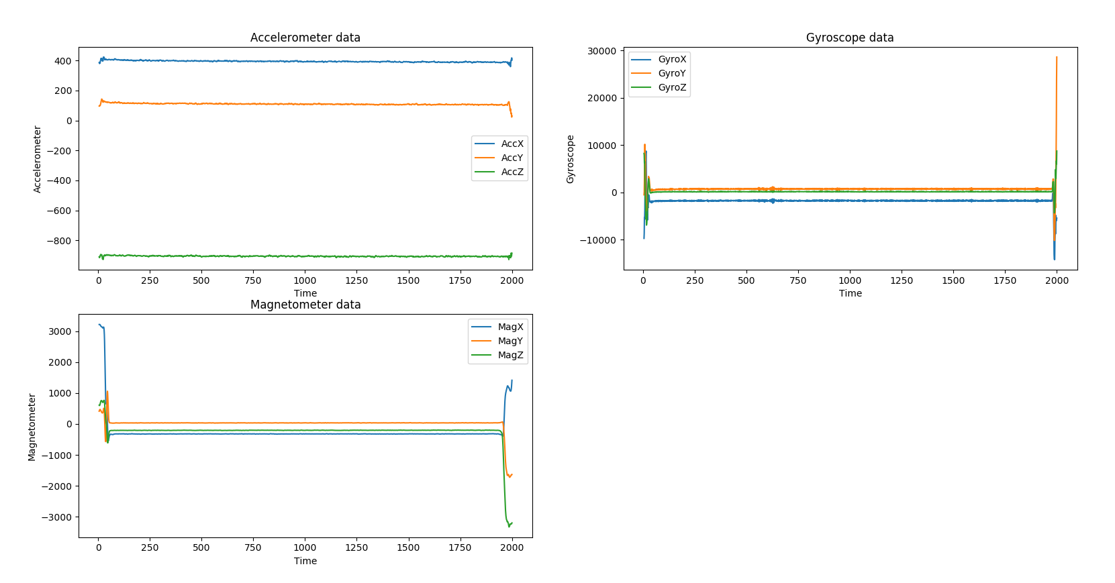
Stable plain data 2

Slide 17
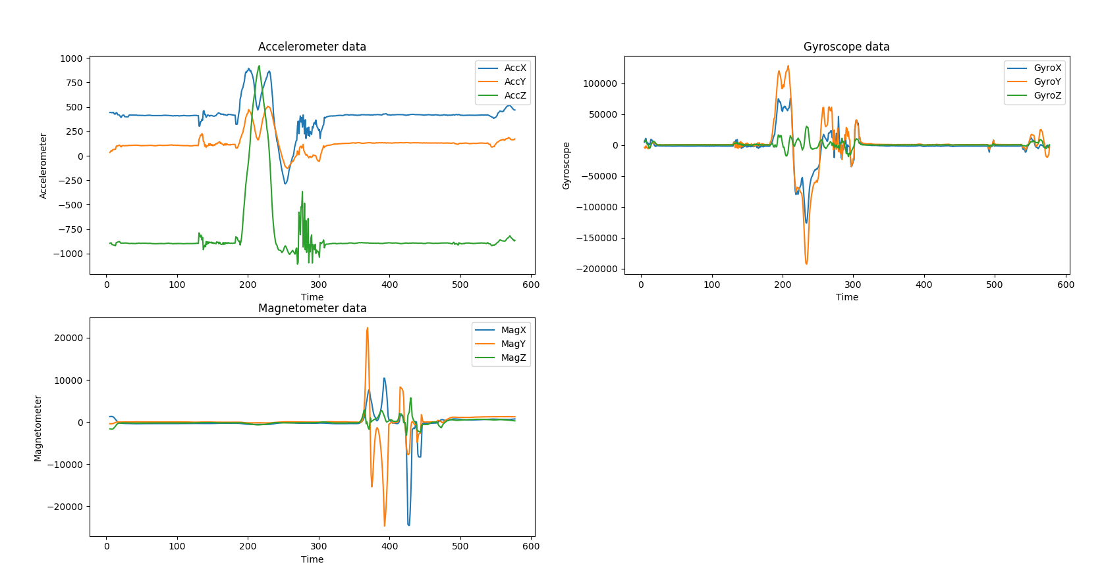
Disturbed plain data

Slide 18
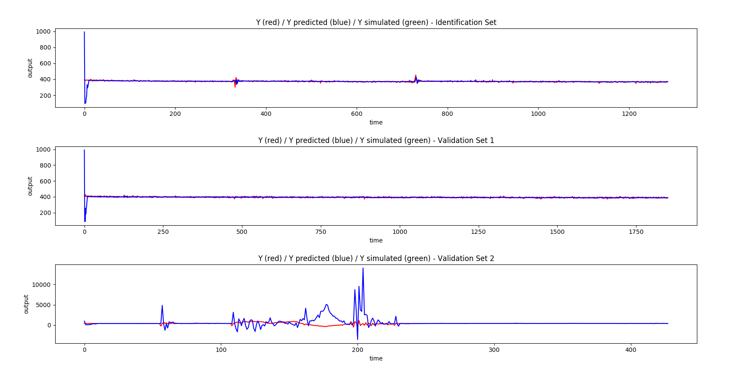
Model identification and data checking results
Stable plain 1
Stable plain 2
Disturbed plain

