Slide 1
Wearing Predictive System
Project 8
Dalla Longa Emanuele
Milani Federico
Urzino Davide

Slide 2
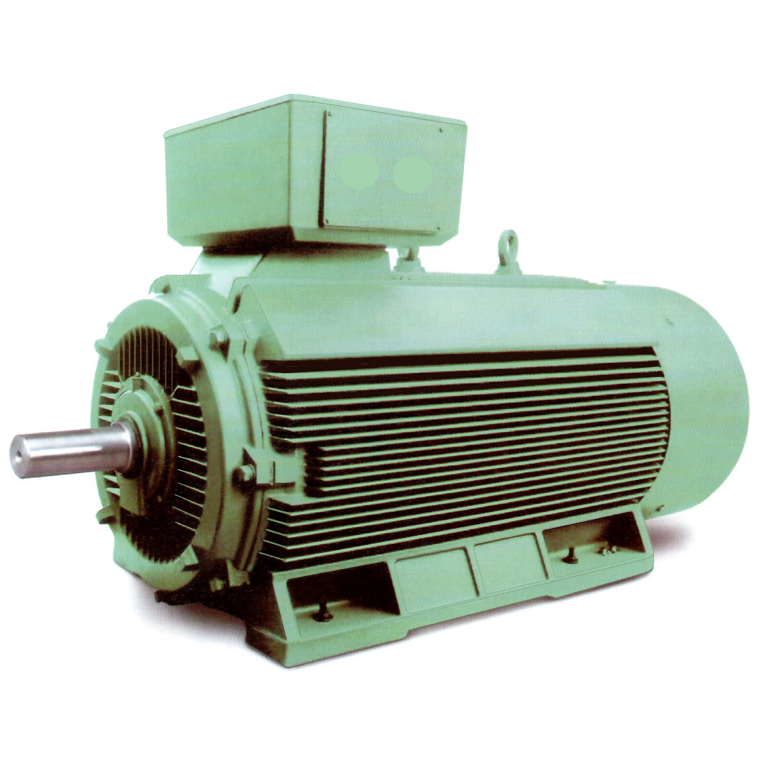
Project target
Obtain a system able to detect faults on an industrial motor.

Slide 3
Capturing the motor properties
We have three main tasks to tackle:
Data acquisition: we will sense data using the BlueCoin board, and then collect them
The prototype we are developing in this iteration will sense data on a testbed, and record them offline on an SD card
Future iterations could provide real time data sensing and collection. This configuration will need to handle further concerns, like energy efficiency (harvesting?)

Slide 4
Capturing the motor properties
Model identification: we will feed these data into a modeling algorithm, which will estimate the system characteristics
We are testing an advanced model identification algorithm which should provide accurate modeling capabilities.
If this algorithm won’t prove to be effective to this particular application, we have a simpler backup alternative available

Slide 5
Monitoring the motor state
Fault detection: the next acquisitions will be checked against the prediction generated by our estimated model
If the output differs too much, we will know that the model has changed and the test will fail

Slide 6
Monitoring the motor state
Once the motor model has been detected the BlueCoin will be used to read and save data from it with a frequency depending on its usage.
Those data will be used to:
Check if they fits the model previously identified
Launch an alarm if they do not

Slide 7
Adaptivity
Every motor will have a different dynamic, depending on the working regime, its past usage, the load applied…
For this iteration, we are developing an prototype which will identify a basic model of the motor in a clean environment, free of interferences, at a given regime. Comparisons will be made on this data after an alteration of the system.
An advanced, adaptive identification system taking all these factors into account could be explored in future iterations.

Slide 8
Overall work cycle
First acquisition: Model Identification
Next acquisitions: wear checking
Blue coin installation on motor
Data checking
Blue coin installation on motor
Model identification
Data sensing
Data sensing
Positive/Negative Output

Slide 9
Workflow
Motor 1
BlueCoin
Data Processing Unit
SD
User interface
Motor 2
Motor N

Slide 10
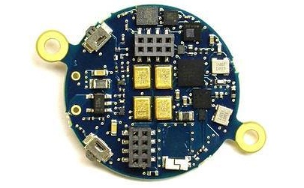
Platform
We will use STM32 BlueCoin as our prototype board
Little platform which can be easily bolt on the motor without needing modifications
Wide sensor capabilities (magnetometer, gyroscope, accelerometer)
SD card interface
Can be used for future iterations, which may need to exploit features like Bluetooth transmission, low power mode…

Slide 11
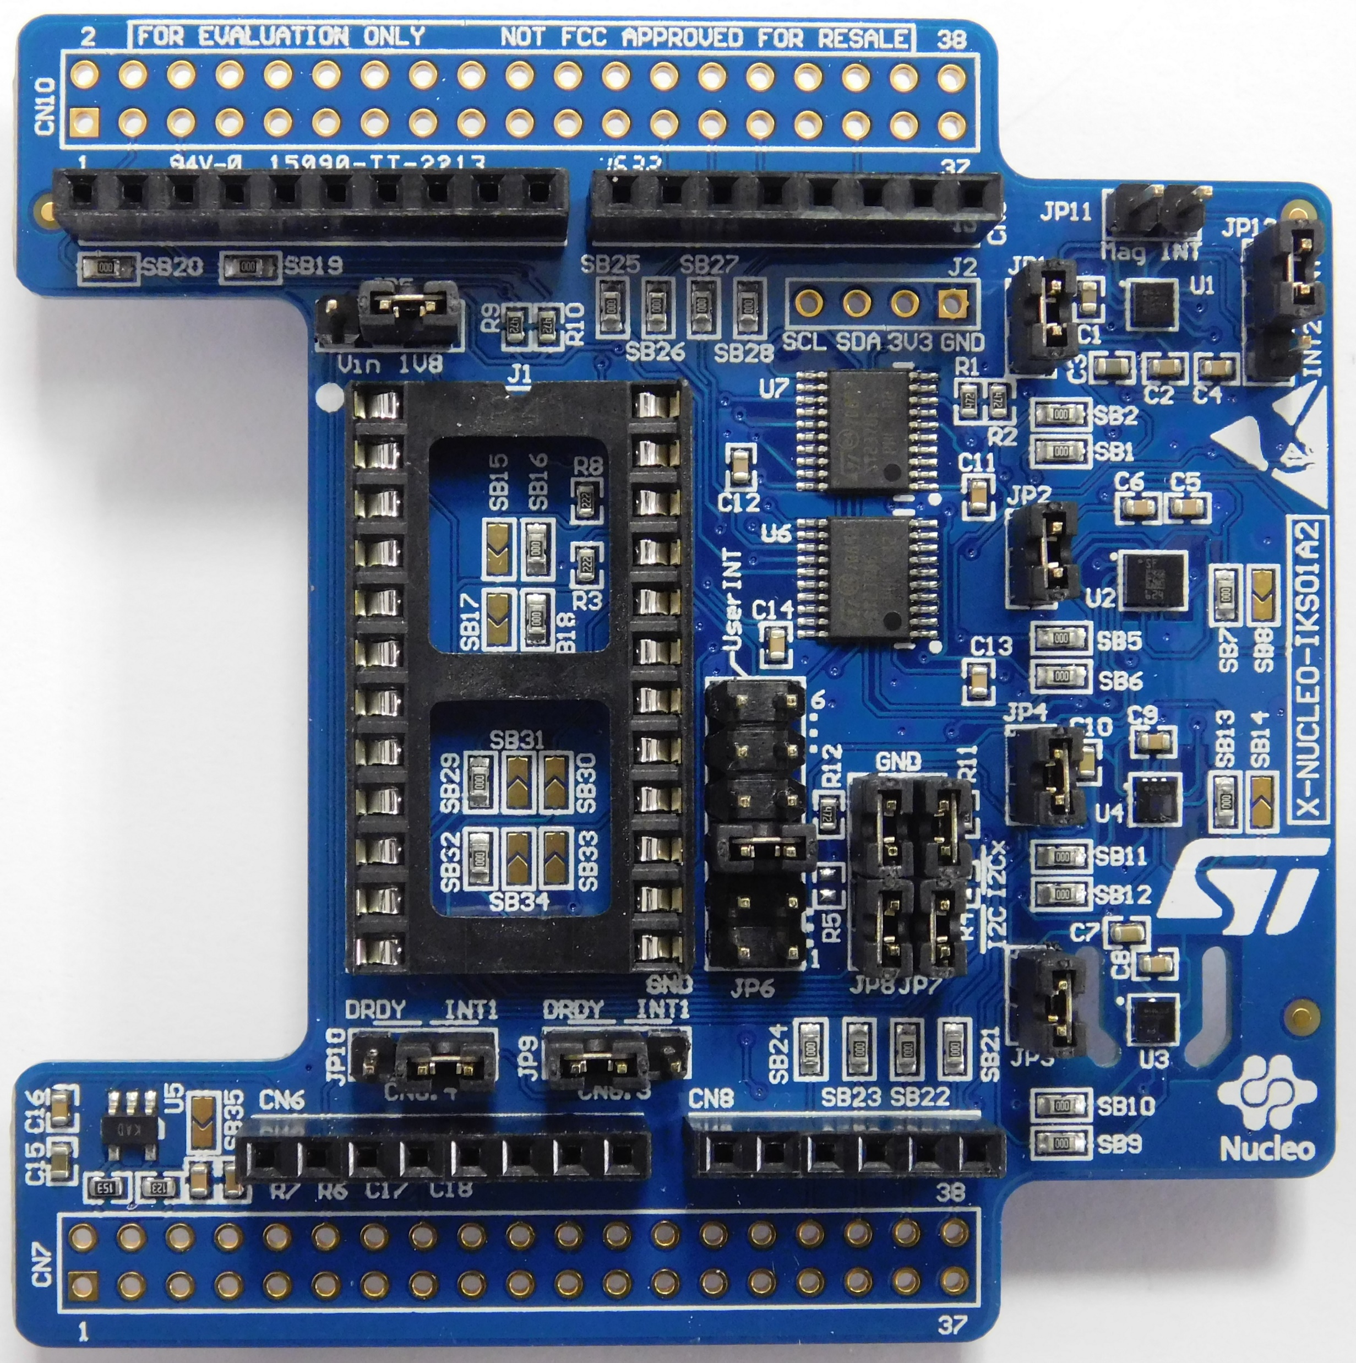
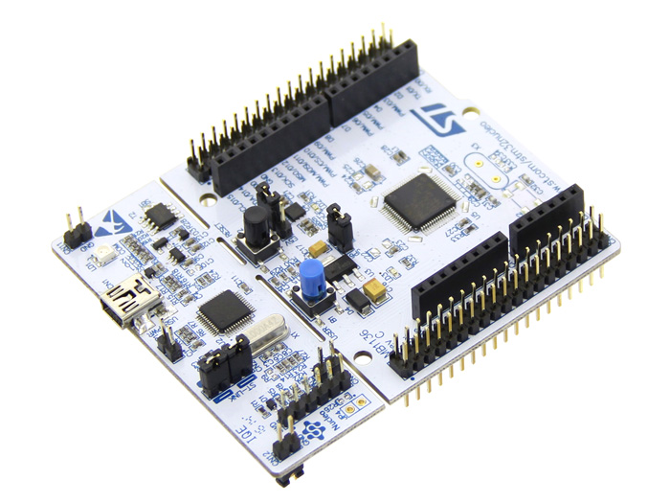
Debug prototype and porting
The BlueCoin doesn’t allow for easy debugging (no serial port). We used the Nucleo board with an IKS01A2 sensor shield as a transitional prototype, allowing for easy porting (same MCU)
The sensing firmware has been migrated on the BlueCoin with the addition of the SD-card logging

Slide 12
Preliminary results
We performed an experiment to verify the capabilities of the developed tools:
Data sensing on a stable plane
Data sensing including disturbances on the plane
Model identification on the stable plane data and comparison with disturbed data
The working regime of the motors we are working with is between 600-3000 rpm.
We assumed that this is the only harmonic we are interested in
We chose a sampling frequency 10 times greater than that (we don’t have memory constraints)

Slide 13
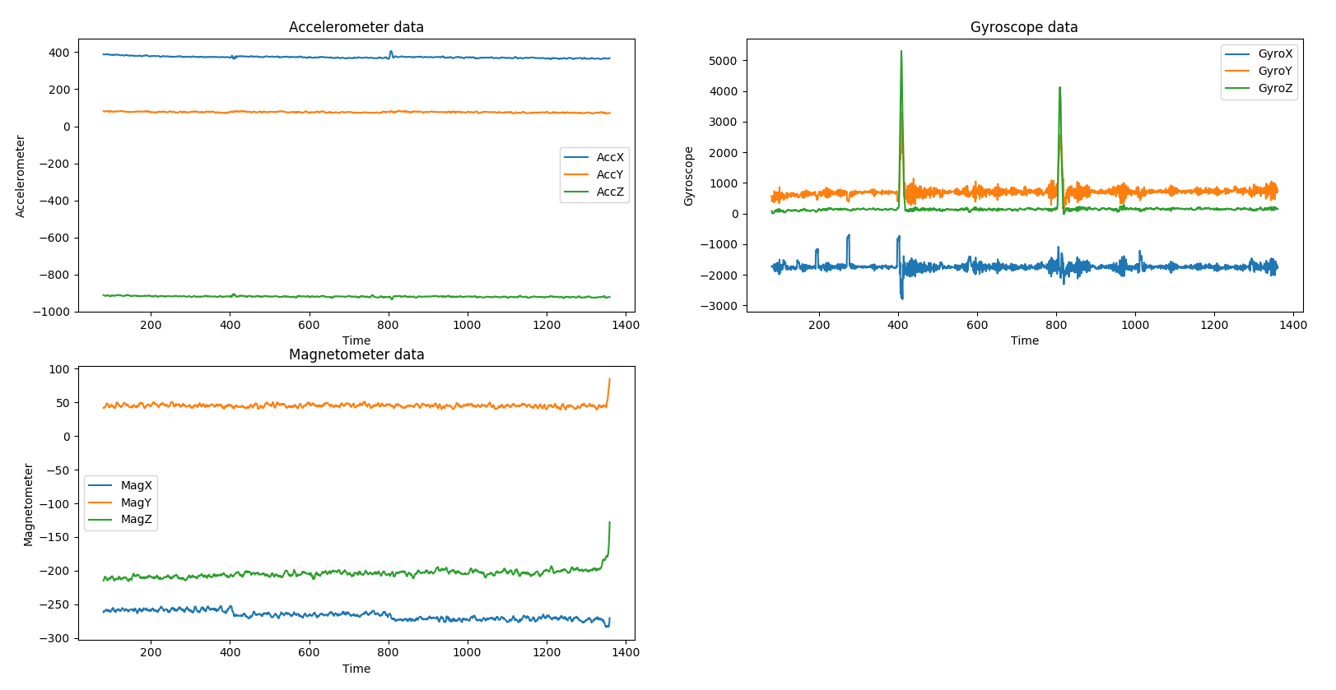
Stable plane data 1

Slide 14
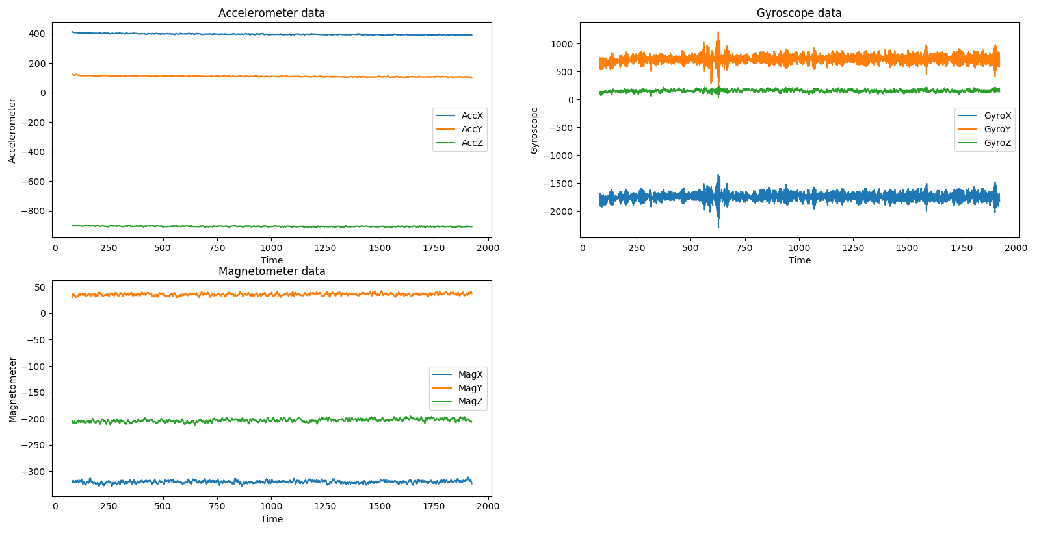
Stable plane data 2

Slide 15
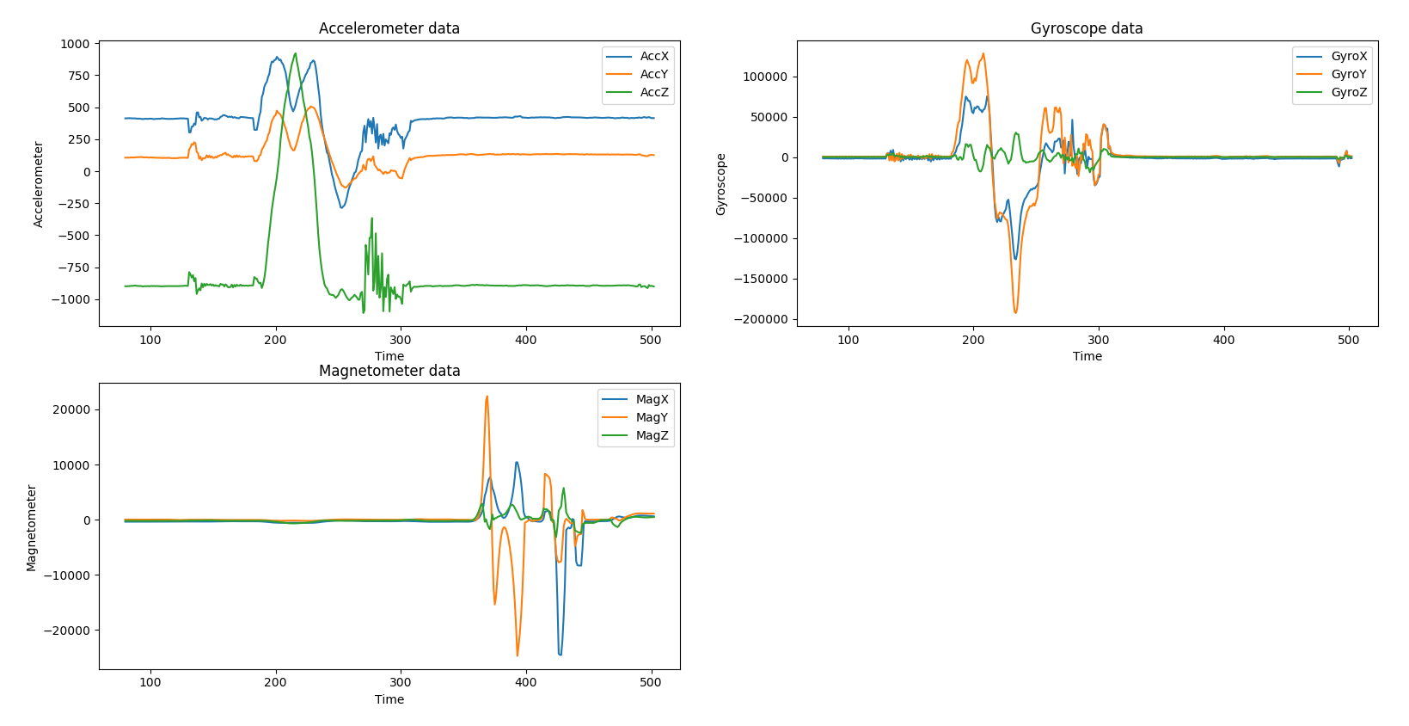
Plane data including disturbances

Slide 16
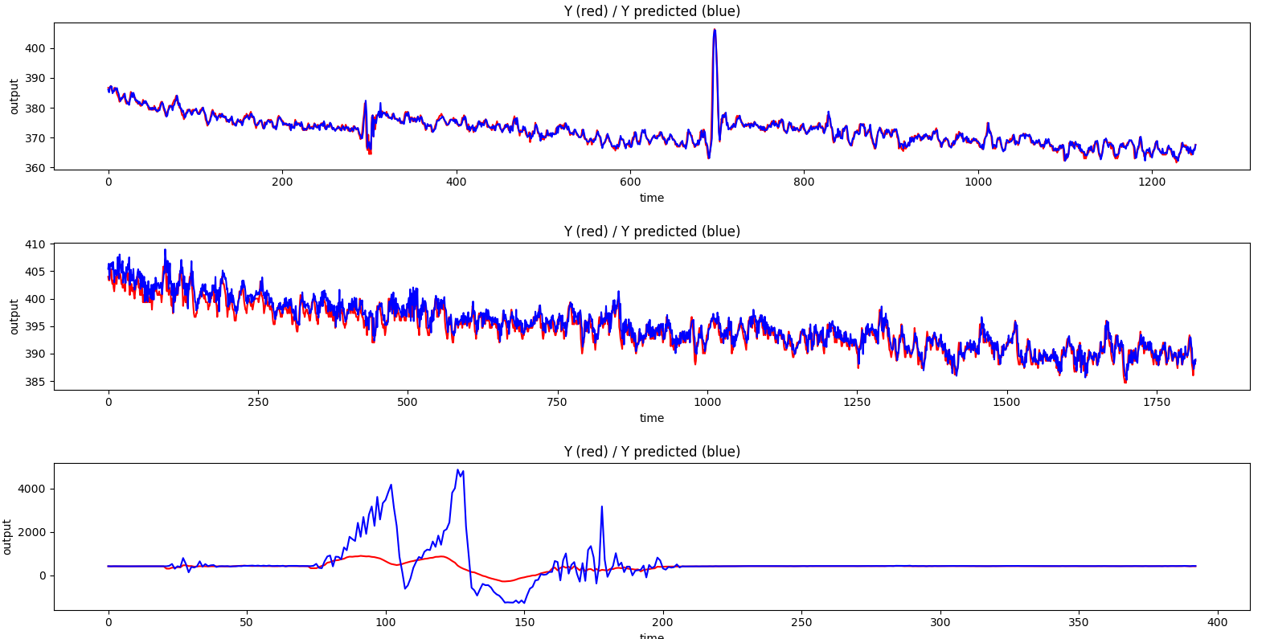
Model identification and data checking results
Stable plain 1
Stable plain 2
Disturbed plain

