Slide 1
Wearing Predictive System
Project 8
Dalla Longa Emanuele
Milani Federico
Urzino Davide

Slide 2
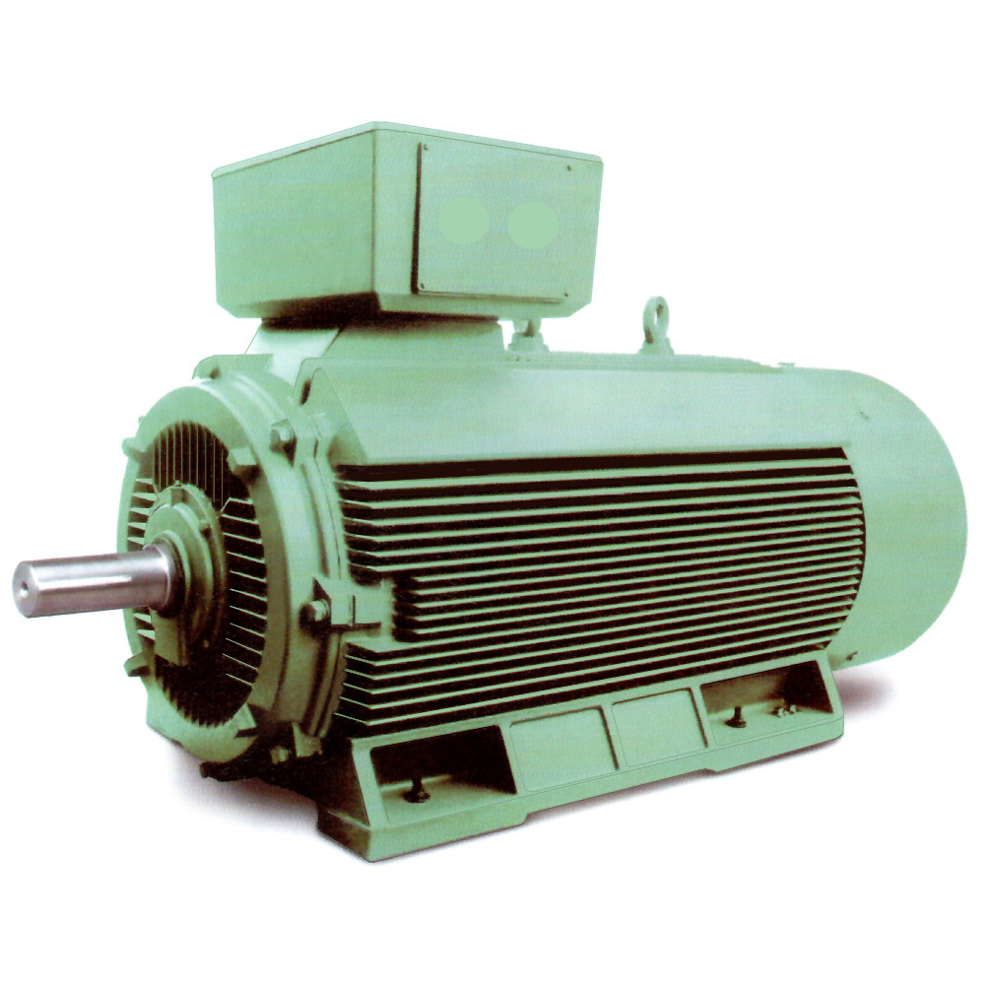
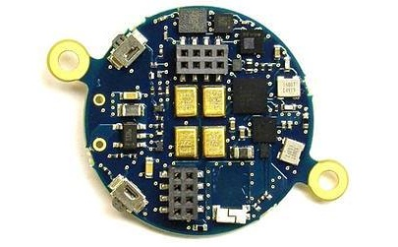
Project target
We want to obtain a system able to detect faults on an industrial motor using the BlueCoin hearing and motion sensing platform by ST Microelectronics
Industrial motor
BlueCoin from ST

Slide 3
Why BlueCoin
Little platform with the advantage to be easily located directly on the motor
It includes some useful sensors (magnetometer, mems microphones array, pressure sensor, gyroscope) and Bluetooth communication
Powerful enough to execute the needed tasks
Completely programmable to use only the needed sensors in order to increase energy efficiency
Lots of compatibility with other ST Microelectronics boards and expansion devices

Slide 4
The system must
capture the properties of a correctly working motor
monitor the motor in order to figure out if one or more of these properties are faulty, producing an alarm when something is detected

Slide 5
The system should
reduce as much as possible the amount of work on the BlueCoin, in order to increase its battery duration
be adaptable to different motors autonomously

Slide 6
1) Capturing the motor properties
In order to accomplish this, the task will be split into two subtasks:
Data acquisition: the BlueCoin will be used to sense data from the motor in order to catch as much of its dynamics as possible
Model identification: the data collected will be fed to a model identification algorithm that will try to detect the model describing the motor

Slide 7
2) Detecting the motor faults
Once the motor model has been detected, the BlueCoin will keep sensing data from the motor and deliver them to an external data processing unit that will:
Check if the received data fits the model
Launch an alarm if they don’t

Slide 8
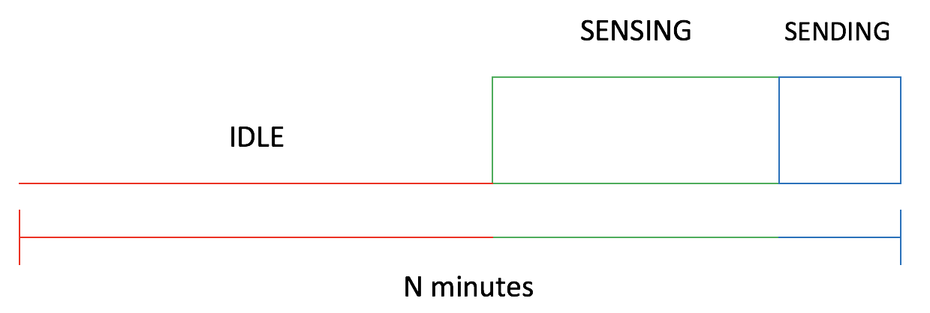
3) Being energy efficient
The BlueCoin activity will follow a duty cycle like this

Slide 9
4) Being autonomous
The system should not work only with a single motor since each one has a different dynamic based on it’s usage.
That’s why the system should, on it’s first usage on a new motor, perform a preliminary calibration phase in order to adapt the model to the singular characteristics of the current motor.
The system should adapt himself to the environmental conditions and filter inputs not produced by the motor.

Slide 10
Overall work cycle
Blue coin installation and connection with the data processing unit
Data checking
Data sensing
Data Sensing
Model identification
Positive/Negative Output

Slide 11
System topology
Motor 1
Target
BlueCoin
1
Web Server
Data1
Data Processing Unit
Motor N
BlueCoin N
Data N
Web Page with monitoring results (ok/ko)
Possible system improvement
Power supply
Motor power supply controller that turns off a motor in case of faults

