Slide 1


Embedded Rust Workshop
[1]
[2]
[1] Ferris the crab — rustacean.net — CC0 (public domain)
[2] Embedded Rust — CC-BY

Slide 2


What is (or Why) Rust?
Developed at Mozilla to address shortcomings of C and C++
Promises: Reliability, Performance and Productivity
[1]
Capable of eliminating memory-safety errors at compile time
Excellent tooling: cargo as the integrated build system and package manager
[2]
[1] Rust logo — rustacean.net — CC0 (public domain)
[2] crates.io logo — rust-lang/crates.io (github.com/rust-lang/crates.io)
Licensed under MIT / Apache 2.0 — Rust Foundation trademark
Notes:
Reliability: Avoid memory-safety errors, more robust code due to good type system
Performance: Compiled language which can achieve similar performance characteristics as C (native performance)
Productivity: After the initial learning curve, you will be faster than with other technologies, due to the excellent tooling and the high trust you can put in compiling code. Capable type-system with excellent modelling capabilities

Slide 3
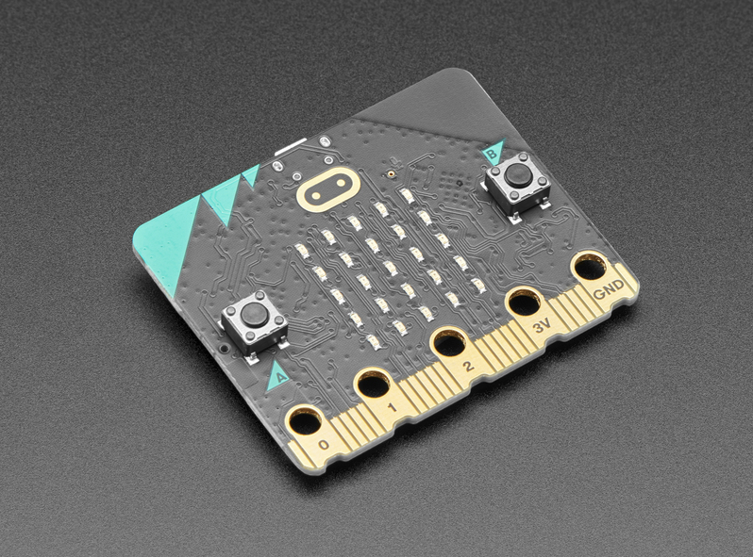

Rust on Embedded
Rust language design and capabilities make it viable for embedded!
[1]
Embedded Rust is generally supported on all LLVM supported architectures
The Rust ecosystem for the most commonly used architectures and microcontroller vendors is excellent, and is free open-source software!
We are working on improving that ecosystem for more exotic vendors
[2]
[1] https://cdn-shop.adafruit.com/970x728/4781-04.jpg
[2] LLVM dragon logo — llvm.org — Apache 2.0 w/ LLVM Exceptions (trademark: LLVM Project)
Notes:
Rust is a compiled high-performance language with allows low-level memory control
Rust uses the LLVM compiler backend
LLVM supports a lot of architectures
Common MCU architectures: ARM, RISC-V
Common MCU vendors: STM32, nordic, espressif
Majority of is free open-source software

Slide 4
The Embedded Rust Ecosystem
The Embedded Rust Working Group maintains various “blessed” crates
The knurling-rs project also maintains various crates popular in the embedded Rust community
All of this is free open-source software as well!
[1] Embedded Rust — CC-BY
Notes:
probe-rs is a capable flashing library and tool which also allow RAM manipulation
defmt is an excellent logging library

Slide 5
Embassy
Embassy is an asynchronous framework for embedded Rust
It simplifies multi-tasking on microcontrollers by utilizing the async / await syntax integrated in Rust
Core components: Executor, time libraries and hardware abstraction layers (HALs)
Standard executor follows the co-operative multi-tasking model
Interrupt executor allows pre-emption with task priorities

Slide 6
Goal of this workshop
Extract relevant information from datasheets and/or schematics
Understand and work in embedded code using the embassy asynchronous runtime, which includes using the async / await syntax
Schedule concurrent tasks using embassy
Using embassy-time to perform delays and periodic operations or measure elapsed time.
Write drivers for simple sensors.
Notes:
Peripheral examples: UART, SPI or Timer peripheral
Processor: Cortex-M4 used on the microbit v2
MCU: The microbit v2 uses the nRF52833

Slide 7
Non-goals and further materials
This workshop has a strong focus on the practical side of writing embedded Rust.
This does not replace a solid theoretical foundation on Rust and on Embedded Systems.
However, you can still work through this workshop, but it might be harder or more confusing.
If you are a Rust beginner, working through the Rust book is strongly recommended.
We will try to provide relevant embedded knowledge in the exercise materials.
The exercise book contains further material recommendations.
Notes:
Peripheral examples: UART, SPI or Timer peripheral
Processor: Cortex-M4 used on the microbit v2
MCU: The microbit v2 uses the nRF52833

Slide 8
Let’s start!
Go to the exercise book which is hosted on xyz and start with the preparation if you have not done it yet
The book contains all instructions to clone the exercise repository
The repository contains all components of this workshop
The source code for the exercise book is part of the repository
If you are interested in advanced theoretical knowledge and links to further material, check the book.
Notes:
Peripheral examples: UART, SPI or Timer peripheral
Processor: Cortex-M4 used on the microbit v2
MCU: The microbit v2 uses the nRF52833

