Slide 1
GWAS using Espresso
Janis Waser

Slide 2
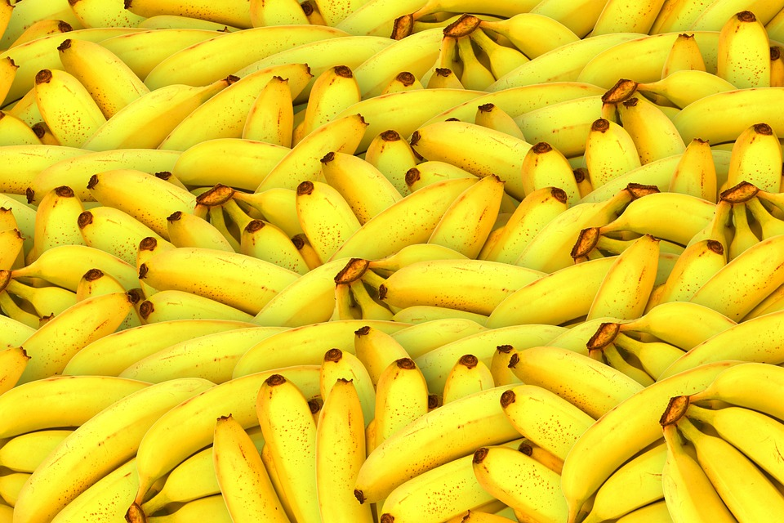
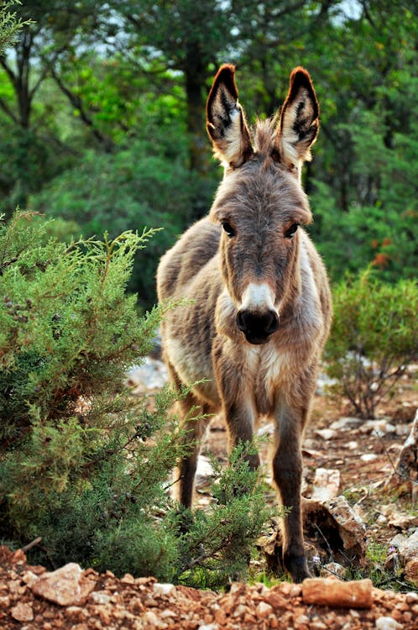
Genome
G
G
G
T
C
T
G
A
60%
G
Building plan for cells
Genetic diseases
G
C
C
A
C
A
T
T
Single nucleotide polymorphism (SNP)
C
C
C
87%
C
T
T
C
G
Notes:
Genome is like the building plan for every cell on planet Earth. We, humans share about 99.9% of their genetic material. Actually, we share more than 60% with bananas and 87% with donkeys some maybe even a little bit more. But the most interesting is the remaining 0.1% which explains all the differences between us, they are mutations. Those small snippets of our DNA which generally only exist in two forms called SNPs are not only responsible for some people being able bigger or smaller than others, but also for genetic diseases such as certain cancer types, autism or colorblindness.

Slide 3
Genome Wide Association Study (GWAS)
G
G
G
T
C
T
G
A
G
Aim to identify
>1’000’000 SNPs
100+ subjects
Problem in NP
G
C
C
A
C
A
T
T
C
C
C
C
T
T
C
G
Notes:
Not always clear how the relations are, for example in Alzheimer or some psychiatric traits. GWAS aims to identify responsible SNPs out of the over one million SNPs. (3billion base pairs total).
This makes huge files, more than 100 subjects which is the data we work with is half GB but this is small for GWAS. And if the problem was not already hard enough, we know it is in NP.

Slide 4
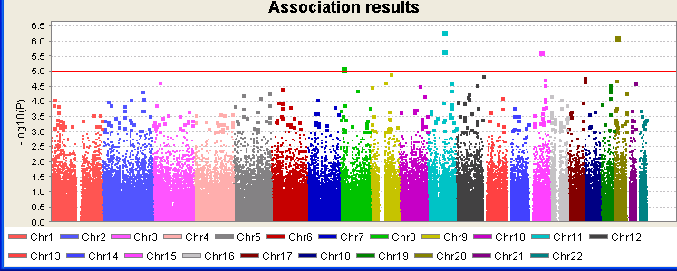
State-of-the-Art
Frequency of SNPs
Effect sizes
Polygenic risk score (PRS)
?
?
?
?
Notes:
Today GWAS is done using the frequencies of appearance of the less common variant called risk allele. One can calculate an effect size for every SNP. Combining them gives us a polygenic risk score. This tells us how likely a person is to have the phenotype (prediction), which is just a fancy way of saying observing the disease. This methods does not directly identify SNPs responsible, but rather you can look at the effect sizes and take an educated guess. They called this plot Manhattan plot and I do not know Manhattan but I believe there are many high buildings, so maybe just look for high building that good of an advice.
We aim to fix this, for this we want to use Espresso but before we can do that, we have to translate genetic data into understandable form.

Slide 5
Data
Family ID PH SNP1 SNP2 SNP3 …
1328 NA06989 2 A G C T C G
1377 NA11891 2 0 0 C T G G
1349 NA11843 1 G G 0 0 C C
1330 NA12341 2 A G C C G G
1328 NA06984 1 A A T T 0 0
.
.
.
Mother
Father
Notes:
The data we have in some form like this. We inherit one copy from both our parents. A phenotype can be recessive or dominant. There are two version possible, one mutating the other regular(risk/norisk).

Slide 6
Translation
AA 2 11
Aa 1 01
aA 1 01
aa 0 00
00 ? --
Notes:
First we have to translate the data: this we do through determining the allele’s types and we can then count the occurrence of the risk allele. We are not able to distinguish aA from Aa. We can only count the the occurences of A. We opted to encode this ternary information in a binary way but since Hamming distance between 10 and 01 is 2 instead of 1 while between 0/2 only 1 bit differs, we encoded with 11 as 2.

Slide 7
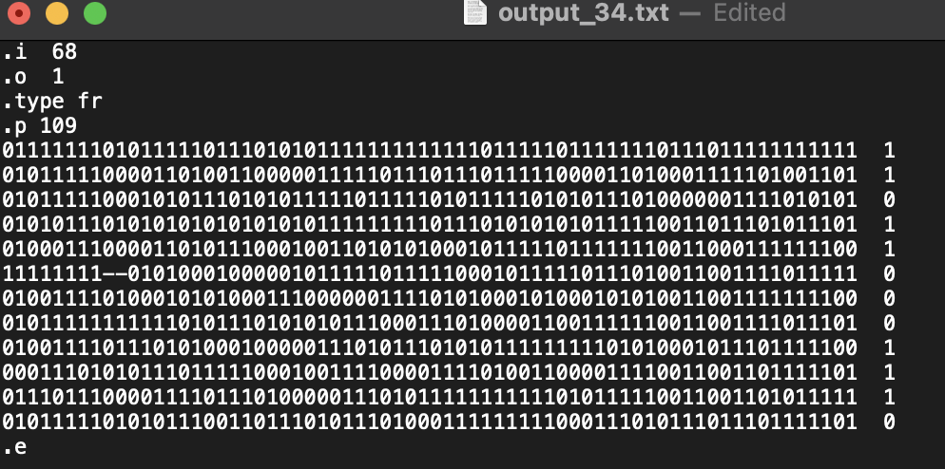
Truth table
Phenotype
Notes:
Now, we combine with the phenotype, hence if we have the disease or not. What we get is a truth table.

Slide 8
Espresso
Truth table minimisation
Gives minimal cover as sum of products
Heuristic approach
No optimal solution
Notes:
This truth table we can give into Espresso. Espresso finds a minimal cover as a sum of products. Unfortunately, this tool as magic as it seems, it is not perfect, it in fact uses heuristic to approximate the solution and therefore does not always find the optimal solution.

Slide 9

Primitive approaches
Entire dataset
Iteration
Partial analysis
Notes:
Giving the entire dataset at once to Espresso is too much. It is not able to handle such large data.
Simply adding more and more SNPs does not work either as the analysis are handled independently and even if we introduce specific criteria: We could say only if the found cover is better in terms of literals, we keep the SNP does not work due to sheer size and also it would only analyse single significance and would always be skewed to the starting set.
Partial analysis does work but obviously we want to analyse the entire set. Though, we can use the results from those analysis as benchmarks for our expectations for other analysis in terms of time and result form. We can in fact use this concept for our method.

Slide 10
Pyramid
Partition SNP
CACTCG
ACCIGACCDIGACTCGAC
ACGTCDIGACACGACGTACGTACGTCDIGACACGTCDIG
Notes:
So we thought of partitioning the SNPs. -> We analyse the partitions-> The found minimal cover is composed of some SNPs, we keep them and write the results to the next level-> Again we partition-> find a cover ->go up one level-> finally we can analyse it all in one go to find result
Still takes a long time for our dataset, also it is too perfect overly influenced by wrong data/incomplete.

Slide 11
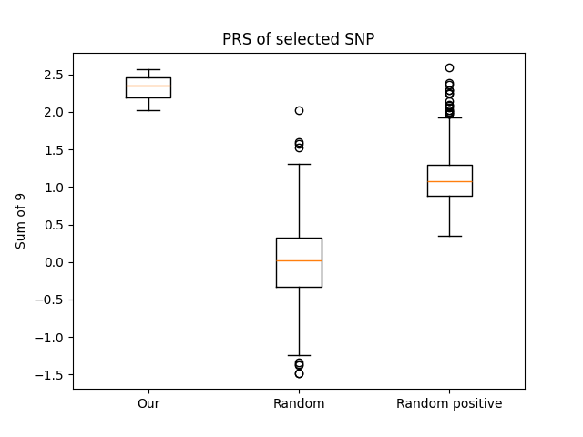
PRS analysis
p<=0.0024%
Notes:
We compared the results of our analysis with the results of the State-of-the-Art analysis. Our selection of 9 SNP compared to a random selection of the one million SNPs showed that our selections are much more significant.

Slide 12
Group
1
3
1
2
4
Group individuals
Each level its own group of individuals
Notes:
We group individuals into different groups say 4 equal sized groups. On every level of the pyramid, we only include the data from this group. On the next level we change the group. We find cover for those people.
This makes a single person have less influence as this person is not always included. It also decreases the needed computing time significantly to about 3h.

Slide 13
Evaluation
Notes:
To evaluate results, one can leave out a couple of individuals and use them as out of sample test cases. We did that with our data and with the found cover predict their phenotype and compare it to measured phenotype. Unfortunately, are just barely above the random guessing rate. At least our refined method-> works the best out of all the variations.

Slide 14
Evaluation
Notes:
Repeated experiments with changed selections yield different results but also there exist reoccurring SNPs, which probably are important. If we shuffle phenotypes and do the same analysis, we do not find repeating results. The SNPs with a high frequency also have high PRS values. We therefore believe that our approach does in fact work in detecting significant SNPs.

Slide 15
Could our method work?
Or testing
Simulate Dataset
One product
Multiple products
?
Notes:
Or the phenotype with another SNP, did not yield the expected result
We went on to simulate datasets. With only one product, it works pretty well, but sometimes it doesn’t need all literals to find a cover.
With multiple products, it start failing if there are more than 100 SNPs, sometimes even before.

Slide 16
Espresso can’t understand products!

Slide 17
Conclusion
Use SMT solver
Encode ternary values
Analyse relationships of SNPs
Find better data
Notes:
We conclude that we need to replace Espresso for example with a SMT solver, in which we would also be able to encode the ternary values more naturally. Together with better data and computation power it should be possible to improve knowledge relating to relationships between SNPs. Especially with more data and also data which actually contain the relations we try to search for, should yield better results.

Slide 18
Questions?

Slide 19
Partial dataset results
Input size (2n) | Products | Literals | Time
<120 | - | - | < 1 s
200 | 50 | 3-6 | 5 s
400 | 40 | 2-4 | 10 s
1000 | 30 | 2-3 | 40 s
2000 | 25 | 2 | 8 min

Slide 20
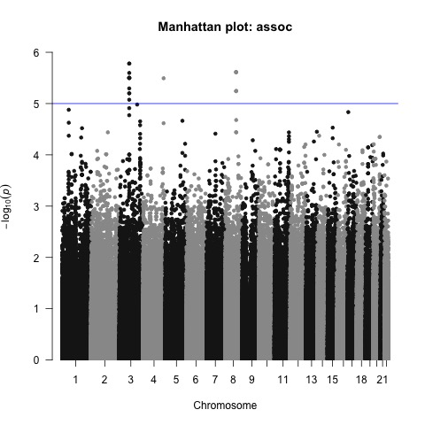
Manhattan plot (PRS)
Notes:
Spikes might correspond, but we discover also other SNPs which were disregarded before.

Slide 22
