Slide 1
GWAS using Espresso
Janis Waser

Slide 2
Genome
G
G
G
T
C
T
G
A
G
Building plan for cells
Differences as SNPs
Genetic diseases
G
C
C
A
C
A
T
T
C
C
C
C
T
T
C
G
Notes:
Ever heard of DNA, composed of A,C,G,T?
Genome is the building plan every cell on planet Earth. We, humans share about 99.9% of their genetic material. Actually, we share more than 60% with bananas and 87% with donkeys some maybe even a little bit more. But the most interesting is the remaining 0.1% which explains all the differences between us, they are mutations. Those small snippets of our DNA which generally only exist in two forms called SNPs are not only responsible for some people being able bigger or smaller than others, but also for genetic diseases such as certain cancer types, autism or colorblindness.

Slide 3
Genome Wide Association Study (GWAS)
G
G
G
T
C
T
G
A
G
Aim to identify
>1’000’000 SNPs
100+ subjects
Problem in NP
G
C
C
A
C
A
T
T
C
C
C
C
T
T
C
G
Notes:
Not always clear how the relations are, for example in Alzheimer or some psychiatric traits. GWAS aims to identify responsible SNPs out of the over one million SNPs. (3billion base pairs total).
This makes huge files, more than 100 subjects which is the data we work with is half GB but this is small for GWAS. And if the problem was not already hard enough, we know it is in NP.

Slide 4
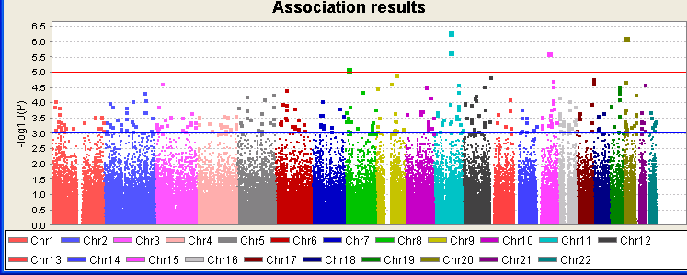
State of the Art
Frequency of SNPs
Effect sizes
Polygenic risk score (PRS)
?
?
?
?
Notes:
Today GWAS is done using the frequencies of appearance of the less common variant called risk allele. One can calculate an effect size for every SNP. Combining them gives us a polygenic risk score. This tells us how likely a person is to have the phenotype (prediction), which is just a fancy way of saying observing the disease. This methods does not directly identify SNPs responsible, but rather you can look at the effect sizes and take an educated guess.
We aim to fix this, for this we want to use Espresso but before we can do that, we have to translate genetic data into understandable form.

Slide 5
Data
Family ID PH 1 2 3 …
1328 NA06989 2 A G C T C G
1377 NA11891 2 0 0 C T G G
1349 NA11843 1 G G 0 0 C C
1330 NA12341 2 A G C C G G
1328 NA06984 1 A A T T 0 0 …
Father
Mother
Notes:
First we have to translate the data: this we do through determining the allele’s types and we can then count the occurrence of the risk allele. We are not able to distinguish aA from Aa. We can only count the the occurences of A. We opted to encode this ternary information in a binary way but since Hamming distance between 10 and 01 is 2 instead of 1 while between 0/2 only 1 bit differs, we encoded with 11 as 2.

Slide 6
Translation
AA 2 11
Aa 1 01
aA 1 01
aa 0 00
00 ? --
Notes:
First we have to translate the data: this we do through determining the allele’s types and we can then count the occurrence of the risk allele. We are not able to distinguish aA from Aa. We can only count the the occurences of A. We opted to encode this ternary information in a binary way but since Hamming distance between 10 and 01 is 2 instead of 1 while between 0/2 only 1 bit differs, we encoded with 11 as 2.

Slide 7
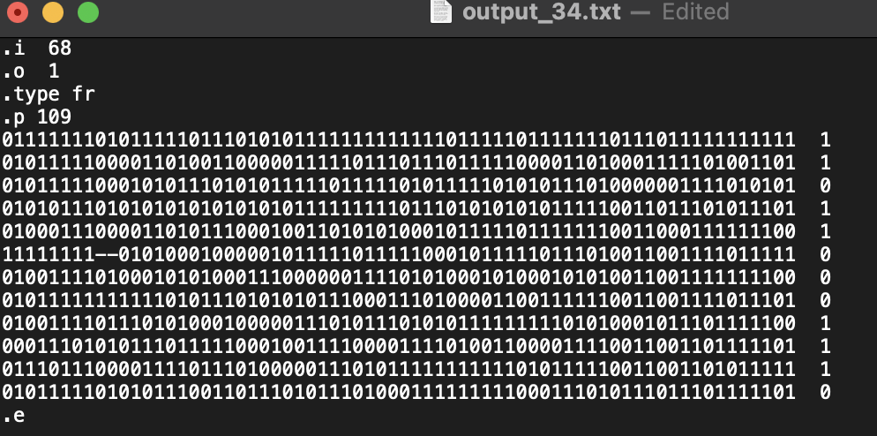
Truth table
Phenotype
Notes:
Now, we combine with the phenotype, hence if we have the disease or not. What we get is a truth table.

Slide 8
Espresso
Truth table minimisation
Gives minimal cover as sum of products
Heuristic approach
No optimal solution
Notes:
This truth table we can give into Espresso. Espresso finds a minimal cover as a sum of products. Unfortunately, this tool as magic as it seems, it is not perfect, it in fact uses heuristic to approximate the solution and therefore does not always find the optimal solution.

Slide 9
Primitive approaches
Entire dataset
Iteratiation
Partial analysis
Notes:
Donkey genes were present, hence we start with those approaches.

Slide 10
Pyramid
Partition SNP
CACTCG
ACCIGACCDIGACTCGAC
ACGTCDIGACACGACGTACGTACGTCDIGACACGTCDIG

Slide 11
Group

Slide 12
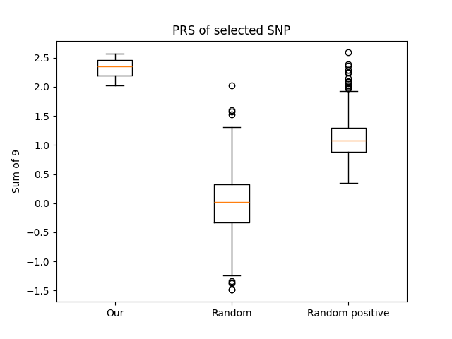
Evaluation
Highlight selected methods

Slide 13
Could our method work?
Add checks

Slide 14
Conclusion
Towards SMT
Methods needs work

