Slide 1
GWAS using Espresso
Janis Waser

Slide 2
Genome
Building plan for cells
Differences as SNPs
Genetic diseases
Notes:
Ever heard of DNA, composed of A,C,G,T?
Genome is the building plan every cell on planet Earth. We, humans share about 99.9% of their genetic material. Actually, we share more than 60% with bananas and 87% with donkeys some maybe even a little bit more. But the most interesting is the remaining 0.1% which explains all the differences between us, they are mutations. Those small snippets of our DNA which generally only exist in two forms called SNPs are not only responsible for some people being able bigger or smaller than others, but also for genetic diseases such as certain cancer types, autism.

Slide 3
Genome Wide Association Study (GWAS)
Aim to identify
>1’000’000 SNPs
100+ subjects
Problem in NP
Notes:
Not always clear how the relations are, for example in Alzheimer or some psychiatric traits. GWAS aims to identify responsible SNPs out of the over one million SNPs. (3billion base pairs total).
This makes huge files, more than 100 subjects which is the data we work with is half GB but this is small for GWAS. And if the problem was not already hard enough, we know it is in NP.

Slide 4
State of the Art
Frequency of SNPs
Effect sizes
Polygenic risk score (PRS)
Predict phenotype
Not identification of SNPs
Notes:
Today GWAS is done using the frequencies of appearance of the less common variant called risk allele. One can calculate an effect size for every SNP. Combining them gives us a polygenic risk score. This tells us how likely a person is to have the phenotype, which is just a fancy way of saying observing the disease. This methods does not directly identify SNPs responsible, but rather you can look at the effect sizes and take an educated guess.
We aim to fix this, for this we want to use Espresso but before we can do that, we have to translate genetic data into understandable form.

Slide 5
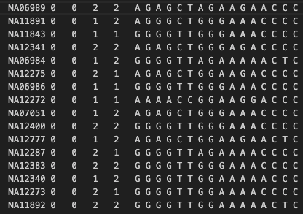
Translation
Mother
Father
AA 11
Aa 01
aA 01
aa 00
00 --
Notes:
Ternary to binary

Slide 6
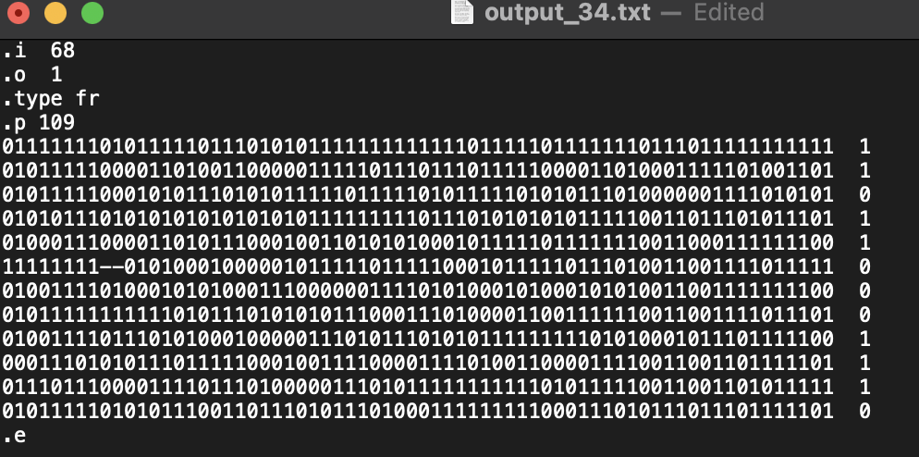
Translation
Phenotype
AA 11
Aa 01
aA 01
aa 00
00 --
Notes:
Ternary to binary

Slide 7
Espresso
Truth table minimisation
Gives minimal cover as sum of products
Heuristic approach
No optimal solution

Slide 8
Primitive approaches
Entire dataset
Iterate through
Partial analysis
Notes:
Donkey genes were present, hence we start with those approaches.

Slide 9
Pyramid

Slide 10
Group

Slide 11
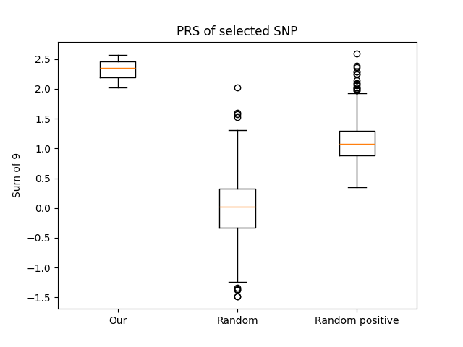
Evaluation
Highlight selected methods

Slide 12
Could our method work?
Add checks

Slide 13
Conclusion
Towards SMT

