Slide 1
Project: Airline Data Analysis & Prediction
TEAM MEMBERS: SHARANYA PATNAIK
SYED MUJAHED
UTKARSH SHRIVASTAVA

Slide 2
Project Statement: After obtaining datasets on flight cancellation and delay, the data was to be analysed and visualised with respect to flight cancellation based on different factors. Followed by the building of the model based on logistic regression for prediction based on test values.

Slide 3
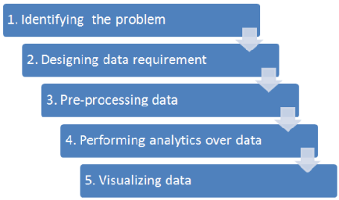
Data Analysis Flow Chart

Slide 4
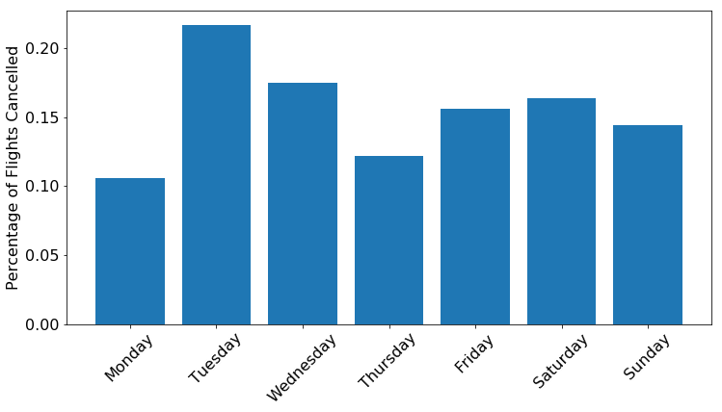
1. Percentage of flights cancelled with respect to days of the week
%= Flights cancelled on a day* 100
Flights cancelled on all days

Slide 5
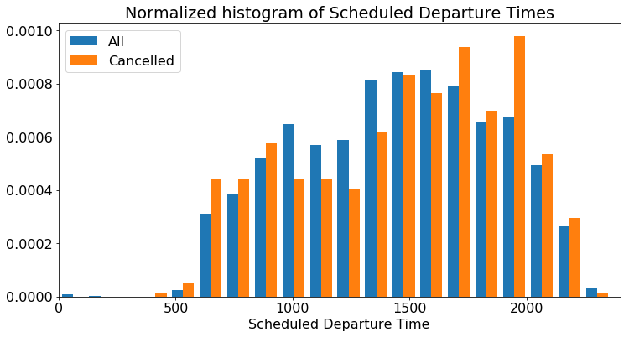
2. Departure Time Wise Analysis:
Higher rate of cancellation witnessed for late night flights.

Slide 6
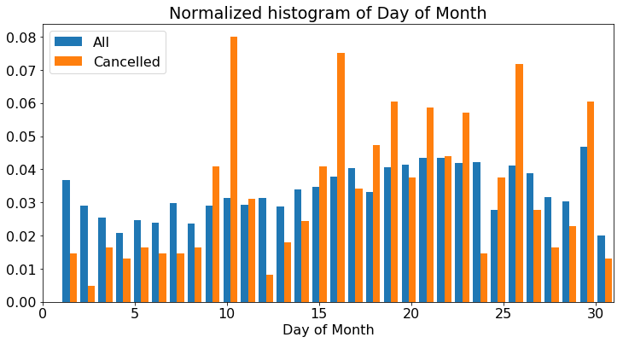
3. Days of the Month

Slide 7
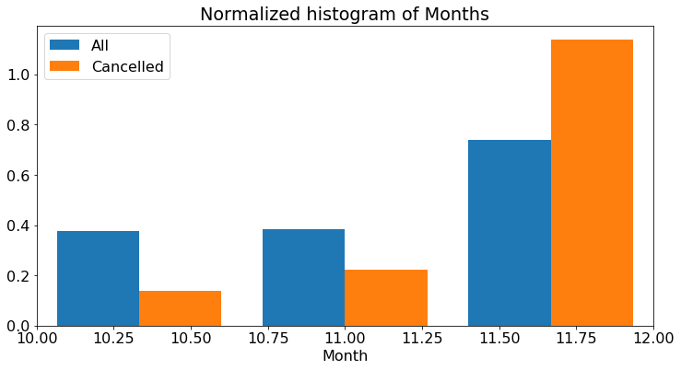
4. Month wise analysis
Highest number of cancellations can be seen in December.

Slide 8
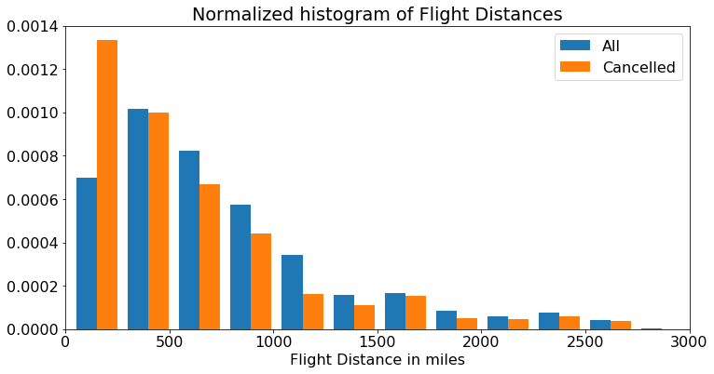
5. Distance wise analysis
.
Shorter distance flights were more likely to get cancelled.

Slide 9
After visualisation, we proceeded with building the model for prediction:
The train test split for the entire dataset was performed as follows :
1. Test data(25%)
2. Train data (75%)

Slide 10
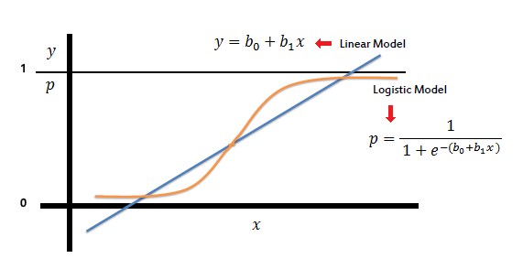
Building the model:
After importing the sklearn library for performing train-test split of data and using it for building the logistic regression model, train data was fitted onto the model and the training of the model was performed.

Slide 11
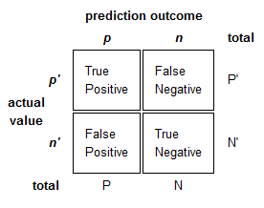

Prediction
Confusion matrix
After the training of the model, prediction on the test features was performed.
A confusion matrix was used to check the precision of the model.

Slide 12


For the project the following libraries(packages) were used:
Pandas
Numpy
Matplotlib.pyplot
Sklearn:
Train test split
Logistic Regression Model
Confusion Matrix
The project was made using Spyder and Python 3.6

Slide 13
THANK YOU!

