Slide 1
Alien Invasion Game

Slide 2
Purpose of Alien Invasion Game (Shooter Game)
Understanding how the axis(X and Y) is used in the game development
How something is moved on the screen
Developing Intuition regarding how shooting and gaining points concept works
Understanding how art and animation concepts are used in Game Development

Slide 3
Technologies Stack
Python language
Python Library named Pygame

Slide 4
Features of Alien Invasion Game
Score System
Score Updation
Renewal of Life
Increase of Hardness Level

Slide 5
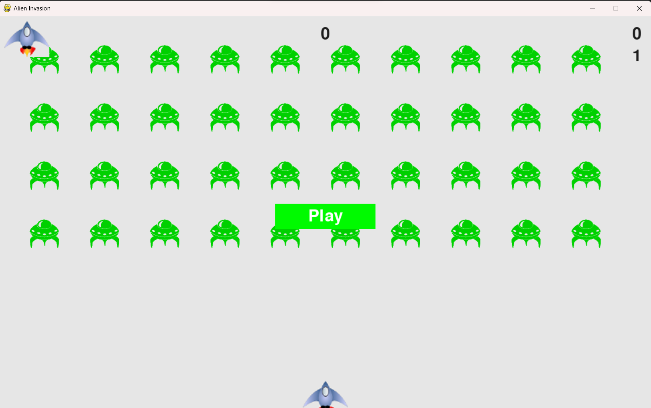
Demo

