Slide 1

Disney World
is the magic Evolving?
By Nadia Morgen

Slide 2
Purpose
Disney has delighted guests at its theme parks for nearly 50 years. As we approach our 50th anniversary, it is prudent to assess our brand to determine whether to stay the course or to pivot.

Slide 3
Specific Questions
Does our brand remain distinct from other theme parks?
When past and current guests visit, do they embrace the brand?

Slide 4
Approach
Review social media (Reddit) threads on Disney and Universal
Can an NLP model determine which posts came from which subreddit? How well?

Slide 5
Subreddits Used
Focus on park visits and park visitors
disneyparks
universalstudios

Slide 6


Data
Complete Dataframe (Title Analysis)
5,093 posts from disneyparks
5,084 posts from universalstudios
Truncated Dataframe (selftext analysis)
1,413 from disneyparks
2,498 from universalstudios

Slide 7
Procedure
Title and selftext were stripped of stop words, then tokenized and lemmatized
I included a custom list of stop words specific to Disney & Universal

Slide 8
Exploratory Data Analysis

Slide 9
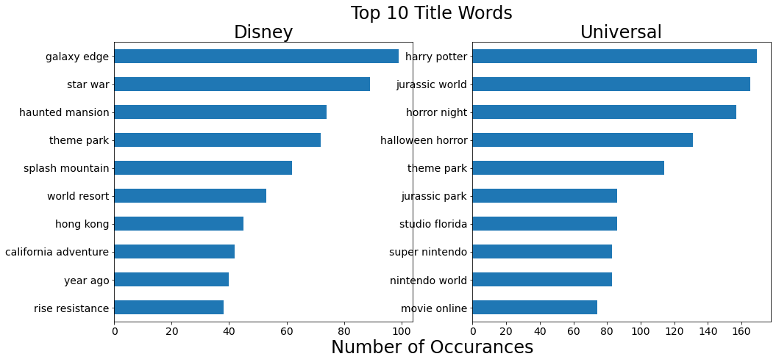

Slide 10
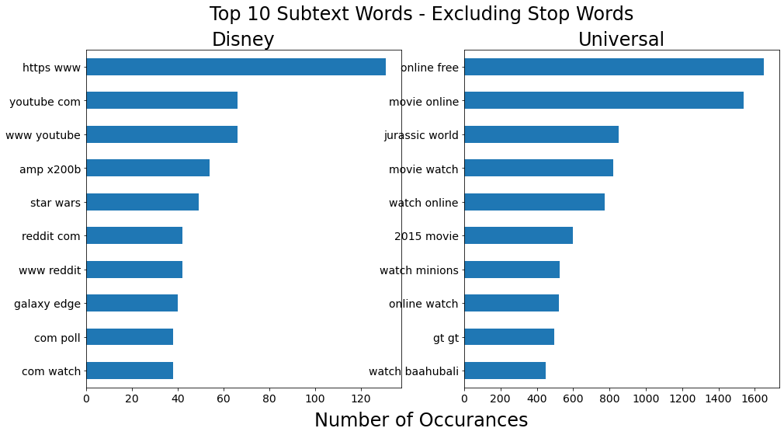

Slide 11
Modeling

Slide 12
Null Model
50% Chance that the post came from disneyparks
50% chance that the post came from universalstudios

Slide 13
Random Forest Classifier Cleaned, tokenized, lemmatized title
Best score = .78
Good start, but aim higher
Extra Trees Classifier:
Best score = .79
Only minimally better

Slide 14
Naïve Bayes
Results
Cross-val score | .82
Pipe score (test) | .84

Slide 15
Naïve Bayes + Grid Searches
4 different searches using different parameters
Searches 3 and 4 had nearly identical results
All 4 Grid Searches had very similar results

Slide 16
Naïve Bayes + Grid Search
Results
Best Training Score | .82
Best Test Score | .84
Best Parameters | Max features: 9,000 Min df: [1, 2] Max df: .85 Ngram: [1, 2]

Slide 17
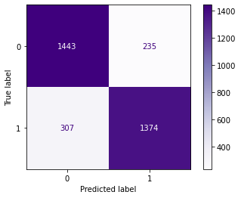
Confusion Matrix Naïve Bayes + Grid Search #4
True Label
Predicted Label

Slide 18
Which Model is Best?
Test scores are all similar, but
Grid Search did not improve the model
Grid Search had slightly lower precision & specificity
Multinomial Naïve Bayes is the best model

Slide 19
Why are Models So Similar?
Overlap between two brands and offerings
Shared language (”annual pass,” “park,” “world”)
Magic (Magic Kingdom, Harry Potter)

Slide 20

Magic

Slide 21
Magic Counts Cleaned Title
Disney | Universal
180 | 45
N = 5,093 | N = 5,084

Slide 22
Recommendations for Further Research
Is “Magic” still Disney’s brand? Or diluted somewhat by Harry Potter and other Universal franchises?
Perform the same analysis on more unofficial Disney & Universal feeds

Slide 23
Recommendations for Further Research
Is “Magic” still Disney’s brand? Or diluted by Harry Potter and other Universal franchises?
Recent Disney movies are more coming of age stories than magical, though include some magical elements (Moana, Coco, Zootopia, Finding Dory, Inside Out)

Slide 24
Recommendations for Further Research
Is “Magic” still Disney’s brand? Or diluted by Harry Potter and other Universal franchises?
Conduct qualitative meta- analysis on recent (past 10 – 20 years) of Disney film to assess degree of magical content.

Slide 25

Questions

Slide 26
Table of Custom Stop Words
anaheim | epcot | land | platinum pass | studios hollywood
animal kingdom | eurodisney | land paris | power pass
beijing | express pass | magic kingdom | preferred pass | studios orlando
blizzard beach | express unlimited | main street | preferred pass | tokyo land
bronze pass | gold pass | mickey | premier pass | typhoon lagoon
city walk | hollywood studios | moscow | seasonal pass | universal
cruise | incredi-pass | park hopper | silver pass | volcano bay
disney | islands of adventure | pirate pass | singapore | walt
disneyland |  | pixie dust pass | sorcerer pass | wdw

