Slide 1
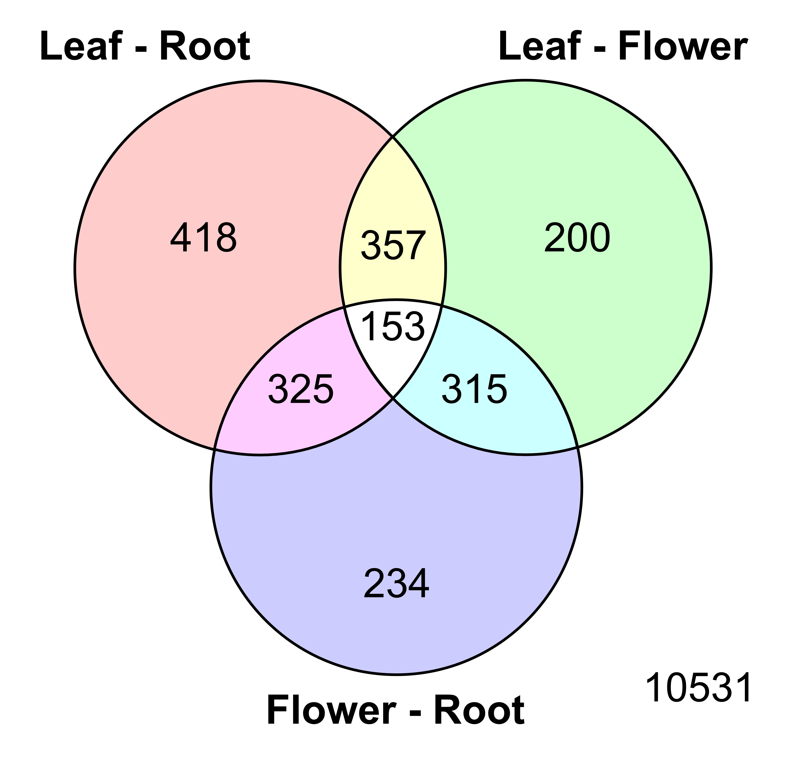
Figure 2
Figure 2: Venn diagram showing the numbers of genes called significantly differentially expressed when comparing tomato leaf, flower and root tissue. The numbers include both up- and downregulated genes. Genes that are differentially regulated in more than one comparison are depicted in the overlapping areas. As indicated by the number in the lower right corner, 10531 genes were not significantly affected.

