Slide 1
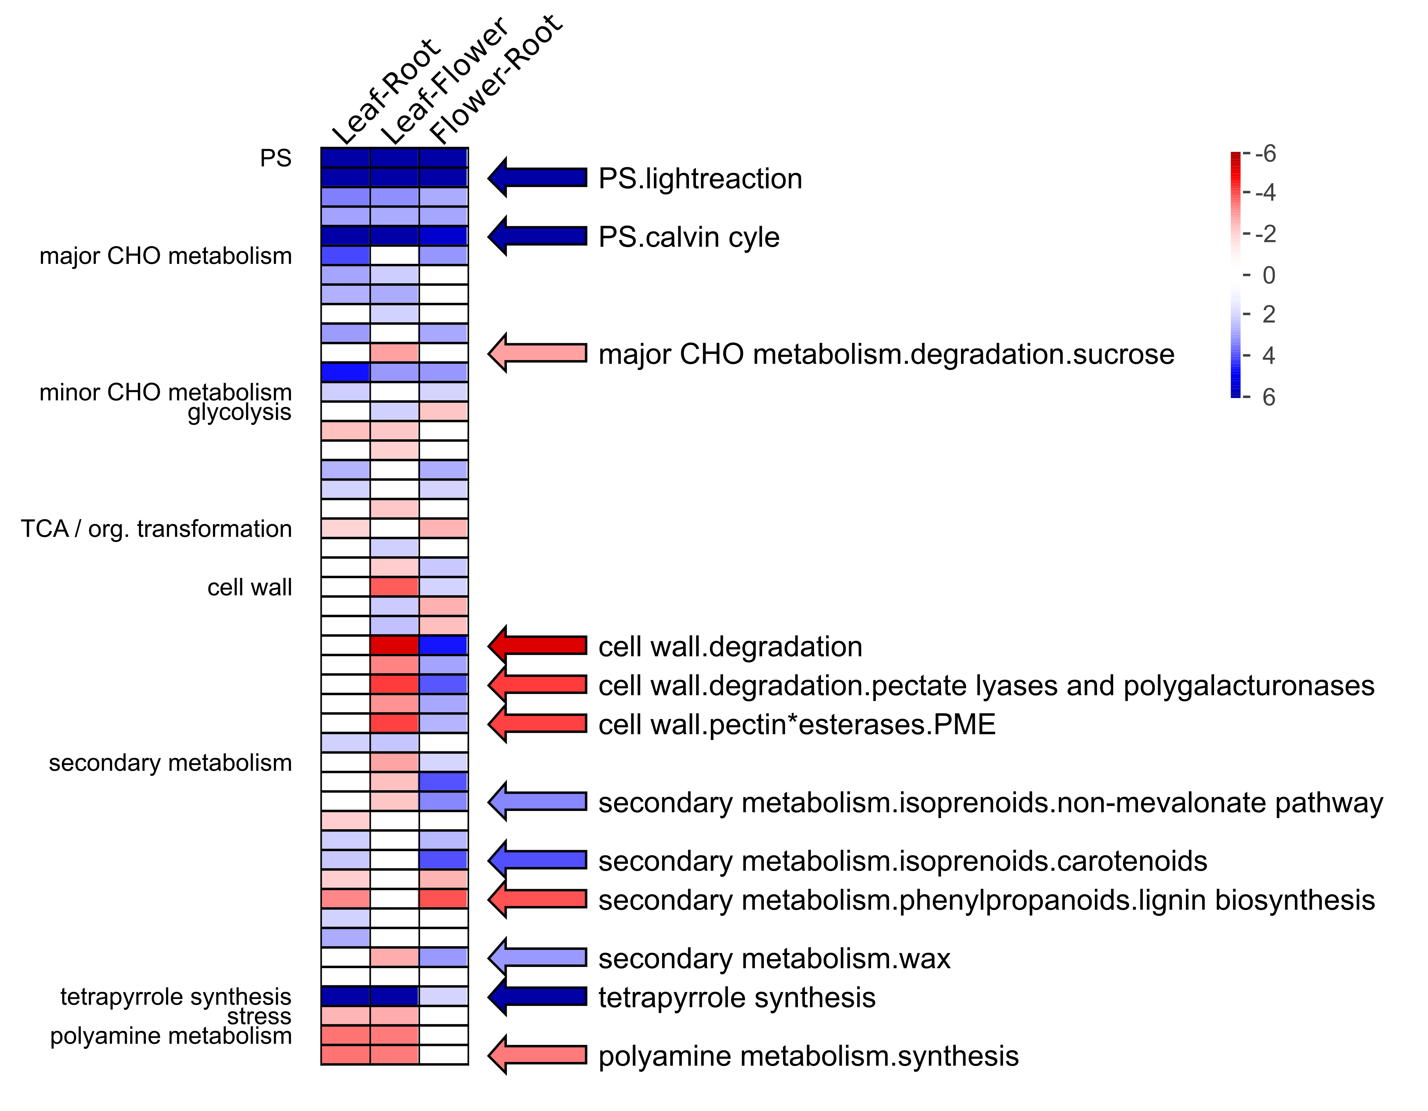
Figure 3
Figure 3: PageMan analysis of the tomato case study. A wilcoxon test was performed, analogous to the test implemented in MapMan, to identify significantly differentially regulated MapMan bins. Individual bins that show distinct responses are highlighted. The plot shows the color coded Z scores of the p-values computed in the test.

