Slide 1
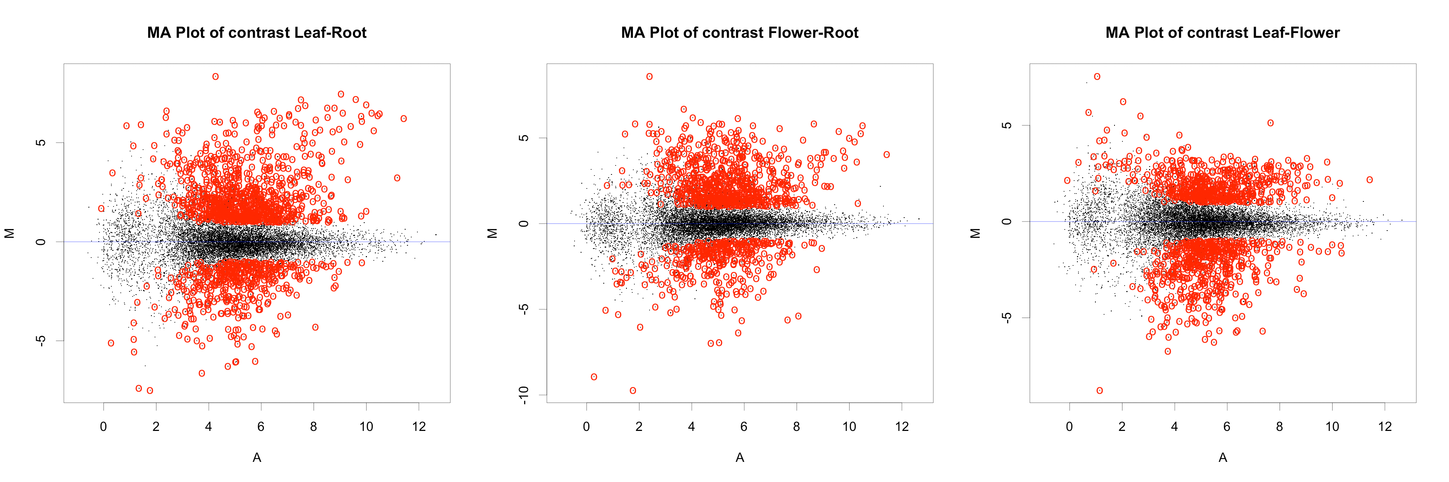
Supplementary Figure S2
Supplementary figure S2: MA plots of the three comparisons made in the tomato case study experiment. The plots show the average signal intensity (A) and the average normalized log2-fold change (M) individually for each comparison. Genes showing significant differential regulation are highlighted by red circles.

