Slide 1
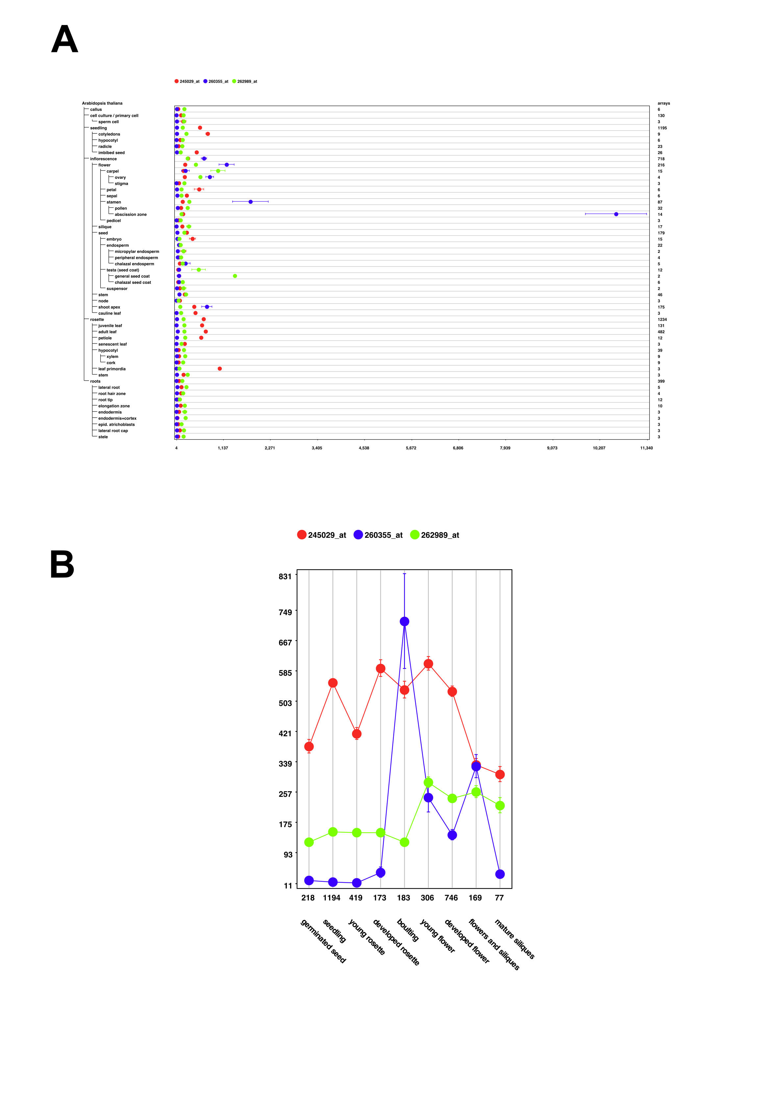
Supplementary Figure S4

Slide 2
Supplementary figure S4: Expression patterns of three YABBY transcription factor homologs from Arabidopsis created using the Genevestigator web application. The Affymetrix probe set identifiers correspond to the following YABBY genes: 245029_at: YABBY family protein At2g26580; 260355_at:Crabs claw (CRC) protein At1g69180; 262989_at: Inner no outer (INO) protein At1g23420.

