Slide 1
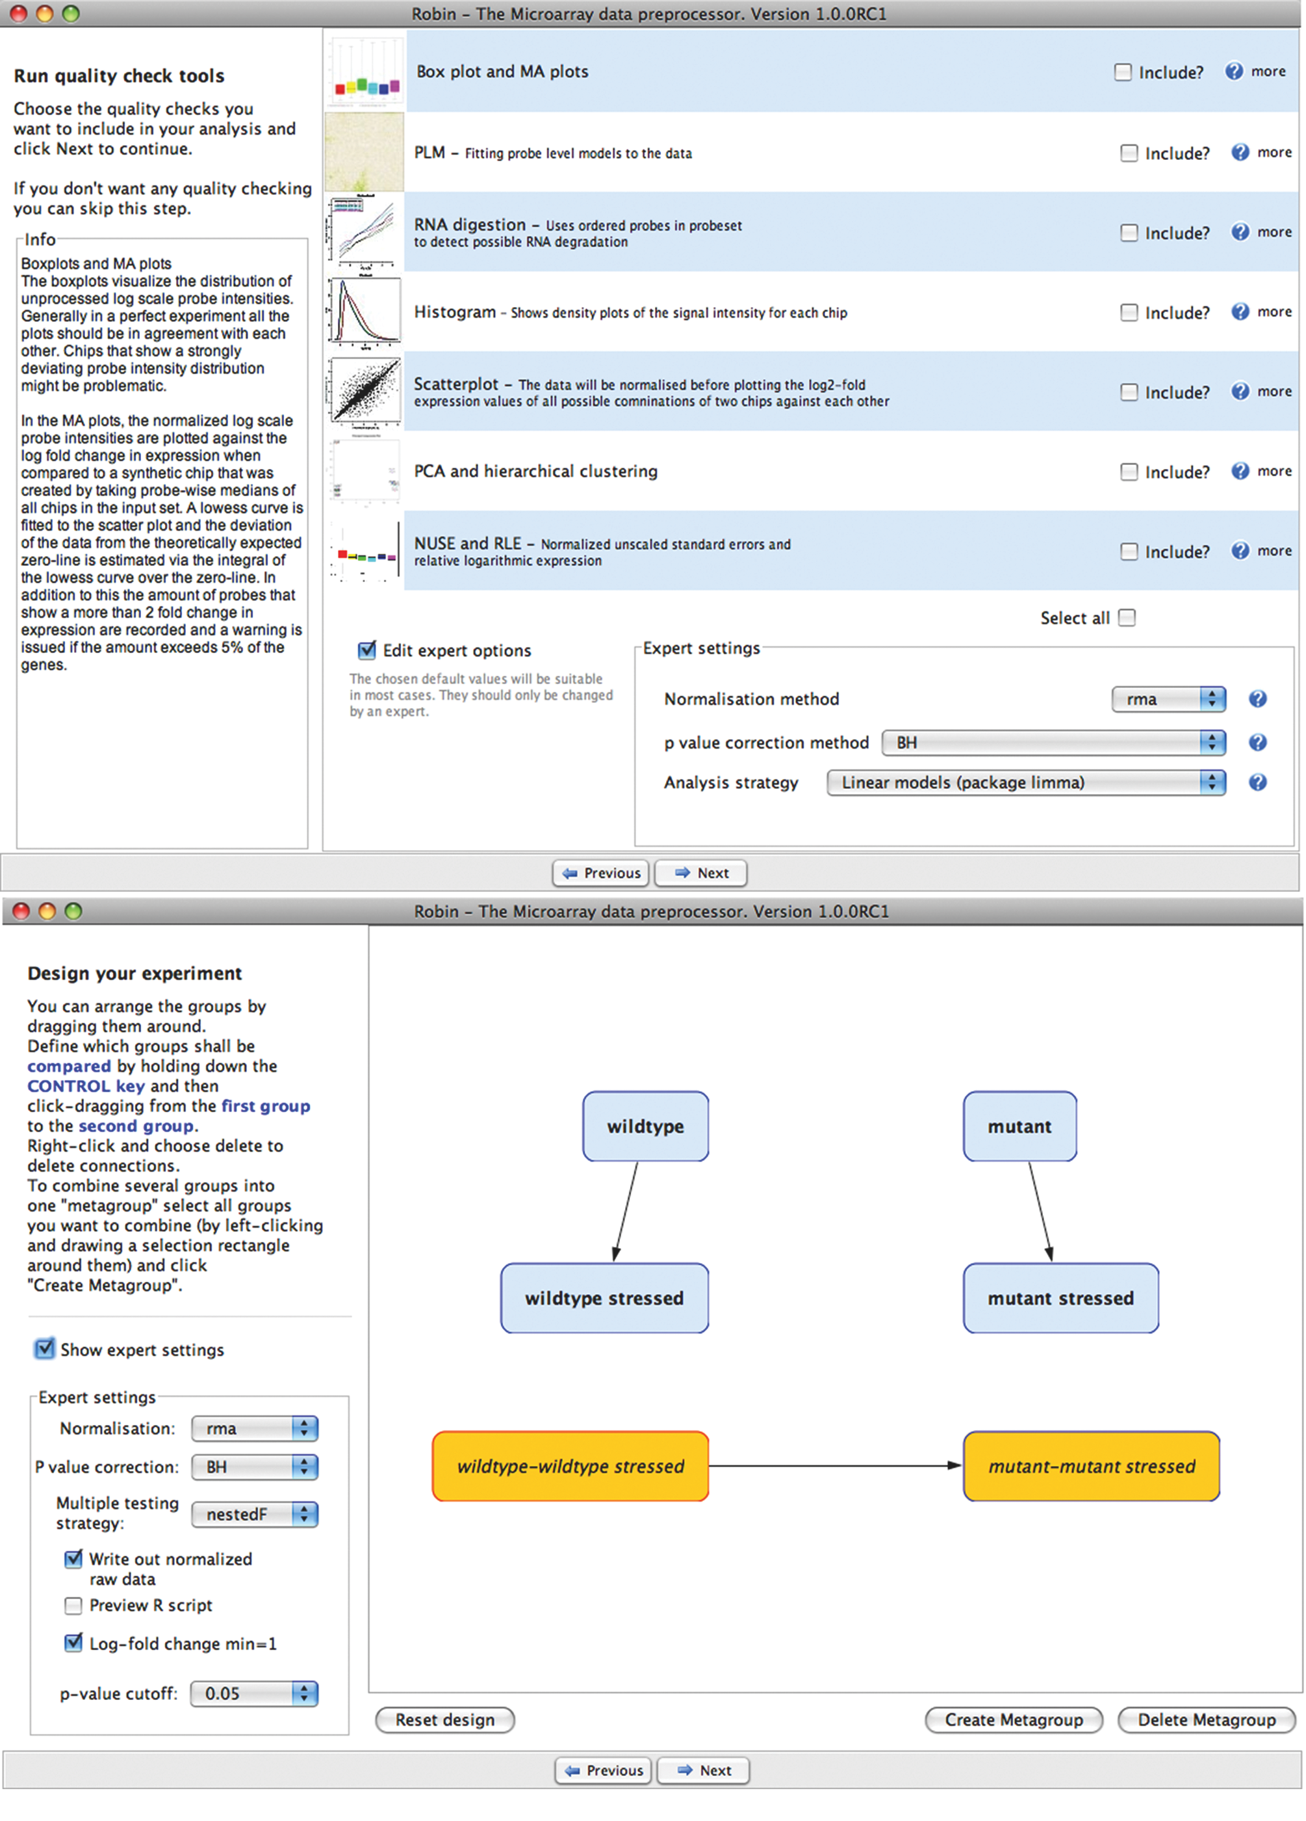
Figure 1
Figure 1: (A) Screenshot of the quality assessment functions available for Affymetrix (R) chips. All methods can be freely combined to obtain an overview of the input data quality. Short inline explanations for each method are displayed in the info field on the left side upon clicking the question marks. The expert panel at the bottom of the user interface is providing more option for customizing the analysis settings. By default, robust analysis methods are predefined and panel is hidden to provide a less cluttered interface to inexperienced users. (B) Screenshot of the graphical experiment designer panel. Comparisons between the previously defined groups of biological replicate chips can be configured by dragging visual connections between them. The arrowhead defines the direction of the comparison. E.g. the arrow between the ‘wildtype’ group and the ‘wildtype stress’ group is interpreted as the ‘wildtype - wildtype stress’ contrast, meaning that genes showing a higher expression level in the ‘wildtype stress’ group will have a negative log2 fold change value in the output and vice versa. Interaction terms can be defined via ‘metagroups’ shown as orange boxes.

