Slide 1
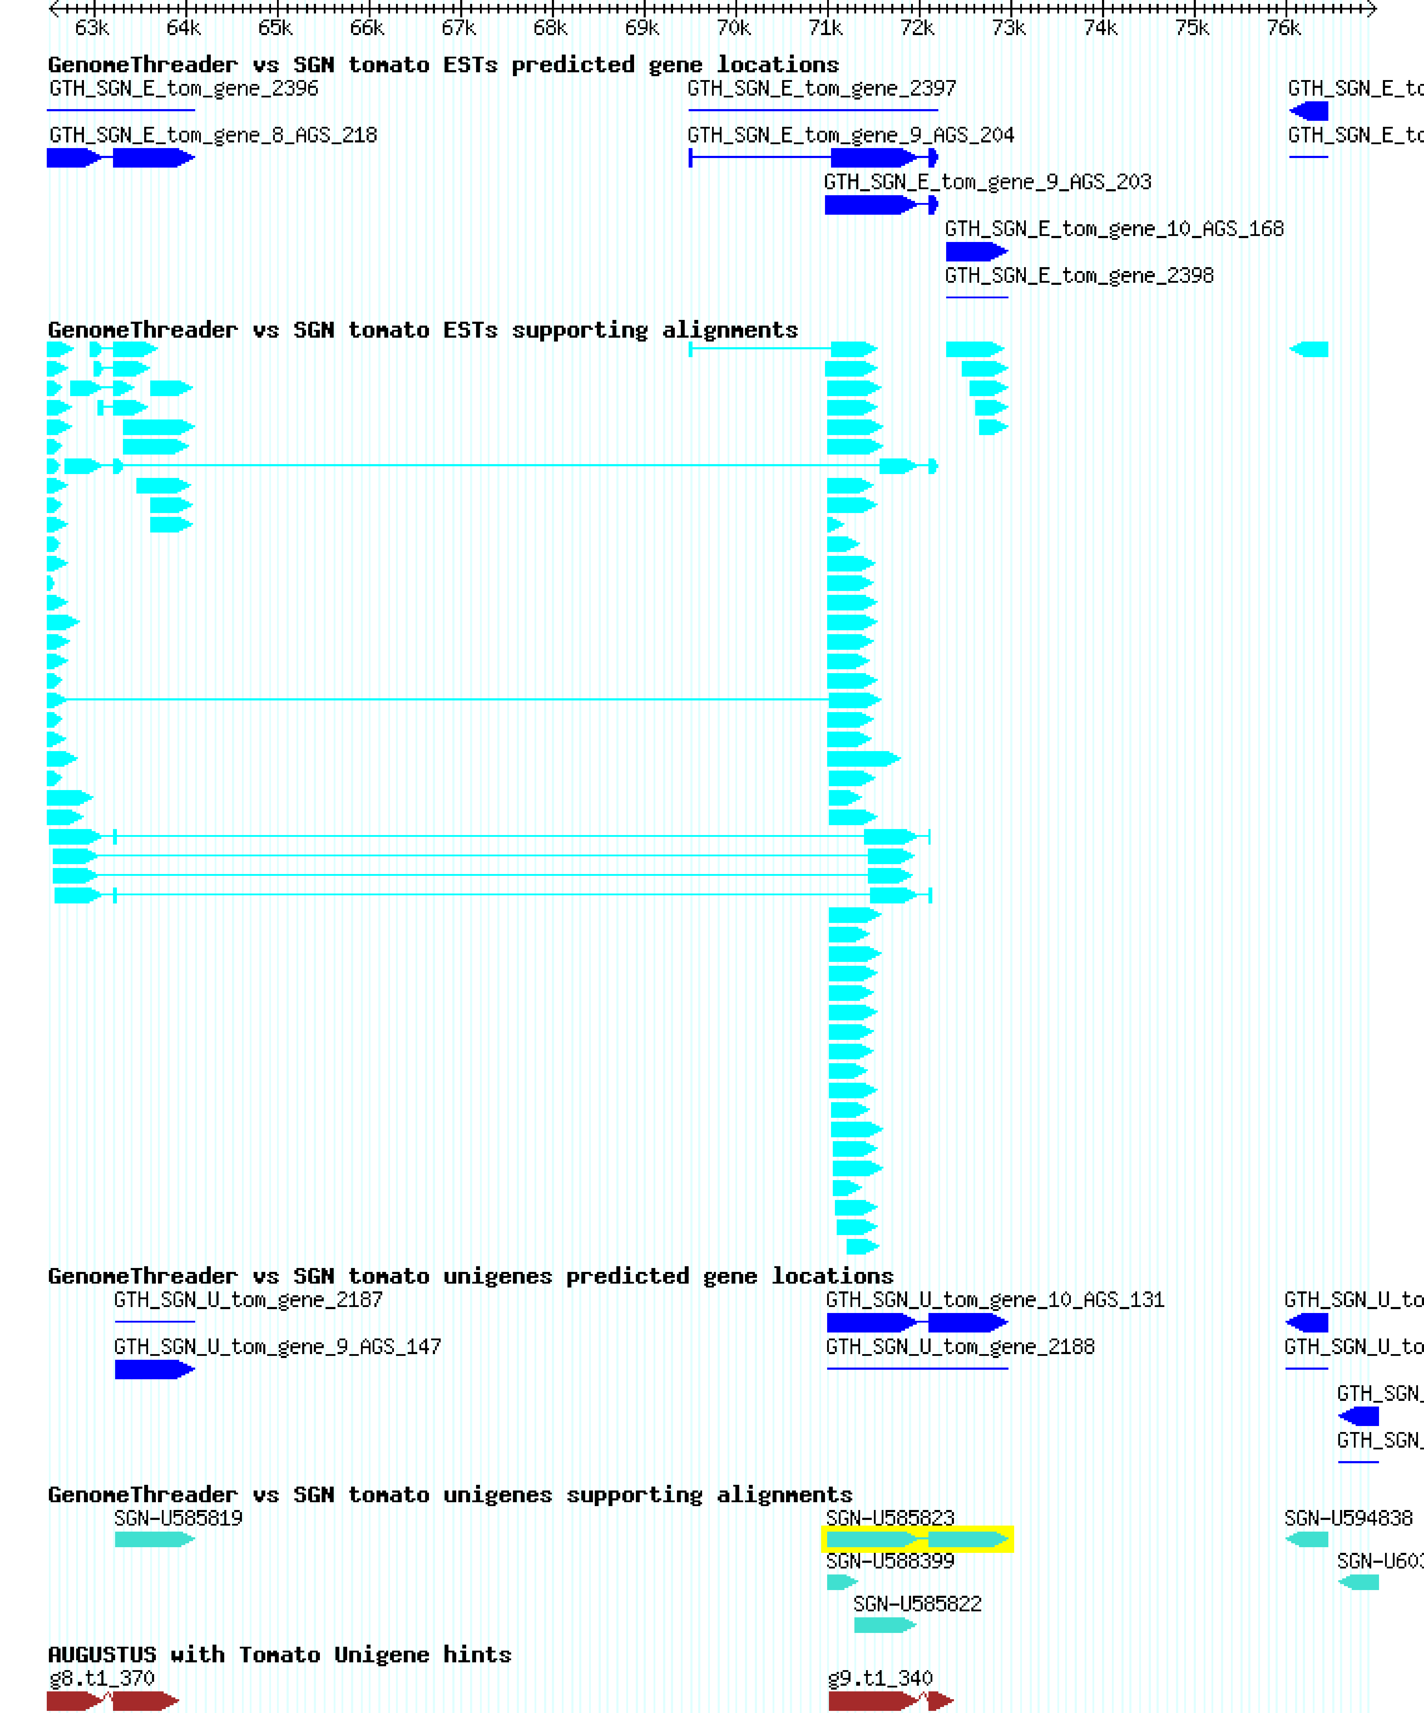
Supplementary Figure S5
Supplemental figure S5: Genomic locations of two putative pectin methyl esterases from tomato (SGN-U585819 and SGN-U585823) as shown by the Gbrowse genome browser (http://solgenomics.net/gbrowse/gbrowse/ITAG_devel_genomic/). The genes are located on the same chromosome within a range of less than 10kb possibly indicating that they originate from a genetic duplication event.

