Slide 1
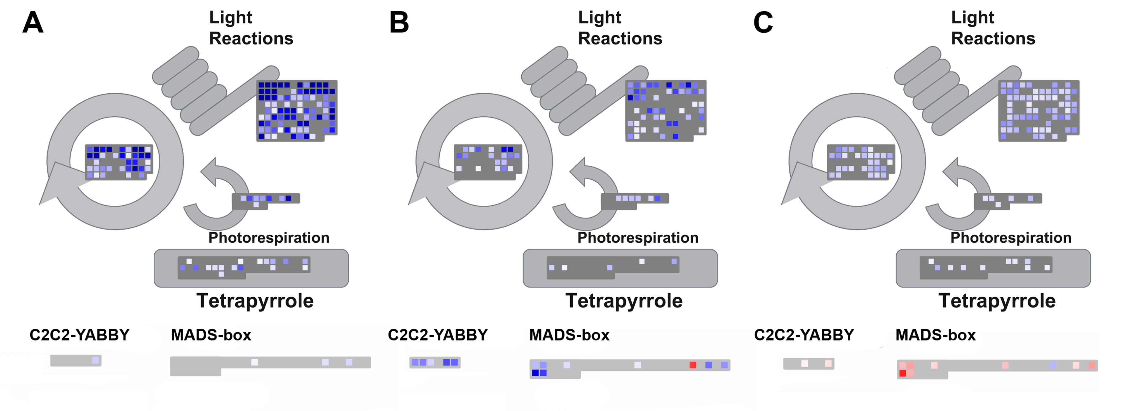
Supplementary Figure S3
Supplementary figure S3: Exemplary visualization of the most strongly reacting bins using MapMan. Genes that are not significantly regulated are greyed out using the built-in filter function. The comparisons shown are (A) Leaf – Root, (B) Flower – Root and (C) Leaf – Flower.

