Slide 1
Boggart
A Shape-Shifting Connectivity

Slide 2
Concept [the story]
Unify the diversified interfaces of data transport mediums
Implement it on top of established APIs and protocols
Make it on top of platform abstraction
Should have an injectable and modular architecture
Should offer event-driven execution

Slide 3
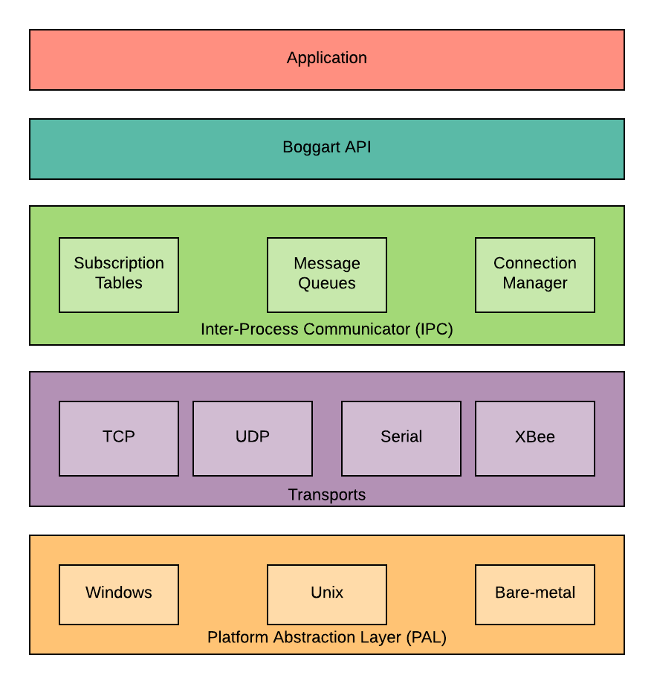
Architecture [the stage setting]

Slide 4
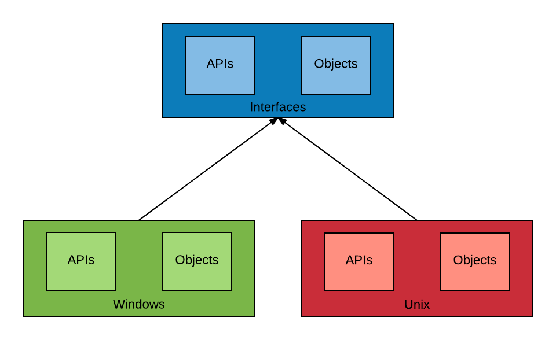
Platform Abstraction Layer (PAL) [the organizer]
Provides interface to the OS and hardware
Abstracts the Platform APIs
System Time
Abstracts the Platform Objects
Sockets
Serial Ports

Slide 5
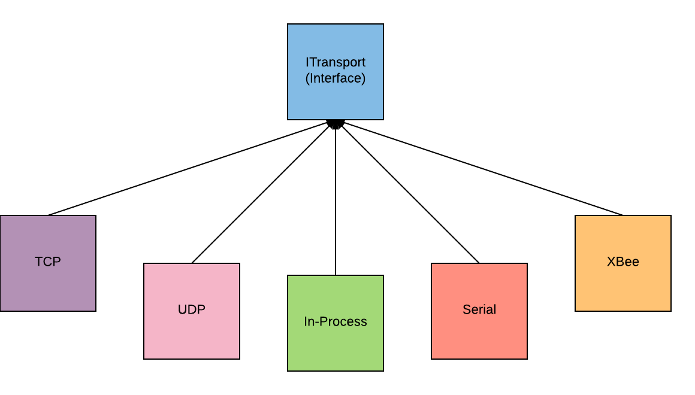
Transports [the backstage crew]
Responsible for providing data-transportation
Provides an interface for the implementation of underlying data transport mediums
Any transport derived from this interface can be ‘injected’ in Boggart API

Slide 6
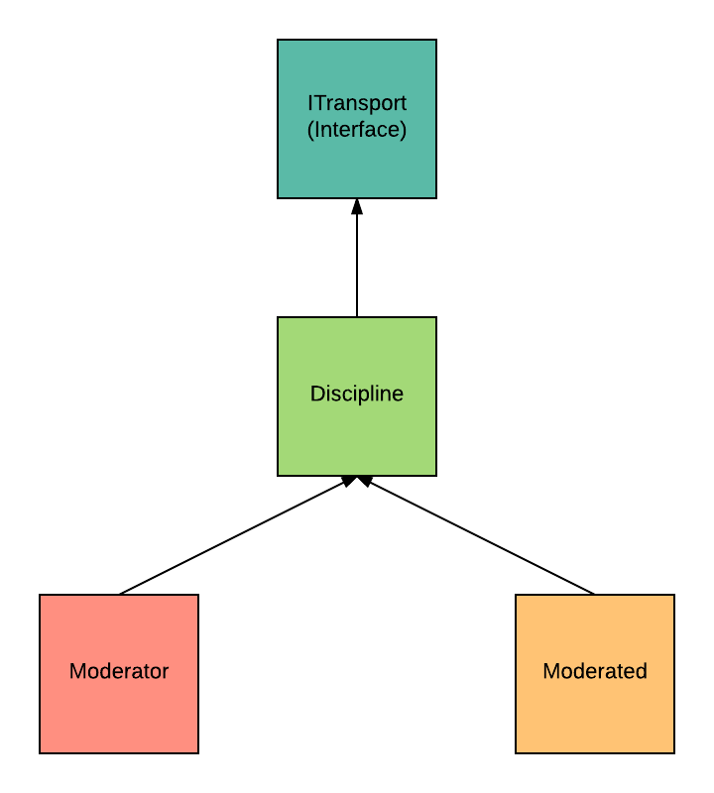
Transports (continued) [the backstage crew]
Data buses are needed to be disciplined
Boggart framework provides ‘Discipline’ as a base for implementing rules
At this time, Moderator and Moderated disciplines implemented for Serial transport
Any transport can be ‘disciplined’ by injecting it in Discipline

Slide 7
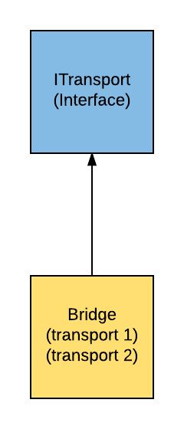
Transports (continued) [the backstage crew]
Bridge exchanges data between any two transports
Imagine, data sent from cloud, being seamlessly transferred via ethernet, bridged via Xbee and further bridged via serial to reach the far end of the deployment through a single API (feeling thrilled yet? an example might be coming up in following slides)
Remember ‘Shape-shifting’ …?

Slide 8
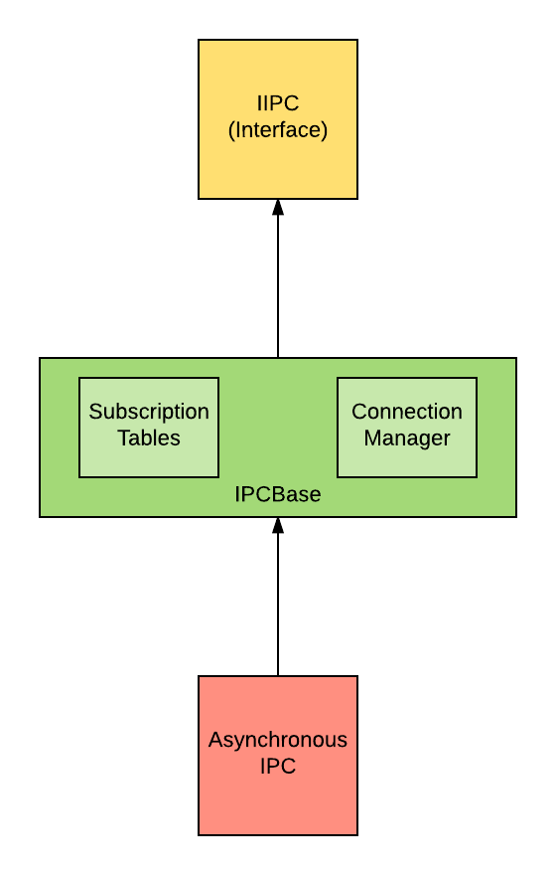
Inter-Process Communicator (IPC) [the performer]
Responsible for connection and network monitoring
Maintains subscription tables of itself and remote nodes
Why named ‘Inter-Process’?
Because it essentially talks to other processes by using the provided transport. Processes could be running on another device or devices

Slide 9
Boggart [the director]
Integrates all the components and wire all the dependencies together
Provides a simplistic API to the Application for data exchange
API:
Send(destination, message)
Subscribe(message type, callback)

Slide 10
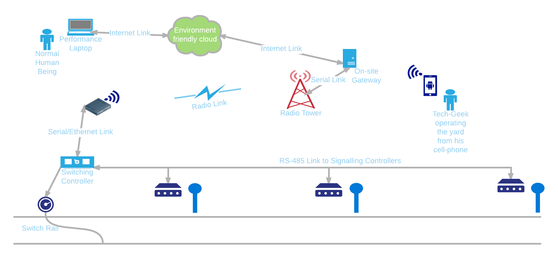
Example: A Typical Railyard Application [the audience]

Slide 11
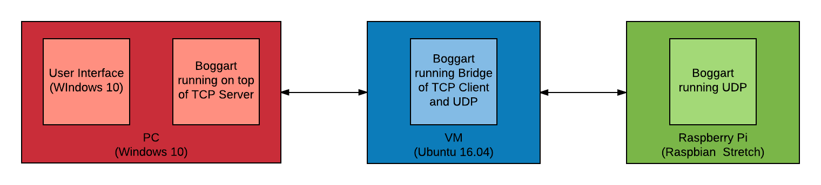
Demonstration [the acting]
User Interface running on PC is capable of commanding all the Boggarts to:
Subscribe on the given topic
Send given data on the given topic

Slide 12
What Can It Achieve [the curtain call]
Boost the development time
Development can be done quickly on Windows PC, by using TCP, which can then be replaced with the desired transport
Application, transport and rules can be developed independent of each other. Just like MVVM (oops …!)
Ease with diagnostics
Modular development makes it easy to identify and debug the issues
Platform, application and transport can be individually analyzed for debugging
Resource efficiency
Developed in C++ with event-driven approach

Slide 13
Future Plans [the round of applause]
Implement dynamic broker creation
Implement serial transport
Implement Bluetooth transport
Implement HTTP transport
Add support for Arduino
Add support for Surface

Slide 14
The End

Slide 16
Add a Slide Title - 4

Slide 17
Add a Slide Title - 5

