Slide 1
C++高级程序设计
Advanced Programming in C++
（part 1）
郑 滔 zt@nju.edu.cn 费彝民楼904室
潘敏学 mxp@nju.edu.cn 费彝民楼927室

Slide 2
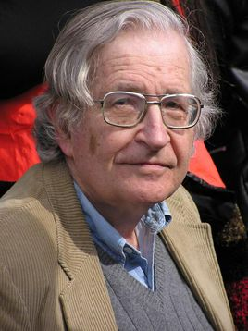
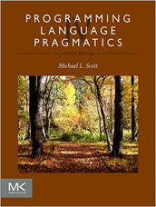
Language
{V_{N}} U {V_{T}}
https://isocpp.org/std/the-standard
<ID> ::= <A> |<ID> <AD>
<AD> ::= <A>|<D>|
<AD><A>|
<AD><D>
<A> ::= _|a|b| …… X|Y|Z
<D> ::= 0| ……| 8 | 9
Deduct
Reduce
  Syntax、Semantics、Pragmatics
  Avram Noam Chomsky MIT
    1955
    RG FA
    CFG PDA
    CSG LBA
    PSG TM
Backus–Naur Form
EBNF/语法图
Static semantics
Dynamic semantics
letter = [a-zA-Z]
digit = [0-9]
identifier = letter (letter|digit)*
G=（V_{N}，V_{T}，P，Z）
nat = [0-9]+
signedNat = (+|-)?nat
Number = signedNat(. nat)?(E signedNat)?
ad hoc
“Pragmatics studies the factors that govern our choice of language
in social interaction and the effects of our choice on others.”
  Michael L. Scott

Slide 3
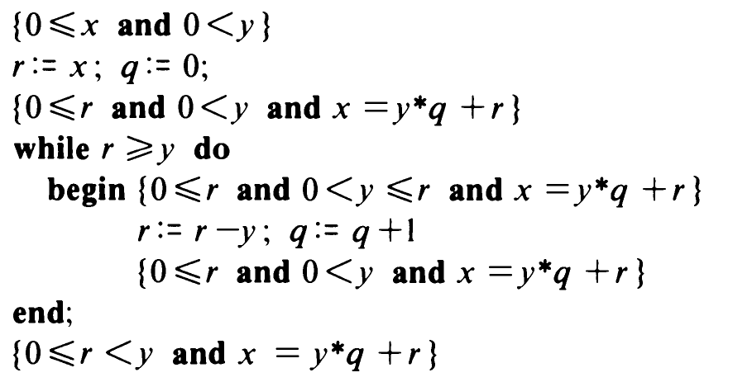
Programming
calculus
{ Q } S { R }
The Science of programming David Gries
The Art of Computer Programming Donald Ervin Knuth
{ y>0}
r:=x; q:=0;
while r>y
begin
r = r-y;
q:=q+1;
end;
{ x=y*q+r}
{ y>0}
r:=x; q:=0;
while r ≥ y
begin
r = r-y;
q:=q+1;
end;
{ x=y*q+r and r<y}
{ x ≥ 0 and y>0}
r:=x; q:=0;
while r ≥ y
begin
r = r-y;
q:=q+1;
end;
{ x=y*q+r and r<y}
r:=x; q:=0;
while r>y
begin
r = r-y;
q:=q+1;
end;
    The process of prepairing programs for a digital computer is especially attractive, not only because it can be economically and scientifically rewarding, but also because it can be an aesthetic experience much like composing poetry or music。
    In many cases people are not able to appreciate the full beauty of such an algorithm unless they also have some knowledge of a computer's machine language; the efficiecy of the corresponding machine program is a vital factor that cannot be divorced from the algorithm itself.

Slide 4
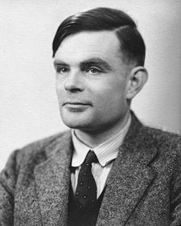
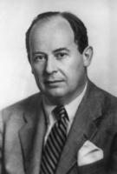
ACM 1947
Association of Computing Machinery
Turing Award 1966
A man provided with paper, pencil, and rubber,
and subject to strict discipline,
is in effect a universal Turing Machine.
论可计算数及其在判定性问题上的应用
Alan Mathison Turing
John von Neumann
ENIAC：Electronic Numerical Integrator and Computer
Mauchly、Eckert John Vincent Atanasoff
EDVAC：Electronic Discrete Variable Automatic Computer 1945
John von Neumann、Mauchly、Eckert
EDSAC (Electronic Delay Storage Automatic Calculator）1949
Maurice Vincent Wilke

Slide 5
Programming Paradigm
Imperative programming
Procedural
  based upon the concept of the procedure call
Object-Oriented
  The theory of concepts, and models of human interaction with real world phenomena

Slide 6
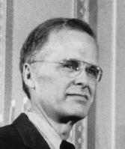
First Programming Language
ＦＯＲＴＲＡＮ
John Backus，
1953, 1977
Can Programming Be Liberated from the von Neumann Style?
A Functional Style and Its Algebra of Programs

Slide 7
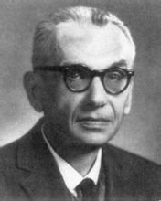
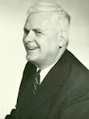
Alonzo Church
Kurt Godel
A man provided with paper, pencil, and rubber,
and subject to strict discipline,
is in effect a universal Turing Machine.
论可计算数及其在判定性问题上的应用
Alan Mathison Turing
John von Neumann

Slide 8

Programming Paradigm
declarative programming
Functional
  Mathematics and the theory of functions
  Lisp (atom, list, cons)
Logical
  Automatic proofs within artificial intelligence
  Based on axioms, inference rules, and queries
  prolog

Slide 9
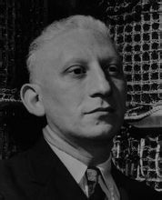

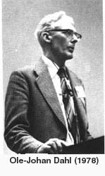
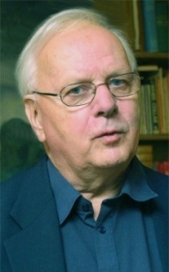

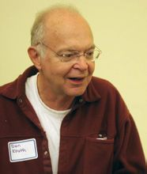
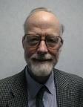
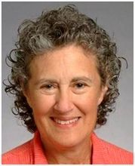
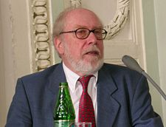
ＦＯＲＴＲＡＮ
Alan J．Perlis ，
1958,1966
E.W.Dijkstra
1960,1972
John Backus，
1953, 1977
Algol 60
Ole-Johan Dahl
Kristen Nygaard
1962, 2001
PL/1
BCPL
Simula 67
C
Dennis Ritchie
Ken Thompson
1972,1983
Algol 68
C With Classes
C. A. R. Hoare
1966,1980
Donald E.Knuth
1965,1974
ANSI C
CLu
Ada
……
C++
Barbara Liskov
1987, 2008
C++20
Niklaus Wirth
1966, 1994

Slide 10
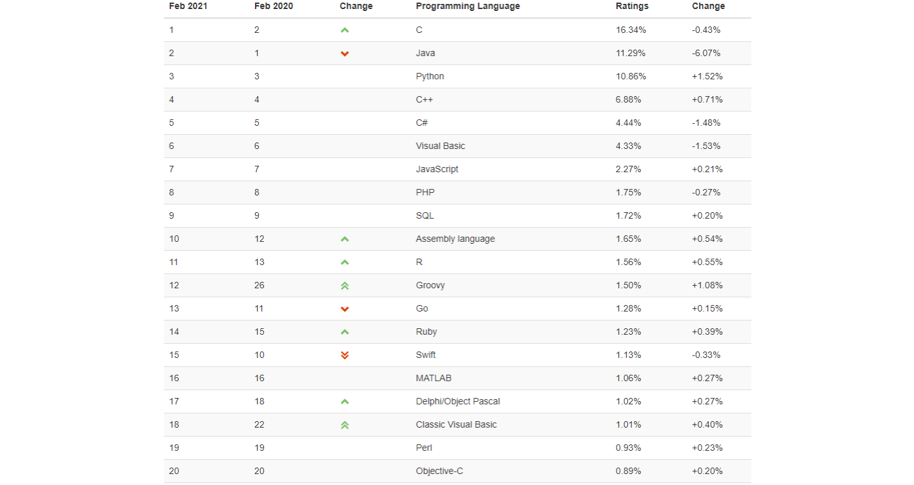
https://www.tiobe.com/tiobe-index/
an indicator of the popularity of programming languages
not about the best
not the language in which most lines of code have been written
TIOBE
The Importance of Being Earnest
the top 8 of the TIOBE index: unchanged for the last 7 years
positions 9 and 10
The last 12 months: SQL, Assembly, R, Groovy, Go, and Swift
Rob Pike
Ken Thompson
Robert Griesemer

Slide 11
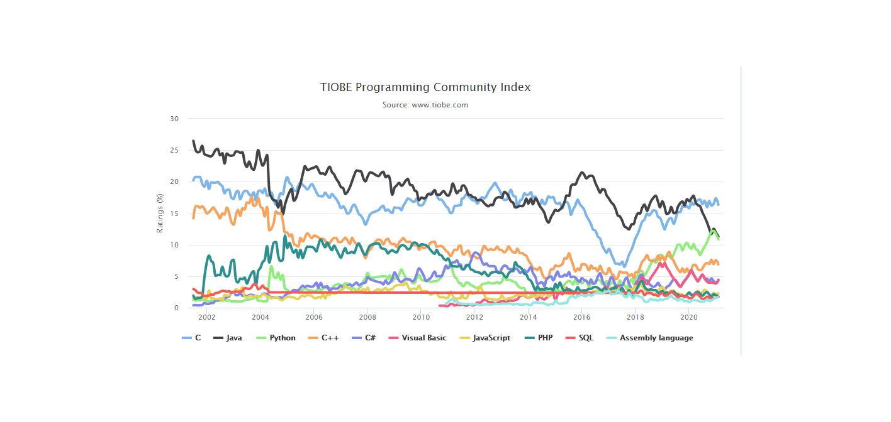
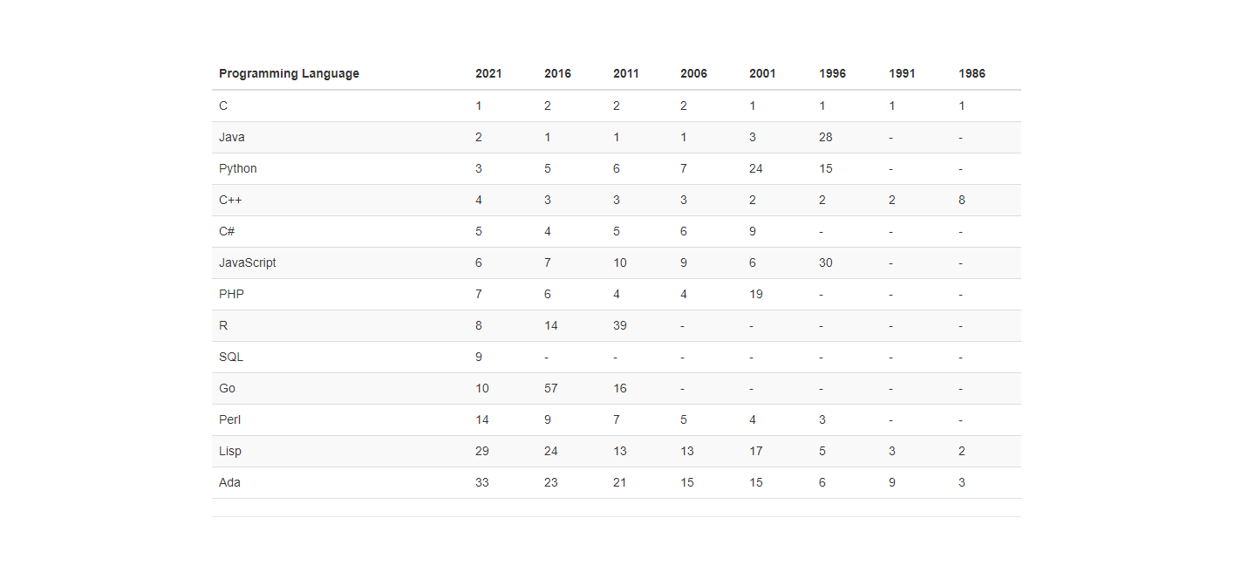
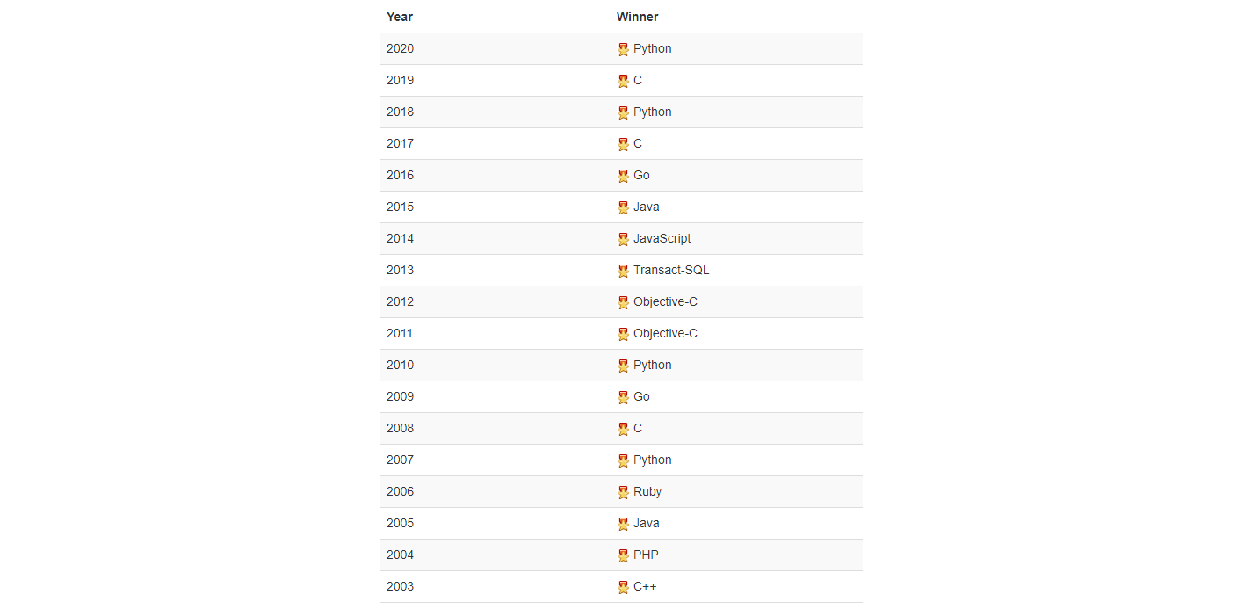

Slide 12
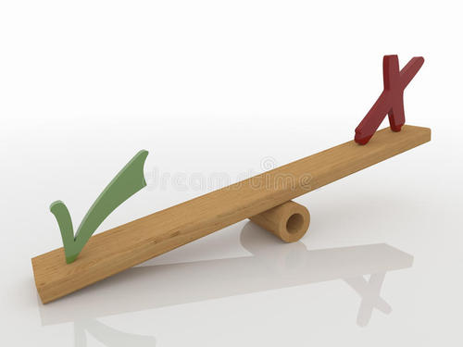
Why is learning C still necessary?
开发效率
易用性和安全性
运行效率
trading balance
3D渲染
Q1：硬件如此便宜，有必要让软件更快吗？
自动驾驶
功耗
Q2：难道不能发明一种同样快的语言，但没有C语言那么多的坑？
Linux, Window, MacOS，Unix，Vxworks
NASA
程序正确性证明？

