Slide 1
Bank Marketing Data Analysis

Slide 2
Data Description
Bank Marketing Data
“
The data is related with direct marketing campaigns of a Portuguese banking institution.
The marketing campaigns were based on phone calls.
Often, more than one contact to the same client was required,
in order to access if the product (bank term deposit) would be (or not) subscribed.
“
Data Population
45,211 customers
The data was collected from May 2008 to November 2010
The classification goal is to predict if the client will subscribe a term deposit (variable y).

Slide 3
Data Description
Introducing Data
Attributes (Variables)
Var Name | Description | Var Type | Responses
age | age | numeric
job | type of job | categorical | "admin.", "unknown", "unemployed", "management", "housemaid", "entrepreneur", "student", "blue
marital | marital status | categorical | "married", "divorced", "single"
education | education level | categorical | "unknown", "secondary", "primary", "tertiary"
default | has credit in default? | binary | "yes", "no"
balance | average yearly balance, in euros | numeric
housing | has housing loan? | binary | "yes", "no"
loan | has personal loan? | binary | "yes", "no"
contact | contact communication type | categorical | "unknown", "telephone", "cellular"
day | last contact day of the month | numeric
month | last contact month of year | categorical | "jan", "feb", "mar", ..., "nov", "dec"
duration | last contact duration, in seconds | numeric
campaign | number of contacts performed during this campaign and for this client | numeric
pdays | number of days that passed by after the client was last contacted from a previous campaign | numeric
previous | number of contacts performed before this campaign and for this client | numeric
poutcome | outcome of the previous marketing campaign | categorical | "unknown", "other", "failure", "success"
y | has the client subscribed a term deposit? | binary | "yes", "no"

Slide 4
Data Cleaning
Missing Values
– 0 Missing in the data
Data Sampling
– 4,521 customer data were randomly drawn from the full data (10%)
New Variable
– age_group
Age variable has minimum 18 and maximum 95.
age_group classify the customer age by three different categories
“Under 25 years”, “25-50 years”, “above 50 years”

Slide 5
Data Cleaning
Data Conversion
- Duration
duration variable has been converted from seconds to minutes
Encoding Categorical Variables to Numeric
- Month
Characters are converted into numeric (e.g. “jan” to 1)
- Education
'unknown’, 'primary’, 'secondary’, 'tertiary’ to 0, 1, 2, 3
- Binary Variables: y, default, housing, loan
No = 0, Yes = 1

Slide 6
Research Question
What are the attributes that the clients will be more likely to subscribe to a term deposit?
► Which predictor(s) can accurately predict which client will subscribe a term deposit?
The model can increase campaign efficiency and identify the main attributes that affect subscription success. Therefore, it would increase the marketing effectiveness.
Logistic regression is used for predictive analytics and modeling when dependent variable is finite or categorical. In our case, our response variable “y” is binary (“Yes” or “No), the logistic regression was used to find the relationship between the dependent variable and independent variables by estimating probabilities.

Slide 7
Selection of Variables
Numeric Variables – T test and Variance test
#Age - based on the test variances between the two groups are not equal; and the mean is not equal to zero
var.test(age ~ y, data=bank) #p-value < 2.2e-16
t.test(age ~ y, data=bank, var.equal = TRUE) #p-value = 0.004024
#balance - based on the test variances between the two groups are not equal; and the mean is not equal to zero
var.test(balance ~ y, data=bank) #p-value = 0.01103
t.test(balance ~ y, data=bank, var.equal = TRUE) #p-value = 0.005565
#day - based on the test variances between the two groups are EQUAL; and the mean is not equal to zero
var.test(day ~ y, data=bank) #p-value = 0.6838
t.test(day ~ y, data=bank, var.equal = FALSE) #p-value = 0.03987
#duration - based on the test variances between the two groups are not equal; and the mean is not equal to zero
var.test(duration ~ y, data=bank) #p-value = < 2.2e-16
t.test(duration ~ y, data=bank, var.equal = TRUE) #p-value = < 2.2e-16
#campaign - based on the test variances between the two groups are not equal; and the mean is not equal to zero
var.test(campaign ~ y, data=bank) #p-value = < 2.2e-16
t.test(campaign ~ y, data=bank, var.equal = TRUE) #p-value = 6.389e-07
#pdays - based on the test variances between the two groups are not equal; and the mean is not equal to zero
var.test(pdays ~ y, data=bank) #p-value = 1.103e-09
t.test(pdays ~ y, data=bank, var.equal = TRUE) #p-value = 3.564e-14
#previous - based on the test variances between the two groups are not equal; and the mean is not equal to zero
var.test(previous ~ y, data=bank) #p-value = < 2.2e-16
t.test(previous ~ y, data=bank, var.equal = TRUE) #p-value = 2.305e-14

Slide 8
Selection of Variables
Categorical Variables – $X^{2}$ test
chisq.test(bank$marital, bank$y) #p-value = 0.0001211
chisq.test(bank$education, bank$y) #p-value = 0.00162
chisq.test(bank$default, bank$y) #p-value = 0.7692 - to drop because p-value > .05
chisq.test(bank$housing, bank$y) #p-value < 2.2e-16
chisq.test(bank$loan, bank$y) #p-value = 1.376e-06
chisq.test(bank$contact, bank$y) #p-value < 2.2e-16
chisq.test(bank$poutcome, bank$y) #p-value < 2.2e-16
chisq.test(bank$age_group, bank$y) #p-value = 7.685e-15
chisq.test(bank$month, bank$y, simulate.p.value = TRUE ) #p-value = 0.0004998
chisq.test(bank$job, bank$y, simulate.p.value = TRUE ) #p-value = 0.0004998

Slide 9
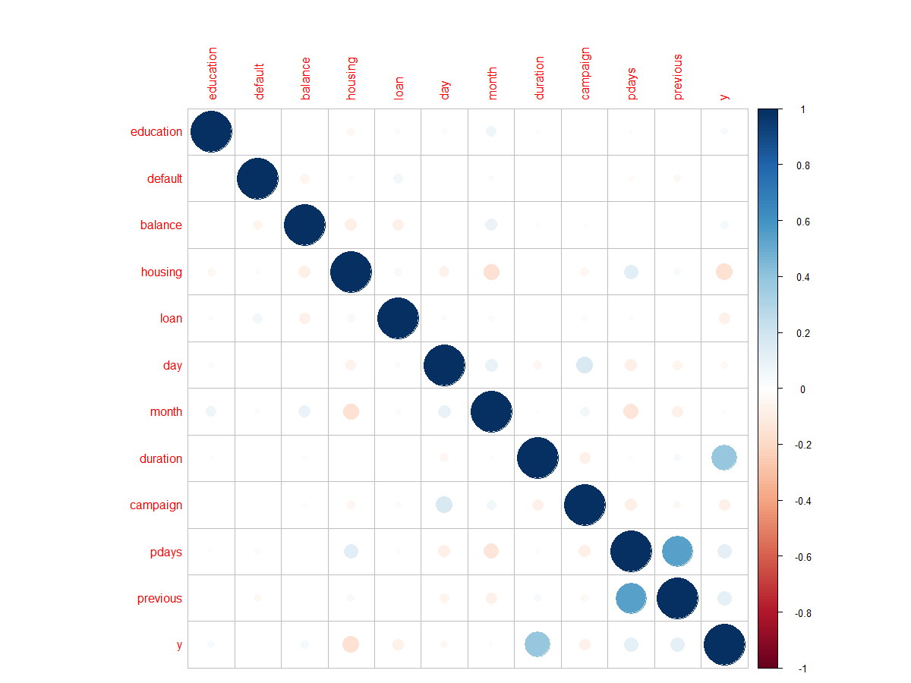
Multicollinearity

Slide 10
Interaction Terms
Possible Interaction Terms
Job:Housing
Marital:Housing
Education:Housing
Loan:Housing
Loan:Education

Slide 11
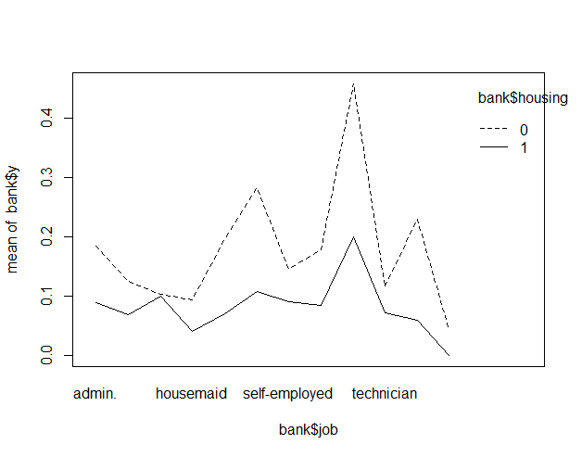
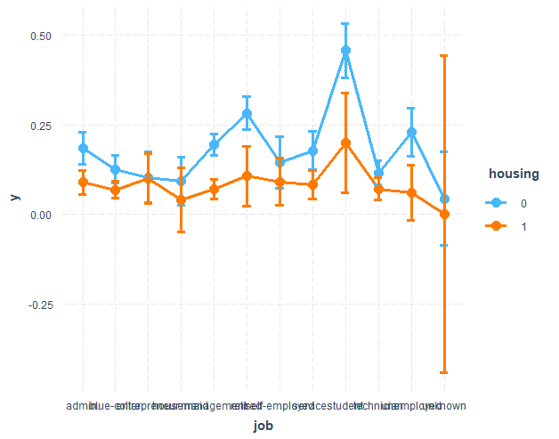
Interaction Plots

Slide 12
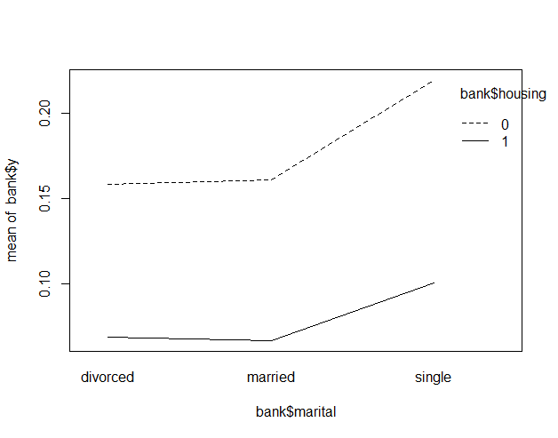
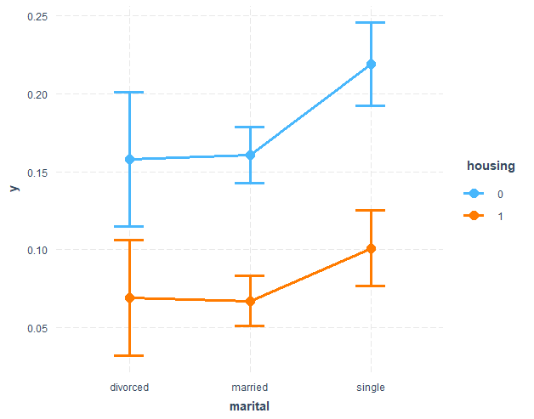
Interaction Plots

Slide 13
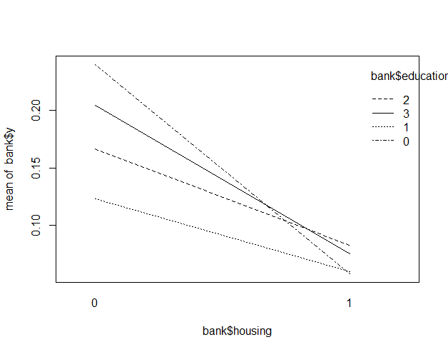
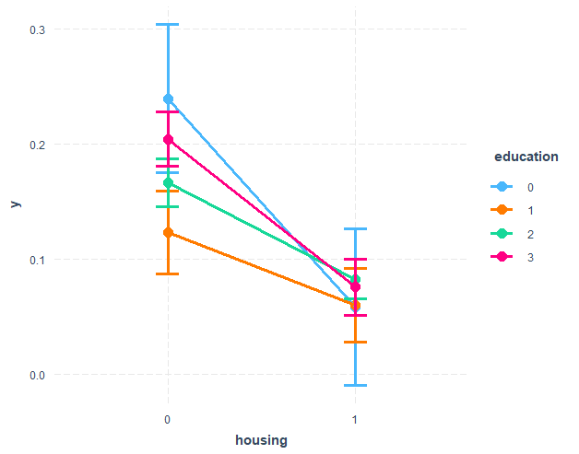
Interaction Plots

Slide 14
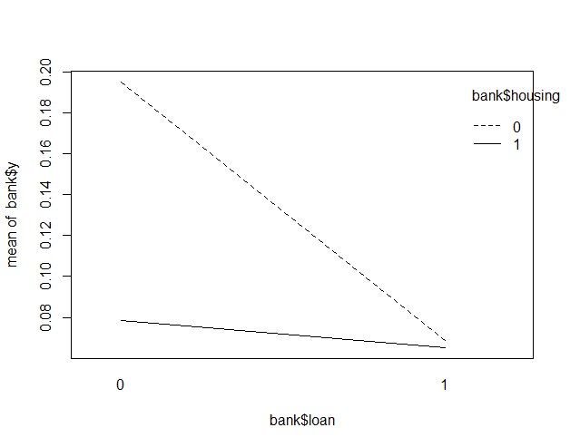
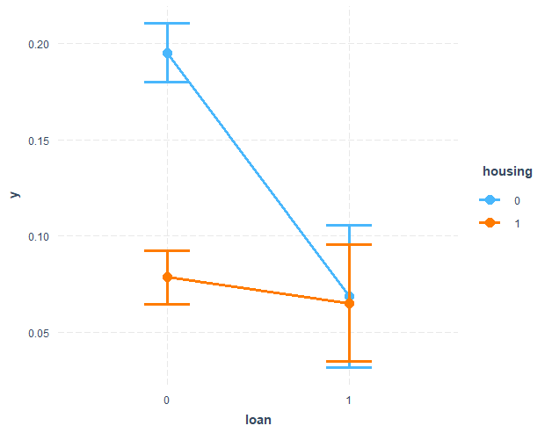
Interaction Plots

Slide 15
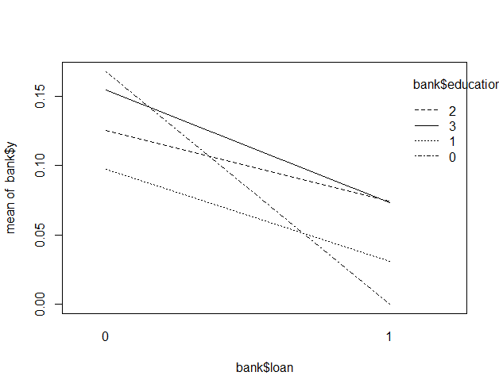
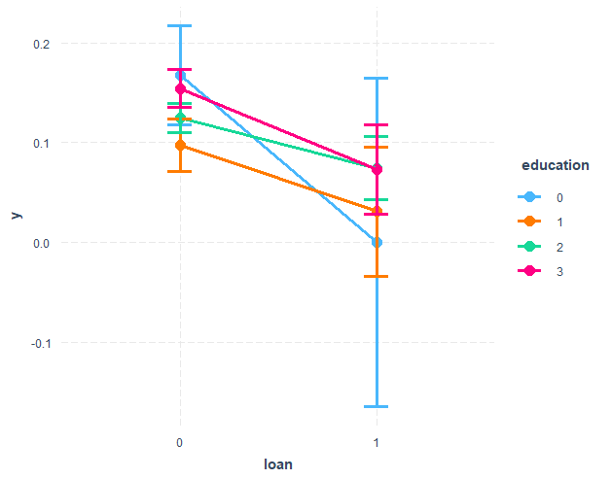
Interaction Plots

Slide 16
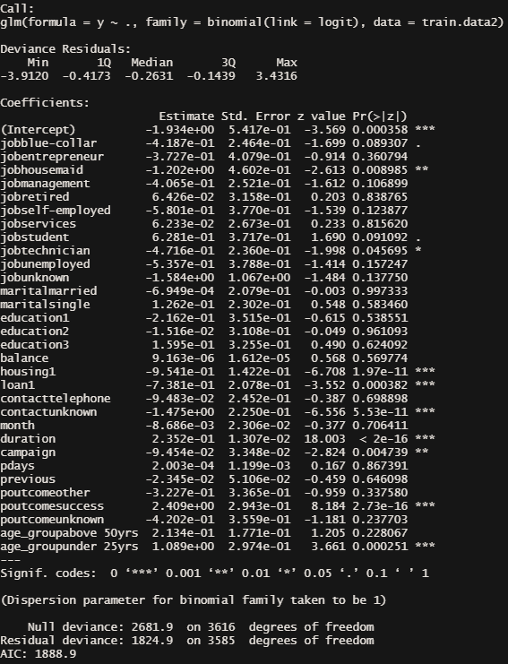
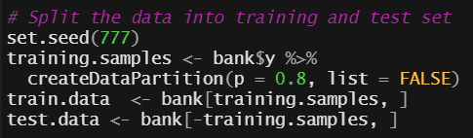
Splitting Data and Full Model

Slide 17
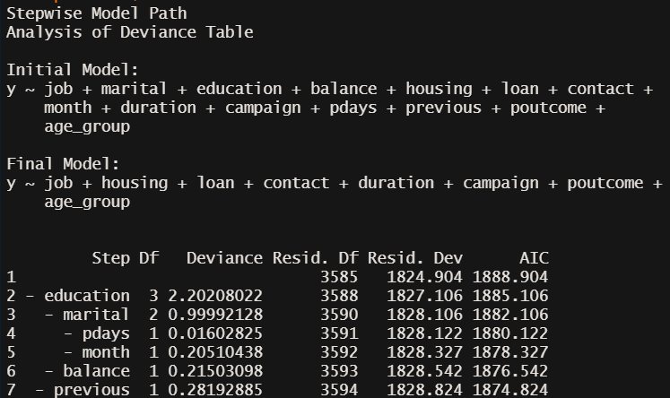
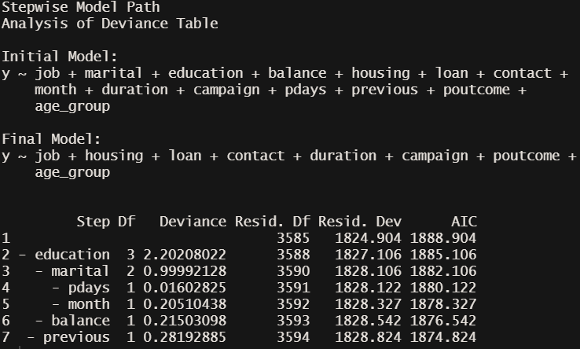
Stepwise Regression
Both
Backward

Slide 18
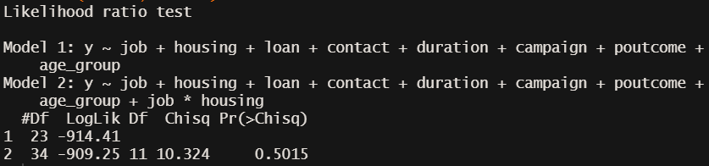
Full Model Comparison
With and Without Interaction Terms
Likelihood Ratio Test with Job*Housing
Note that p-value > .05, indicating that the model without interaction predictors fits significantly better than the model with interaction terms.

Slide 19
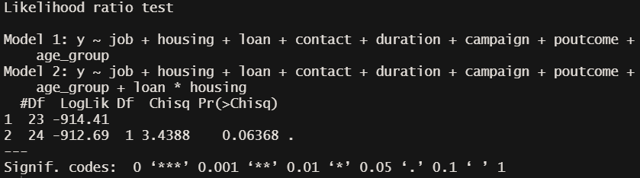
Full Model Comparison
With and Without Interaction Terms
Likelihood Ratio Test with Loan*Housing
Note that p-value > .05, indicating that the model without interaction predictors fits slightly better than the model with interaction terms.

Slide 20
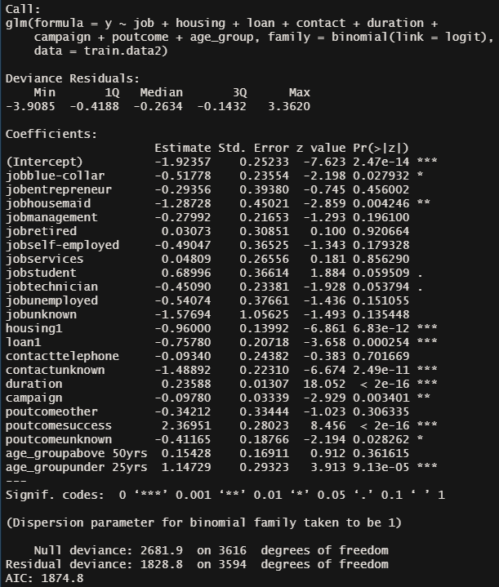
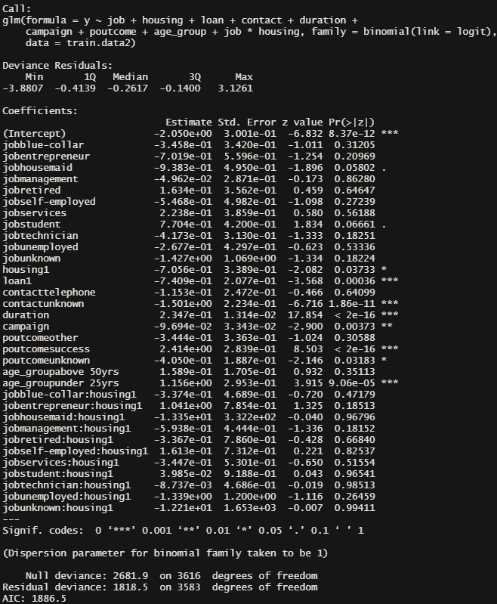
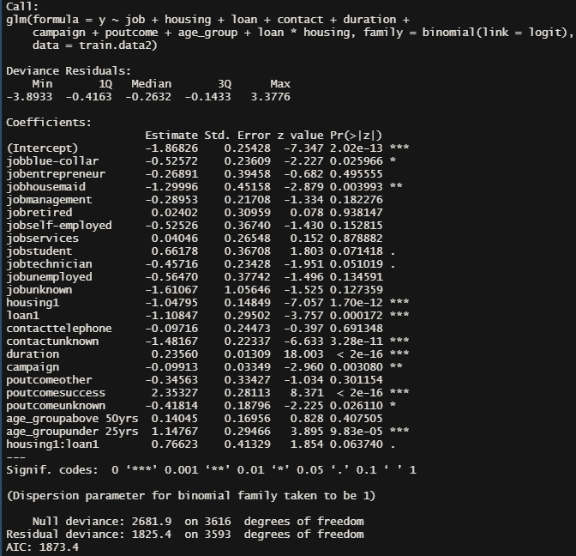
Model Comparison
With and Without Interaction Terms

Slide 21
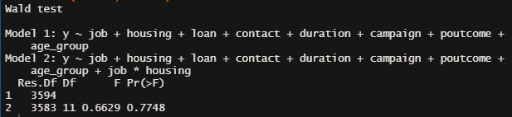
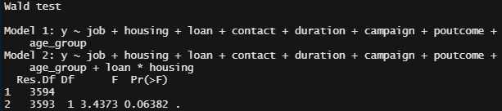
Model Comparison – Wald Test
With and Without Interaction Terms
With job*housing interaction
With loan*housing interaction

Slide 22
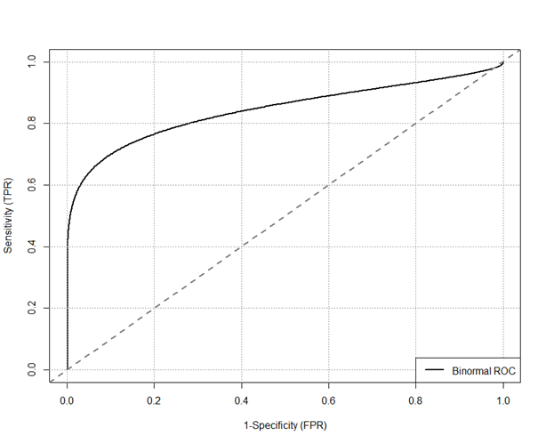


Classification Report
The model without Interaction Terms
Confusion Matrix
The test data has 797 observations for y=0, 107 for y=1. Therefore, the result is biased and may not accurate

Slide 23
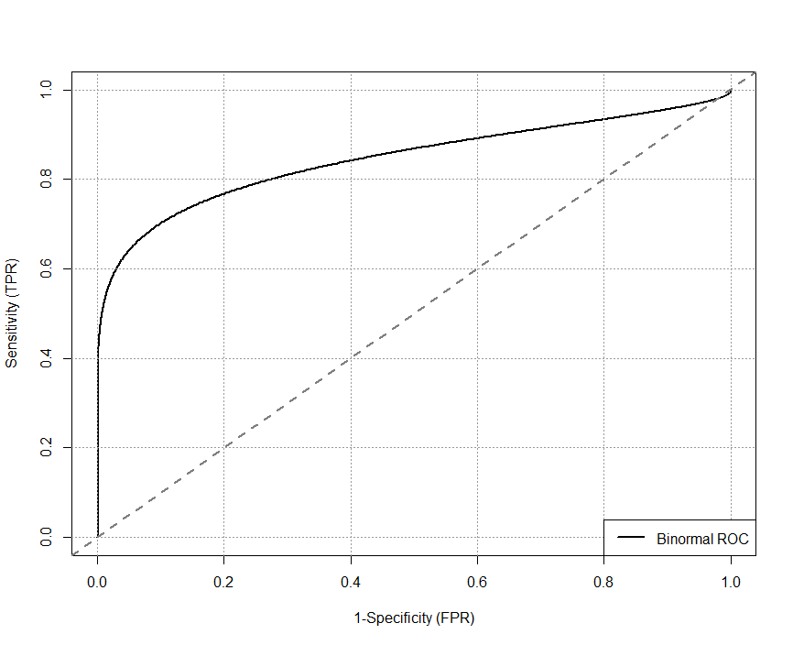


Classification Report
The model with Interaction Terms (Housing * job)
Confusion Matrix
The test data has 797 observations for y=0, 107 for y=1. Therefore, the result is biased and may not accurate

Slide 24



Classification Report
The model with Interaction Terms (Housing * Loan)
Confusion Matrix
The test data has 797 observations for y=0, 107 for y=1. Therefore, the result is biased and may not accurate

Slide 25
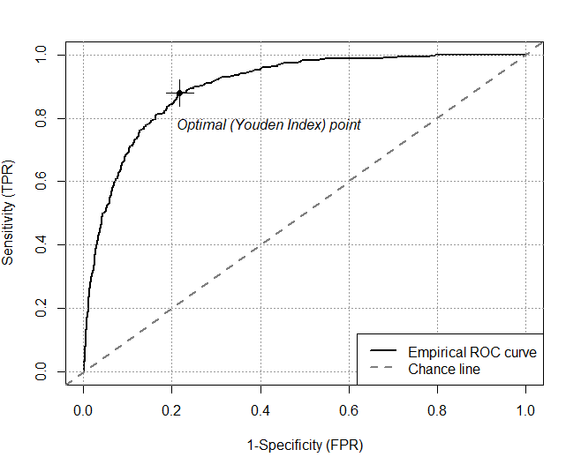

ROC Curve
The optimal cut-off point can be seen below

Slide 26
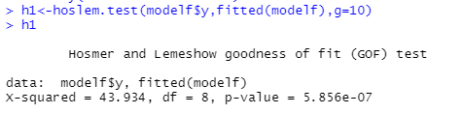
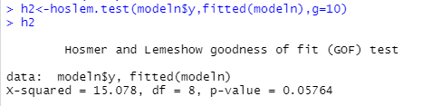
Lack of Fit
H0: Model without interaction is better
Ha: Model with interaction is better
Without interaction
With interaction
P-value closer to 1 means the model is a good fit.
Here, model with interaction is a mediocre fit.

Slide 27
Thank you
Insert the title of your subtitle Here

