Slide 1


Joo Lottery

Slide 2
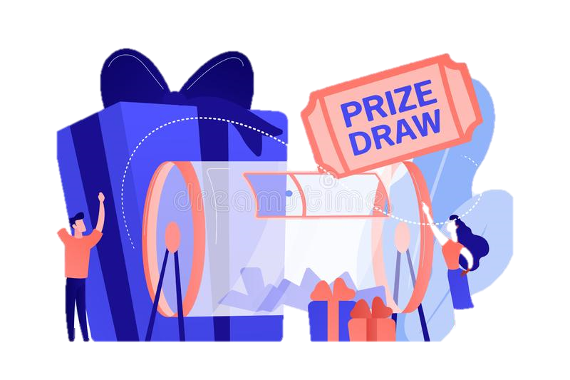
Try Your Luck

Slide 3


banner1.jpg

Slide 4
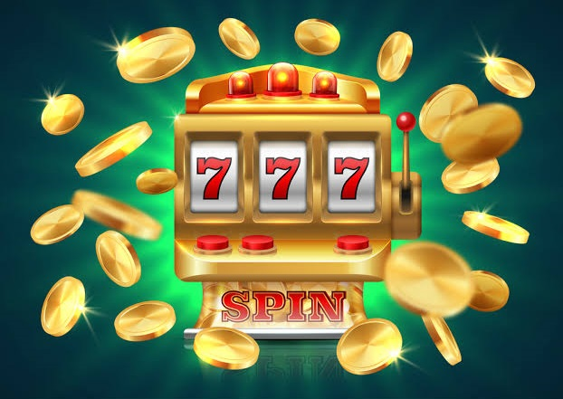
banner1.jpg

Slide 5


