Slide 1


Final Year Project
Khas – C2C Marketplace
Supervised By: Mr Osamah Ahmed (Junior Lecturer)

Slide 2
Project Team
Syed Mushahid Hussain (13629)
Talha Khizar (13676)
Usama Shah (13784)

Slide 3
Table of Content
Opportunity & Stakeholders
Existing Systems
Problem Statement
Endeavour (Team + Work + Way of Working)
System
Requirements Summary
Design Summary
Implementation Summary
Testing & Evaluation Summary
Conclusion and Outlook

Slide 4
Opportunity & Stakeholders

Slide 5
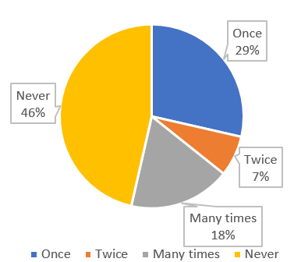
Opportunity
Online C2C shopping is currently done by users without any platform for monitoring or handling their online transaction and delivery.
Scams and fraud are common in online C2C shopping. Users cannot recover their losses in case of a scam.
No. of times people faced
scams online.

Slide 6
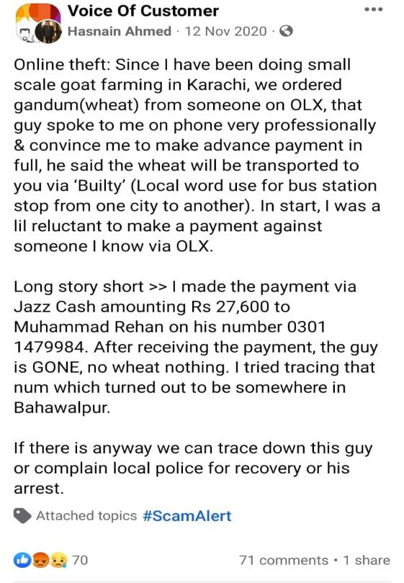
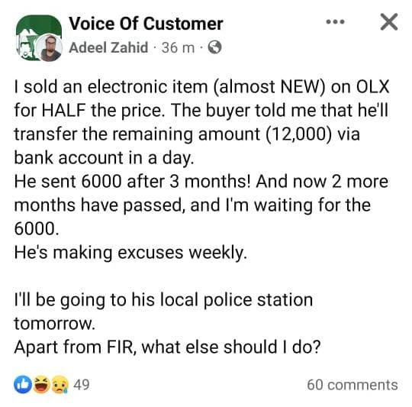
Sometimes the buyer pays for a product but the seller does not send the product or vice versa.

Slide 7

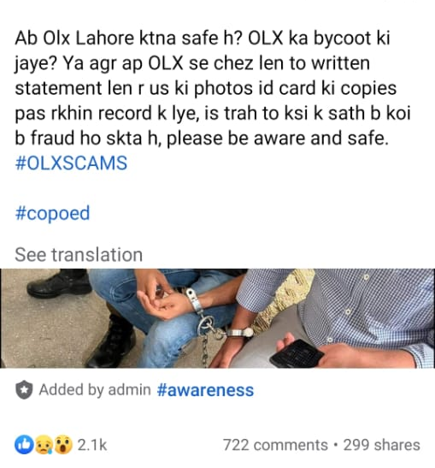
Sometimes deals are done offline after contacting online, but there are many risks involved in it.

Slide 8
Opportunity
Online product postings often do not include full specifications of the item.
So In most cases, people do not receive the exact product listed online.

Slide 9
Stakeholders
Admin
Seller
Buyer
Delivery Service

Slide 10
Existing Systems

Slide 11
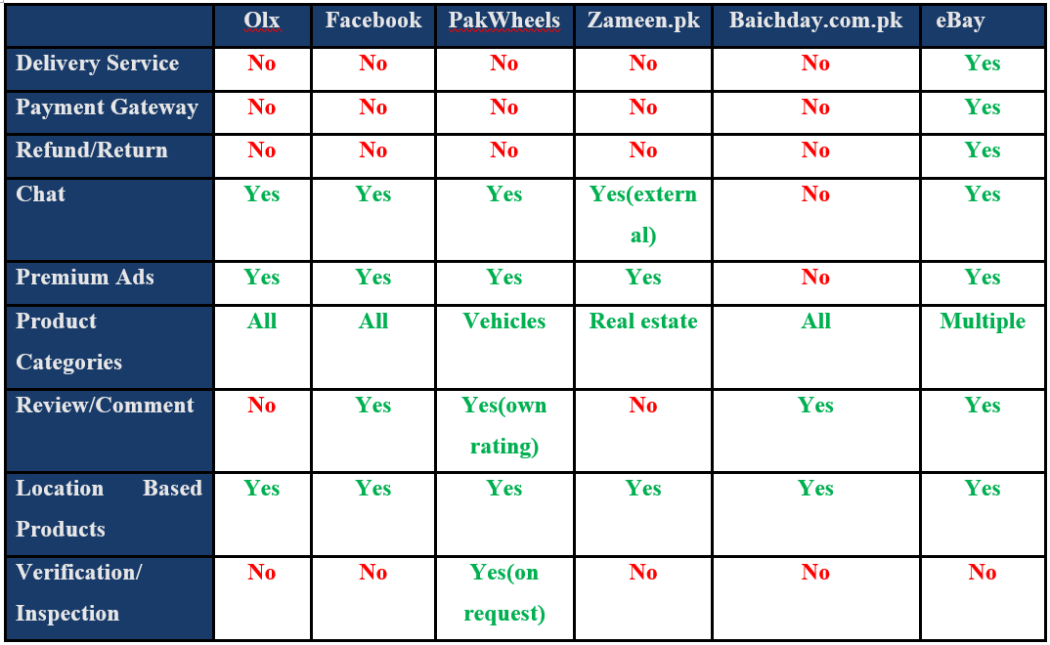

Slide 12
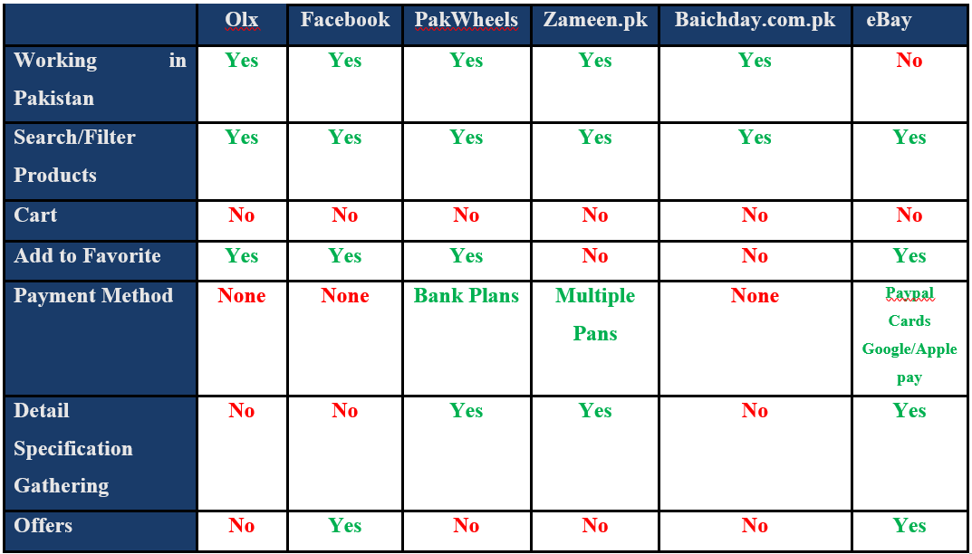

Slide 13
Problem Statement

Slide 14
Problem Statement
lack of product quality control.
No payment guarantees.
Time consumption process.
Seller credibility are unknown.
Security Risks .

Slide 15
Endeavour (Team + Work + Way of Working)

Slide 16
Endeavour (Team + Work + Way of Working)
Team:
Syed Mushahid Hussain
Usama Shah
Talha Khizar
Work: The team follows agile methodologies and uses tools and technologies such as VS Code, Git, Github, Xampp, PHP, MySQL, Jquery, Datatable, Stripe, Laravel, and Bootstrap.
Way of Working: We are following agile methodologies for better collaboration and faster delivery. The team follows best practices such as MVC pattern and writes clean, readable, and well-documented code.

Slide 17
Solution

Slide 18
Requirements Summary
Elicitation Techniques / Tools
Interviews
Brainstorming
Prototyping

Slide 19
Requirements Summary
Functional Requirements:
Total 190 functional requirements
User Requirements (120)
Admin (70)
Non-Functional Requirements:
Security in term of transaction.
Scalability to handle increased traffic as the business grows.

Slide 20
Design Summary
Architecture Diagram
Use Case Diagram + Fully Dressed Use Cases
Activity Diagram
Class Diagram
Entity Relation Diagram
Deployment Diagram

Slide 21
Implementation Summary
IDE:
Visual Studio
Version Control:
Git
Server:
Apache
Database:
My SQL
Framework:
Laravel
bootstrap

Slide 22
Testing & Evaluation Summary
Identify Test Case Scenarios
Used ECP (Equivalence Class Partitioning) technique
Test cases design

Slide 23
Conclusion And outlook

Slide 24
Conclusion
Khas is your go-to destination for all your phone shopping needs. With an extensive range of high-quality phones from top brands, we provide a seamless and convenient shopping experience.
Khas is designed to offer a user-friendly interface, allowing you to easily browse through the latest models, compare specifications, and make informed purchase decisions.
We prioritize customer satisfaction and offer competitive prices, along with secure payment options and reliable shipping services.

