Slide 1

DAB103 Analytic Tools & Decision Making
GROUP- 6
PROJECT PRESENTATION -1

Slide 2
Team Members
Usama Norat
Sadaf Ahmed Charkay
Deep Johal
Neha Babu
Mohammad Mazhar Noor

Slide 3
Content of Report
01. Background/Motivation
02. Problem Statement
03. Project Proposal
04. Analysis based on the dataset.
05. Data Description
06. Exploratory Data Analysis (EDA)

Slide 4

Background/Motivation
Data analytics is the most booming industry of the decade. Thousands of people now a moving towards data analytics as it is one of the most interesting and highest paying jobs in the corporate world.
Thousands of students graduate with degree and certification in data analytics and look for jobs in different fields with data analytics department.
The main motivation of our project is to find the best and the highest paying jobs in this field so that a data analyst can have a clear picture to go about getting the best fitting jobs.

Slide 5
Problem Statement
Any Data Analyst needs to have a good insight about the different jobs available to them , the salaries associated and the locations of the offices .
Identifying the best fit data analyst jobs, salary estimate , companies hiring and information regarding the companies.

Slide 6
Project Proposal
Our project team will prepare a detailed analysis to examine various jobs that a data analyst can apply for , estimate salaries , companies hiring and information about the companies.

Slide 7
Analysis based on the dataset.
Different job titles available for data analysts to apply for and estimate salary associated with different job titles .
Name of the companies and their associated ratings.
The Size of the company and the associated revenue.
The type of ownership of the company and the industry it belongs to.
Different companies under various sectors.

Slide 8
Data Description
This is a fictitious dataset. The dataset (2253R X 14C) contains numeric and categorical data types defining job titles , estimate salaries, background and attributes of the company , competitors and many others.
Source : https://www.kaggle.com/durgeshrao9993/data-analyst-jobs-datset

Slide 9
Variables and description.
Variables | Description
Job Title | Name of the job title
Salary Estimate | The estimated salary associated with the job title
Job Description | Brief description of the job
Rating | The company’s rating out of 5.0
Company Name | Name of the company
Location | The city where the office of the company is located
Headquarters | Name of the city where the headquarters are located
Size | Number of employees in the company
Founded | Year In which the company was established

Slide 10
Variables and description.
Variable | Description
Type of ownership | Refers to control over the enterprise
Industry | Refers to which industry the company belongs to
Sector. | Refers to the sector if the company
Revenue | Amount of money made buy the company in a year.
Competitors | Name of the companies in competition
Easy Apply | Gives whether it is easy to apply or not

Slide 11
Exploratory Data Analysis (EDA)
Does the data include missing values or incomplete data?
Does the data have outliers?
Is the selected data imbalanced?
How was the data collected?
Can you generate preliminary visualization?

Slide 12
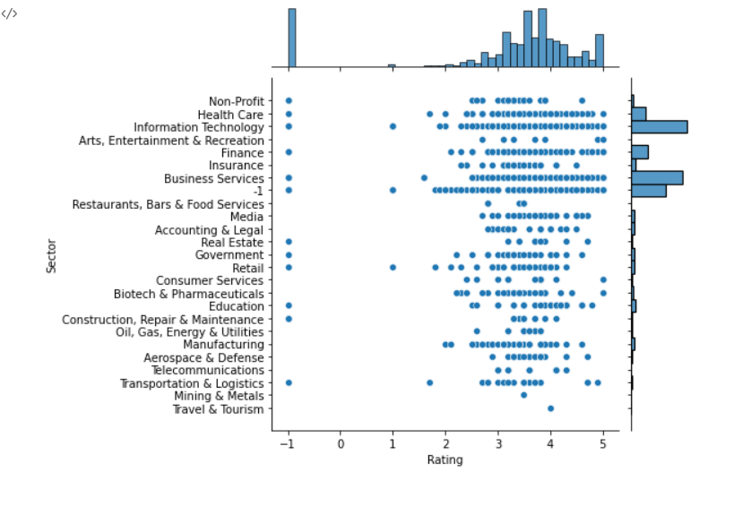
Does the data include missing value or incomplete data or invalid data?
Yes, there are lots of null or missing values in the dataset, like every column contains null values.
The column rating has -1 represented as a missing or unavailable value .

Slide 13
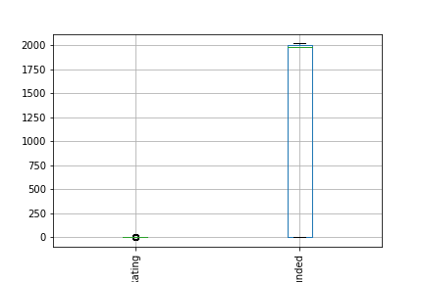
Does the data have outliers?
As you can see in the graph, there are lots of outliers contained within the data.

Slide 14
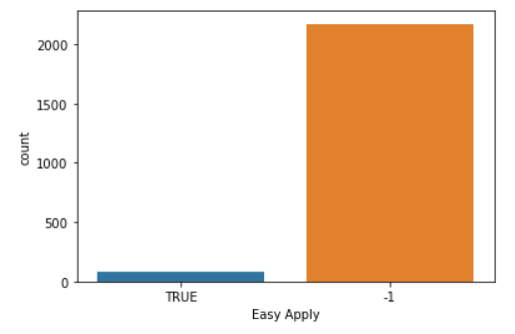
Is the selected data imbalance?
Easy Apply is the target column of dataset as per graph, it is clearly seen that data is imbalance

Slide 15
How was the data collected?
We have use Kaggle.com for finding this dataset.
Link for dataset: https://www.kaggle.com/durgeshrao9993/data-analyst-jobs-datset

Slide 16
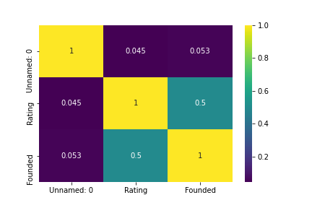
Can you generate preliminary visualization?

Slide 17
THANKYOU
Group 6

