Slide 1
ANALYSIS OF INDIAN PREMIER LEAGUE
2008-2019

Slide 2
About data
ANALYSIS ON DATASET OF MATCH AND DELIVERIES FROM
2008-2019
Source - Kaggle

Slide 3
OBJECTIVES
TOP BATSMAN FROM 2008-2019
TOP BOWLERS FROM 2008-2019
TOP MAN OF THE MATCH WINNERS FROM 2008-2019
TEAMS WON MATCHES IN IPL
HEAD-TO-HEAD OF TOP TWO TEAMS
MATCH WINNER WHO IS ALSO A TOSS WINNER

Slide 4

TOP 10 BATSMAN FROM 2008-2019
We can say that these Players are the most valuable Batsman in IPL

Slide 5

TOP 10 BOWLERS FROM 2008-2019
These Players are the most valuable Bowlers in IPL

Slide 6

TOP 10 MAN OF THE MATCH WINNERS FROM 2008-2019
These players have won most man of the match awards compare to other players

Slide 7
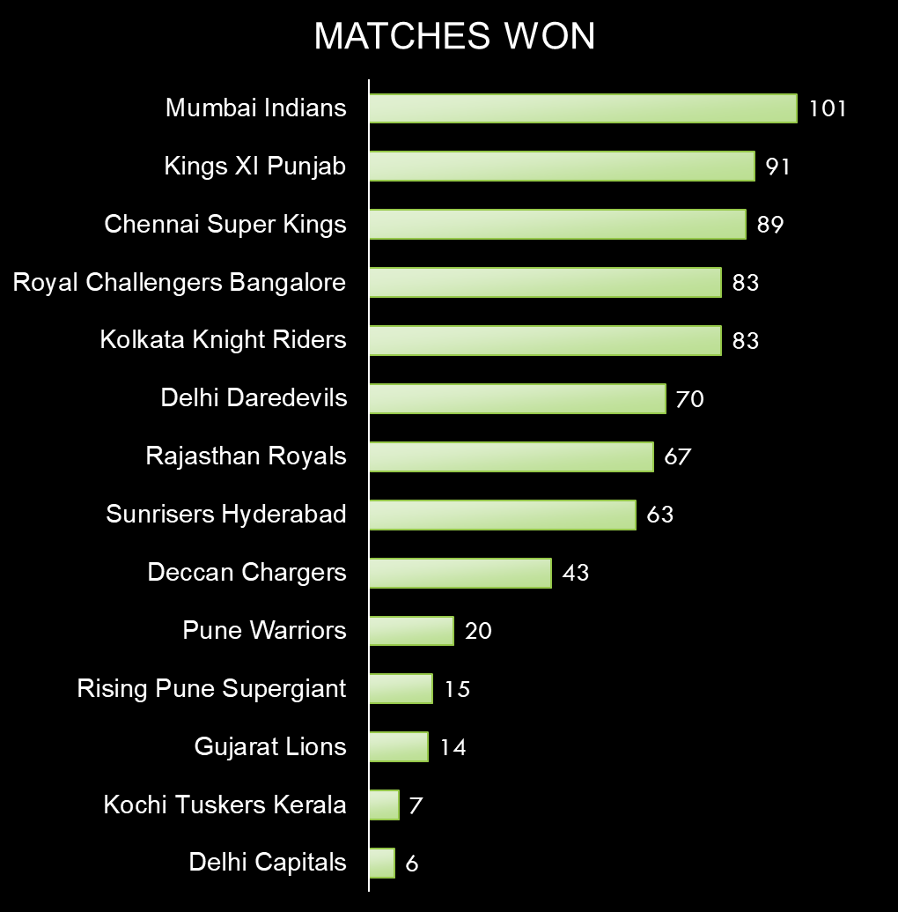
TEAMS WON MATCHES IN IPL
Mumbai Indians is the best team as they won Highest matches
Delhi Capitals and Kochi Tuskers Kerala has the lowest success rate with 6 and 7 respectively

Slide 8

HEAD-TO-HEAD OF TOP TWO TEAMS
This is the graph of number matches won by teams when played with each others

Slide 9

MATCH WINNER WHO IS ALSO A TOSS WINNER
This is the graph shows likeliness of the team who won a toss also wins the match

Slide 10
THANK YOU

