Slide 1
Parameter Efficient Fine and Prompt Tuning

Slide 2
Topics
What is Fine-Tuning
Parameter Efficient Fine-Tuning Techniques
The way of Re-Parameterization
What are Adapters
Lora and QLora Fine tuning techniques
Our work and Results for Lora
The way of Prompt tuning
Difference between Hard and Soft Prompt
Parameter efficient prompt tuning
Our work and Results
Conclusion and Way Forward

Slide 3
What is Model Fine tuning?
Train a Model that has already been designed and trained like ChatGPT, Llama and take advantage of what the model has already learned without having to develop it from scratch.
ChatGPT
(Pretrained on 570GB of Text Data)
Fine-Tuned
(On Task specific 500MB of Text Data)
Trained Model
(on task specific data with less time)

Slide 4
Parameter Efficient Fine-Tuning (PEFT)
Additive
Soft Prompt
Prompt Tuning
Prefix Tuning
Selective
Focus on updating few foundation model layer
BitFit- Updating only bias parameters
Re-Parameterization
Decompose weight matrix into smaller-rank matrix
Lora
QLora

Slide 5
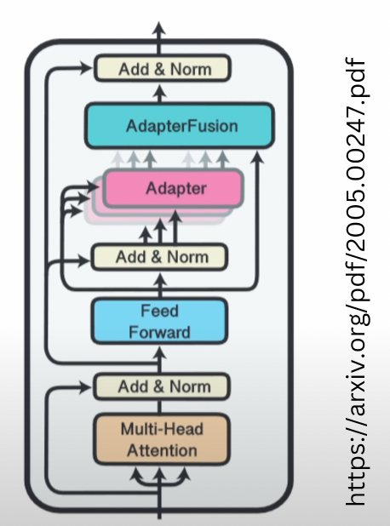
Model Adapters
Adapters add a small number of of new parameters to a model which are trained on downstream task
Adapters are trained in the same manner as full fine-tunes model
The parameters of original networks are frozen and only the adapter parameters will be trained

Slide 6
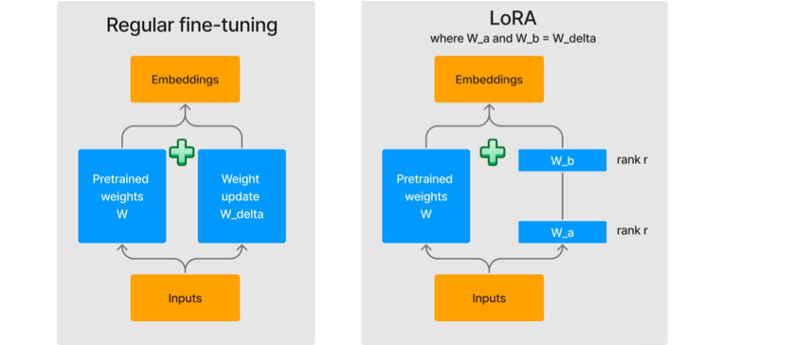
What is Lora?
Low Ranking Adaptation is an efficient fine-tuning technique which injects low rank decomposition matrix into the layer of pretrained models
It only updates the new low dimensional added weights while keeping the original weights frozen
After Fine tuning the updated weights are then added with the respective model weights

Slide 7
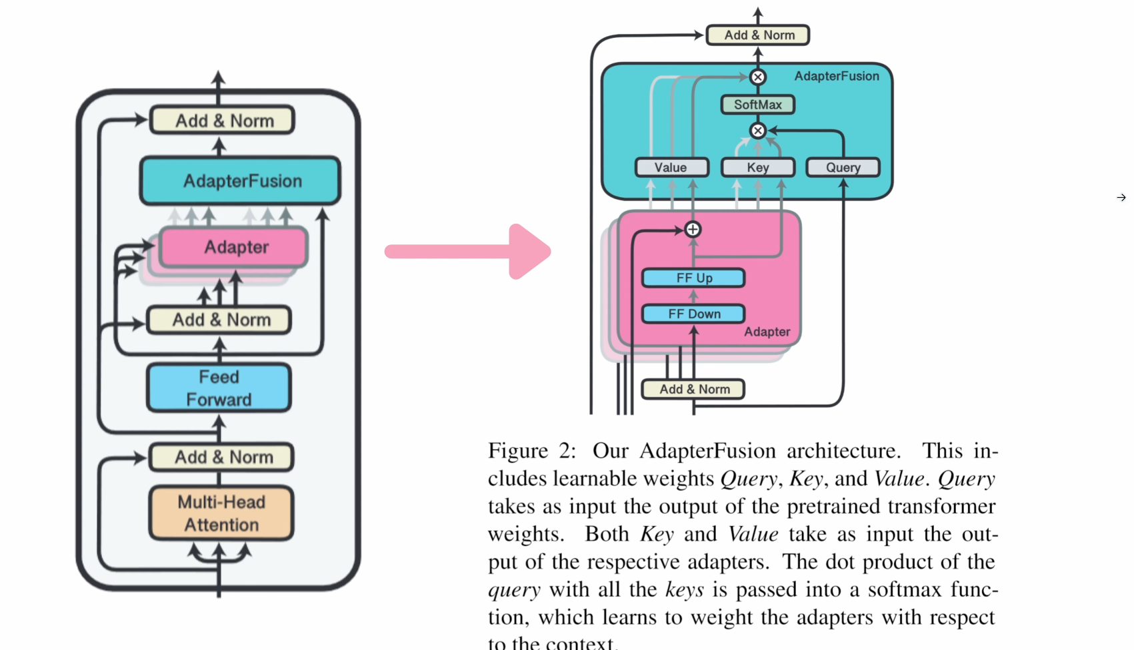
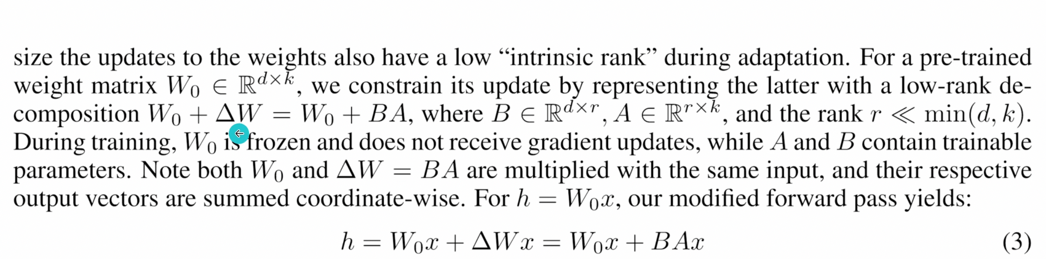
During the fine-tuning, the model is initialized to pre-trained weights W0 and all are updated to W0+W1
One of the main drawbacks for full fine-tuning is that for each downstream task, we learn a different set of parameter W1
Lora adopts a more parameter efficient approach, where the task-specific parameter is decomposed into much smaller-size parameters and then train on those less parameters

Slide 8
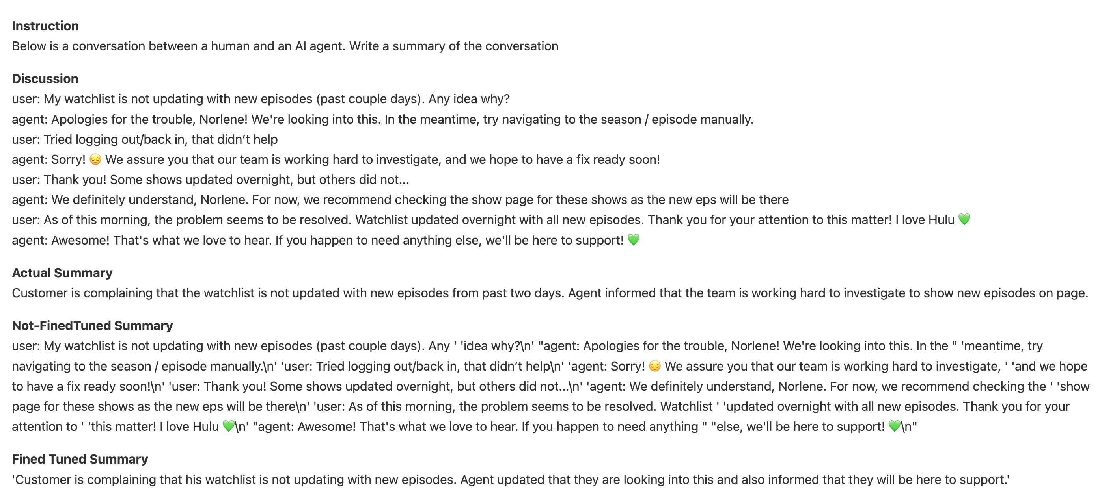
Lora Fine-Tuning On Llama-2-7B Demo

Slide 9
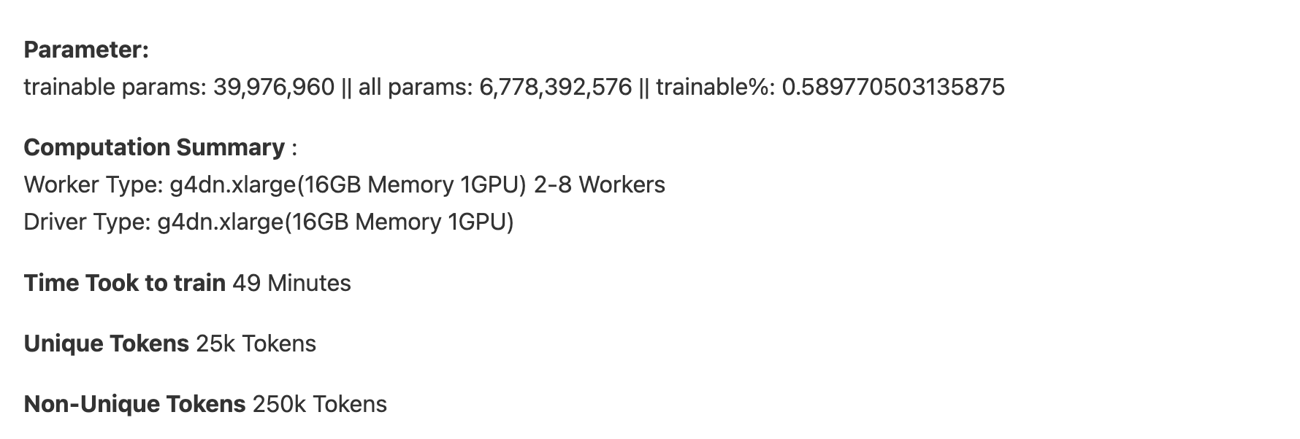
Parameters

Slide 10

Prompts
Hard Prompts
2. Soft Prompts
Answer the given question in 1-3 words. Do
n’t provide detail expla
.......
When was Lewis hamilton born?
Pre-Trained Model
7 7 January 1985
I Initial Examples/Instruction
Pre-Trained Model
When was Lewis hamilton born?
Prompt Tuned Model
7 7 January 1985

Slide 11
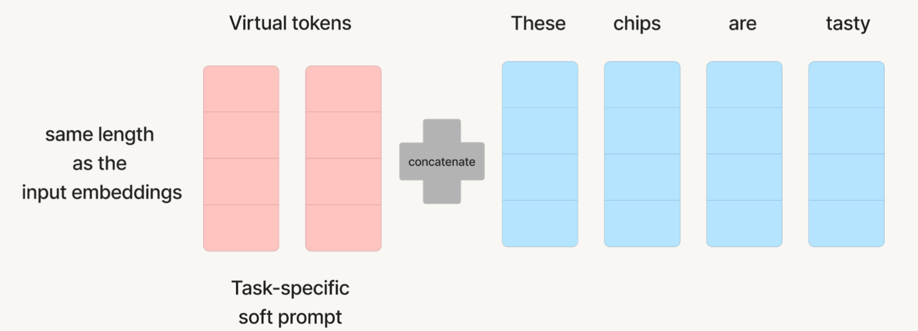
Soft Prompt
Soft Prompt concatenate trainable parameter with input embeddings
It Learns a new sequence of task-specific embeddings
We call this prompt tuning, not model tuning, because we only update prompt weights

Slide 12
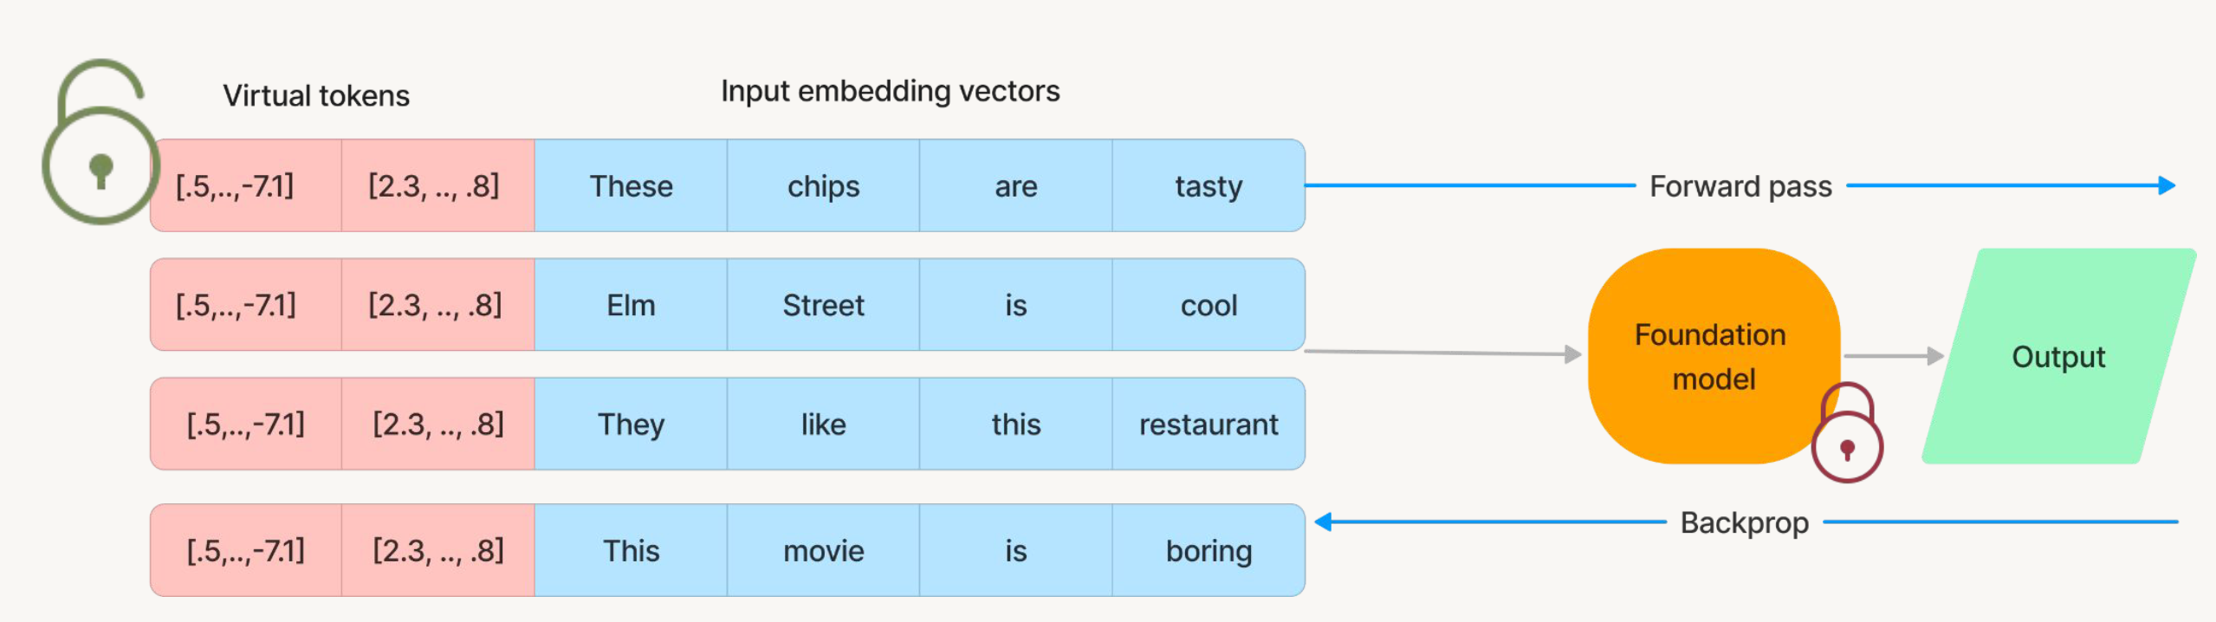
Parameter Efficient Prompt Tuning
Parameter efficient prompt tuning is a technique for fine-tuning large language models (LLMs) with a small number of parameters. This is done by using a trainable prompt vector that is prepended to the input sequence. The prompt vector is tuned during training to guide the LLM to perform the desired task.
It creates the virtual tokens and will prepend in the input embedding.
It will freeze the pretrained model and will only be fine-tuned on these virtual prompt token

Slide 13
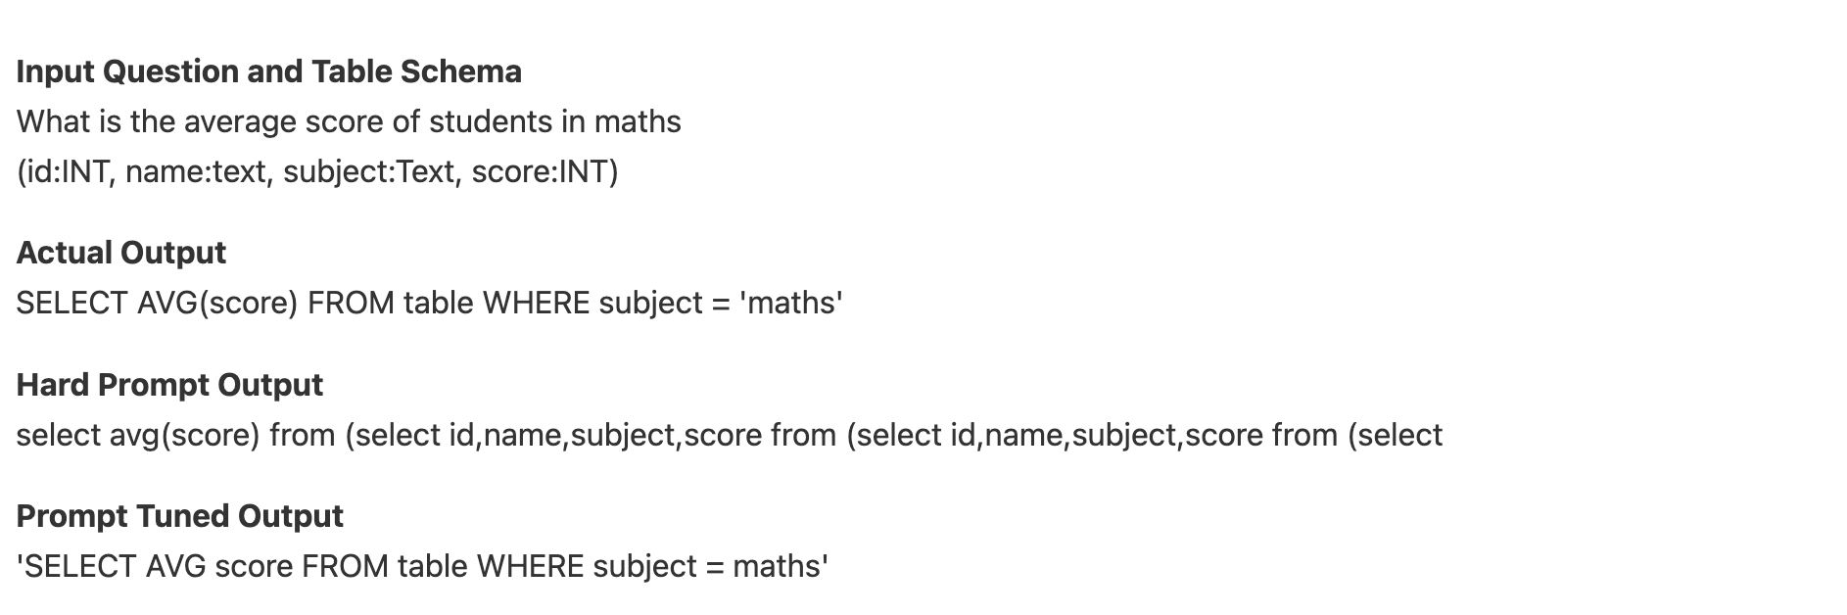
Prompt-Tuning On Llama-2-7B Demo

Slide 14
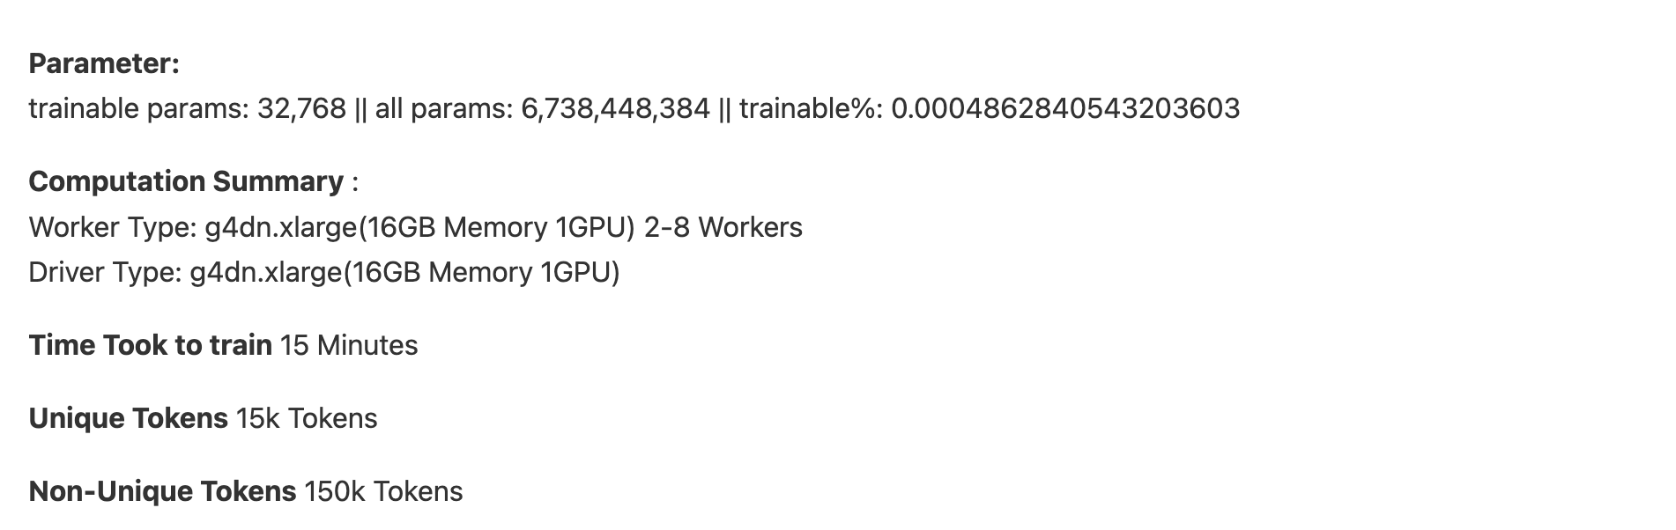
Parameters

