Slide 1
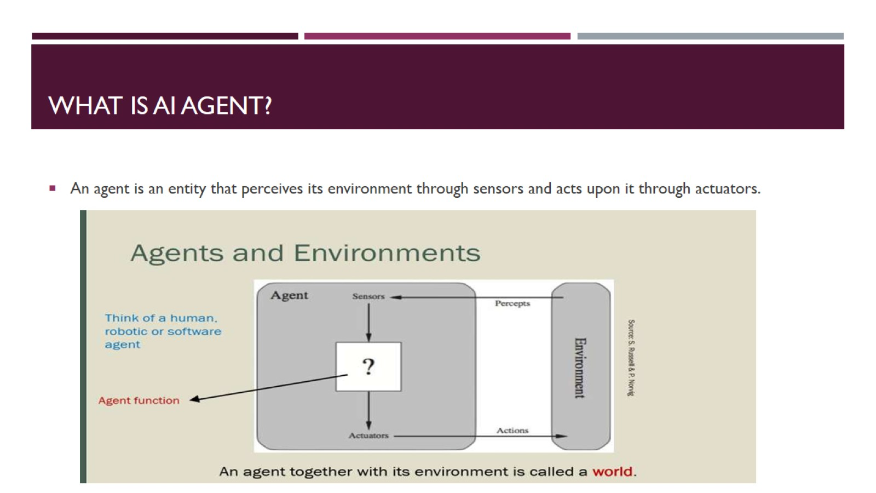
What is AI Agent?

Slide 2
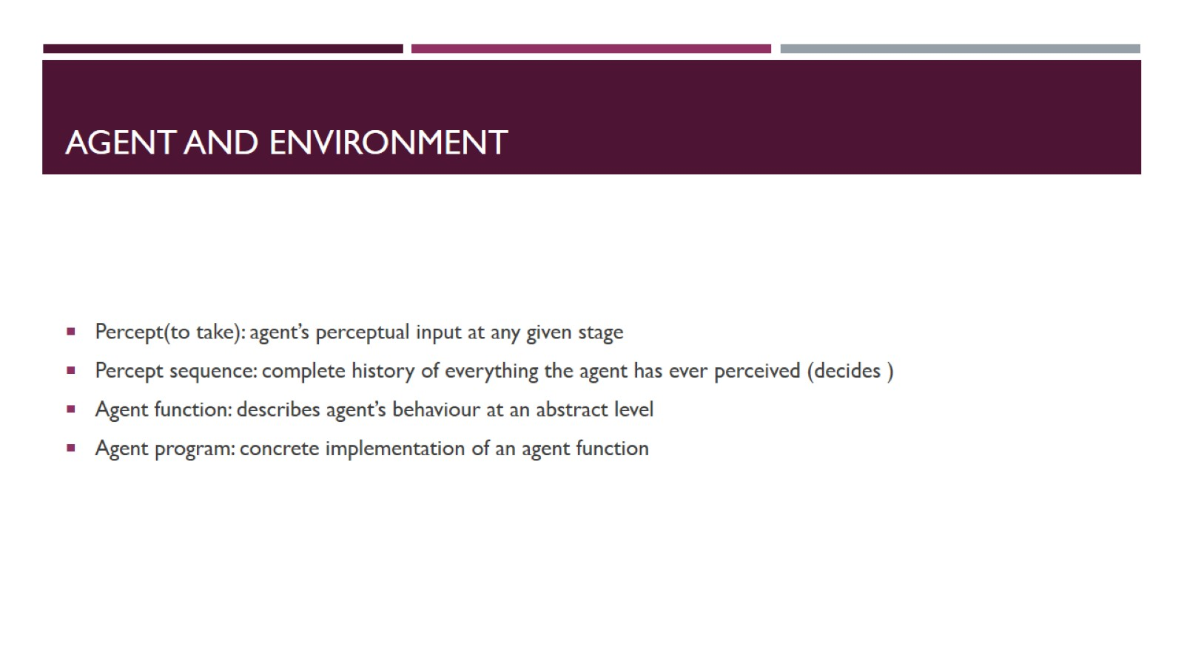
Agent And Environment

Slide 3
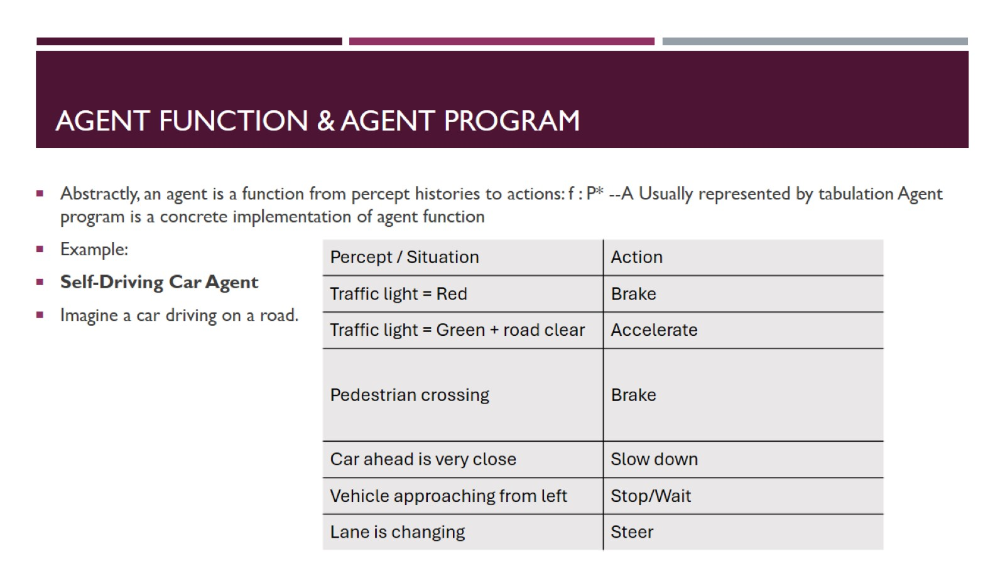
Agent Function & Agent Program

Slide 4
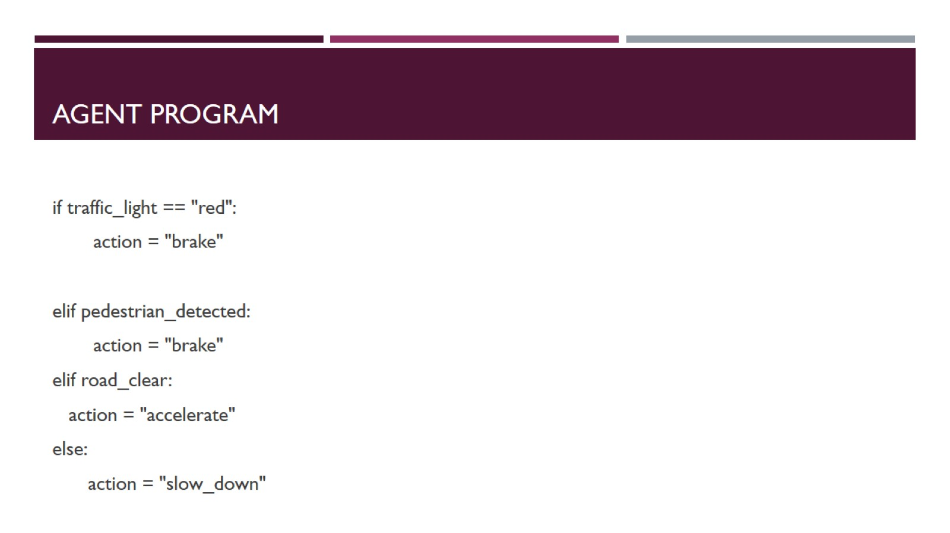
Agent program

Slide 5
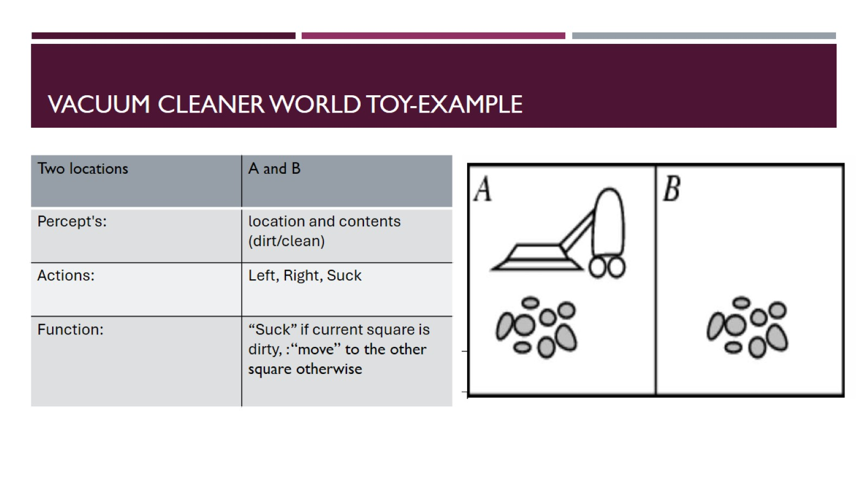
Vacuum Cleaner World Toy-Example

Slide 6
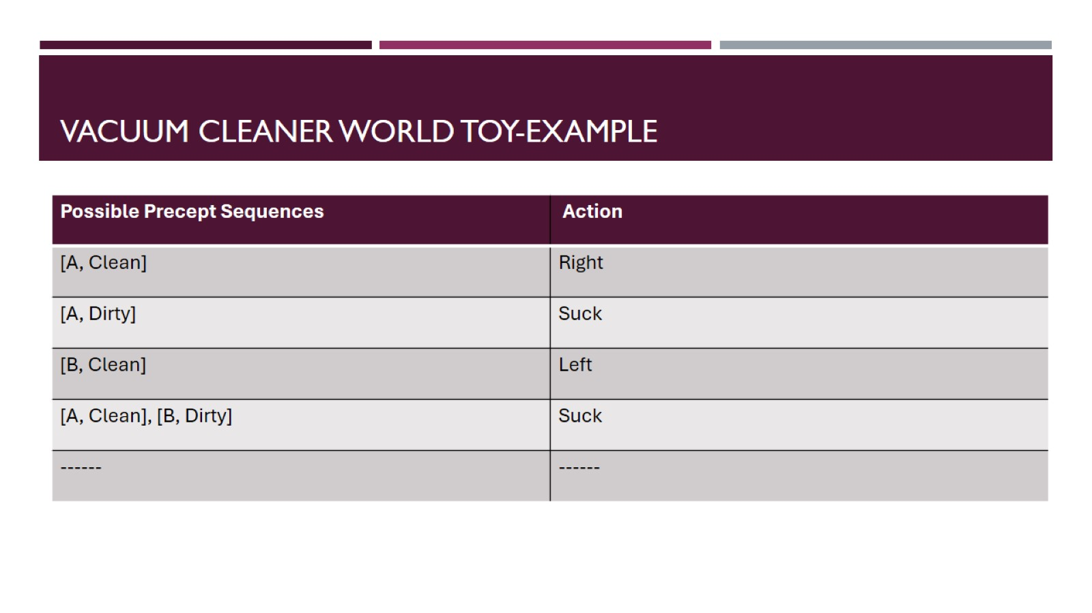
Vacuum Cleaner World Toy-Example

Slide 7
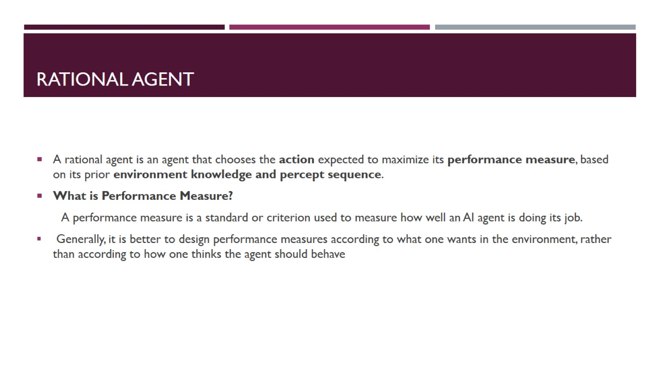
Rational Agent

Slide 8
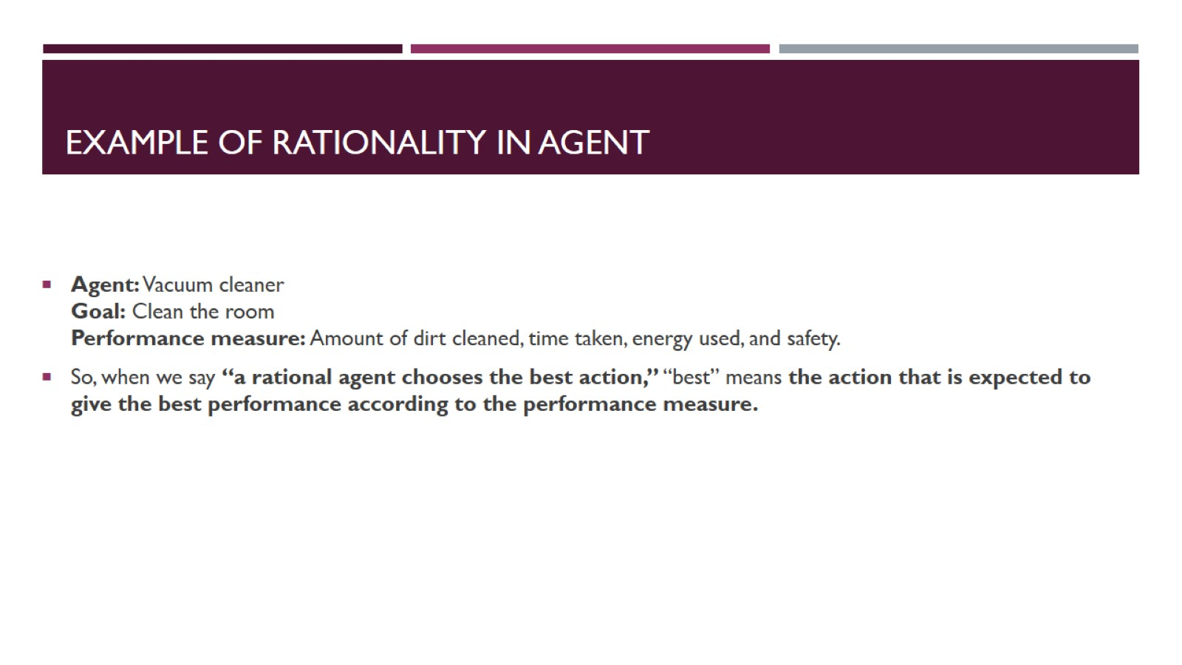
Example of Rationality In Agent

Slide 9
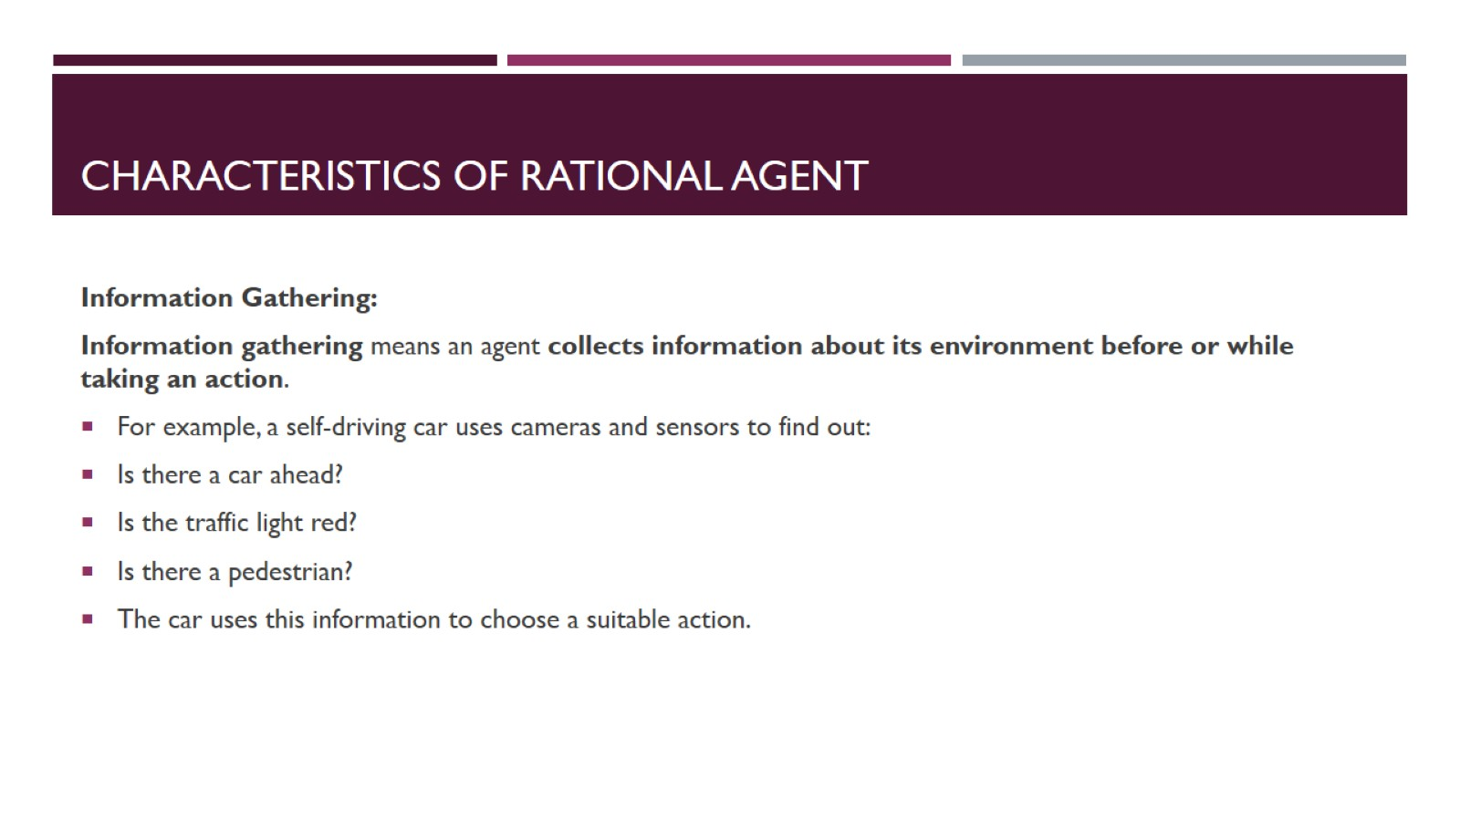
Characteristics of Rational Agent

Slide 10
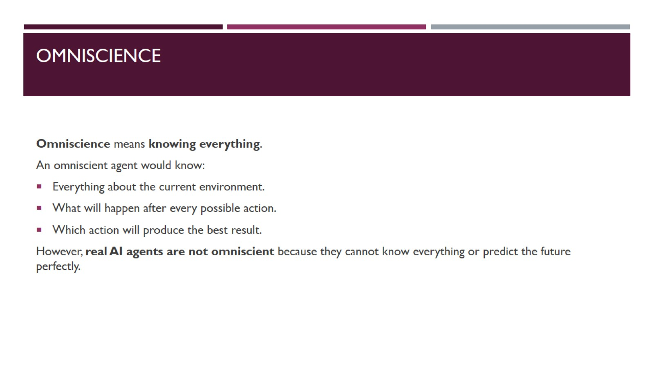
Omniscience

Slide 11
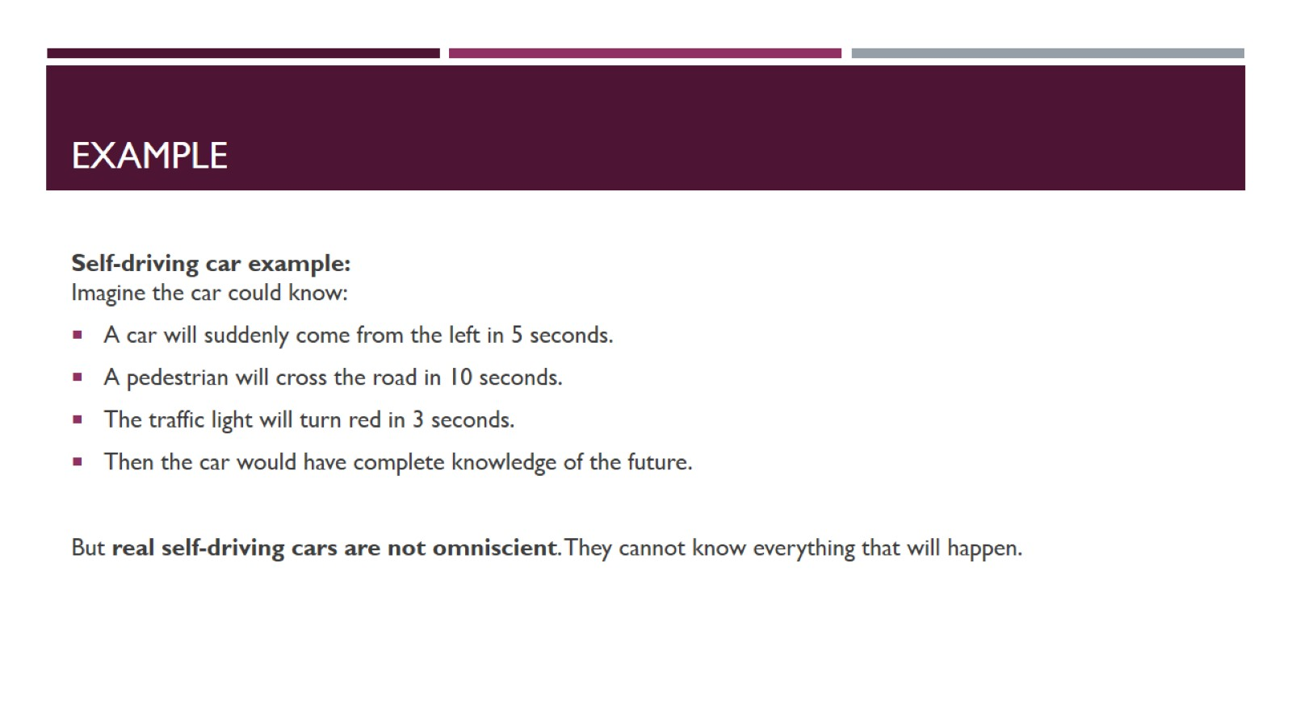
Example

Slide 12
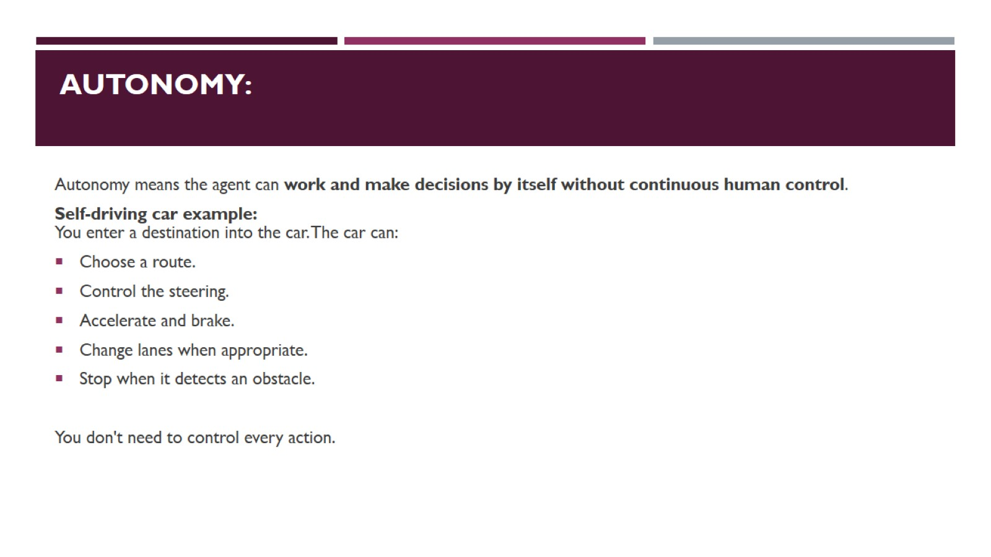
Autonomy:

Slide 13
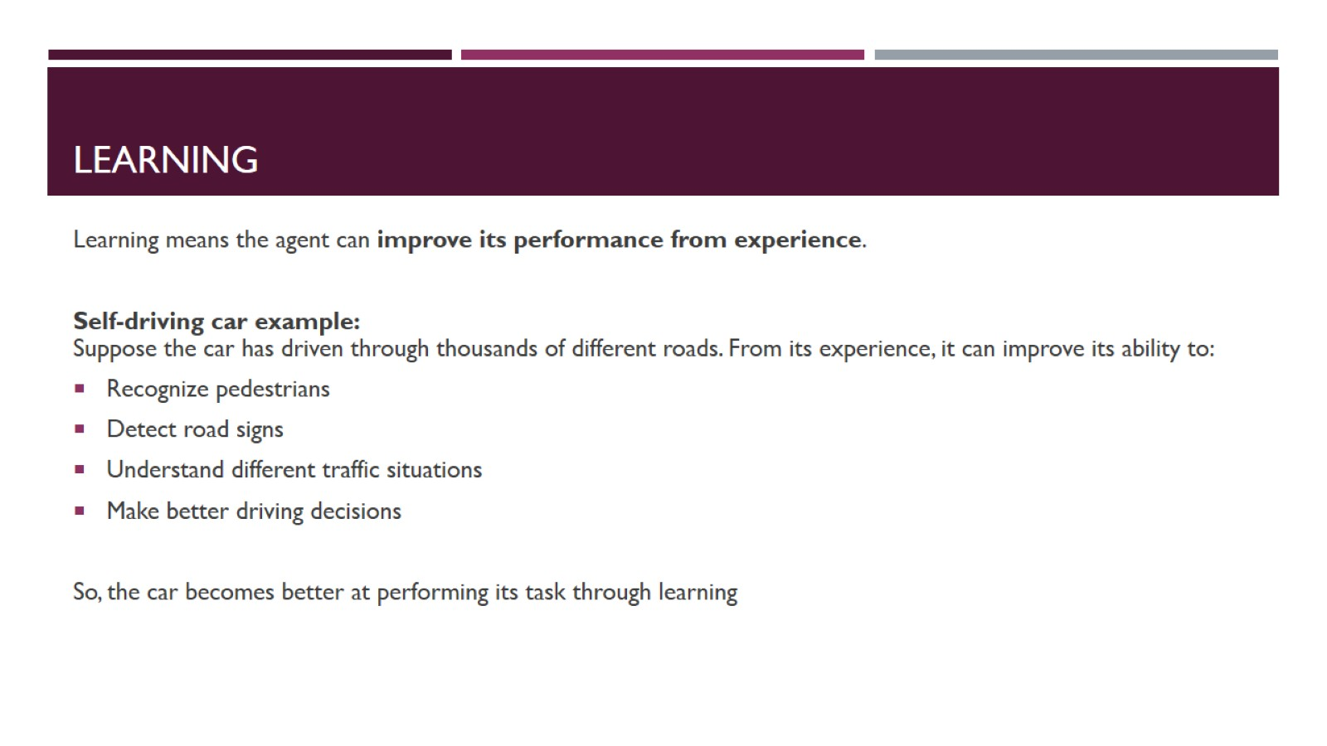
Learning

Slide 14
