Slide 1
Module 0: Course Introduction and Exam Orientation
Everything the AIGP exam can ask, in the order the IAPP (International Association of Privacy Professionals) lists it
Body of Knowledge version 2.1
AIGP Exam Prep Masterclass
Module 0
Notes:
Welcome to the A I G P Exam Prep Masterclass. This is Module zero: Course Introduction and Exam Orientation. The A I G P, short for Artificial Intelligence Governance Professional, is a credential from the I A P P, the International Association of Privacy Professionals. This course covers everything the exam can ask, in the order the I A P P lists it. This first module is short. It shows you the exam, its scope, and how to use the rest of the course.

Slide 2
What You Will Learn
Module 0
Describe the exam: length, format and scoring
Explain how single-answer and multi-select questions work
Plan booking, retakes and maintenance
Read the Body of Knowledge: 4 domains, 13 competencies, 58 indicators
Use the verbs of the indicators to judge how deep to study
Use this course: modules, tags and practice questions
AIGP Exam Prep Masterclass | Certified AI Governance Professional
Module 0: Course Introduction and Exam Orientation
2 / 12
Notes:
By the end of this module you will be able to do six things. Describe the exam: its length, its format and how it is scored. Explain how single-answer and multi-select questions work. Plan how to book the exam, retake it if you need to, and keep the credential. Read the Body of Knowledge, with its four domains, thirteen competencies and fifty-eight performance indicators. Use the verbs of the indicators to judge how deep to study. And use this course well: the modules, the tags and the practice questions.

Slide 3
Case Check-In: Meet Helios
Module 0
CASE CHECK-IN · Helios
Helios is a fictional company of about 2,000 people that uses AI to hire and to serve customers
A hiring tool from the vendor Veridex screens applications
A customer assistant runs on a general-purpose model from Corvid Labs
You are the AI governance lead; Samira Haddad, the Chief AI Officer, asks you to build the program
Each module follows Helios one step further, in the order of the exam's own domains
AIGP Exam Prep Masterclass | Certified AI Governance Professional
Module 0: Course Introduction and Exam Orientation
3 / 12
Notes:
Meet Helios. Helios is a fictional company of about two thousand people, and it uses A I in two places. A hiring tool, bought from a vendor called Veridex, screens job applications. A customer assistant, built on a general-purpose model from a provider called Corvid Labs, answers customer questions. You are the A I governance lead. Samira Haddad, the Chief A I Officer, asks you to build the governance program. In every module, Helios takes one more step, and you take it with the company.

Slide 4
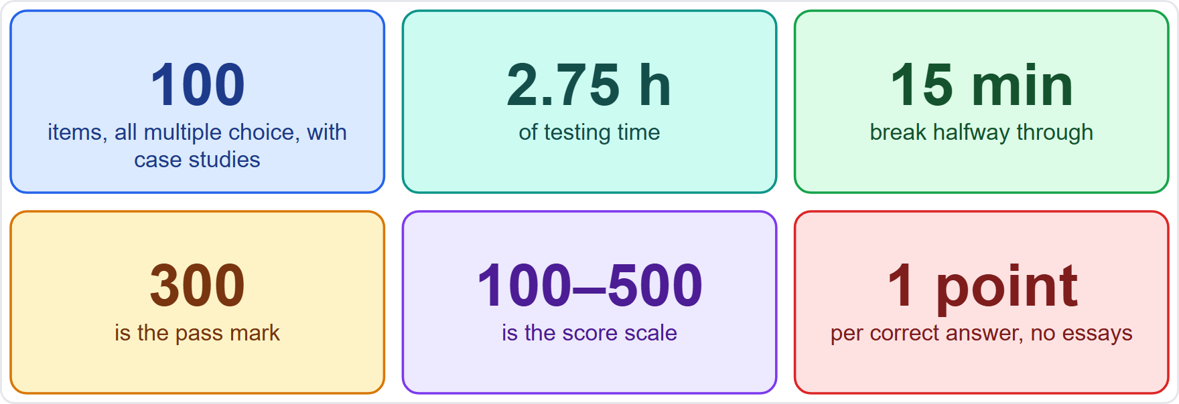
The Exam at a Glance
Module 0
100 items, all multiple choice, with case studies
2.75 hours of testing plus a 15-minute break
Pass mark 300 on a scale of 100 to 500
One point per correct answer; no essay questions
Taken at a Pearson VUE test center or online with OnVUE
EXAM TIP The Study Guide calls it a three-hour exam. That is the 2.75 hours plus the 15-minute break, which together come to exactly three hours.
AIGP Exam Prep Masterclass | Certified AI Governance Professional
Module 0: Course Introduction and Exam Orientation
4 / 12
Notes:
Here is the exam at a glance. It has one hundred items. All are multiple choice, and they include case studies. You get two and three quarter hours of testing, plus a fifteen-minute break. The pass mark is three hundred, on a scale from one hundred to five hundred. Each correct answer earns one point, and there are no essay questions. You take the exam at a Pearson VUE test center, or online with a system called OnVUE. The Study Guide calls this a three-hour exam. That is the two and three quarter hours plus the fifteen minutes of break.

Slide 5
One Answer or Several: The Question Formats
Module 0
Single answer: choose one option; the Study Guide's samples show four
Multi-select: the question says how many to choose (the sample shows 3 of 5); you must choose exactly that many, and there is no partial credit
A question can follow a scenario: you read the case, then answer questions about it
You can be asked to apply what you know to a situation the study material never showed
Every question is worth the same one point
EXAM TIP On a multi-select question, the number in the stem is a rule, not a hint. Choose exactly that many options.
AIGP Exam Prep Masterclass | Certified AI Governance Professional
Module 0: Course Introduction and Exam Orientation
5 / 12
Notes:
Now the question formats. A single-answer question asks you to choose one option; the Study Guide's samples show four. A multi-select question tells you how many to choose, and you must choose exactly that many. There is no partial credit. The Study Guide's own sample asks for three of five options. Some questions follow a scenario: you read a case, then answer questions about it. And you can be asked to apply what you know to a situation your study material never showed. Every question is worth one point. Exam tip: on a multi-select question, the number in the stem is a rule, not a hint. Choose exactly that many.

Slide 6
Scoring and Results
Module 0
Your result is a score from 100 to 500; 300 passes
IAPP sets the pass mark through beta testing, expert review and psychometric analysis
The FAQ says all it takes is a set number of correct answers; it states no per-domain minimum
You see pass or fail and your score at once; an email then gives access to a section breakdown
IAPP does not tell you how many answers were correct, and the section percentages cannot be averaged into your score
EXAM TIP Each correct answer earns one point and IAPP describes no penalty for a wrong one, so answer every question.
AIGP Exam Prep Masterclass | Certified AI Governance Professional
Module 0: Course Introduction and Exam Orientation
6 / 12
Notes:
Next, scoring. Your result is a score from one hundred to five hundred, and three hundred passes. The I A P P sets the pass mark through beta testing, review by experts, and psychometric analysis. Its F A Q says all it takes is answering a set number of questions correctly. It states no minimum for each domain. You see pass or fail and your score at once, and an email gives you access to a section breakdown. The I A P P does not tell you how many answers were correct, and you cannot average the section percentages to get your score. Exam tip: each correct answer earns one point, and the I A P P describes no penalty for a wrong one. So answer every question.

Slide 7
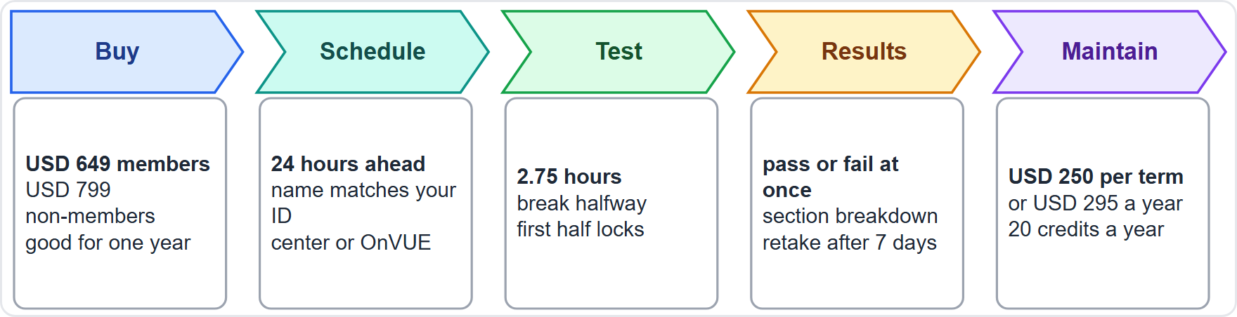
Booking, Taking and Keeping the Credential
VERIFY LIVE
Module 0
Buy in the IAPP store: USD 649 for members, USD 799 for non-members
Schedule at least 24 hours ahead and test within one year of purchase; your profile name must match your ID
Test at a center or online; the break comes halfway, and the first half cannot be reopened
Retake no sooner than 7 days after a failed attempt, at a discounted price
Maintain: USD 250 for a two-year term, or membership at USD 295 a year, plus 20 credits a year
As of 27 October 2026: fees and rules change, so confirm them on IAPP's site before you book
EXAM TIP Plan the break. Each half holds half the questions and half the time, and you cannot go back to the first half after you submit it.
AIGP Exam Prep Masterclass | Certified AI Governance Professional
Module 0: Course Introduction and Exam Orientation
7 / 12
Notes:
Booking and keeping the credential. This slide carries a verify-live tag, because fees and rules can change. As of the twenty-seventh of October, twenty twenty-six, it works like this. You buy the exam in the I A P P store: six hundred forty-nine U S dollars for members, seven hundred ninety-nine for non-members. You schedule at least twenty-four hours ahead and test within one year of buying, and the name in your profile must match your I D. The break comes halfway, and you cannot reopen the first half after you submit it. If you fail, you can retake no sooner than seven days later, at a discounted price. To keep the credential, pay a two hundred fifty dollar fee for a two-year term, or join the I A P P at two hundred ninety-five dollars a year, and earn twenty credits a year. Confirm every fee and rule on the I A P P's site before you book.

Slide 8
The Body of Knowledge Is Your Scope
DATES
Module 0
The Body of Knowledge (BoK) is IAPP's list of what the exam covers; this course follows version 2.1, effective 2 February 2026
IAPP states that no question will fall outside a topic or subtopic of the BoK
The Study Guide adds that a question may come from any topic listed under an area
The credential covers the U.S., EU and other jurisdictions
IAPP updates exams every year: about 10% to 15% of the content changes, and changes are announced at least 90 days ahead
EXAM TIP Treat every listed topic as testable. A short bullet in the BoK can still be a question.
AIGP Exam Prep Masterclass | Certified AI Governance Professional
Module 0: Course Introduction and Exam Orientation
8 / 12
Notes:
The Body of Knowledge is your scope. This slide carries a dates tag, because the date is part of the fact. The Body of Knowledge is the I A P P's list of what the exam covers. This course follows version two point one, which took effect on the second of February, twenty twenty-six. The I A P P states that no question will fall outside a topic or subtopic of the Body of Knowledge. The Study Guide adds that a question may come from any topic listed under an area. The credential covers the U S, the E U and other jurisdictions. And the exams are updated every year: about ten to fifteen percent of the content changes, announced at least ninety days ahead. Exam tip: treat every listed topic as testable.

Slide 9
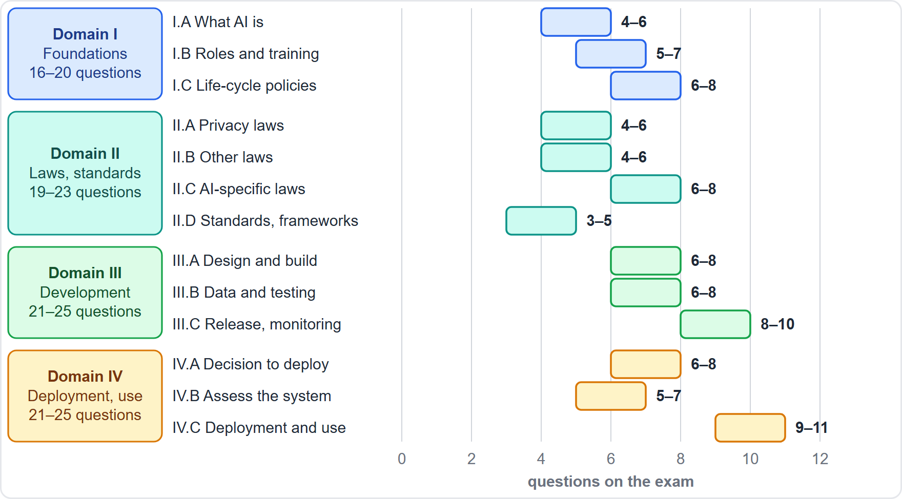
Four Domains, Thirteen Competencies
Module 0
Four domains: I foundations, II laws and standards, III governing development, IV governing deployment and use
13 competencies, each with a range of exam questions, and 58 performance indicators
Domain ranges: I 16 to 20, II 19 to 23, III 21 to 25, IV 21 to 25
The largest single competencies are IV.C (9 to 11) and III.C (8 to 10)
EXAM TIP The ranges show weight, not a promise. A competency with a small range can still decide a close result.
AIGP Exam Prep Masterclass | Certified AI Governance Professional
Module 0: Course Introduction and Exam Orientation
9 / 12
Notes:
The Body of Knowledge has four domains, thirteen competencies, and fifty-eight performance indicators. Domain one covers the foundations of A I governance. Domain two covers laws, standards and frameworks. Domain three covers governing development. Domain four covers governing deployment and use. On the chart, each bar shows the minimum and maximum number of questions for one competency. The domain ranges are sixteen to twenty, nineteen to twenty-three, twenty-one to twenty-five, and twenty-one to twenty-five. The two largest competencies are competency C of domain four, with nine to eleven questions, and competency C of domain three, with eight to ten. Exam tip: the ranges show weight, not a promise. A small competency can still decide a close result.

Slide 10
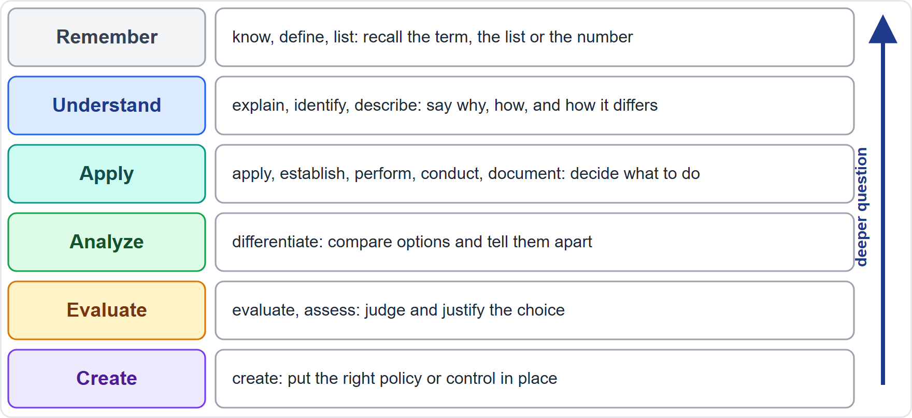
How the Verbs Set the Depth
Module 0
Every indicator starts with a verb, and the verb sets the depth of the question
Remember (know, define): recall the term, the list, the number
Understand (explain, identify): say why, how, and how it differs
Apply (apply, establish, perform, conduct, document): decide what to do in a situation
Analyze, Evaluate, Create (differentiate, assess, create): compare options and justify the choice
EXAM TIP In this course a scenario question may sit above its indicator's level, never below it.
AIGP Exam Prep Masterclass | Certified AI Governance Professional
Module 0: Course Introduction and Exam Orientation
10 / 12
Notes:
Every performance indicator starts with a verb, and the verb sets how deep the question goes. Remember verbs, such as know and define, ask you to recall a term, a list or a number. Understand verbs, such as explain and identify, ask why, how, and how one thing differs from another. Apply verbs, such as apply, establish, perform, conduct and document, ask what you would do in a situation. Analyze, evaluate and create verbs, such as differentiate, assess and create, ask you to compare options and justify your choice. Exam tip: in this course, a scenario question may sit above its indicator's level, never below it.

Slide 11
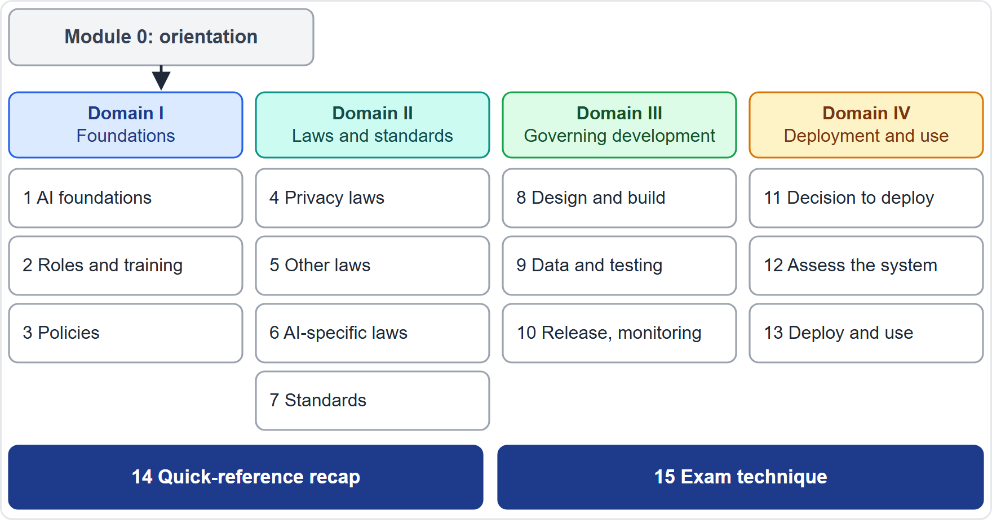
How This Course Works
Module 0
16 modules: this orientation, 13 content modules in IAPP's order, a quick-reference recap and an exam-technique module
Each content module has what you will learn, a Helios case check-in, Exam Tips, a recap and practice questions
About 30% of the questions are multi-select, as on the exam; there is no separate mock exam
Slide tags: Beyond the BoK (needed to answer, not in the BoK text), Dates (a date to know), Verify live (the law was still moving; shows an "as of" date)
AIGP Exam Prep Masterclass | Certified AI Governance Professional
Module 0: Course Introduction and Exam Orientation
11 / 12
Notes:
Here is how the course works. There are sixteen modules: this orientation, thirteen content modules that follow the I A P P's order, a quick-reference recap, and an exam-technique module. Each content module opens with what you will learn and a Helios case check-in. It teaches with slides and exam tips, closes with a recap, and ends with practice questions. About thirty percent of the questions are multi-select, as on the exam. There is no separate mock exam. Watch for three tags. Beyond the Body of Knowledge means you need the fact to answer, but the text does not state it. Dates marks a date to know. Verify live marks a law that was still moving, with an as-of date.

Slide 12
Your Study Plan and Ground Rules
Module 0
1
2
3
Work in order
IAPP advises at least 30 hours of study; study one module, then do its questions
Cover every indicator, because any listed topic can be asked
domains I to IV, then the recap and exam technique
4
This course is independent
5
It uses no IAPP training, practice questions or exam dumps, and it is educational, not legal advice
it is not affiliated with, endorsed by or sponsored by IAPP
EXAM TIP Before you book, read IAPP's current Study Guide and handbook. They outrank this course on every exam rule.
AIGP Exam Prep Masterclass | Certified AI Governance Professional
Module 0: Course Introduction and Exam Orientation
12 / 12
Notes:
Your study plan and the ground rules. The I A P P advises at least thirty hours of study. Study one module, then do its questions. Cover every indicator, because any listed topic can be asked. Work in order: domains one to four, then the recap and exam technique. This course is independent. It is not affiliated with, endorsed by or sponsored by the I A P P. It uses no I A P P training, no practice questions from the I A P P, and no exam dumps. It is educational, not legal advice. Exam tip: before you book, read the I A P P's current Study Guide and handbook. They outrank this course on every exam rule.

