Slide 1
Module 1: AI Foundations
What AI is, what can go wrong, and the principles that guide it
Domain I · Competency A · Indicators I.A.1 to I.A.4
AIGP Exam Prep Masterclass
Module 1 · Part 1
Notes:
Welcome to Module one: A I Foundations. This module covers domain one, competency A, of the Body of Knowledge. You will learn what A I is, what can go wrong with it, why it needs its own kind of governance, and the principles that guide responsible use. It is the vocabulary for everything that follows.

Slide 2
What You Will Learn
Part 1
Define AI and tell its main types apart
Separate an AI model, an AI system and a general-purpose AI model
Name the harms and risks AI poses to people, groups, organizations and society
Explain the characteristics that make AI need its own governance
Apply the common principles of responsible AI and see where they conflict
AIGP Exam Prep Masterclass | Certified AI Governance Professional
Module 1
2 / 28
Notes:
By the end of this module you will be able to do five things. Define A I and tell its main types apart. Separate an A I model, an A I system, and a general-purpose A I model. Name the harms and risks that A I poses to people, groups, organizations and society. Explain the characteristics that make A I need its own governance. And apply the common principles of responsible A I, including where they conflict.

Slide 3
Case Check-In: Two Kinds of AI at Helios
Part 1
CASE CHECK-IN · Helios
Lucia Moreno, Head of Talent Acquisition, owns the hiring tool: it predicts which applicants fit a role
Anika Berg, Customer Support director, owns the assistant: it generates answers to customer questions
Samira Haddad asks whether these are the same kind of AI, and what can go wrong with each
Your answers set the scope of the governance program
AIGP Exam Prep Masterclass | Certified AI Governance Professional
Module 1
3 / 28
Notes:
At Helios, two leaders own two different systems. Lucia Moreno, Head of Talent Acquisition, owns the hiring tool, which predicts which applicants fit a role. Anika Berg, the Customer Support director, owns the assistant, which generates answers to customer questions. Samira Haddad asks you whether these are the same kind of A I, and what can go wrong with each. Your answers will set the scope of the governance program.

Slide 4
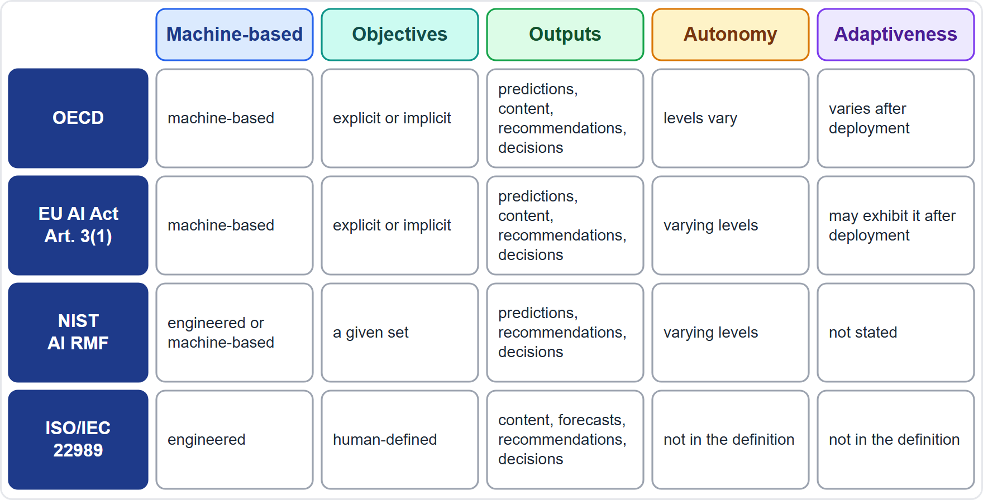
Defining AI: Four Sources, One Core
BEYOND THE BOK
Part 1
Core idea: a machine-based (engineered) system that, for given objectives, generates outputs such as predictions, content, recommendations or decisions
OECD (Organisation for Economic Co-operation and Development) and EU AI Act: objectives may be explicit or implicit; the system infers how to produce outputs from its input; levels of autonomy and adaptiveness vary (Article 3(1))
NIST (National Institute of Standards and Technology): adapted from the OECD and the International Organization for Standardization (ISO) wording; outputs influence real or virtual environments
ISO/IEC 22989: an engineered system for human-defined objectives (depth marked: from the standard's public summaries)
EXAM TIP The wording differs, but a question about the definition asks for the shared core: a system that generates outputs for objectives.
AIGP Exam Prep Masterclass | Certified AI Governance Professional
Module 1
4 / 28
Notes:
This is a beyond-the-Body-of-Knowledge slide. The Body of Knowledge asks for the generally accepted definitions, so here are four. The core idea is shared: a machine-based system that, for given objectives, generates outputs such as predictions, content, recommendations or decisions. The O E C D, short for Organisation for Economic Co-operation and Development, and the E U A I Act, in Article three, point one, add that objectives may be explicit or implicit, and that autonomy and adaptiveness vary. N I S T, the National Institute of Standards and Technology, adapts the same wording. The International Organization for Standardization, I S O, standard twenty-two nine eight nine, speaks of human-defined objectives; that depth comes from public summaries. Exam tip: expect the shared core.

Slide 5
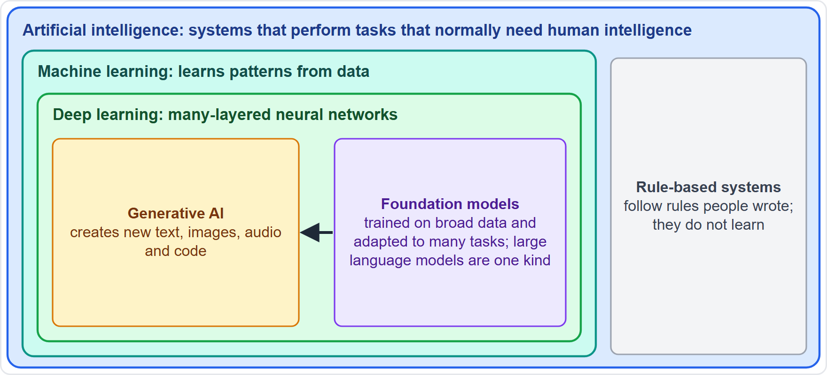
Types of AI: Nested Families
Part 1
AI is the broad field: systems that perform tasks that normally need human intelligence
Rule-based systems follow rules people wrote; they are AI in the broad sense but do not learn
Machine learning learns patterns from data instead of following written rules
Deep learning is machine learning with many-layered neural networks, behind most vision and language models
Generative AI creates new content; many such systems are foundation models
EXAM TIP If a question asks which is the broadest term, the answer is AI; machine learning is one way of building it.
AIGP Exam Prep Masterclass | Certified AI Governance Professional
Module 1
5 / 28
Notes:
The types of A I nest like boxes. A I is the broad field. Rule-based systems follow rules that people wrote, so they do not learn. Machine learning learns patterns from data instead. Deep learning is machine learning with many-layered neural networks, and it sits behind most vision and language models. Generative A I creates new content, and many generative systems are foundation models. Exam tip: if a question asks for the broadest term, the answer is A I. Machine learning is one way of building it.

Slide 6
How Machines Learn: Three Approaches
Part 1
Approach | Learns from | Typical output | Example
Supervised | labeled examples | a label or a value | scoring an application as a fit or not a fit
Unsupervised | unlabeled data | groups, patterns, outliers | grouping customers; spotting unusual transactions
Reinforcement | rewards for actions | a way of acting | a robot or game player improving by trial
Self-supervised learning builds labels from the data itself; it trains many large language models
Labels cost effort and can carry human bias, which is why they matter to governance
EXAM TIP Labels point to supervised learning, no labels to unsupervised, rewards to reinforcement.
AIGP Exam Prep Masterclass | Certified AI Governance Professional
Module 1
6 / 28
Notes:
There are three classic ways a machine learns. Supervised learning uses labeled examples and outputs a label or a value, such as scoring an application as a fit or not. Unsupervised learning uses unlabeled data to find groups, patterns or outliers. Reinforcement learning learns from rewards for its actions, like a robot improving by trial. Self-supervised learning builds its own labels from the data, and it trains many large language models. Exam tip: labels mean supervised, no labels mean unsupervised, rewards mean reinforcement.

Slide 7
Predictive, Generative and Agentic AI
Part 1
Kind | What it does | Helios example
Predictive | scores, classifies or forecasts from past data | the hiring tool ranks applicants
Generative | creates new text, images, audio or code | the assistant writes answers
Agentic | pursues a goal by planning and acting with tools, with few human steps | a proposed function that books meetings itself
Narrow AI is built for specific tasks; artificial general intelligence would match people across tasks and is a goal, not what today's laws regulate
More autonomy means more need for human oversight (modules 10 and 13)
EXAM TIP Do not confuse general-purpose AI (a legal term for breadth of use) with general AI (human-level ability).
AIGP Exam Prep Masterclass | Certified AI Governance Professional
Module 1
7 / 28
Notes:
Now three kinds by what the system does. Predictive A I scores, classifies or forecasts from past data, like the Helios hiring tool. Generative A I creates new text, images, audio or code, like the Helios assistant. Agentic A I pursues a goal by planning and acting with tools, with few human steps. Narrow A I is built for specific tasks. Artificial general intelligence would match people across tasks, and it is a goal, not what today's laws regulate. Exam tip: general-purpose A I is a legal term for breadth of use. It is not general A I.

Slide 8
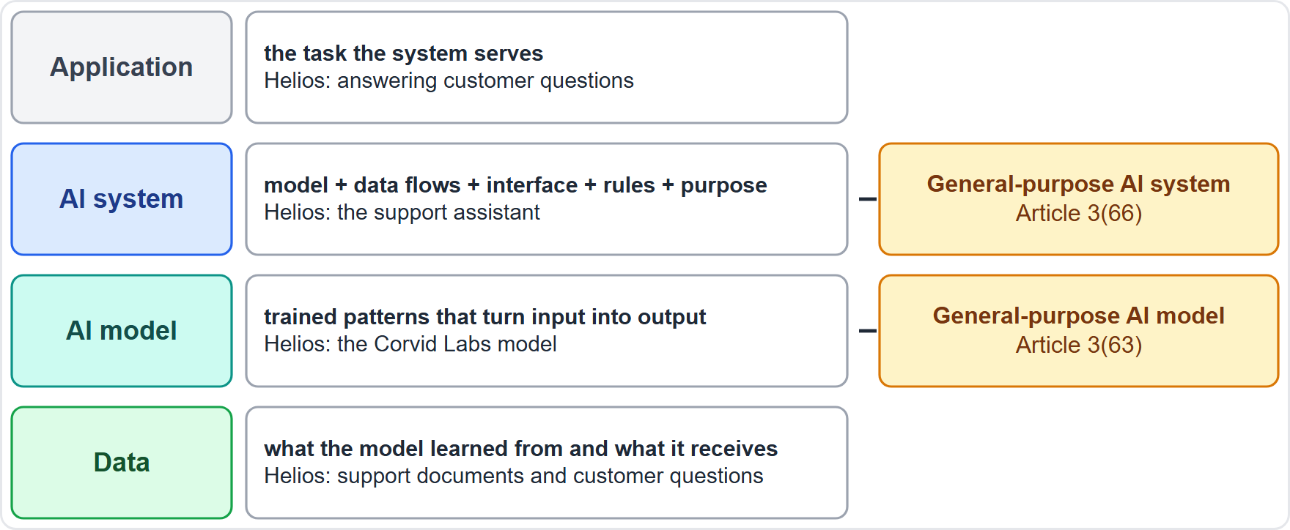
AI Model, AI System, General-Purpose AI
BEYOND THE BOK
Part 1
An AI model is the trained component: the learned patterns that turn input into output
An AI system puts a model to work with data flows, an interface, rules and a purpose
General-purpose AI model (Article 3(63)): shows significant generality, is competent at a wide range of distinct tasks, and can be built into many downstream systems
General-purpose AI system (Article 3(66)): a system based on such a model that can serve a variety of purposes
Helios: the Corvid Labs model is a general-purpose model; the support assistant built on it is an AI system
EXAM TIP Law and standards often attach duties to the system, and some, such as the general-purpose AI rules in module 6, to the model.
AIGP Exam Prep Masterclass | Certified AI Governance Professional
Module 1
8 / 28
Notes:
This is a beyond-the-Body-of-Knowledge slide. An A I model is the trained component, the learned patterns that turn input into output. An A I system puts a model to work, with data flows, an interface, rules and a purpose. Under Article three, point sixty-three, of the E U A I Act, a general-purpose A I model shows significant generality, performs a wide range of distinct tasks competently, and can be built into many downstream systems. Under Article three, point sixty-six, a general-purpose A I system is a system based on such a model. At Helios, the Corvid Labs model is general-purpose, and the support assistant is an A I system.

Slide 9
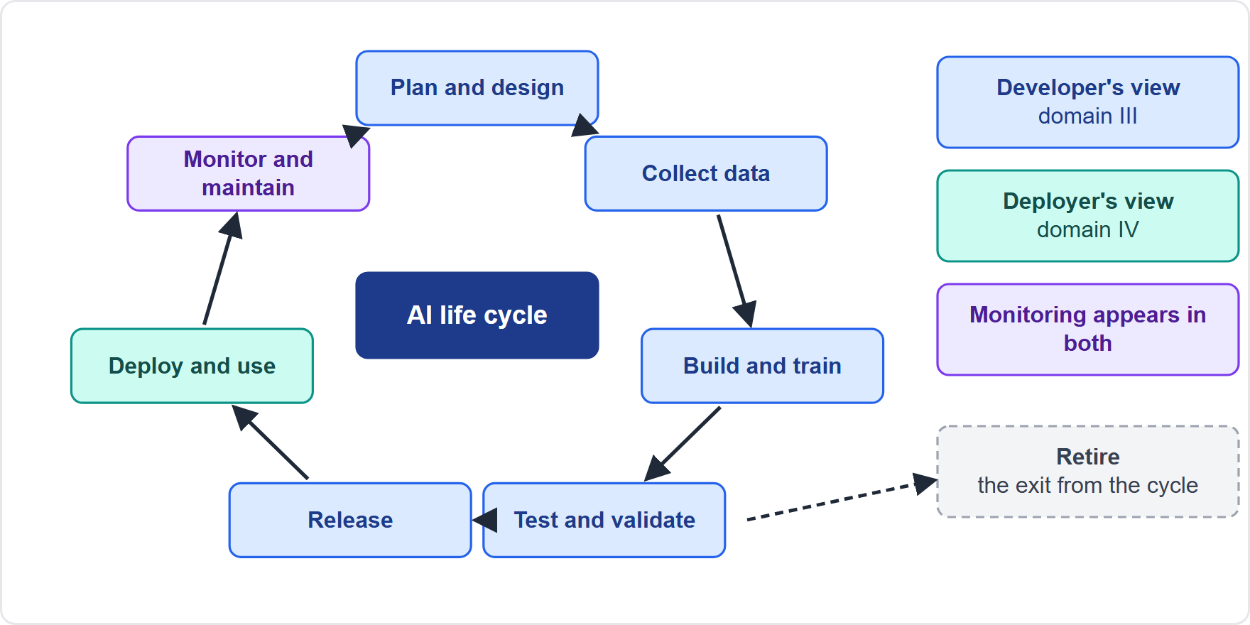
The AI Life Cycle Frames the Whole Exam
Part 1
Stages: plan and design, collect data, build and train, test and validate, release, deploy and use, monitor and maintain, retire
Domain III governs development as the developer sees it; domain IV governs deployment and use as the deployer sees it
Risks and duties differ by stage, so policies are written stage by stage (module 3)
Governance does not stop at release: monitoring and retirement belong to the life cycle
EXAM TIP When a question names a stage, ask who acts at that stage: the developer or the deployer.
AIGP Exam Prep Masterclass | Certified AI Governance Professional
Module 1
9 / 28
Notes:
The A I life cycle frames the whole exam. The stages are: plan and design, collect data, build and train, test and validate, release, deploy and use, monitor and maintain, and finally retire. Domain three governs development as the developer sees it. Domain four governs deployment and use as the deployer sees it. Risks and duties differ by stage, so policies are written stage by stage. Governance does not stop at release. Exam tip: when a question names a stage, ask who acts at that stage.

Slide 10
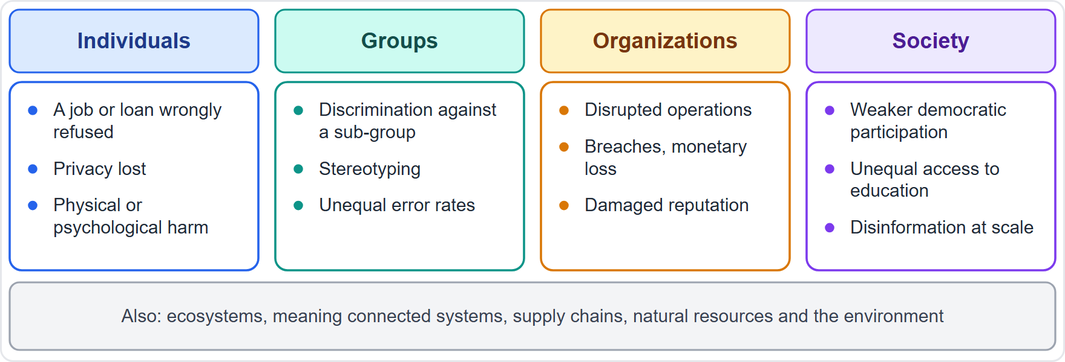
Who Gets Hurt: People, Groups, Organizations, Society
Part 1
Individuals: a wrongly rejected application, loss of privacy, physical or psychological harm, lost economic opportunity
Groups: discrimination against a sub-group, stereotyping
Organizations: disrupted operations, security breaches, monetary loss, damaged reputation
Society: weakened democratic participation, unequal access to education, disinformation at scale
NIST also counts harm to ecosystems: connected systems, supply chains, natural resources and the environment
EXAM TIP Name who bears the harm first; the category follows from the victim.
AIGP Exam Prep Masterclass | Certified AI Governance Professional
Module 1
10 / 28
Notes:
The Body of Knowledge asks you to identify harms to individuals, groups, organizations and society. Individuals suffer a wrongly rejected application, lost privacy, or physical or psychological harm. Groups suffer discrimination or stereotyping. Organizations suffer disrupted operations, security breaches, monetary loss and damaged reputation. Society suffers weakened democratic participation, unequal access to education, and disinformation at scale. N I S T also counts harm to ecosystems, such as supply chains and the environment. Exam tip: name who bears the harm first. The category follows from the victim.

Slide 11
Types of Risk: Misalignment, Ethics and Bias, Complexity and Scale
Part 1
Risk type | What it means | Helios example
Misalignment with objectives | the system optimizes something other than what people intended | the hiring tool learns to favor the style of past hires, not job performance
Ethics and bias risk | unfair, discriminatory or intrusive outcomes | one group of applicants scores lower for reasons unrelated to the job
Complexity and scalability | the system is hard to understand and test, and one flaw repeats at volume | the same flaw touches every one of about 12,000 applications a quarter
EXAM TIP Misalignment means the objective the system really pursues differs from the objective the organization meant to give it.
AIGP Exam Prep Masterclass | Certified AI Governance Professional
Module 1
11 / 28
Notes:
The Body of Knowledge names three types of risk. Misalignment with objectives means the system optimizes something other than what people intended. For example, the hiring tool might learn to favor the style of past hires instead of job performance. Ethics and bias risk means unfair, discriminatory or intrusive outcomes, such as one group of applicants scoring lower for reasons unrelated to the job. Complexity and scalability means the system is hard to understand, and a single flaw repeats across about twelve thousand applications a quarter. Exam tip: misalignment is a gap between intended and actual objectives.

Slide 12
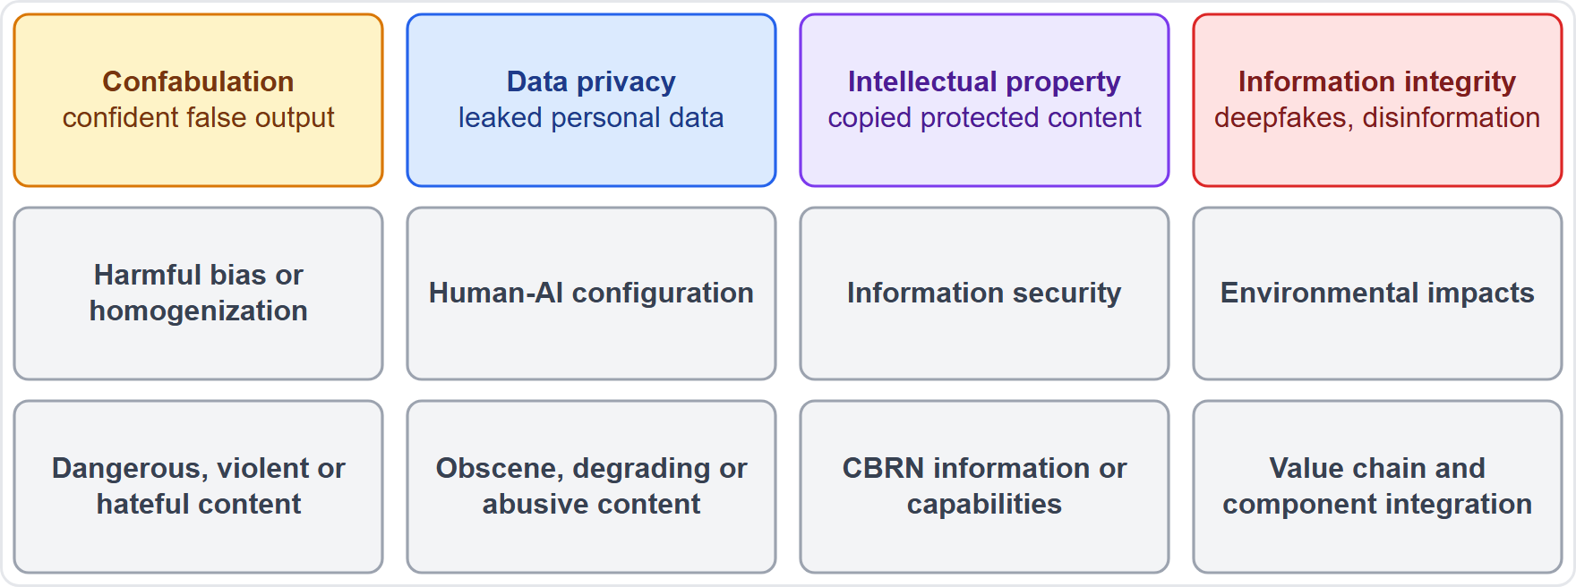
Generative AI Adds Its Own Risks
BEYOND THE BOK
Part 1
NIST's generative-AI profile names twelve risks unique to or made worse by generative AI
Confabulation: confident, false output (often called hallucination)
Data privacy: leakage or unauthorized use of personal or sensitive data
Intellectual property: easier copying or replication of protected content
Information integrity: deepfakes and disinformation at scale
The rest include harmful bias, over-reliance on the system, security, environmental cost and opaque supply chains
EXAM TIP Hallucination is the popular name; the NIST term is confabulation.
AIGP Exam Prep Masterclass | Certified AI Governance Professional
Module 1
12 / 28
Notes:
This is a beyond-the-Body-of-Knowledge slide. The N I S T generative A I profile names twelve risks that are unique to, or made worse by, generative A I. Recognize four on sight. Confabulation is confident, false output, often called hallucination. Data privacy is leakage or unauthorized use of personal or sensitive data. Intellectual property is easier copying of protected content. Information integrity covers deepfakes and disinformation at scale. The rest include harmful bias, over-reliance, security, environmental cost and opaque supply chains. Exam tip: hallucination is the popular name. The N I S T term is confabulation.

Slide 13
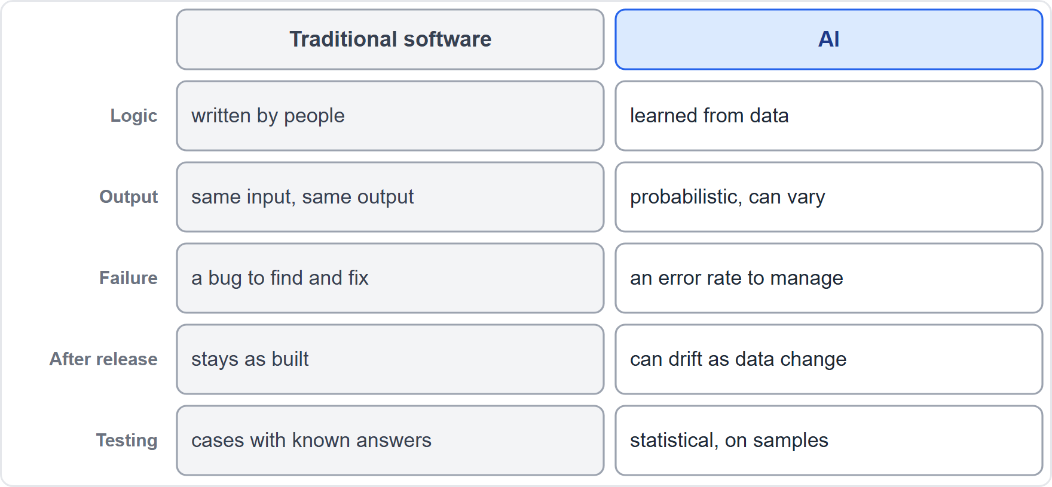
Why AI Needs Its Own Governance Approach
Part 1
Traditional software: logic written by people; the same input gives the same output
AI: patterns learned from data; outputs are probabilities and can vary
A software failure is a bug to find and fix; an AI failure is an error rate to manage
AI behavior can drift as data change, so maintenance never ends
Testing is statistical, on samples, because no checklist can cover every input
EXAM TIP Deterministic versus probabilistic output is the contrast the BoK itself names.
AIGP Exam Prep Masterclass | Certified AI Governance Professional
Module 1
13 / 28
Notes:
Why does A I need its own governance approach? Traditional software follows logic that people wrote, so the same input gives the same output. A I learns patterns from data, so its outputs are probabilities and can vary. A software failure is a bug to find and fix. An A I failure is an error rate to manage. A I behavior can drift as the data change, so maintenance never ends. And testing is statistical, run on samples. Exam tip: deterministic versus probabilistic output is the contrast the Body of Knowledge itself names.

Slide 14
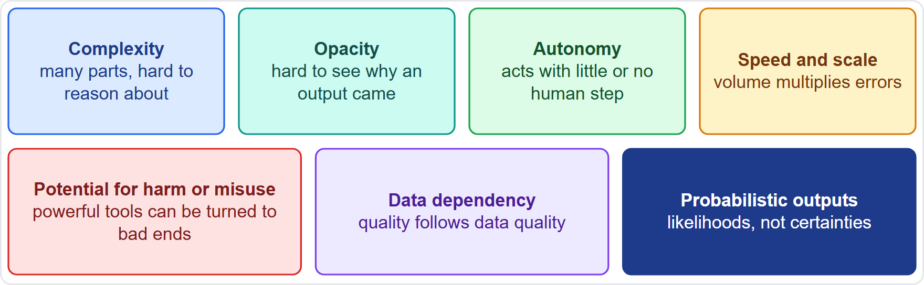
Seven Characteristics That Change Governance
Part 1
Complexity: many components and parameters, hard to reason about
Opacity: hard to see why a given output was produced
Autonomy: acts with little or no human step
Speed and scale: decisions in volume, so errors multiply
Potential for harm or misuse: powerful tools can be turned to bad ends
Data dependency: system quality follows data quality
Probabilistic outputs: likelihoods, not certainties
EXAM TIP A question may give a symptom and ask for the characteristic; match the symptom to the one-line meaning.
AIGP Exam Prep Masterclass | Certified AI Governance Professional
Module 1
14 / 28
Notes:
The Body of Knowledge lists seven characteristics that call for a comprehensive approach. Complexity: many components, hard to reason about. Opacity: hard to see why an output was produced. Autonomy: it acts with little or no human step. Speed and scale: decisions come in volume, so errors multiply. Potential for harm or misuse: powerful tools can be turned to bad ends. Data dependency: system quality follows data quality. And probabilistic outputs: likelihoods, not certainties. Exam tip: a question may give a symptom and ask for the characteristic. Match the symptom to the meaning.

Slide 15
From Characteristic to Governance Response
Part 1
Characteristic | What governance adds
Complexity | documentation, expert review, staged testing
Opacity | explainability methods, model documentation, disclosure
Autonomy | human oversight, limits on what the system may do
Speed and scale | monitoring, thresholds, a way to stop the system
Potential for harm or misuse | risk assessment, use restrictions, access control
Data dependency | data governance, quality and provenance checks
Probabilistic outputs | error-rate targets, confidence information, review of edge cases
EXAM TIP The governance response follows from the characteristic: opacity calls for explanation, autonomy for oversight.
AIGP Exam Prep Masterclass | Certified AI Governance Professional
Module 1
15 / 28
Notes:
Each characteristic points to a governance response. Complexity calls for documentation, expert review and staged testing. Opacity calls for explainability methods, model documentation and disclosure. Autonomy calls for human oversight and limits on what the system may do. Speed and scale call for monitoring, thresholds, and a way to stop the system. Potential for harm or misuse calls for risk assessment, use restrictions and access control. Data dependency calls for data governance. Probabilistic outputs call for error-rate targets and review of edge cases. Exam tip: opacity calls for explanation, autonomy for oversight.

Slide 16
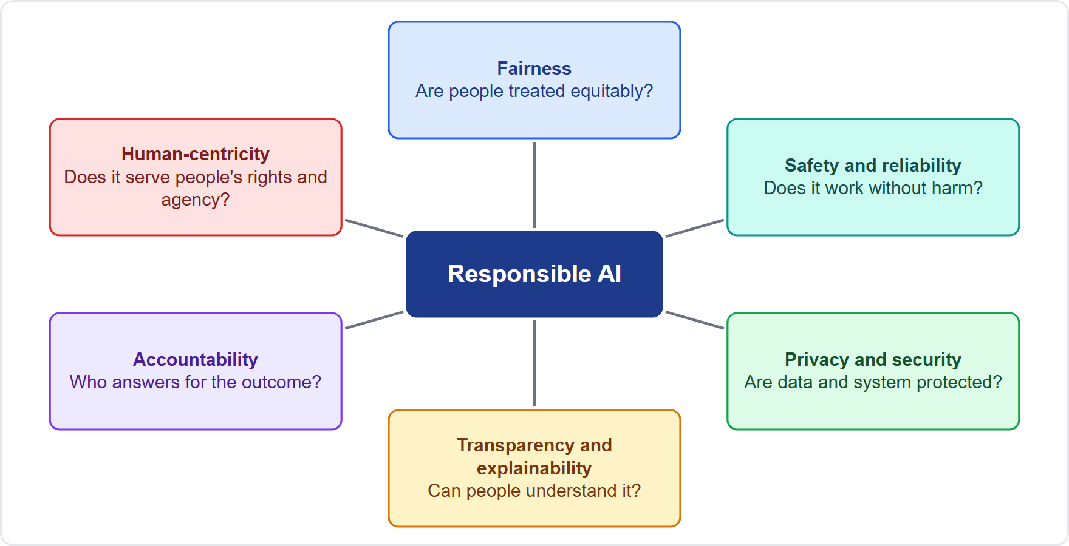
Responsible AI: The Common Principles
BEYOND THE BOK
Part 2
Fairness: are people treated equitably?
Safety and reliability: does it work as intended without harm?
Privacy and security: are people's data and the system protected?
Transparency and explainability: can people see and understand it?
Accountability: who answers for the outcome?
Human-centricity: does it serve human rights, agency and well-being?
Sources use different lists (the OECD five principles, the EU's seven ethical principles in Recital 27, NIST's seven characteristics) but overlap heavily
EXAM TIP Learn the common core, not one source's list; the BoK asks for the principles that recur.
AIGP Exam Prep Masterclass | Certified AI Governance Professional
Module 1
16 / 28
Notes:
This is a beyond-the-Body-of-Knowledge slide. Six principles recur. Fairness: are people treated equitably? Safety and reliability: does it work as intended without harm? Privacy and security: are data and the system protected? Transparency and explainability: can people see and understand it? Accountability: who answers for the outcome? And human-centricity: does it serve human rights, agency and well-being? Sources use different lists: the O E C D has five principles, the E U has seven ethical principles in Recital twenty-seven, and N I S T has seven characteristics. They overlap heavily. Exam tip: learn the common core.

Slide 17
Fairness and the Kinds of Bias
BEYOND THE BOK
Part 2
Kind of bias | Where it comes from | Helios example
Systemic | institutions, norms and society, reflected in data and processes | past hiring favored some groups, and old résumés carry that pattern
Computational and statistical | non-representative samples, flawed measurement or modeling | training data hold few applicants from a new region
Human-cognitive | how people read and use AI output | recruiters accept the score without question (automation bias)
NIST names these three categories; each can occur without any intent to discriminate
Removing bias does not by itself make a system fair: fairness differs across cultures and uses
Test fairness for the context, then document the choice
EXAM TIP Match the example to the source: society and process is systemic, unrepresentative data is statistical, people over-trusting output is cognitive.
AIGP Exam Prep Masterclass | Certified AI Governance Professional
Module 1
17 / 28
Notes:
This is a beyond-the-Body-of-Knowledge slide. N I S T names three categories of bias. Systemic bias comes from institutions, norms and society, and it shows up in data and processes; old résumés can carry the pattern of past hiring. Computational and statistical bias comes from non-representative samples or flawed modeling. Human-cognitive bias comes from how people read and use A I output, such as recruiters accepting a score without question. Each can occur with no intent to discriminate, and removing bias does not by itself make a system fair. Exam tip: match the example to the source.

Slide 18
Safety, Reliability, Privacy and Security
Part 2
Safety: the system does not endanger people, property or the environment, in intended use or in foreseeable misuse
Reliability: it performs as intended and consistently, including on inputs it did not see in training (robustness)
Privacy: people keep control of their personal data; collect and infer only what is needed (AI can infer private facts)
Security: the system, model and data are protected from attack, theft and misuse
The pairs overlap: an insecure model is also unreliable, and a privacy leak can become a security incident
EXAM TIP Safety and reliability ask whether it works without harm; privacy and security ask whether the data and the system are protected.
AIGP Exam Prep Masterclass | Certified AI Governance Professional
Module 1
18 / 28
Notes:
Safety means the system does not endanger people, property or the environment, in intended use or foreseeable misuse. Reliability means it performs as intended and consistently, including on inputs it did not see in training. Privacy means people keep control of their personal data, and the system collects and infers only what is needed. A I can infer private facts. Security means the system, model and data are protected from attack, theft and misuse. The pairs overlap: an insecure model is also unreliable. Exam tip: safety and reliability ask whether it works without harm.

Slide 19
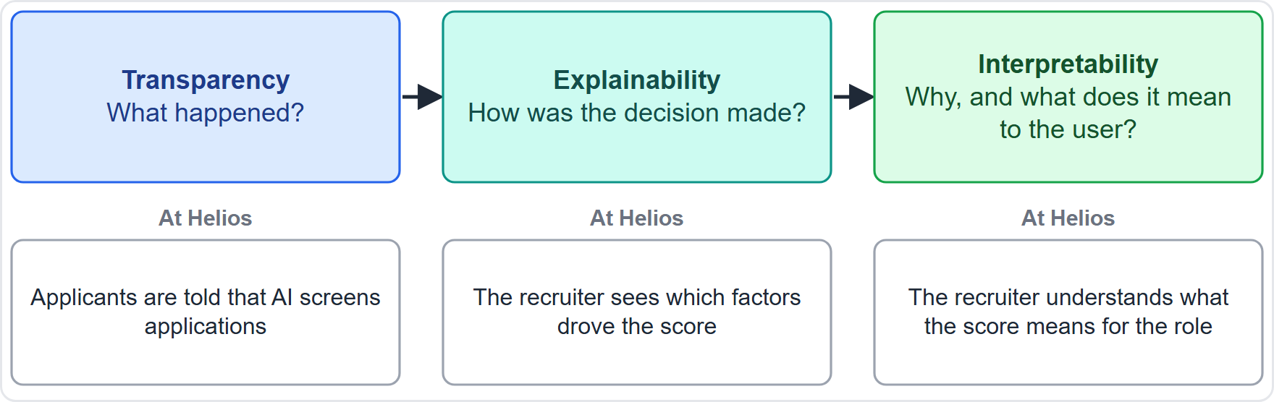
Transparency, Explainability and Interpretability
Part 2
Transparency: what happened in the system, and what information about it is available
Explainability: how a decision was made, the mechanisms behind the operation
Interpretability: why, and what the output means in its context for the user
The three support each other; risk from poor explanation is managed by describing how the system works for the user's role and skill
Helios: applicants are told AI is used (transparency); the recruiter sees which factors drove a score (explainability); the recruiter understands what the score means for the role (interpretability)
EXAM TIP What happened, how, why: that order is transparency, explainability, interpretability.
AIGP Exam Prep Masterclass | Certified AI Governance Professional
Module 1
19 / 28
Notes:
Three related words, and the exam can separate them. According to N I S T, transparency tells what happened in the system. Explainability tells how a decision was made. Interpretability tells why, and what the output means in context for the user. They support each other. At Helios, applicants are told that A I is used: that is transparency. The recruiter sees which factors drove a score: that is explainability. The recruiter understands what the score means for the role: that is interpretability. Exam tip: what happened, how, why.

Slide 20
Accountability and Human-Centricity
Part 2
Accountability: named people answer for each stage and each outcome; it is not left to the model or the vendor
It needs documentation, decision records, escalation paths and the ability to audit
Human-centricity: AI serves people and respects human rights, agency and well-being
Human oversight is often described in three forms: a person decides (in the loop), monitors and can intervene (on the loop) or controls whether and how the system is used (in command)
Helios: a recruiter reviews every rejection the tool recommends, and Samira Haddad is the accountable executive
EXAM TIP A vendor contract can share tasks, but it does not move accountability away from the organization that uses the system.
AIGP Exam Prep Masterclass | Certified AI Governance Professional
Module 1
20 / 28
Notes:
Accountability means named people answer for each stage and each outcome. It is not left to the model or the vendor. It needs documentation, decision records, escalation paths and the ability to audit. Human-centricity means A I serves people and respects human rights, agency and well-being. Human oversight is often described in three forms: a person decides, in the loop; a person monitors and can intervene, on the loop; or a person controls whether and how the system is used, in command. At Helios, a recruiter reviews every rejection the tool recommends. Exam tip: a vendor contract does not move accountability away.

Slide 21
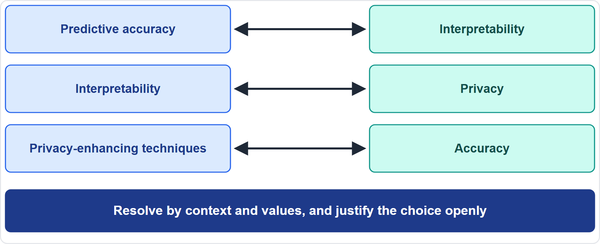
When Principles Pull Apart: Trade-offs
BEYOND THE BOK
Part 2
NIST gives three examples: predictive accuracy versus interpretability, interpretability versus privacy, and privacy-enhancing techniques versus accuracy when data are sparse
Analysis can show that a trade-off exists, not how to resolve it
The resolution depends on the context and values, and should be transparent and justified
Helios: a more accurate hiring model that cannot explain its ranking against a simpler model that can
EXAM TIP The right answer to a trade-off question is rarely to always pick one principle; it is to decide by context and document why.
AIGP Exam Prep Masterclass | Certified AI Governance Professional
Module 1
21 / 28
Notes:
This is a beyond-the-Body-of-Knowledge slide. Principles can pull against each other. N I S T gives three examples: predictive accuracy against interpretability, interpretability against privacy, and privacy-enhancing techniques against accuracy when data are sparse. Analysis can show that a trade-off exists. It cannot tell you how to resolve it. That depends on the context and the values at stake, and the resolution should be transparent and justified. At Helios, a more accurate model that cannot explain itself faces a simpler one that can. Exam tip: the right answer is to decide by context and document why.

Slide 22
Module Recap
Part 2
1
AI
2
Types
3
Harms
a machine-based system that generates outputs for objectives; model, system and general-purpose model are different things
machine learning, deep learning, generative and agentic AI; supervised, unsupervised and reinforcement learning
to individuals, groups, organizations and society; plus generative-AI risks
4
Why different
5
Principles
seven characteristics, from opacity and autonomy to data dependency and probabilistic output
six that recur (fairness, accountability, human-centricity, transparency and explainability, privacy and security, safety and reliability); they can conflict
AIGP Exam Prep Masterclass | Certified AI Governance Professional
Module 1
22 / 28
Notes:
Let us recap. A I is a machine-based system that generates outputs for objectives, and a model, a system and a general-purpose model are different things. The types: machine learning, deep learning, generative and agentic A I, with supervised, unsupervised and reinforcement learning. The harms fall on individuals, groups, organizations and society. A I needs its own governance because of seven characteristics. And the principles, fairness, safety, privacy, transparency, accountability and human-centricity, can conflict.

Slide 23
Practice Question 1
Part 2
Q1
Which feature do the OECD, EU AI Act and NIST definitions of an AI system have in common?
A
The system must learn its own rules from labeled training examples supplied by people
B
The system generates outputs, such as predictions or decisions, for given objectives
C
The system must make its final decisions without a person reviewing them afterwards
D
The system must be offered for sale as a software product in a commercial market
AIGP Exam Prep Masterclass | Certified AI Governance Professional
Module 1
23 / 28
Notes:
Question one. Which feature do the O E C D, E U A I Act and N I S T definitions of an A I system have in common? The four options are on the screen. [PAUSE 12] The answer is B. All three describe a machine-based or engineered system that generates outputs for objectives. None requires labeled training, full autonomy or a market sale.

Slide 24
Practice Question 2
Part 2
Q2
Helios finds that its hiring tool gives lower scores to women than to comparable men. Which TWO harms to people does this show? (Select TWO.)
A
Harm to an ecosystem, through heavy use of computing resources
B
Harm to an individual, through lost economic opportunity
C
Harm to an organization, through disrupted supply chains
D
Harm to a group, through discrimination against a sub-group
E
Harm to society, through weakened democratic participation
AIGP Exam Prep Masterclass | Certified AI Governance Professional
Module 1
24 / 28
Notes:
Question two. Helios finds that its hiring tool gives lower scores to women than to comparable men. Which two harms to people does this show? Select two. The five options are on the screen. [PAUSE 15] The answers are B and D. A woman scored down loses a job opportunity, which is harm to an individual, and the pattern is discrimination against a group. The other harms are not shown by the facts.

Slide 25
Practice Question 3
Part 2
Q3
A team proposes governing a new machine-learning model like any other software release: test it once against a checklist, then leave it unchanged. Which characteristic of AI makes this approach insufficient?
A
AI source code is harder to store and version than other software, so a separate policy is required
B
Testing before release is too slow for AI, so teams usually skip it and rely on user feedback
C
Its outputs are probabilistic and its data can change after release
D
AI always needs a human to approve every single output before anyone uses it
AIGP Exam Prep Masterclass | Certified AI Governance Professional
Module 1
25 / 28
Notes:
Question three. A team proposes governing a new machine-learning model like any other software release: test it once against a checklist, then leave it unchanged. Which characteristic of A I makes this insufficient? The four options are on the screen. [PAUSE 12] The answer is C. Outputs are probabilistic and data can drift, so behavior can change after release, and testing and monitoring must continue.

Slide 26
Practice Question 4
Part 2
Q4
According to the NIST AI Risk Management Framework (RMF), which statement correctly separates transparency, explainability and interpretability?
A
Transparency covers what happened, explainability how it was decided, interpretability why and what it means
B
Transparency covers why a decision was made, explainability what happened, and interpretability how it was reached
C
Transparency covers how a decision was reached, explainability why it was made, and interpretability what happened
D
The three terms are interchangeable, because each one describes the same property of the system as a whole
AIGP Exam Prep Masterclass | Certified AI Governance Professional
Module 1
26 / 28
Notes:
Question four. According to the N I S T A I Risk Management Framework, or R M F, which statement correctly separates transparency, explainability and interpretability? The four options are on the screen. [PAUSE 12] The answer is A. Transparency tells what happened, explainability tells how a decision was made, and interpretability tells why and what it means to the user. The other orders swap the questions.

Slide 27
Practice Question 5
Part 2
Q5
Veridex offers a more accurate ranking model that cannot show why it ranks candidates as it does, and a simpler model that can. Lucia Moreno asks what to do. What is the best answer?
A
Choose the more accurate model, because predictive performance is the principle that matters most in practice
B
Choose the simpler model, because fairness requires accepting the less accurate option in hiring
C
Choose whichever model the vendor has certified, because certification removes the trade-off
D
Weigh accuracy against interpretability in this context, then document why you chose
AIGP Exam Prep Masterclass | Certified AI Governance Professional
Module 1
27 / 28
Notes:
Question five. Veridex offers a more accurate ranking model that cannot show why it ranks candidates as it does, and a simpler model that can. Lucia Moreno asks what to do. What is the best answer? The four options are on the screen. [PAUSE 12] The answer is D. Accuracy and interpretability can trade off. Weigh them for this context, then document and justify the choice.

Slide 28
Answers at a Glance
Part 2
Question | Answer | Why
Q1 | B | The shared core: outputs generated for objectives
Q2 | B, D | Harm to an individual's opportunity and to a group
Q3 | C | Probabilistic, data-dependent behavior needs ongoing testing
Q4 | A | What happened, how, why
Q5 | D | Weigh the trade-off by context and justify it
AIGP Exam Prep Masterclass | Certified AI Governance Professional
Module 1
28 / 28
Notes:
Here are all five answers. Question one: B. Question two: B and D. Question three: C. Question four: A. Question five: D. That completes Module one. Next, Module two covers governance roles, training and approaches: who does what in an A I governance program.

