Slide 1
Module 2: Governance Roles, Training and Approaches
Who does what, who needs to know what, and how the approach fits the organization
Domain I · Competency B · Indicators I.B.1 to I.B.5
AIGP Exam Prep Masterclass
Module 2 · Part 1
Notes:
Welcome to Module two: Governance Roles, Training and Approaches. This module covers competency B of domain one. It answers four practical questions. Who does what in an A I governance program? Who needs to be trained, and on what? How should the approach fit the organization? And how do developers, providers, deployers and users differ?

Slide 2
What You Will Learn
Part 1
Define the roles and responsibilities of AI governance stakeholders
Build cross-functional collaboration into the program
Create a training and awareness program for every stakeholder group
Differentiate governance approaches by the organization's size, maturity, sector and risk tolerance
Tell developers, providers, deployers and users apart by their governance duties
AIGP Exam Prep Masterclass | Certified AI Governance Professional
Module 2: Governance Roles, Training and Approaches
2 / 25
Notes:
By the end of this module you will be able to do five things. Define the roles and responsibilities of A I governance stakeholders. Build cross-functional collaboration into the program. Create a training and awareness program for every stakeholder group. Differentiate governance approaches by size, maturity, sector and risk tolerance. And tell developers, providers, deployers and users apart by their governance duties.

Slide 3
Case Check-In: Who Owns What at Helios?
Part 1
CASE CHECK-IN · Helios
Samira Haddad, the Chief AI Officer, must stand up an AI governance committee
Lucia Moreno's recruiters will use the hiring tool every day and have never been trained on it
Veridex supplies the tool; Helios uses it in its own hiring
You must say who decides, who advises, who checks and who is trained
AIGP Exam Prep Masterclass | Certified AI Governance Professional
Module 2: Governance Roles, Training and Approaches
3 / 25
Notes:
At Helios, Samira Haddad, the Chief A I Officer, must stand up an A I governance committee. Meanwhile, Lucia Moreno's recruiters will use the hiring tool every day, and nobody has trained them on it. Veridex supplies the tool, and Helios uses it in its own hiring. Your job is to say who decides, who advises, who checks, and who gets trained.

Slide 4
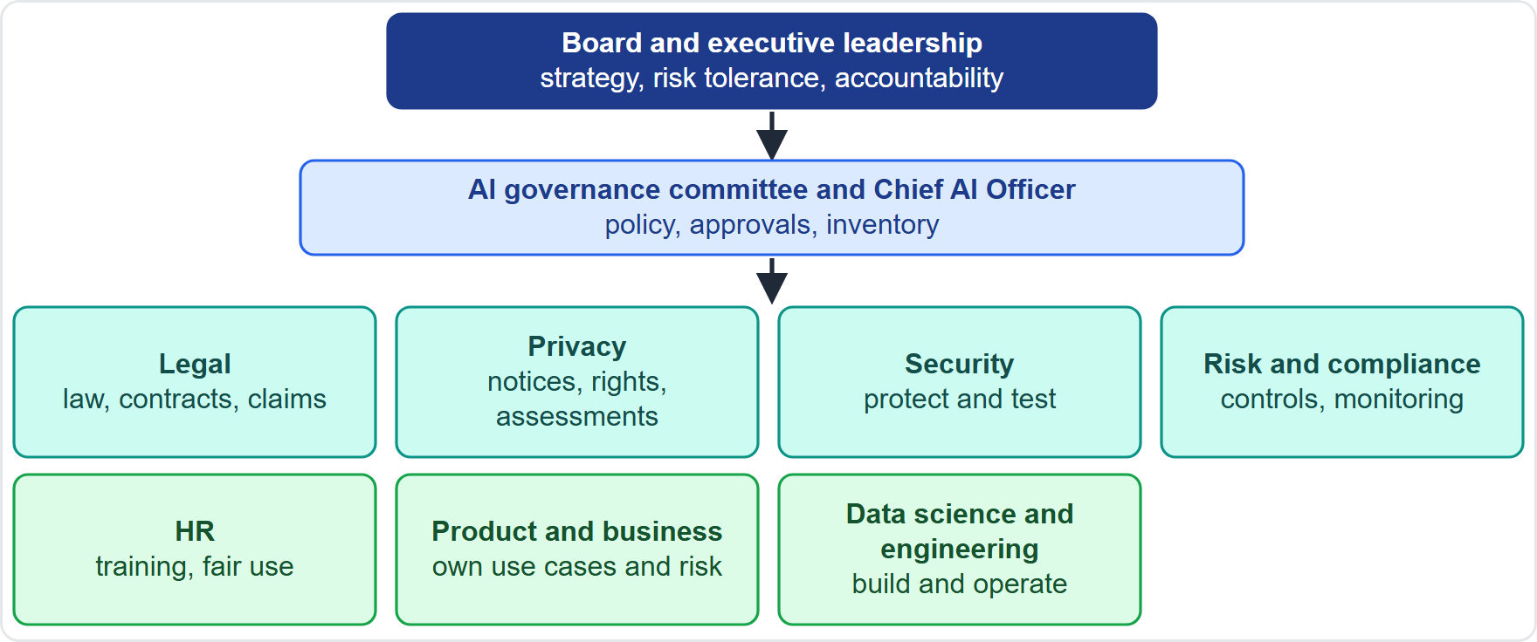
Who Does What in AI Governance
Part 1
Board and executives: set strategy and risk tolerance, provide resources and take responsibility for decisions about AI risk (NIST GOVERN 2.3)
AI governance committee and Chief AI Officer: set policy, approve high-risk use cases, track the inventory
Legal and privacy: interpret laws, run privacy and impact assessments
Security and risk: test and monitor threats, set the risk process
HR, product and business owners, data science: train people, own use cases, build and operate systems
EXAM TIP Read a role question as a duty question: who decides, who advises, who builds, who checks.
AIGP Exam Prep Masterclass | Certified AI Governance Professional
Module 2: Governance Roles, Training and Approaches
4 / 25
Notes:
Start with the roles. The board and executives set strategy and risk tolerance, provide resources, and take responsibility for decisions about A I risk. That is N I S T subcategory Govern two point three. The A I governance committee and the Chief A I Officer set policy, approve high-risk use cases and track the inventory. Legal and privacy interpret laws and run impact assessments. Security and risk test threats and run the risk process. H R, business owners and data science train people, own use cases, and build the systems. Exam tip: read a role question as a duty question.

Slide 5
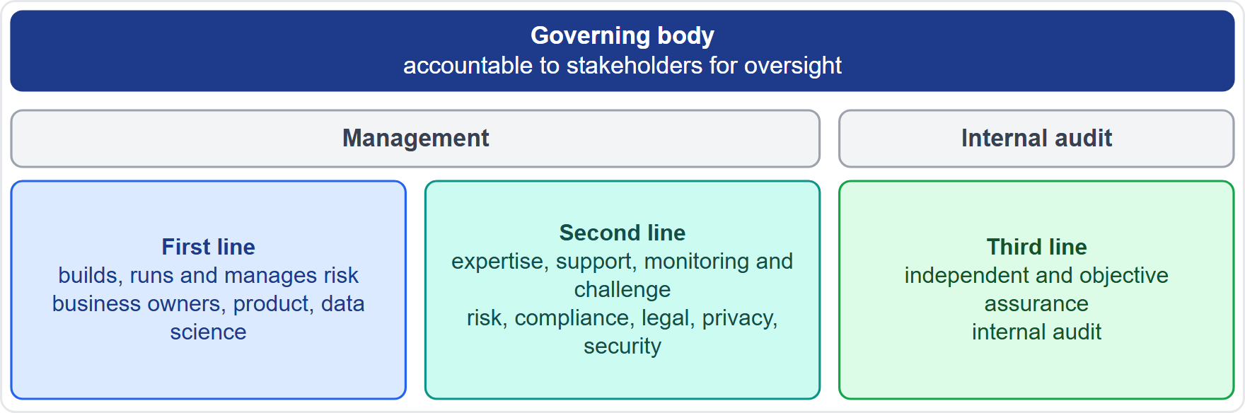
The Three Lines Applied to AI
BEYOND THE BOK
Part 1
Governing body: accountable to stakeholders; ensures structures and processes for effective governance
First line: delivers the product or service and manages risk: business owners, product teams, data science
Second line: expertise, support, monitoring and challenge: risk, compliance, legal, privacy, security, the AI governance office
Third line: internal audit, independent and objective assurance to the governing body
First and second line roles can be blended or separated; the third line stays independent
EXAM TIP Independent assurance means internal audit, not the committee that wrote the policy.
AIGP Exam Prep Masterclass | Certified AI Governance Professional
Module 2: Governance Roles, Training and Approaches
5 / 25
Notes:
This is a beyond-the-Body-of-Knowledge slide. The I I A's Three Lines Model is a common way to organize roles. The governing body is accountable to stakeholders and ensures effective structures. The first line delivers the product or service and manages risk: business owners, product teams and data science. The second line provides expertise, support, monitoring and challenge: risk, compliance, legal, privacy, security and the A I governance office. The third line is internal audit, giving independent assurance. Exam tip: independent assurance means internal audit, not the committee that wrote the policy.

Slide 6
What Legal, Privacy, Security, Risk and HR Each Bring
Part 1
Function | AI governance duty | Helios example
Legal | track AI and sector law, review contracts and claims | Jonas Weber reviews the Veridex agreement
Privacy | lawful basis, notices, data subject rights, impact assessments | an EU applicant asks what Helios holds
Security | protect models, data and pipelines; test for attacks | Mei Tanaka tests the assistant for abuse
Risk and compliance | risk process, controls, monitoring of policy | tracks risk in the AI inventory
HR | training, role changes, fair use in hiring | Lucia Moreno's recruiters need training
Business owner | owns the use case, its outcomes and its risk | Anika Berg answers for the assistant
EXAM TIP The business owner of a use case owns its risk; legal, privacy and security advise and check.
AIGP Exam Prep Masterclass | Certified AI Governance Professional
Module 2: Governance Roles, Training and Approaches
6 / 25
Notes:
Each function brings a distinct duty. Legal tracks A I and sector law and reviews contracts and claims, as Jonas Weber does with the Veridex agreement. Privacy handles lawful basis, notices, data subject rights and impact assessments. Security protects models, data and pipelines and tests for attacks. Risk and compliance run the risk process and monitor policy. H R handles training, role changes and fair use in hiring. And the business owner owns the use case, its outcomes and its risk. Exam tip: the business owner owns the risk. The others advise and check.

Slide 7
Accountability in Writing
Part 1
NIST asks that roles, responsibilities and lines of communication for AI risk be documented and clear to everyone (GOVERN 2.1)
Executive leadership takes responsibility for decisions about AI risk in development and deployment (GOVERN 2.3)
Document decision rights: who proposes, who approves, who can stop a system
Name an escalation path from the team to the committee to the board
Define roles for human oversight of each system (GOVERN 3.2)
A simple responsibility matrix (who is responsible, accountable, consulted, informed) keeps the roles from blurring
EXAM TIP If a question says responsibilities were unclear, the fix is a documented role and escalation path.
AIGP Exam Prep Masterclass | Certified AI Governance Professional
Module 2: Governance Roles, Training and Approaches
7 / 25
Notes:
Accountability has to be written down. N I S T asks that roles, responsibilities and lines of communication for A I risk be documented and clear to everyone. That is Govern two point one. Executive leadership takes responsibility for decisions about A I risk, Govern two point three. Document decision rights: who proposes, who approves, and who can stop a system. Name an escalation path from the team to the committee to the board. Define roles for human oversight, Govern three point two. A responsibility matrix keeps roles from blurring. Exam tip: unclear responsibility is fixed with documented roles and escalation.

Slide 8
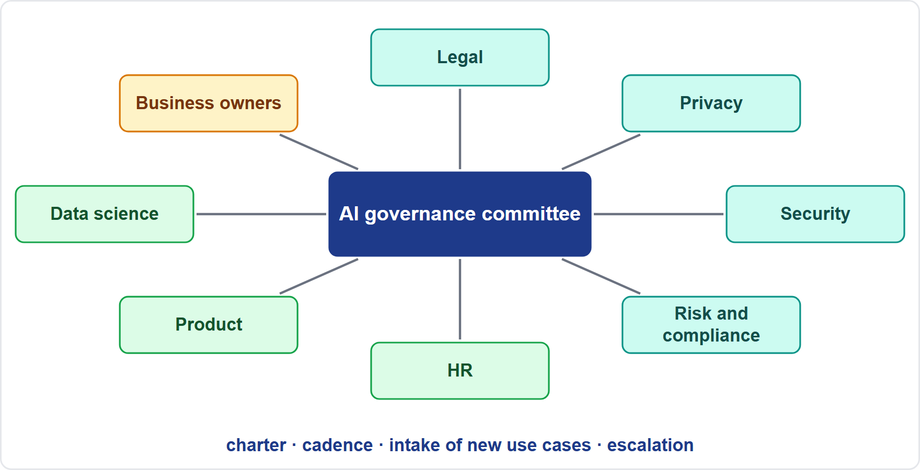
Cross-Functional Collaboration
Part 1
AI risk cuts across law, data, security, people and product, so no single function can govern it
A cross-functional committee brings these views to each decision
NIST: decision-making is informed by a diverse team (GOVERN 3.1)
Make collaboration work: a charter, a regular cadence, a clear intake route for new use cases and an escalation path
Give the committee decision rights, not only advice
EXAM TIP Collaboration is judged by effect: use cases get reviewed from every angle before approval.
AIGP Exam Prep Masterclass | Certified AI Governance Professional
Module 2: Governance Roles, Training and Approaches
8 / 25
Notes:
A I risk cuts across law, data, security, people and product, so no single function can govern it. A cross-functional committee brings those views to each decision. N I S T says decision-making should be informed by a diverse team, Govern three point one. To make collaboration work, give the committee a charter, a regular cadence, a clear intake route for new use cases, and an escalation path. And give it decision rights, not only advice. Exam tip: collaboration is judged by effect. Every use case is reviewed from every angle before approval.

Slide 9
A Range of Expertise and Viewpoints
Part 1
NIST asks for teams diverse in demographics, disciplines, experience, expertise and backgrounds
Different disciplines catch different risks: lawyers see liability, engineers see failure modes, HR sees fairness
Affected people (candidates, customers, frontline staff) see harms the builders miss
Silos hide risk: a model approved by data science alone may never meet legal or privacy review
Helios: the committee adds recruiters and support leads, and consults candidate and customer feedback
EXAM TIP When a question asks how to improve effectiveness, widen who is in the room, not just how often they meet.
AIGP Exam Prep Masterclass | Certified AI Governance Professional
Module 2: Governance Roles, Training and Approaches
9 / 25
Notes:
N I S T asks for teams diverse in demographics, disciplines, experience, expertise and backgrounds. Different disciplines catch different risks: lawyers see liability, engineers see failure modes, and H R sees fairness. Affected people, such as candidates, customers and frontline staff, see harms that builders miss. Silos hide risk: a model approved by data science alone may never meet legal or privacy review. At Helios, the committee adds recruiters and support leads, and it listens to candidate and customer feedback. Exam tip: to improve effectiveness, widen who is in the room.

Slide 10
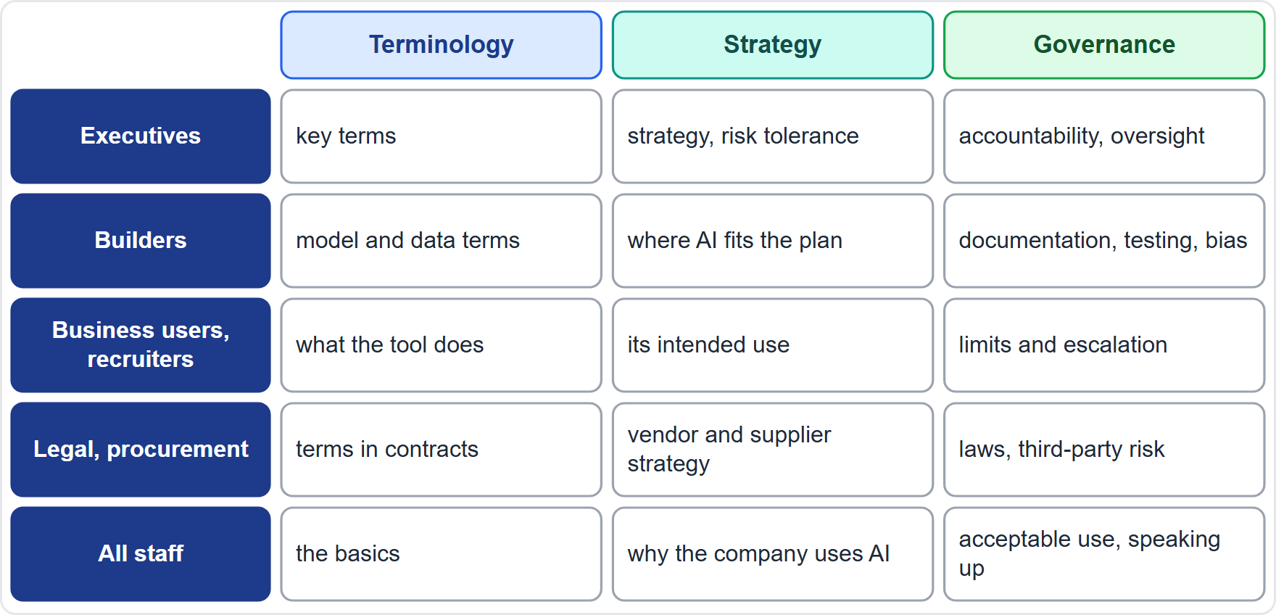
Training and Awareness: Who Needs What
Part 1
Program content: AI terminology, strategy and governance
Executives: strategy, risk tolerance, accountability
Builders (data science, engineering): governance requirements, documentation, testing and bias
Business users and recruiters: how the tool works, its limits, when to escalate
Legal and procurement: laws, vendor terms, third-party risk
All staff: basics, acceptable use, how to raise a concern
EXAM TIP One generic course for everyone is the wrong answer; training is matched to role.
AIGP Exam Prep Masterclass | Certified AI Governance Professional
Module 2: Governance Roles, Training and Approaches
10 / 25
Notes:
The training program covers A I terminology, strategy and governance, and each audience needs a different mix. Executives need strategy, risk tolerance and accountability. Builders need governance requirements, documentation, testing and bias. Business users and recruiters need to know how the tool works, its limits, and when to escalate. Legal and procurement need laws, vendor terms and third-party risk. All staff need the basics, acceptable use, and how to raise a concern. Exam tip: one generic course for everyone is the wrong answer.

Slide 11
The AI Literacy Duty in the EU AI Act
BEYOND THE BOK · DATES · VERIFY LIVE
Part 1
Article 4 applies to providers and deployers of AI systems, whatever the risk level
Applies since 2 February 2025 (Article 113)
As now worded, they take measures to support AI literacy of staff and others operating AI for them, considering knowledge, experience, education, training, the context of use and the people affected
It does not require guaranteeing a specific literacy level for any individual
The Digital Omnibus on AI rewrote the Article; earlier it asked providers and deployers to ensure, to their best extent, a sufficient level
As of 27 October 2026: check the consolidated text; the Commission and Member States support organizations, especially small and medium-sized enterprises (SMEs)
EXAM TIP Whichever wording a question uses, the duty is training matched to the people and the context, for every provider and deployer.
AIGP Exam Prep Masterclass | Certified AI Governance Professional
Module 2: Governance Roles, Training and Approaches
11 / 25
Notes:
This is a beyond-the-Body-of-Knowledge slide, tagged dates and verify live. Article four of the E U A I Act applies to providers and deployers of A I systems, whatever the risk level. It has applied since the second of February, twenty twenty-five. As now worded, they take measures to support A I literacy of staff and others operating A I for them, considering knowledge, experience, education, training, the context of use and the people affected. It does not require guaranteeing a specific level for any individual. The Digital Omnibus rewrote the Article; before, it asked them to ensure, to their best extent, a sufficient level. As of the twenty-seventh of October, twenty twenty-six, check the consolidated text.

Slide 12
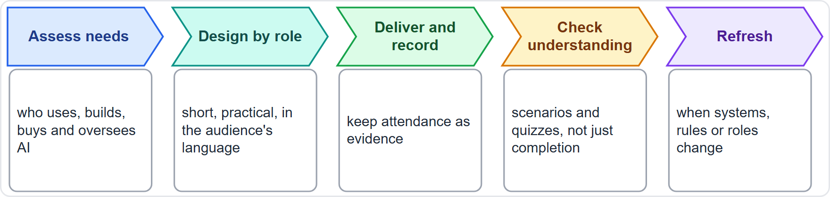
Building a Training Program That Works
Part 1
Assess needs: who uses, builds, buys and oversees AI, and what each knows
Design by role: short, practical modules in the language of the audience
Deliver and record: keep attendance, as evidence for audit and regulators
Check understanding: quizzes and scenarios, not only completion
Refresh: when systems, rules or incidents change what people must know (GOVERN 2.2 asks that personnel and partners be trained for their duties)
EXAM TIP Training is a cycle, not an event: it is repeated when systems, rules or roles change.
AIGP Exam Prep Masterclass | Certified AI Governance Professional
Module 2: Governance Roles, Training and Approaches
12 / 25
Notes:
A training program that works is a cycle. First, assess needs: who uses, builds, buys and oversees A I, and what each group knows. Second, design by role, with short, practical modules in the language of the audience. Third, deliver and record, keeping attendance as evidence. Fourth, check understanding with quizzes and scenarios, not only completion. Fifth, refresh when systems, rules or incidents change what people must know. N I S T Govern two point two asks that personnel and partners be trained for their duties. Exam tip: training is a cycle, not an event.

Slide 13
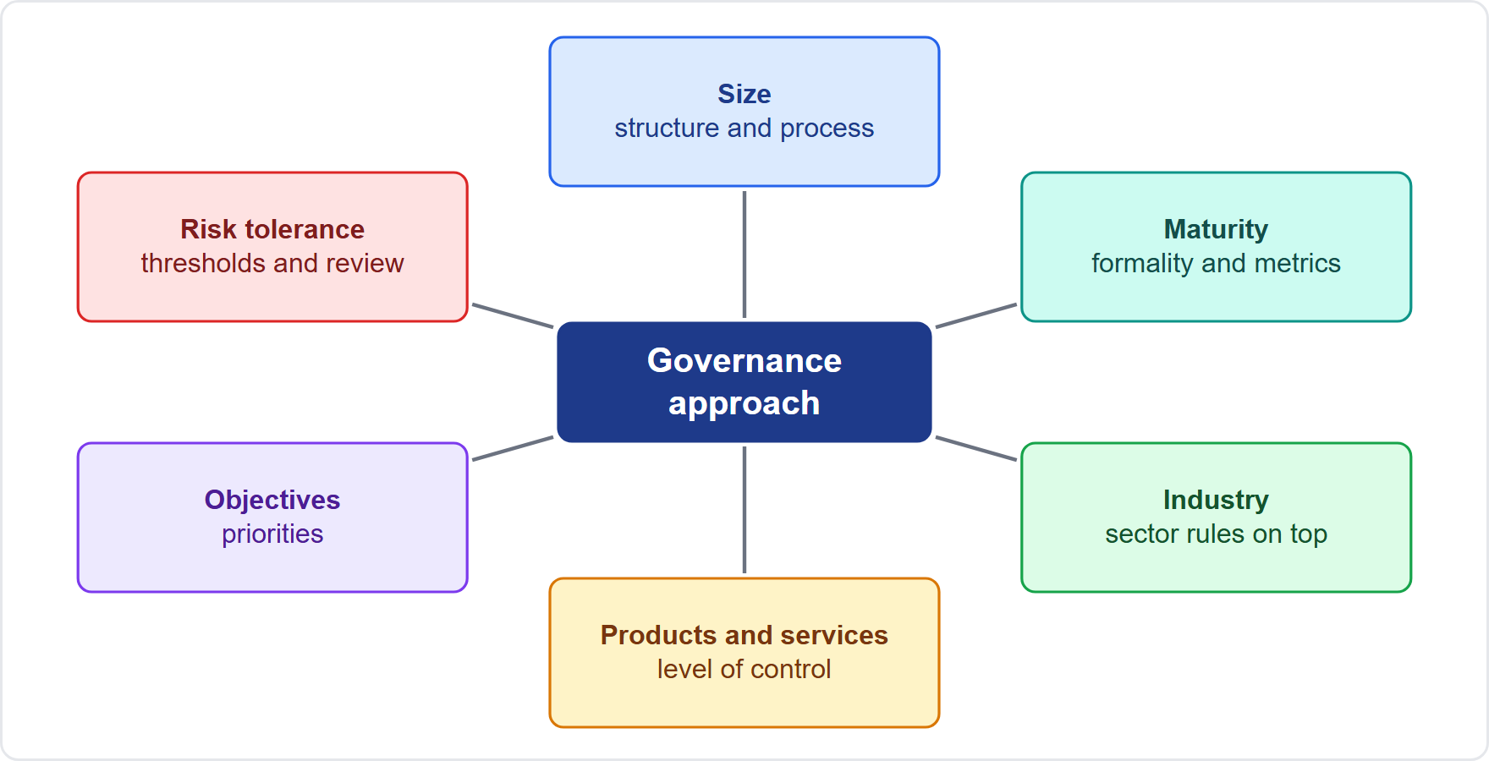
Fitting the Approach to the Organization
Part 2
Size: a small firm uses a named owner and light process; a large one a committee and several lines
Maturity: early programs start with an inventory and basic policy; mature ones add metrics, audits and automation
Industry: regulated sectors add sector rules on top of AI rules
Products and services: systems that affect people's rights or safety need stronger controls
Objectives and risk tolerance: the willingness to accept risk sets thresholds and the amount of review (GOVERN 1.3)
EXAM TIP A comparison question wants a fit: more formal for large, regulated or high-risk, lighter for small and low-risk, never none.
AIGP Exam Prep Masterclass | Certified AI Governance Professional
Module 2: Governance Roles, Training and Approaches
13 / 25
Notes:
Governance has to fit the organization. Size: a small firm uses a named owner and light process, while a large one uses a committee and several lines. Maturity: early programs start with an inventory and basic policy, while mature ones add metrics, audits and automation. Industry: regulated sectors add sector rules on top of A I rules. Products and services: systems that affect rights or safety need stronger controls. Objectives and risk tolerance set thresholds and the amount of review, Govern one point three. Exam tip: a comparison question wants a fit, never no governance at all.

Slide 14
Governance Operating Models
Part 2
Model | How it works | Fits | Watch for
Centralized | one team sets and runs governance for all AI | smaller or highly regulated organizations | bottleneck, distance from the business
Federated (hub and spoke) | a central team sets policy, business units run their own AI within it | large, diverse organizations | uneven practice across units
Decentralized | each unit governs itself | very early stage only | gaps, inconsistency, hidden risk
Helios: a hybrid; a central committee sets policy, and business units run their AI with its approval
EXAM TIP Hybrid or hub-and-spoke is the usual answer for a large company with many units.
AIGP Exam Prep Masterclass | Certified AI Governance Professional
Module 2: Governance Roles, Training and Approaches
14 / 25
Notes:
Three operating models are worth knowing. Centralized: one team sets and runs governance for all A I. It suits smaller or highly regulated organizations, but can become a bottleneck. Federated, or hub and spoke: a central team sets policy and business units run their own A I within it. It suits large, diverse organizations, but practice can be uneven. Decentralized: each unit governs itself. That suits only the earliest stage, and it leaves gaps. Helios uses a hybrid. Exam tip: for a large company with many units, hybrid is the usual answer.

Slide 15
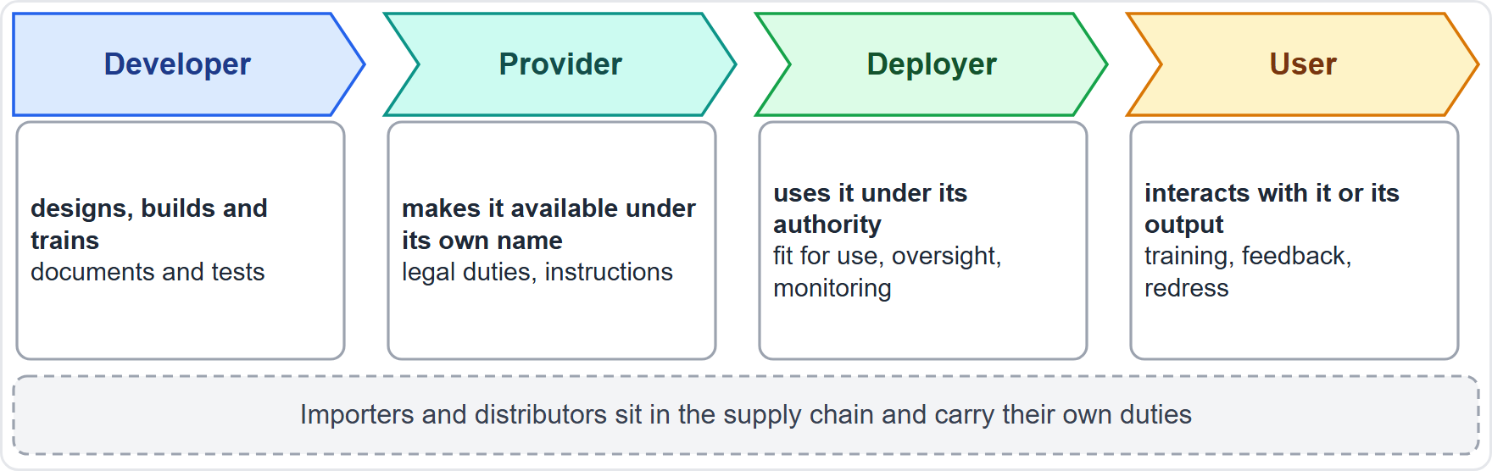
The Actors in the AI Chain
BEYOND THE BOK
Part 2
Developer: designs, builds and trains the model or system
Provider: places the system on the market or puts it into service under its own name (often the developer, sometimes not)
Deployer: uses the system under its own authority in its operations
User: the person who interacts with the system or its output; may be an employee or a member of the public
Importers and distributors sit in the supply chain and carry their own duties
EXAM TIP One company can hold several roles for different systems; assign the role per system.
AIGP Exam Prep Masterclass | Certified AI Governance Professional
Module 2: Governance Roles, Training and Approaches
15 / 25
Notes:
This is a beyond-the-Body-of-Knowledge slide. The Body of Knowledge asks you to tell four actors apart. The developer designs, builds and trains the model or system. The provider places the system on the market or puts it into service under its own name, often the developer, sometimes not. The deployer uses the system under its own authority in its operations. The user interacts with the system or its output, and may be an employee or a member of the public. Importers and distributors sit in the supply chain. Exam tip: one company can hold several roles, so assign the role per system.

Slide 16
The AI Act's Names for the Roles
BEYOND THE BOK
Part 2
Term (Article 3) | Meaning in short
Provider (3) | develops or has developed a system or general-purpose model and places it on the market or puts it into service under its own name or trademark
Deployer (4) | uses an AI system under its authority, except for personal non-professional use
Authorized representative (5) | established in the Union, holds a written mandate from a provider
Importer (6) | established in the Union, places on the market a system bearing a third-country person's name or trademark
Distributor (7) | in the supply chain, neither provider nor importer, makes a system available on the Union market
Operator (8) | the umbrella term: provider, product manufacturer, deployer, authorized representative, importer or distributor
EXAM TIP The Act speaks of deployers, not users; a user is an individual, a deployer is an organization acting under its authority.
AIGP Exam Prep Masterclass | Certified AI Governance Professional
Module 2: Governance Roles, Training and Approaches
16 / 25
Notes:
This is a beyond-the-Body-of-Knowledge slide. Article three of the E U A I Act defines the roles. A provider develops a system or general-purpose model, or has one developed, and places it on the market under its own name or trademark. A deployer uses a system under its authority, except for personal non-professional use. An authorized representative holds a written mandate from a provider. An importer places on the Union market a system bearing a third-country name. A distributor makes a system available without being provider or importer. Operator is the umbrella term. Exam tip: the Act says deployer, not user.

Slide 17
Responsibilities, Opportunities and Needs by Role
Part 2
Role | Governance responsibility | Opportunity | Need
Developer | document design, test for bias and safety | build governance in from the start | clear requirements, quality data
Provider | meet legal duties, supply instructions and information | earn trust with transparent products | feedback on use and incidents
Deployer | fit the system to the use, oversee it, monitor | choose vendors on evidence | documentation and support from the provider
User | use the system as intended, report problems | give frontline feedback | training, clear information, a way to complain
Helios: Veridex is the provider of the hiring tool; Helios is its deployer; recruiters are users
EXAM TIP Deployers depend on providers' information; asking for it in the contract is part of governance.
AIGP Exam Prep Masterclass | Certified AI Governance Professional
Module 2: Governance Roles, Training and Approaches
17 / 25
Notes:
Each role has its own responsibility, opportunity and need. Developers document design and test for bias and safety; they can build governance in from the start, and they need clear requirements and quality data. Providers meet legal duties and supply instructions; they can earn trust with transparent products, and need feedback on use and incidents. Deployers fit the system to the use and oversee it; they can choose vendors on evidence, and need documentation from the provider. Users use the system as intended and report problems; they need training and a way to complain. Exam tip: ask providers for information in the contract.

Slide 18
Module Recap
Part 2
1
Roles
2
Collaboration
3
Training
leadership decides risk tolerance, the committee sets policy, functions advise, business owners own use cases, audit assures
diverse, cross-functional, with a charter, cadence and decision rights
by audience, covering terminology, strategy and governance; a cycle, not an event; Article 4 duty
4
Approach
5
Actors
fits size, maturity, sector, products, objectives and risk tolerance
developer, provider, deployer, user; roles are per system
AIGP Exam Prep Masterclass | Certified AI Governance Professional
Module 2: Governance Roles, Training and Approaches
18 / 25
Notes:
Let us recap. Roles: leadership decides risk tolerance, the committee sets policy, functions advise, business owners own use cases, and audit assures. Collaboration is diverse and cross-functional, with a charter, a cadence and decision rights. Training is by audience, covers terminology, strategy and governance, and is a cycle, with the Article four duty in the E U. The approach fits size, maturity, sector, products, objectives and risk tolerance. And the actors are developer, provider, deployer and user, assigned per system.

Slide 19
Practice Question 1
Part 2
Q1
Samira Haddad wants independent assurance, reporting to the board, that Helios's AI governance and risk management are adequate and effective. Which function should provide it?
A
Data science, which builds and tunes the models used in hiring
B
The AI governance committee, which writes the policies under review
C
Internal audit, acting as an independent third line
D
The privacy team, which advises on the rules for personal data
AIGP Exam Prep Masterclass | Certified AI Governance Professional
Module 2: Governance Roles, Training and Approaches
19 / 25
Notes:
Question one. Samira Haddad wants independent assurance, reporting to the board, that Helios's A I governance and risk management are adequate and effective. Which function should provide it? The four options are on the screen. [PAUSE 12] The answer is C. Independent assurance is the third line, internal audit. The builders and the committee that wrote the policy cannot independently assure their own work.

Slide 20
Practice Question 2
Part 2
Q2
Which responsibility belongs to executive leadership in an AI governance program?
A
Labeling the training examples for the models that the company builds
B
Owning the decisions about the risks of developing and deploying AI
C
Running the daily performance dashboards for the deployed models
D
Drafting the technical documentation for each system release before launch
AIGP Exam Prep Masterclass | Certified AI Governance Professional
Module 2: Governance Roles, Training and Approaches
20 / 25
Notes:
Question two. Which responsibility belongs to executive leadership in an A I governance program? The four options are on the screen. [PAUSE 12] The answer is B. Executive leadership sets risk tolerance and takes responsibility for decisions about A I risk. Labeling data, running dashboards and drafting documentation are operational tasks for the teams.

Slide 21
Practice Question 3
Part 2
Q3
A company's AI governance committee has only data scientists and one lawyer, and use cases are approved with little challenge. Which TWO additions would best improve its effectiveness and range of expertise? (Select TWO.)
A
A second senior data scientist to speed up technical review
B
A privacy specialist who can assess data and notice issues
C
The vendor's account manager, given a voting seat
D
A business owner who uses the system and sees its effects
E
A second lawyer to double the legal opinions
AIGP Exam Prep Masterclass | Certified AI Governance Professional
Module 2: Governance Roles, Training and Approaches
21 / 25
Notes:
Question three. A company's A I governance committee has only data scientists and one lawyer, and use cases are approved with little challenge. Which two additions would best improve its effectiveness and range of expertise? Select two. The five options are on the screen. [PAUSE 15] The answers are B and D. A privacy specialist and a business owner bring new disciplines and the user's view. More of the same adds little, and a voting vendor is a conflict.

Slide 22
Practice Question 4
Part 2
Q4
A company plans AI training for recruiters, developers, executives and buyers, and must also meet the EU AI literacy duty. Which plan best meets the stakeholders' needs?
A
One technical course for the developers, because they are the people who build and tune the systems
B
A one-time video for new hires, kept on file as evidence that the company trained staff
C
Training for the teams that run high-risk systems, since the duty is aimed at those systems
D
Role-based training on AI terminology, strategy and governance for each group's needs and context
AIGP Exam Prep Masterclass | Certified AI Governance Professional
Module 2: Governance Roles, Training and Approaches
22 / 25
Notes:
Question four. A company plans A I training for recruiters, developers, executives and buyers, and must also meet the E U A I literacy duty. Which plan best meets the stakeholders' needs? The four options are on the screen. [PAUSE 12] The answer is D. Role-based training covers terminology, strategy and governance, matched to each group's knowledge and context. The E U duty reaches providers and deployers whatever the risk level, so a one-off video or developer-only course falls short.

Slide 23
Practice Question 5
Part 2
Q5
A 40-person startup uses a third-party chatbot, and a multinational bank deploys credit-scoring models. How should their governance approaches differ?
A
The startup uses light, risk-based controls under a named owner; the bank uses a formal committee and stricter tolerance
B
Both use the same committee, the same documentation and the same approval gates, so that practice stays consistent everywhere
C
Only the bank needs any governance, because a startup using a chatbot is too small to create meaningful AI risk
D
The startup needs the framework more than the bank, because small organizations lack the experience to manage AI risk
AIGP Exam Prep Masterclass | Certified AI Governance Professional
Module 2: Governance Roles, Training and Approaches
23 / 25
Notes:
Question five. A forty-person startup uses a third-party chatbot, and a multinational bank deploys credit-scoring models. How should their governance approaches differ? The four options are on the screen. [PAUSE 12] The answer is A. The startup uses light, risk-based controls under a named owner, and the bank uses a formal committee, several lines and a stricter risk tolerance. A uniform approach over-burdens one and under-protects the other.

Slide 24
Practice Question 6
Part 2
Q6
Helios uses the Veridex hiring tool under its own authority to screen applicants. Veridex makes the tool available under its own name. Which TWO statements describe the roles correctly? (Select TWO.)
A
Veridex is the provider of the system
B
Helios is the provider, because it uses the tool in its business
C
Helios is the deployer of the system
D
Veridex is a deployer, because it supports the tool after sale
E
The applicants are deployers, because the tool scores them
AIGP Exam Prep Masterclass | Certified AI Governance Professional
Module 2: Governance Roles, Training and Approaches
24 / 25
Notes:
Question six. Helios uses the Veridex hiring tool under its own authority to screen applicants. Veridex makes the tool available under its own name. Which two statements describe the roles correctly? Select two. The five options are on the screen. [PAUSE 15] The answers are A and C. The party that makes the system available under its own name is the provider, and the organization that uses it under its own authority is the deployer.

Slide 25
Answers at a Glance
Part 2
Question | Answer | Why
Q1 | C | Internal audit gives independent assurance
Q2 | B | Executives own AI risk decisions
Q3 | B, D | Add new expertise and the user's view
Q4 | D | Role-based training for all stakeholders
Q5 | A | Fit the approach to size, sector and risk
Q6 | A, C | Veridex is the provider; Helios is the deployer
AIGP Exam Prep Masterclass | Certified AI Governance Professional
Module 2: Governance Roles, Training and Approaches
25 / 25
Notes:
Here are all six answers. Question one: C. Question two: B. Question three: B and D. Question four: D. Question five: A. Question six: A and C. That completes Module two. Next, Module three turns to policies and procedures across the whole A I life cycle, including third-party risk.

