Slide 1
Module 3: Policies and Procedures Across the AI Life Cycle
Oversight and accountability, stage by stage, and with third parties
Domain I · Competency C · Indicators I.C.1 to I.C.3
AIGP Exam Prep Masterclass
Module 3 · Part 1
Notes:
Welcome to Module three: Policies and Procedures Across the A I Life Cycle. This is competency C of domain one. You will learn how to create policies that give oversight and accountability at every stage, how to review the policies you already have, and how to manage the risk that comes from third parties.

Slide 2
What You Will Learn
Part 1
Create policies for each stage of the AI life cycle
Run an AI inventory and find shadow AI
Evaluate and update existing policies (privacy, security, data governance, IP) for AI
Manage third-party risk through policies, assessments and contracts
Cover procurement, supply chain, HR and acceptable use
AIGP Exam Prep Masterclass | Certified AI Governance Professional
Module 3
2 / 28
Notes:
By the end of this module you will be able to do five things. Create policies for each stage of the A I life cycle. Run an A I inventory and find shadow A I. Evaluate and update existing policies on privacy, security, data governance and intellectual property. Manage third-party risk through policies, assessments and contracts. And cover procurement, supply chain, H R and acceptable use.

Slide 3
Case Check-In: 47 AI Uses, 9 Unregistered
Part 1
CASE CHECK-IN · Helios
Mei Tanaka's first AI inventory at Helios finds 47 AI uses
Nine were never registered: shadow AI in sales, support and recruiting
Ravi Menon is about to sign with Corvid Labs without an AI review
You must write the policies that would have caught both
AIGP Exam Prep Masterclass | Certified AI Governance Professional
Module 3
3 / 28
Notes:
At Helios, Mei Tanaka's first A I inventory finds forty-seven A I uses. Nine of them were never registered. That is shadow A I, spread across sales, support and recruiting. At the same time, Ravi Menon is about to sign with Corvid Labs without any A I review. You must write the policies that would have caught both problems.

Slide 4
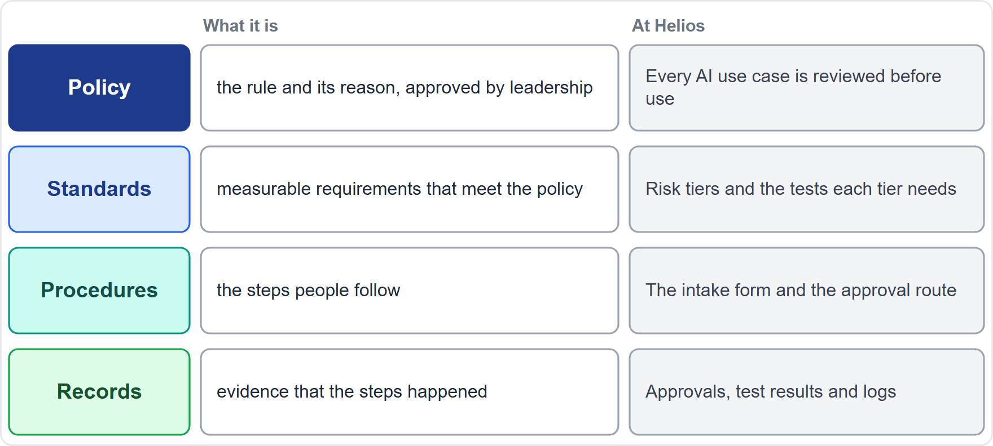
Policy, Standard, Procedure: The Governance Stack
Part 1
Policy: the rule and its reason, approved by leadership (for example, every AI use case is reviewed before use)
Standard: measurable requirements that meet the policy (risk tiers, required tests)
Procedure: the steps people follow (the intake form and approval route)
Records: evidence that the steps happened (approvals, test results, logs)
Oversight and accountability need an owner, an approver and a review date on every policy
EXAM TIP A policy says what must happen; a procedure says how; records prove it.
AIGP Exam Prep Masterclass | Certified AI Governance Professional
Module 3
4 / 28
Notes:
Start with the stack of governance documents. A policy states the rule and its reason, approved by leadership: for example, every A I use case is reviewed before use. A standard sets measurable requirements, such as risk tiers and required tests. A procedure gives the steps, like the intake form and approval route. Records are the evidence that the steps happened. Every policy needs an owner, an approver and a review date. Exam tip: a policy says what, a procedure says how, and records prove it.

Slide 5
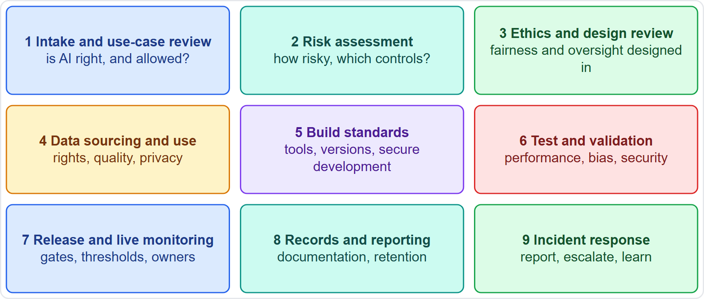
Policies Stage by Stage
Part 1
Intake and use-case review: is AI the right tool, and is it allowed?
Risk assessment: how risky, and what controls?
Ethics and design review: fairness, transparency and oversight designed in
Data sourcing and use: rights, quality and privacy before data are used
Build, test and validation: standards for development and required tests
Release and live monitoring: approval gates, thresholds and owners
Records and incident response: documentation, reporting and escalation
EXAM TIP For a stage question, name the control that belongs to that stage; do not borrow a later stage's control.
AIGP Exam Prep Masterclass | Certified AI Governance Professional
Module 3
5 / 28
Notes:
The Body of Knowledge expects a policy topic for each life-cycle stage. At intake: is A I the right tool, and is it allowed? Risk assessment: how risky, and what controls? Ethics and design review: fairness, transparency and oversight designed in. Data sourcing and use: rights, quality and privacy before data are used. Build, test and validation: standards and required tests. Release and live monitoring: gates, thresholds and owners. And records and incident response: documentation, reporting and escalation. Exam tip: name the control that belongs to the stage in the question.

Slide 6
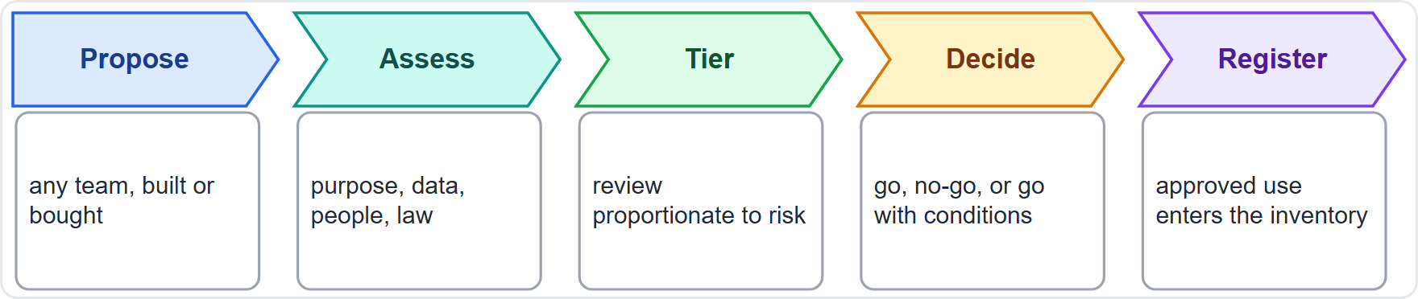
Intake and Use-Case Assessment
Part 1
Every use case enters through one door, whether built, bought or switched on in a tool
Assess the purpose, the data, the affected people and the legal context
Tier the risk so that review is proportionate
Decide: go, no-go, or go with conditions; NIST expects the mapping to inform an initial go or no-go decision
Register the approved use in the inventory
EXAM TIP The earliest control is the use-case gate; it stops problems before money and data are spent.
AIGP Exam Prep Masterclass | Certified AI Governance Professional
Module 3
6 / 28
Notes:
The first stage is intake. Every use case enters through one door, whether it is built, bought, or switched on inside a tool. Assess the purpose, the data, the affected people and the legal context. Tier the risk so that review is proportionate. Decide: go, no-go, or go with conditions. N I S T expects the mapping work to inform an initial go or no-go decision. Then register the approved use in the inventory. Exam tip: the earliest control is the use-case gate. It stops problems before money and data are spent.

Slide 7
Risk Management and Ethics by Design
Part 1
Risk policy: a method to identify, rate and treat risks, linked to the organization's risk tolerance (GOVERN 1.3)
Risk is tiered: more review for systems that affect people's rights, safety or access
Ethics by design: build fairness, explainability, privacy and human oversight into requirements, not bolt them on
Document risks and impacts of what teams design and use, and share them (GOVERN 4.2)
Culture: policies that foster critical thinking and a safety-first mindset (GOVERN 4.1)
EXAM TIP Ethics by design means decisions made at design time, with a record, not a review at the end.
AIGP Exam Prep Masterclass | Certified AI Governance Professional
Module 3
7 / 28
Notes:
A risk policy sets a method to identify, rate and treat risks, linked to the organization's risk tolerance. That is Govern one point three. Risk is tiered, with more review for systems that affect rights, safety or access. Ethics by design builds fairness, explainability, privacy and human oversight into requirements instead of bolting them on. Teams document the risks and impacts of what they design and use, Govern four point two, and policies foster a safety-first mindset, Govern four point one. Exam tip: ethics by design means decisions at design time, with a record.

Slide 8
Data, Development, Training and Testing Policies
Part 1
Data sourcing and use: lawful rights, license terms, consent and notice, minimization, quality checks and provenance records
Build standards: approved tools and libraries, version control for code, data and models, secure development
Training rules: which data may train which model, and who approves
Testing requirements: performance, robustness, security and bias tests with pass criteria
NIST asks for practices that enable AI testing, incident identification and information sharing (GOVERN 4.3)
EXAM TIP If data were not cleared for use, no later test makes the model compliant.
AIGP Exam Prep Masterclass | Certified AI Governance Professional
Module 3
8 / 28
Notes:
Now data, development, training and testing. Data sourcing rules cover lawful rights, license terms, consent and notice, minimization, quality checks and provenance records. Build standards set approved tools, version control for code, data and models, and secure development. Training rules say which data may train which model, and who approves. Testing requirements cover performance, robustness, security and bias, with pass criteria. N I S T Govern four point three asks for practices that enable testing and incident identification. Exam tip: if data were not cleared for use, no later test fixes that.

Slide 9
Release, Monitoring, Records and Incidents
Part 1
Release approval
Live monitoring
Records
a gate that checks test results, documentation and sign-off by the accountable owner
metrics, thresholds, owners and review frequency (GOVERN 1.5)
model documentation, decision logs and reports, kept for the period the policy sets
Incident response
Retirement
report, triage, escalate, fix, learn; a named owner and timelines
processes to decommission or phase out systems safely (GOVERN 1.7)
EXAM TIP The life cycle ends with retirement; a policy set with no decommissioning step is incomplete.
AIGP Exam Prep Masterclass | Certified AI Governance Professional
Module 3
9 / 28
Notes:
After build, policies cover release, monitoring, records and incidents. Release approval is a gate that checks test results, documentation and sign-off by the accountable owner. Live monitoring needs metrics, thresholds, owners and review frequency, Govern one point five. Records keep model documentation and decision logs for the period the policy sets. Incident response means report, triage, escalate, fix and learn, with a named owner. And retirement means decommissioning safely, Govern one point seven. Exam tip: a policy set with no retirement step is incomplete.

Slide 10
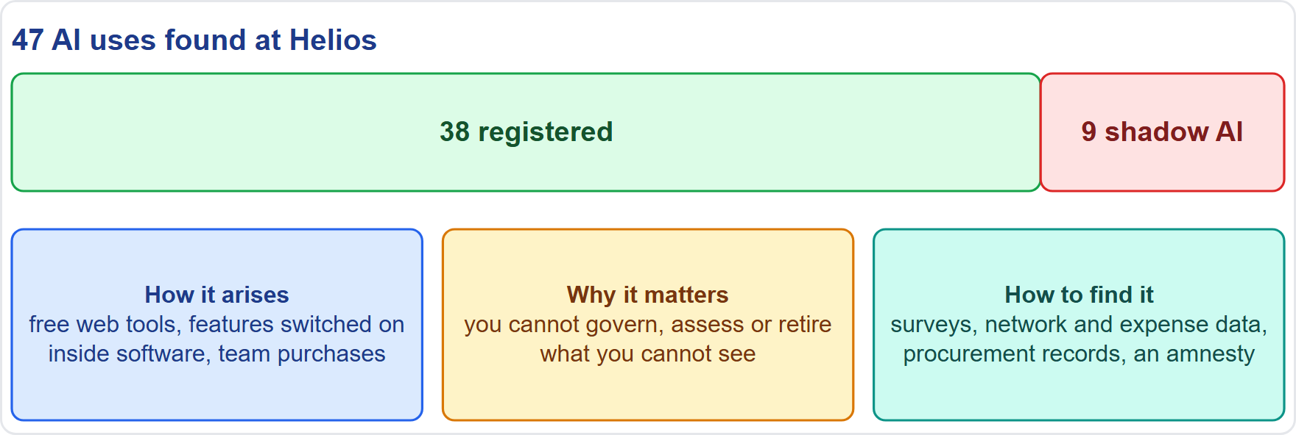
The AI Inventory and Shadow AI
BEYOND THE BOK
Part 1
Inventory: a living list of every AI system and use, its owner, purpose, data and risk tier (NIST GOVERN 1.6)
Shadow AI: AI used without approval, from free web tools to features switched on inside existing software
Why it matters: you cannot govern, assess or retire what you cannot see
Finding it: surveys, network and expense data, procurement records, and an amnesty to report
Helios: 9 of 47 uses were unregistered; policy now requires registration at intake
EXAM TIP An inventory is the first control; the fix for shadow AI is intake plus visibility, not only a ban.
AIGP Exam Prep Masterclass | Certified AI Governance Professional
Module 3
10 / 28
Notes:
This is a beyond-the-Body-of-Knowledge slide. An inventory is a living list of every A I system and use, with its owner, purpose, data and risk tier. N I S T Govern one point six asks for mechanisms to inventory A I systems. Shadow A I is A I used without approval, from free web tools to features switched on inside existing software. You cannot govern, assess or retire what you cannot see. To find it, use surveys, network and expense data, procurement records, and an amnesty to report. At Helios, nine of forty-seven uses were unregistered. Exam tip: the fix is intake plus visibility, not only a ban.

Slide 11
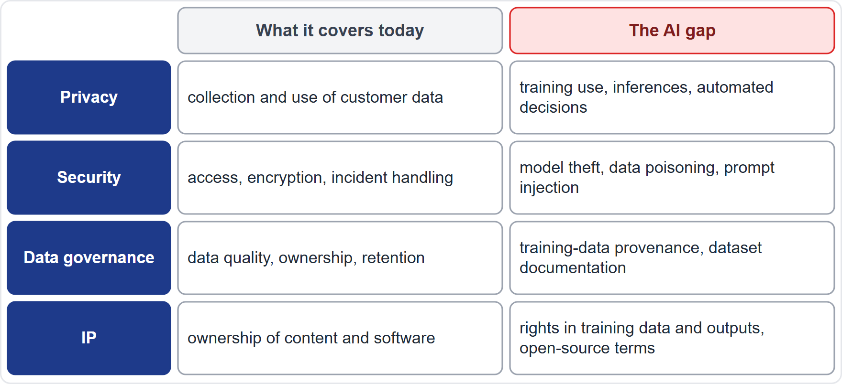
Reviewing Existing Policies for AI
Part 1
Method: list existing policies, test each against AI risks, record the gaps, then decide to update or write a new policy
Privacy: training use, inferences and automated decisions are not covered
Security: model theft, data poisoning and prompt injection are not covered
Data governance: training-data provenance and dataset documentation are not covered
IP: rights in training data and outputs, and open-source terms, are not covered
EXAM TIP Evaluating a policy means checking it against AI-specific risks, not rewriting it from scratch.
AIGP Exam Prep Masterclass | Certified AI Governance Professional
Module 3
11 / 28
Notes:
You do not start from nothing. The method: list your existing policies, test each against A I risks, record the gaps, then decide whether to update or write a new policy. Privacy policies often miss training use, inferences and automated decisions. Security policies often miss model theft, data poisoning and prompt injection. Data governance policies often miss training-data provenance and dataset documentation. And I P policies often miss rights in training data and outputs, and open-source terms. Exam tip: evaluating a policy means checking it against A I-specific risks.

Slide 12
Updating Privacy and Security Policies for AI
Part 1
Policy | What to add for AI
Privacy | purpose and notice for using personal data to train and run models; minimization; handling rights requests for data inside models; limits on sensitive inferences
Security | AI-specific threats (data poisoning, model theft and extraction, prompt injection); access control for models and data; testing and red teaming; supply-chain checks of models and components
Treat model files, prompts and training data as assets to classify and protect
Link the incident process so that AI incidents reach security and privacy teams
EXAM TIP An AI update extends the existing policy with AI-specific rules; the old controls still apply.
AIGP Exam Prep Masterclass | Certified AI Governance Professional
Module 3
12 / 28
Notes:
For privacy, add purpose and notice for using personal data to train and run models, minimization, handling rights requests for data inside models, and limits on sensitive inferences. For security, add A I-specific threats: data poisoning, model theft and extraction, and prompt injection. Add access control for models and data, testing and red teaming, and supply-chain checks of models and components. Treat model files, prompts and training data as assets to classify and protect. And link the incident process so that A I incidents reach security and privacy. Exam tip: an update extends the old policy.

Slide 13
Updating Data Governance and IP Policies for AI
Part 1
Policy | What to add for AI
Data governance | provenance and lineage of training data; quality and representativeness checks; dataset documentation; retention and deletion; who may use data for AI
Intellectual property | rights to use data and content for training; ownership and use of outputs; open-source and model licenses; protection of prompts and confidential data in external tools
Add an acceptable use rule: no confidential or personal data in unapproved tools
Review the policies when systems, laws or incidents change, on a set schedule
EXAM TIP Provenance and licenses are the first questions to ask about any training data.
AIGP Exam Prep Masterclass | Certified AI Governance Professional
Module 3
13 / 28
Notes:
For data governance, add provenance and lineage of training data, quality and representativeness checks, dataset documentation, retention and deletion, and rules on who may use data for A I. For intellectual property, add rights to use data and content for training, ownership and use of outputs, open-source and model licenses, and protection of prompts and confidential data in external tools. Add an acceptable use rule: no confidential or personal data in unapproved tools. Review all of it on a set schedule, and when systems, laws or incidents change. Exam tip: provenance and licenses come first.

Slide 14
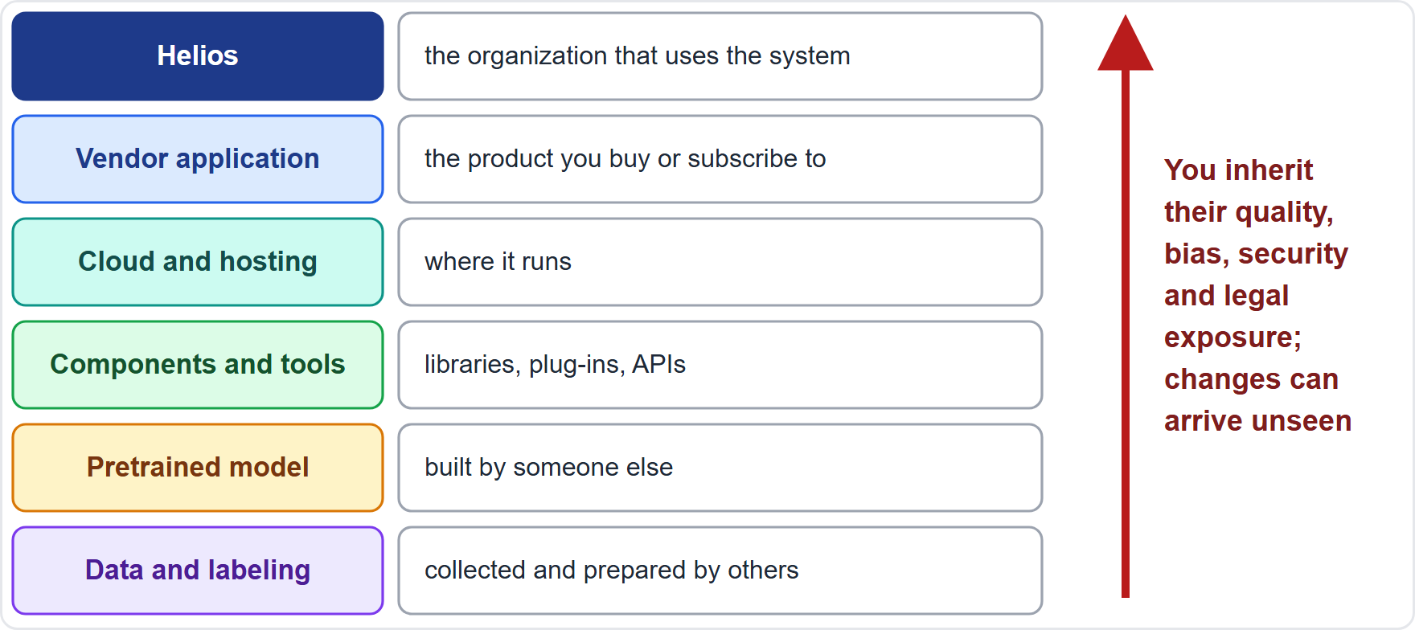
Why Third-Party AI Risk Is Different
Part 2
Most organizations buy or build on others' models, data and components
You inherit their data quality, bias, security and legal exposure
Suppliers can change a model without telling you
NIST names untraceable third-party components and poor supplier vetting as a generative-AI risk (value chain and component integration)
GOVERN 6.1 asks for policies for AI risks tied to third parties, including infringement of their IP or other rights
EXAM TIP Buying AI does not buy the risk away; the organization using the system still owns its outcomes.
AIGP Exam Prep Masterclass | Certified AI Governance Professional
Module 3
14 / 28
Notes:
Now third-party risk. Most organizations buy or build on other people's models, data and components. You inherit their data quality, bias, security and legal exposure, and suppliers can change a model without telling you. N I S T names untraceable third-party components and poor supplier vetting as a generative A I risk. Govern six point one asks for policies on A I risks tied to third parties, including infringement of their intellectual property or other rights. Exam tip: buying A I does not buy the risk away. The organization using the system still owns its outcomes.

Slide 15
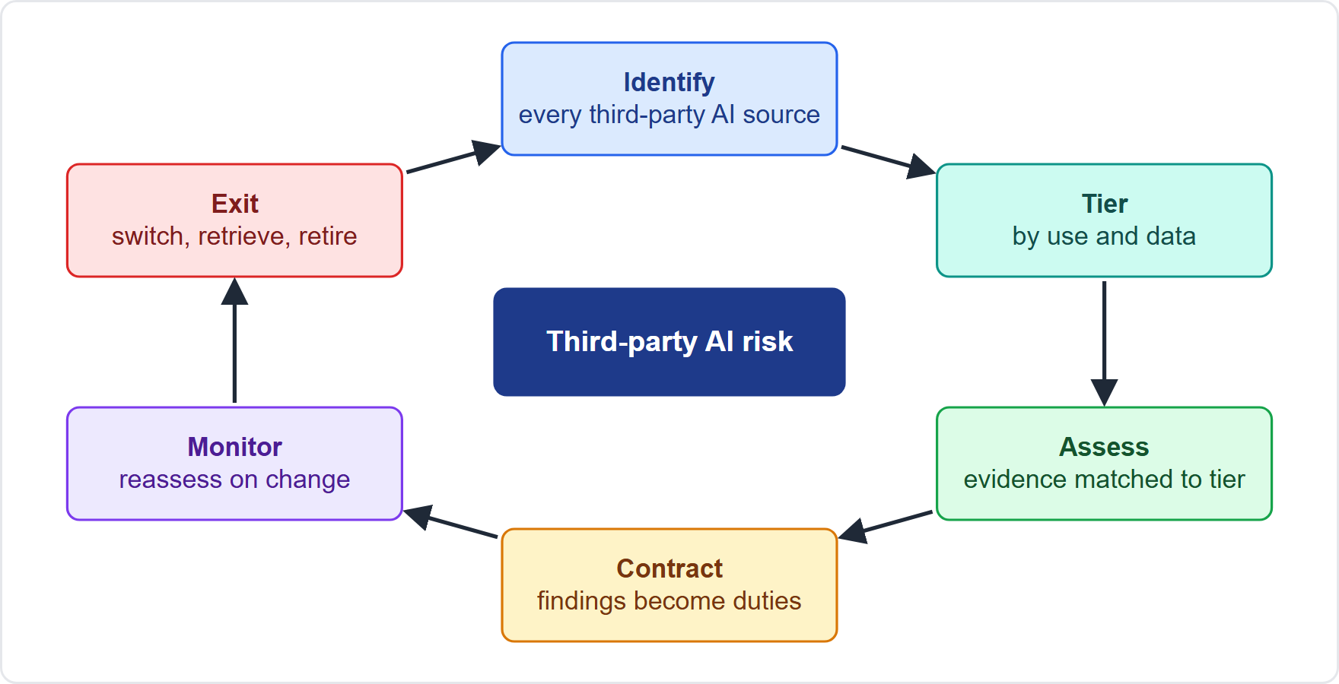
Third-Party Due Diligence and Assessments
Part 2
Identify every third-party AI source, including free tools and embedded features
Tier by what the system does and the data it touches
Assess with evidence matched to the tier: documentation, test and bias results, data provenance, security and privacy controls, incident history
Contract the findings into obligations
Monitor and reassess on change or incident; plan the exit
EXAM TIP Due diligence is proportionate: more evidence for higher-risk uses.
AIGP Exam Prep Masterclass | Certified AI Governance Professional
Module 3
15 / 28
Notes:
Manage third-party risk as a cycle. Identify every third-party A I source, including free tools and embedded features. Tier them by what the system does and the data it touches. Assess with evidence matched to the tier: documentation, test and bias results, data provenance, security and privacy controls, and incident history. Contract the findings into obligations. Monitor and reassess on change or incident, and plan the exit. Exam tip: due diligence is proportionate. Higher-risk uses need more evidence.

Slide 16
Procurement and Supply Chain Policies
Part 2
No AI purchase without review: procurement routes every AI request through the intake gate
Approved suppliers and tools: a list of vetted vendors and models, with conditions of use
Standard questionnaire and clauses: the same questions and the same minimum terms for each bid
Supply-chain mapping: know which models, data and components sit under the vendor's product
Contingency plans: for failures or incidents in third-party data or AI systems that are high-risk (GOVERN 6.2)
EXAM TIP Procurement is a control point: if AI can enter without review, the intake policy fails.
AIGP Exam Prep Masterclass | Certified AI Governance Professional
Module 3
16 / 28
Notes:
Procurement is a control point. Route every A I request through the intake gate, so that nothing is bought without review. Keep a list of approved suppliers and tools, with conditions of use. Use the same questionnaire and the same minimum clauses for each bid. Map the supply chain, so that you know which models, data and components sit under the vendor's product. And have contingency plans for failures or incidents in high-risk third-party data or A I systems, Govern six point two. Exam tip: if A I can enter without review, the intake policy fails.

Slide 17
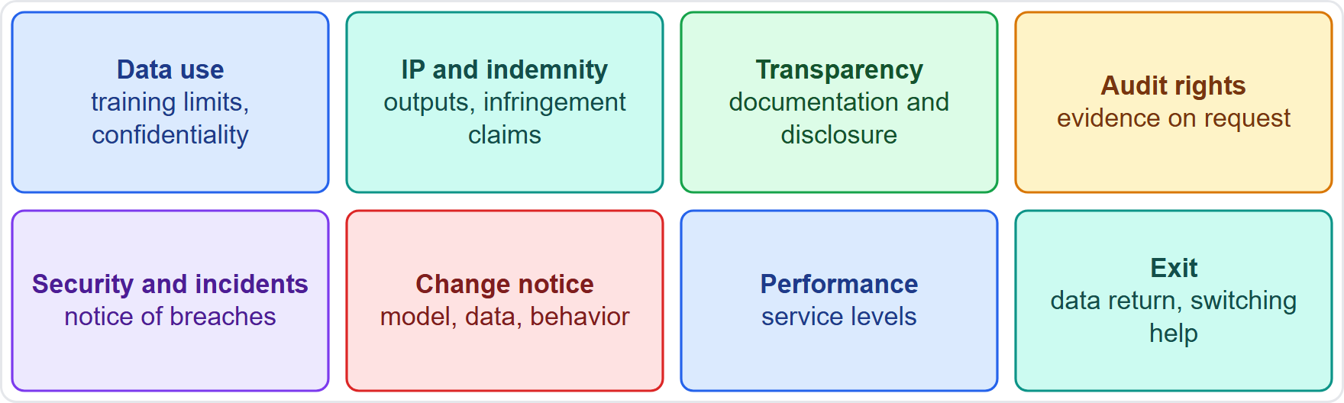
AI Contract Terms
BEYOND THE BOK
Part 2
Data use: limits on training on your data, confidentiality
IP and indemnity: who owns outputs, who covers infringement claims
Transparency and documentation: what the vendor must disclose
Audit rights, incident notice, change notice: you hear about problems and model changes
Performance and exit: service levels and data return
For high-risk systems the AI Act (Article 25) requires a written agreement between provider and supplier on information, capabilities, technical access and assistance
Module 12 goes deeper on vendor agreements
EXAM TIP Contract terms turn findings into duties; a risk found in diligence but left out of the contract is unmanaged.
AIGP Exam Prep Masterclass | Certified AI Governance Professional
Module 3
17 / 28
Notes:
This is a beyond-the-Body-of-Knowledge slide. Contract terms turn due-diligence findings into obligations. Data use: limits on training on your data, and confidentiality. I P and indemnity: who owns outputs and who covers infringement claims. Transparency and documentation: what the vendor must disclose. Audit rights, incident notice and change notice, so you hear about problems and model changes. Performance and exit: service levels and data return. For high-risk systems, Article twenty-five of the E U A I Act requires a written agreement between provider and supplier. Module twelve goes deeper. Exam tip: a risk found but not contracted is unmanaged.

Slide 18
HR and Acceptable Use Policies
Part 2
Acceptable use of AI at work: approved tools, no confidential or personal data in unapproved ones, human review of outputs, disclosure where required
HR policies: how AI may be used in hiring, monitoring and performance decisions; training duties; consequences of misuse
Contractors and partners: the same rules in their agreements
Reporting: a safe way for staff to raise concerns or report incidents
Helios: recruiters may use the hiring tool only after training, and no candidate data may go into public chat tools
EXAM TIP Staff are a source of third-party risk too: the quickest data leak is an employee pasting data into an unapproved tool.
AIGP Exam Prep Masterclass | Certified AI Governance Professional
Module 3
18 / 28
Notes:
People are part of third-party risk too. An acceptable use policy names approved tools, bars confidential or personal data in unapproved ones, requires human review of outputs, and sets disclosure where required. H R policies cover how A I may be used in hiring, monitoring and performance decisions, training duties, and the consequences of misuse. Contractors and partners accept the same rules. Staff need a safe way to raise concerns. At Helios, recruiters use the hiring tool only after training. Exam tip: the quickest leak is an employee pasting data into an unapproved tool.

Slide 19
Keeping Third-Party Risk Under Control
Part 2
Reassess on triggers
Monitor
Keep records
a new model version, a new use, an incident, a change of supplier terms
vendor performance, complaints, incident reports and audit findings
assessments, approvals, contracts and exceptions in one place
Report up
Exit plan
third-party AI risk is a standing item for the AI governance committee
how to switch suppliers, retrieve data and retire dependencies
EXAM TIP Third-party review is a cycle, not a one-time gate at signature.
AIGP Exam Prep Masterclass | Certified AI Governance Professional
Module 3
19 / 28
Notes:
Third-party control continues after signature. Reassess on triggers: a new model version, a new use, an incident, or a change in supplier terms. Monitor vendor performance, complaints, incident reports and audit findings. Keep assessments, approvals, contracts and exceptions in one place. Report up: third-party A I risk is a standing item for the A I governance committee. And keep an exit plan to switch suppliers and retrieve data. Exam tip: third-party review is a cycle, not a one-time gate.

Slide 20
Module Recap
Part 2
1
Stack
2
Stages
3
Inventory
policy, standard, procedure, records; each with an owner and review date
a policy topic for each life-cycle stage, from intake to retirement
list every AI use; shadow AI is found, not just banned
4
Existing policies
5
Third parties
test privacy, security, data governance and IP policies for AI gaps, then update
due diligence by tier, contract terms, procurement gate, acceptable use, ongoing review
AIGP Exam Prep Masterclass | Certified AI Governance Professional
Module 3
20 / 28
Notes:
Let us recap. The stack is policy, standard, procedure and records, each with an owner and a review date. There is a policy topic for each life-cycle stage, from intake to retirement. List every A I use, and find shadow A I instead of only banning it. Test existing privacy, security, data governance and I P policies for A I gaps, then update them. And manage third parties with tiered due diligence, contract terms, a procurement gate, acceptable use, and ongoing review.

Slide 21
Practice Question 1
Part 2
Q1
Helios's first inventory finds nine AI uses that nobody had registered. Which policy change best addresses the cause?
A
Ban generative AI tools across the company until the next annual policy review cycle
B
Ask each business unit to self-report its AI use once a year in a short internal survey
C
Require each AI use case to pass intake and risk tiering, then enter a central inventory
D
Add one sentence about AI use to the annual code of conduct acknowledgment that staff sign
AIGP Exam Prep Masterclass | Certified AI Governance Professional
Module 3
21 / 28
Notes:
Question one. Helios's first inventory finds nine A I uses that nobody had registered. Which policy change best addresses the cause? The four options are on the screen. [PAUSE 12] The answer is C. Unregistered A I appears when there is no single door for new use cases. An intake gate with tiering and a central inventory makes A I visible. A ban drives use underground, and a survey is too slow.

Slide 22
Practice Question 2
Part 2
Q2
A company wants its strongest controls in place before any model is built. Which TWO policies matter most at that stage? (Select TWO.)
A
A policy for decommissioning retired models and their data
B
A use-case assessment and intake policy with a go or no-go decision
C
An incident-response policy with escalation timelines for live systems
D
A data sourcing and use policy covering rights, quality and provenance
E
A monitoring policy with drift thresholds for deployed systems
AIGP Exam Prep Masterclass | Certified AI Governance Professional
Module 3
22 / 28
Notes:
Question two. A company wants its strongest controls in place before any model is built. Which two policies matter most at that stage? Select two. The five options are on the screen. [PAUSE 15] The answers are B and D. Before a build, the use case must be assessed and approved, and the data must be cleared for use. Decommissioning, incident response and monitoring belong to later stages.

Slide 23
Practice Question 3
Part 2
Q3
An organization has policies for data, development and testing but none for what happens after launch. Which addition best closes the gap in oversight and accountability?
A
Monitoring thresholds, an incident-escalation path and a named owner for every live system
B
A second round of testing before each release, using a larger and much newer test dataset
C
A requirement to publish the full source code of the deployed models to the general public
D
A rule that training data must be deleted as soon as a model has been released to users
AIGP Exam Prep Masterclass | Certified AI Governance Professional
Module 3
23 / 28
Notes:
Question three. An organization has policies for data, development and testing but none for what happens after launch. Which addition best closes the gap in oversight and accountability? The four options are on the screen. [PAUSE 12] The answer is A. After launch, accountability rests on monitoring thresholds, a route for escalating incidents, and an owner for each live system.

Slide 24
Practice Question 4
Part 2
Q4
A company's privacy policy covers customer data collected for service. It now wants to train a model on customer support chats. Which update is most needed?
A
None, because the existing policy already covers the use of customer data, wherever it occurs
B
Replace the policy with the model vendor's standard terms of service covering the data
C
Limit the update to the encryption standards used for storing the chat transcripts at rest
D
Rules on using personal data to train and run models: purpose, notice and rights requests
AIGP Exam Prep Masterclass | Certified AI Governance Professional
Module 3
24 / 28
Notes:
Question four. A company's privacy policy covers customer data collected for service. It now wants to train a model on customer support chats. Which update is most needed? The four options are on the screen. [PAUSE 12] The answer is D. Training on personal data raises purpose, notice, minimization and rights-request questions that the old policy did not address. It needs A I-specific additions.

Slide 25
Practice Question 5
Part 2
Q5
A review of an existing security policy for AI should conclude which of the following?
A
The policy is sufficient, because an AI system is just another application to protect
B
The policy should add AI-specific threats: data poisoning, model theft and prompt injection
C
The policy should drop access controls for models, because models are statistical objects
D
The policy should be replaced by the privacy policy, because AI risk is mainly about personal data
AIGP Exam Prep Masterclass | Certified AI Governance Professional
Module 3
25 / 28
Notes:
Question five. A review of an existing security policy for A I should conclude which of the following? The four options are on the screen. [PAUSE 12] The answer is B. Existing controls still apply, but A I adds threats a generic policy does not name: poisoned training data, theft or extraction of models, and prompt injection. Evaluating the policy means closing those gaps.

Slide 26
Practice Question 6
Part 2
Q6
Ravi Menon is about to buy an AI tool for Helios. Which due-diligence step best manages third-party AI risk before signing?
A
Rely on the vendor's marketing material and the reputation of its other well-known customers
B
Ask for price, support hours and delivery dates, then negotiate a larger volume discount
C
Tier the vendor by risk, then request evidence on documentation, testing and security to match
D
Accept the vendor's standard terms unchanged to avoid delaying the purchase for the business teams
AIGP Exam Prep Masterclass | Certified AI Governance Professional
Module 3
26 / 28
Notes:
Question six. Ravi Menon is about to buy an A I tool for Helios. Which due-diligence step best manages third-party A I risk before signing? The four options are on the screen. [PAUSE 12] The answer is C. Due diligence is proportionate to risk: tier the use, then collect evidence on documentation, testing, data provenance and security. Marketing claims and price-only questions leave the risk unassessed.

Slide 27
Practice Question 7
Part 2
Q7
Which TWO contract terms best manage the risk that a vendor changes its AI model without warning? (Select TWO.)
A
A duty to notify the buyer of material changes to the model, data or behavior
B
A right for the vendor to train on customer data without a limit or a review step
C
A disclaimer of warranties about the system's performance, accuracy and fitness
D
An automatic renewal of the agreement for several years without a review point
E
A right to documentation and audit, so the buyer can reassess
AIGP Exam Prep Masterclass | Certified AI Governance Professional
Module 3
27 / 28
Notes:
Question seven. Which two contract terms best manage the risk that a vendor changes its A I model without warning? Select two. The five options are on the screen. [PAUSE 15] The answers are A and E. Notice of material change tells the buyer the system moved, and documentation and audit rights let the buyer reassess it. The other terms add risk.

Slide 28
Answers at a Glance
Part 2
Question | Answer | Why
Q1 | C | One intake gate and a central inventory
Q2 | B, D | Use-case approval and data clearance come first
Q3 | A | Monitoring, escalation and an owner after launch
Q4 | D | Add AI-specific privacy rules for training
Q5 | B | Add AI-specific threats to the security policy
Q6 | C | Tiered due diligence with matching evidence
Q7 | A, E | Change notice and audit rights
AIGP Exam Prep Masterclass | Certified AI Governance Professional
Module 3
28 / 28
Notes:
Here are all seven answers. Question one: C. Question two: B and D. Question three: A. Question four: D. Question five: B. Question six: C. Question seven: A and E. That completes Module three, and with it domain one. Next, domain two begins with Module four: privacy laws applied to A I.

