Slide 1
Module 4: Privacy Laws Applied to AI
How existing data-protection law reaches AI systems
Domain II · Competency A · Indicators II.A.1 to II.A.4
AIGP Exam Prep Masterclass
Module 4 · Part 1
Notes:
Welcome to Module four: Privacy Laws Applied to A I. This opens domain two, which is about laws, standards and frameworks. Competency A asks how existing data privacy laws apply to A I. We will use the G D P R as the main example, with US state laws alongside, and we follow Helios through a privacy request.

Slide 2
What You Will Learn
Part 1
Explain how notice, choice, the lawful basis and the limits on purpose apply to AI
Explain data minimization and privacy by design for AI
Explain the controller's duties: assessments, processors, transfers, rights, automated decisions, breaches and records
Explain the rules for sensitive and special-category data, including biometrics
AIGP Exam Prep Masterclass | Certified AI Governance Professional
Module 4: Privacy Laws Applied to AI
2 / 27
Notes:
By the end of this module you will be able to do four things. Explain how notice, choice, the lawful basis and the limits on purpose apply to A I. Explain data minimization and privacy by design for A I. Explain the controller's duties: assessments, processors, transfers, rights, automated decisions, breaches and records. And explain the rules for sensitive and special-category data, including biometrics.

Slide 3
Case Check-In: An Applicant Asks What Helios Holds
Part 1
CASE CHECK-IN · Helios
An EU applicant to the hiring tool writes to Helios: what do you hold about me, and how was I scored?
The tool also analyzes a video interview; Veridex hosts the data in the United States
Jonas Weber, Head of Legal and Privacy, must answer within the legal deadline
You will see which privacy duties are in play and who carries them
AIGP Exam Prep Masterclass | Certified AI Governance Professional
Module 4: Privacy Laws Applied to AI
3 / 27
Notes:
At Helios, an applicant in the European Union writes to ask what Helios holds about them, and how the hiring tool scored them. The tool also analyzes a video interview, and Veridex hosts the data in the United States. Jonas Weber, Head of Legal and Privacy, must answer within the legal deadline. Over this module you will see which privacy duties are in play, and who carries them.

Slide 4
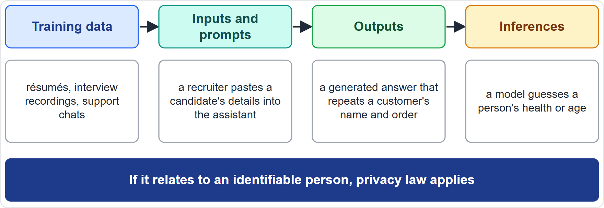
Why Privacy Law Reaches AI
BEYOND THE BOK
Part 1
Personal data is any information relating to an identified or identifiable person (General Data Protection Regulation, GDPR, Article 4(1)); processing is any operation on it (Article 4(2))
It appears in training data, in inputs and prompts, in outputs and in inferences about people
Profiling is automated evaluation of personal aspects such as performance, preferences or behavior (Article 4(4))
The controller decides purposes and means; the processor acts on its behalf (Articles 4(7) and 4(8))
US state privacy laws, such as Colorado's, use the same ideas: controllers, processors, and rights over profiling
EXAM TIP If data relate to an identifiable person at any stage, privacy law applies, even to a model's output.
AIGP Exam Prep Masterclass | Certified AI Governance Professional
Module 4: Privacy Laws Applied to AI
4 / 27
Notes:
This is a beyond-the-Body-of-Knowledge slide. Personal data is any information relating to an identified or identifiable person, in Article four, point one of the G D P R, the General Data Protection Regulation. Processing is any operation on it. In an A I system, personal data appears in training data, in inputs and prompts, in outputs, and in inferences about people. Profiling is automated evaluation of personal aspects. The controller decides purposes and means, and the processor acts on its behalf. U S state laws, such as Colorado's, use the same ideas. Exam tip: if data relate to an identifiable person at any stage, privacy law applies.

Slide 5
Transparency and Notice for AI
BEYOND THE BOK
Part 1
Question | What the GDPR asks
Principle | process lawfully, fairly and transparently (Article 5(1))
How | concise, intelligible, easy to find, clear and plain language (Article 12(1))
When | at collection (Article 13); when data come from elsewhere, within the set time (Article 14)
What | who the controller is, purposes and legal basis, recipients, transfers, rights
AI-specific | the existence of automated decision-making, including profiling, and meaningful information about the logic involved (Article 13(2)(f))
Notice for AI must say that AI is used, for what, and with what effect on the person
A generic privacy policy line is not enough for a hiring or credit decision
EXAM TIP Transparency about AI is part of privacy notice, not only an AI-law duty.
AIGP Exam Prep Masterclass | Certified AI Governance Professional
Module 4: Privacy Laws Applied to AI
5 / 27
Notes:
This is a beyond-the-Body-of-Knowledge slide. The G D P R requires processing that is lawful, fair and transparent, in Article five. Information must be concise, intelligible, easy to find, and in clear and plain language, Article twelve. It is given at collection under Article thirteen, or within the set time when data come from elsewhere, under Article fourteen. For A I, the notice must mention automated decision-making, including profiling, and meaningful information about the logic involved. Say that A I is used, for what, and with what effect. Exam tip: transparency about A I is part of privacy notice.

Slide 6
Choice, Consent and the Lawful Basis
BEYOND THE BOK · VERIFY LIVE
Part 1
Basis (Article 6(1)) | AI example
Consent (a) | an opt-in to have a chat used to improve a model
Contract (b) | processing an application the applicant asked for
Legal obligation (c) | keeping records the law requires
Vital interests (d) | rare in AI; an emergency
Public task (e) | a public body's benefit-eligibility model
Legitimate interests (f) | fraud detection, product security, sometimes model training, after a balancing test
Consent must be freely given, specific, informed and unambiguous; it is weak where there is a power imbalance, as in employment
No basis is ranked above another; the controller picks the right one and documents it
Legitimate interests need a three-step test: a real interest, necessity, and balancing against people's rights (European Data Protection Board, EDPB, Opinion 28/2024)
As of 27 October 2026: proposed GDPR changes for AI training (a new Article 88c) were not confirmed as adopted
EXAM TIP Consent is not always the basis; the question usually asks which basis fits the facts.
AIGP Exam Prep Masterclass | Certified AI Governance Professional
Module 4: Privacy Laws Applied to AI
6 / 27
Notes:
This is a beyond-the-Body-of-Knowledge slide, tagged verify live. Article six lists six lawful bases: consent, contract, legal obligation, vital interests, public task, and legitimate interests. Consent must be freely given, specific, informed and unambiguous, and it is weak where there is a power imbalance, as in employment. No basis is ranked above another. Legitimate interests need a three-step test: a real interest, necessity, and balancing against people's rights, as the European Data Protection Board, or E D P B, explained in its Opinion twenty-eight of twenty twenty-four. As of the twenty-seventh of October, twenty twenty-six, proposed G D P R changes for A I training, a new Article eighty-eight C, were not confirmed as adopted. Exam tip: consent is not always the basis.

Slide 7
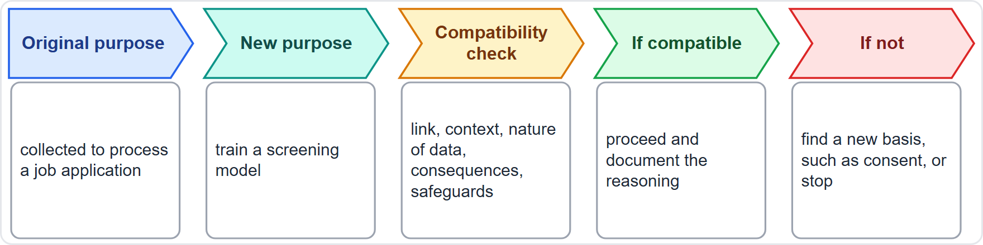
Purpose Limitation and Reuse of Data
Part 1
Data must be collected for specified, explicit and legitimate purposes and not used in an incompatible way (Article 5(1)(b))
To judge compatibility, weigh five factors (Article 6(4)): link between purposes, context, nature of the data, consequences for people, safeguards
If the new purpose is not compatible, it needs its own basis, such as consent, or it should not proceed
Helios: application data collected to process a job application are not automatically fit to train a screening model
EXAM TIP For reuse, ask first whether the new purpose is compatible with the original one.
AIGP Exam Prep Masterclass | Certified AI Governance Professional
Module 4: Privacy Laws Applied to AI
7 / 27
Notes:
Purpose limitation says data must be collected for specified, explicit and legitimate purposes, and not used in an incompatible way. That is Article five, paragraph one, point b. To judge compatibility, weigh five factors from Article six, paragraph four: the link between the purposes, the context, the nature of the data, the consequences for people, and the safeguards. If the new purpose is not compatible, it needs its own basis, such as consent, or it should not proceed. At Helios, application data are not automatically fit to train a screening model. Exam tip: for reuse, ask whether the new purpose is compatible.

Slide 8
What the Exam Asks: Notice, Choice, Basis, Purpose
Part 1
Notice must be specific to the use: it names AI, the purpose and the effect
Consent is one basis of six, and is often the wrong one in employment
A basis is needed for each purpose, including training and reuse
Purpose limitation blocks silent reuse; a compatibility check or new basis is required
Legitimate interests is not a default: it needs a balancing test and safeguards
Penalties: breaches of the principles, lawful basis and rights can be fined up to EUR 20 million or 4% of worldwide annual turnover, whichever is higher (Article 83(5))
EXAM TIP If a question lacks a basis for training, the answer is to establish one before using the data.
AIGP Exam Prep Masterclass | Certified AI Governance Professional
Module 4: Privacy Laws Applied to AI
8 / 27
Notes:
Here are the usual traps. Notice must be specific to the use: it names A I, the purpose and the effect. Consent is one basis of six, and often the wrong one in employment. A basis is needed for each purpose, including training and reuse. Purpose limitation blocks silent reuse. Legitimate interests is not a default; it needs a balancing test. And penalties: breaches of principles, lawful basis and rights can be fined up to twenty million euros or four percent of worldwide annual turnover, whichever is higher, under Article eighty-three. Exam tip: establish the basis before using the data.

Slide 9
Data Minimization in AI Systems
Part 1
Data must be adequate, relevant and limited to what is necessary for the purposes (Article 5(1)(c))
Also accurate (Article 5(1)(d)) and kept no longer than necessary (Article 5(1)(e))
For AI this means: choose features for the purpose, drop what the model does not need, set retention limits for training sets
The EDPB asks, for legitimate-interest training, whether there is a less intrusive way and whether the amount of data is proportionate
More data for a better model is not a legal defense
EXAM TIP Minimization asks for the least data that does the job, not the most data that might help.
AIGP Exam Prep Masterclass | Certified AI Governance Professional
Module 4: Privacy Laws Applied to AI
9 / 27
Notes:
Data must be adequate, relevant and limited to what is necessary for the purposes. That is Article five, paragraph one, point c. Data must also be accurate and kept no longer than necessary. For A I, that means choosing features for the purpose, dropping what the model does not need, and setting retention limits for training sets. The E D P B asks, for legitimate-interest training, whether there is a less intrusive way and whether the amount of data is proportionate. More data for a better model is not a legal defense. Exam tip: the least data that does the job.

Slide 10
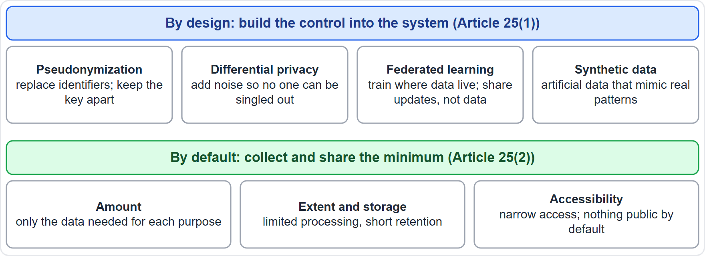
Privacy by Design and by Default
BEYOND THE BOK
Part 1
By design (Article 25(1)): build measures, such as pseudonymization, into the system from the start
By default (Article 25(2)): only the data needed for each purpose, in the amount, extent, storage period and accessibility
Pseudonymization: replace identifiers; extra information is kept apart
Differential privacy: add noise so no single person can be singled out
Federated learning: train where the data live, share model updates, not the data
Synthetic data: artificial data that mimic patterns of real data
EXAM TIP Privacy by default is the setting at the start: the narrowest sharing and shortest retention unless the person chooses otherwise.
AIGP Exam Prep Masterclass | Certified AI Governance Professional
Module 4: Privacy Laws Applied to AI
10 / 27
Notes:
This is a beyond-the-Body-of-Knowledge slide. Article twenty-five has two parts. By design: build measures, such as pseudonymization, into the system from the start. By default: process only the data needed for each purpose, in the amount, extent, storage period and accessibility. Privacy-enhancing techniques help. Pseudonymization replaces identifiers, with extra information kept apart. Differential privacy adds noise so no single person can be singled out. Federated learning trains where the data live and shares model updates, not data. Synthetic data mimic patterns of real data. Exam tip: privacy by default means the narrowest setting at the start.

Slide 11
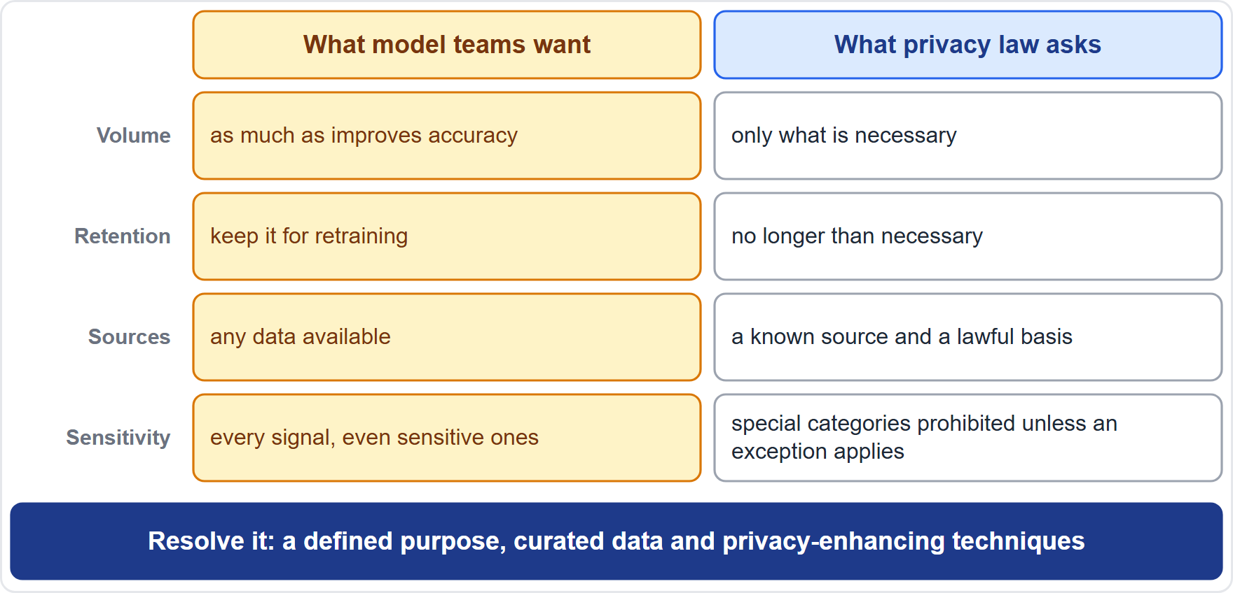
The Tension: Data-Hungry Models and Minimization
Part 1
Teams want more data, kept longer, from more sources
The law asks for the necessary amount, for the purpose, for as long as needed
Resolve it with a defined purpose, curated data, privacy-enhancing techniques, and retention limits
Document the necessity reasoning; regulators ask for it
EXAM TIP The answer to the tension is neither more data nor no AI: it is purpose, curation and technique, with a record.
AIGP Exam Prep Masterclass | Certified AI Governance Professional
Module 4: Privacy Laws Applied to AI
11 / 27
Notes:
Here is the tension. Model teams want more data, kept longer, from more sources. The law asks for the necessary amount, for the purpose, for as long as needed. Governance resolves it with a defined purpose, curated data, privacy-enhancing techniques and retention limits. And it documents the necessity reasoning, because regulators ask for it. Exam tip: the answer is neither more data nor no A I. It is purpose, curation and technique, with a record.

Slide 12
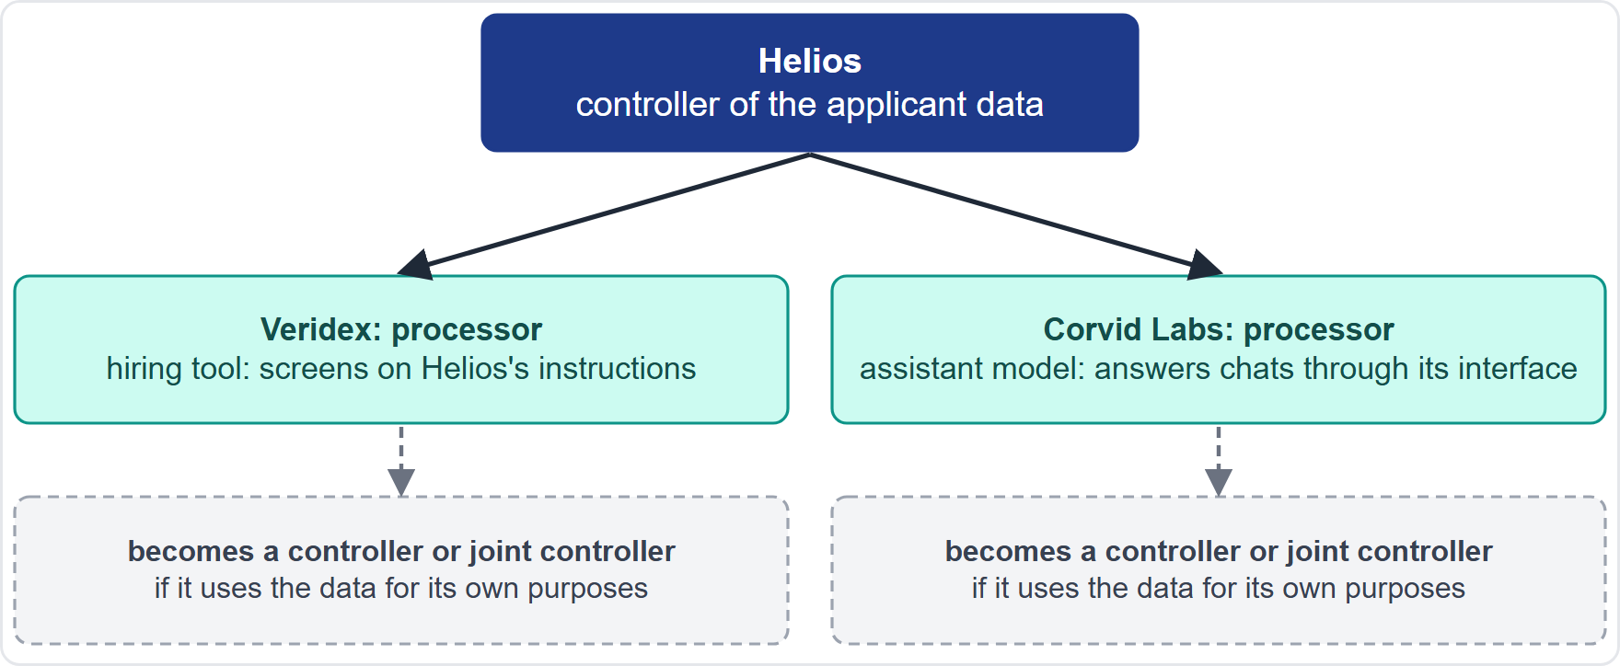
Controller, Processor and Joint Controller in AI
BEYOND THE BOK
Part 1
The controller decides purposes and means; the processor acts on its documented instructions (Articles 4(7), 4(8))
Joint controllers decide together and must set out who does what; people may exercise rights against each (Article 26)
Helios is the controller of applicant data; Veridex screens on its instructions, so it is a processor
If Veridex uses the data to improve its own model, it decides a purpose of its own and may become a controller or joint controller
Corvid Labs is a processor for chats sent through its interface, on the same test
EXAM TIP The label follows who decides purposes and means, not the contract title.
AIGP Exam Prep Masterclass | Certified AI Governance Professional
Module 4: Privacy Laws Applied to AI
12 / 27
Notes:
This is a beyond-the-Body-of-Knowledge slide. The controller decides purposes and means. The processor acts on documented instructions. Joint controllers decide together and must set out who does what, and people may exercise rights against each, under Article twenty-six. At Helios, Helios is the controller of applicant data. Veridex screens on its instructions, so it is a processor. But if Veridex uses the data to improve its own model, it decides a purpose of its own, and may become a controller or joint controller. Corvid Labs is a processor for chats sent through its interface, on the same test. Exam tip: the label follows who decides.

Slide 13
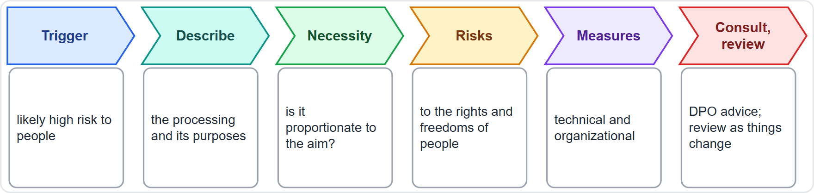
Impact Assessments: DPIA and Its Relatives
BEYOND THE BOK
Part 2
A data protection impact assessment (DPIA) is required before processing that is likely to result in a high risk to people (Article 35(1))
Named cases include systematic, extensive evaluation based on automated processing (profiling) leading to significant decisions, and large-scale special-category data (Article 35(3))
Minimum content: description and purposes, necessity and proportionality, risks, measures (Article 35(7)); seek the data protection officer's advice (Article 35(2))
US: Colorado requires a documented data protection assessment for profiling with defined risks and for sensitive data
A DPIA feeds the AI impact assessments of modules 8 and 12
EXAM TIP A hiring tool that scores people is a textbook DPIA case: profiling with significant effects.
AIGP Exam Prep Masterclass | Certified AI Governance Professional
Module 4: Privacy Laws Applied to AI
13 / 27
Notes:
This is a beyond-the-Body-of-Knowledge slide. A data protection impact assessment is required before processing that is likely to result in a high risk to people. That is Article thirty-five, paragraph one. Named cases include systematic, extensive evaluation based on automated processing, such as profiling, and large-scale special-category data. The minimum content is a description and purposes, necessity and proportionality, risks, and measures. Seek the data protection officer's advice. In the U S, Colorado requires a documented assessment for profiling with defined risks and for sensitive data. A D P I A feeds the A I impact assessments of modules eight and twelve. Exam tip: a scoring hiring tool is a textbook case.

Slide 14
Third-Party Processors and Sub-Processors
Part 2
Rule (Article 28) | What it means for AI vendors
Sufficient guarantees | choose processors that can meet the GDPR; assess them
Binding contract | processing only on documented instructions; confidentiality; security; help with rights and assessments; delete or return data; audit information
Sub-processors | none without the controller's written authorization; same duties passed down; the first processor stays fully liable
In AI supply chains, a model provider or cloud host is often a sub-processor
Ask for the list of sub-processors, and bar use of your data to train the vendor's own models without your approval
EXAM TIP A processor contract is mandatory, and the vendor cannot add sub-processors without the controller's authorization.
AIGP Exam Prep Masterclass | Certified AI Governance Professional
Module 4: Privacy Laws Applied to AI
14 / 27
Notes:
Article twenty-eight governs processors. The controller must use processors with sufficient guarantees. A binding contract requires processing only on documented instructions, confidentiality, security, help with rights and assessments, deletion or return of data, and audit information. Sub-processors need the controller's written authorization, they carry the same duties, and the first processor stays fully liable. In A I supply chains, a model provider or cloud host is often a sub-processor. Ask for the list, and bar use of your data to train the vendor's own models. Exam tip: a processor contract is mandatory.

Slide 15
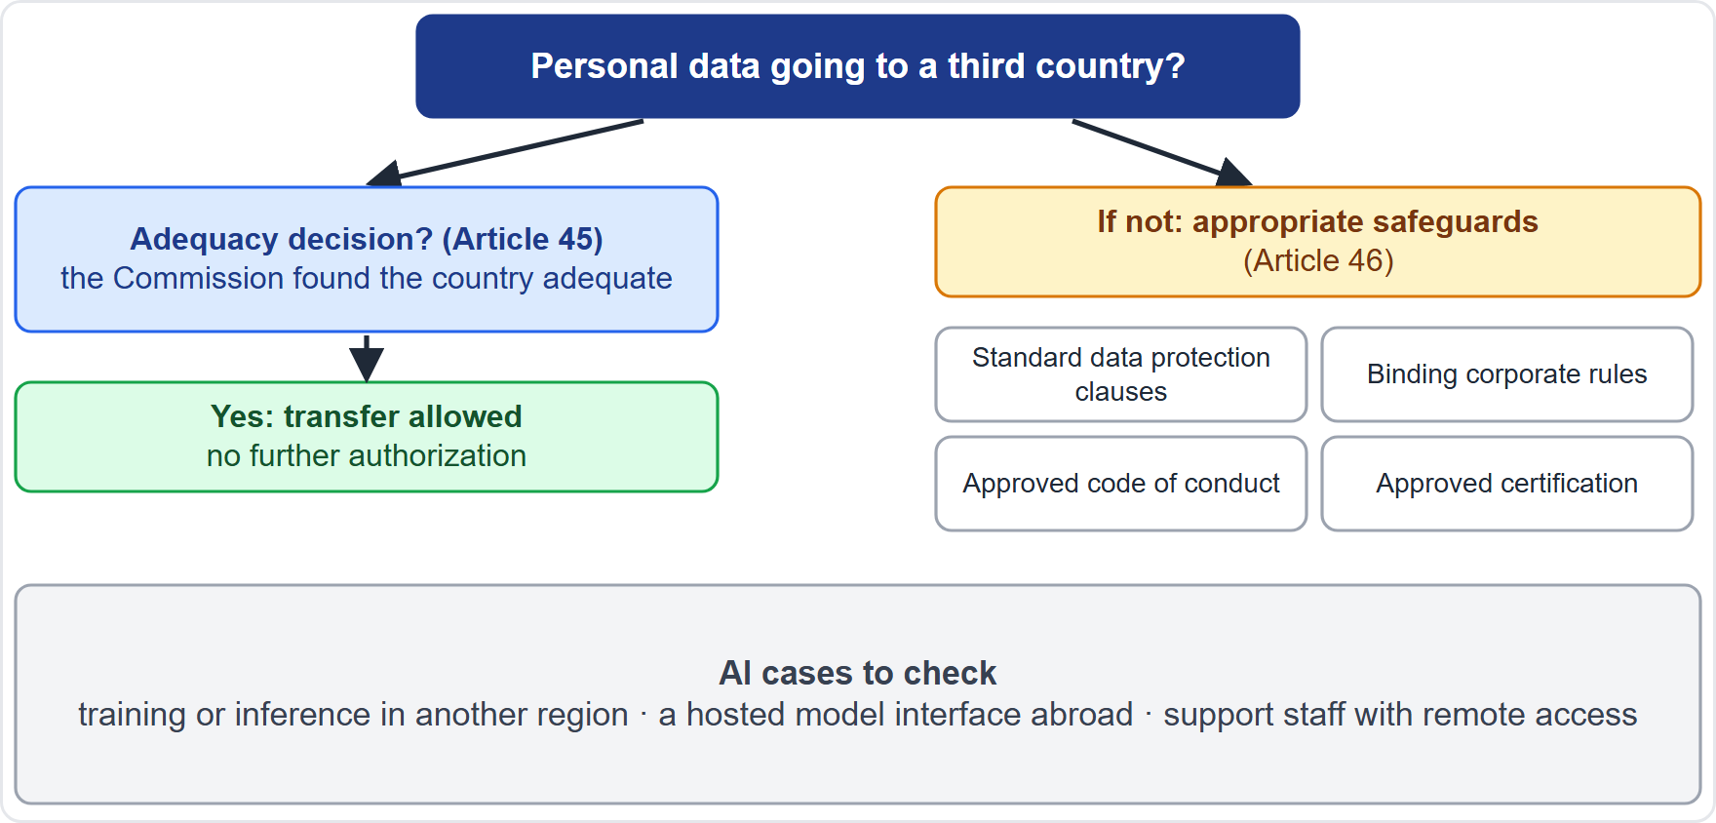
Cross-Border Transfers
BEYOND THE BOK · VERIFY LIVE
Part 2
Chapter V governs transfers (Articles 44 to 49); breaches fall in the higher fine tier
Adequacy decision (Article 45): the Commission finds a country, territory or sector adequate; no further authorization is needed
Otherwise appropriate safeguards (Article 46): standard data protection clauses, binding corporate rules, an approved code of conduct or certification, with enforceable rights and remedies
AI cases: training or inference in another region, a hosted model interface abroad, and support staff with remote access
As of 27 October 2026: adequacy decisions, such as the EU-US Data Privacy Framework for certified US companies, can be challenged; check the current list
EXAM TIP Remote access from a third country is a transfer too; look for the mechanism, not only the server location.
AIGP Exam Prep Masterclass | Certified AI Governance Professional
Module 4: Privacy Laws Applied to AI
15 / 27
Notes:
This is a beyond-the-Body-of-Knowledge slide, tagged verify live. Chapter five of the G D P R governs transfers, in Articles forty-four to forty-nine. First, an adequacy decision under Article forty-five: the Commission finds a country, territory or sector adequate. Otherwise, appropriate safeguards under Article forty-six: standard data protection clauses, binding corporate rules, an approved code of conduct or certification. A I cases include training or inference in another region, a hosted model interface abroad, and remote support access. As of the twenty-seventh of October, twenty twenty-six, adequacy decisions, such as the E U-U S Data Privacy Framework, can be challenged. Exam tip: remote access is a transfer too.

Slide 16
Data Subject Rights Applied to AI
BEYOND THE BOK
Part 2
Right | Article | The AI angle
Access | 15 | a copy of the data; for automated decisions, meaningful information about the logic involved and the consequences
Rectification | 16 | fix wrong data; wrong inputs mean wrong outputs
Erasure | 17 | grounds include data no longer needed, withdrawn consent, unlawful processing
Portability | 20 | data the person provided, under consent or contract, by automated means
Objection | 21 | to processing based on public task or legitimate interests, including profiling
Answer within one month, extendable by two further months where needed (Article 12(3))
Erasure from a trained model is hard: prevent it by keeping personal data out of training where possible, and document how requests are handled
EXAM TIP Match the right to the request: copy is access, fix is rectification, stop is objection or erasure, move is portability.
AIGP Exam Prep Masterclass | Certified AI Governance Professional
Module 4: Privacy Laws Applied to AI
16 / 27
Notes:
This is a beyond-the-Body-of-Knowledge slide. Five rights matter most. Access, Article fifteen: a copy of the data, and for automated decisions, meaningful information about the logic involved. Rectification, Article sixteen: fix wrong data. Erasure, Article seventeen, with grounds such as data no longer needed or withdrawn consent. Portability, Article twenty, for data the person provided under consent or contract. Objection, Article twenty-one, to processing based on public task or legitimate interests. Answer within one month, extendable by two months. Erasure from a trained model is hard, so keep personal data out of training where possible. Exam tip: match the right to the request.

Slide 17
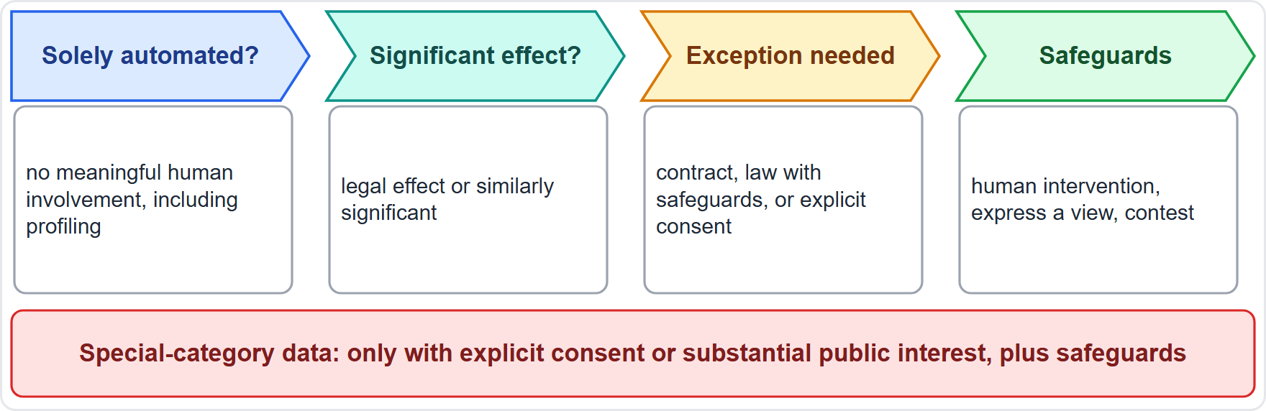
Automated Decision-Making: Article 22 and the SCHUFA Ruling
BEYOND THE BOK · DATES
Part 2
Article 22(1): a right not to be subject to a decision based solely on automated processing, including profiling, with legal or similarly significant effects
Exceptions (Article 22(2)): necessary for a contract, authorized by law with safeguards, or based on explicit consent
Safeguards (Article 22(3)): at least human intervention, the chance to express a view and to contest the decision
Special-category data (Article 22(4)) only with explicit consent or substantial public interest, plus safeguards
CJEU, 7 December 2023 (SCHUFA, C-634/21): an automated credit score can itself be a decision where a third party draws strongly on it
EXAM TIP A rubber-stamp human review does not turn a solely automated decision into a human one.
AIGP Exam Prep Masterclass | Certified AI Governance Professional
Module 4: Privacy Laws Applied to AI
17 / 27
Notes:
This is a beyond-the-Body-of-Knowledge slide, tagged dates. Article twenty-two, paragraph one, gives a right not to be subject to a decision based solely on automated processing, including profiling, with legal or similarly significant effects. Exceptions: a contract, authorization by law with safeguards, or explicit consent. Safeguards: at least human intervention, the chance to express a view, and to contest the decision. Special-category data only with explicit consent or substantial public interest. On the seventh of December, twenty twenty-three, the Court of Justice ruled in SCHUFA that an automated credit score can itself be a decision, where a third party draws strongly on it. Exam tip: a rubber-stamp review does not make it human.

Slide 18
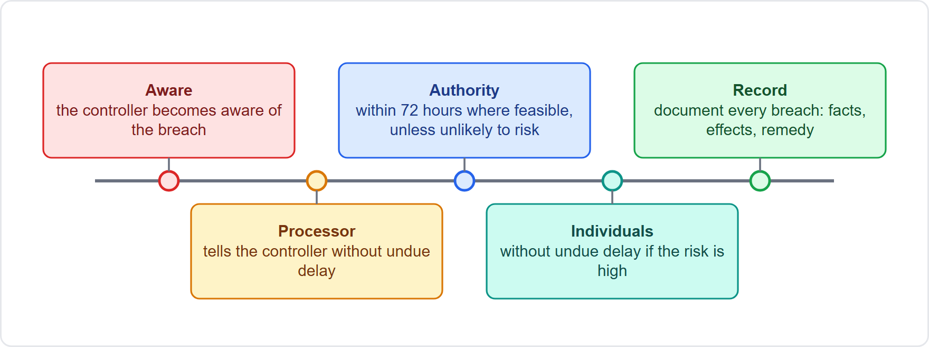
Incidents, Breach Notification and Records
Part 2
A processor tells the controller without undue delay (Article 33(2))
The controller notifies the authority without undue delay and where feasible within 72 hours of becoming aware, unless the breach is unlikely to result in a risk (Article 33(1))
If risk is high, inform the people without undue delay; not needed if the data were protected, such as by encryption (Article 34)
Document every breach, with facts, effects and remedial action (Article 33(5))
Record keeping: a record of processing activities (Article 30), with purposes, data, recipients, transfers, retention and security; small organizations are exempt only in limited cases
EXAM TIP The 72 hours run from becoming aware, and a late notice must give its reasons.
AIGP Exam Prep Masterclass | Certified AI Governance Professional
Module 4: Privacy Laws Applied to AI
18 / 27
Notes:
A processor tells the controller without undue delay. The controller notifies the authority without undue delay and, where feasible, within seventy-two hours of becoming aware, unless the breach is unlikely to result in a risk. That is Article thirty-three. If the risk is high, inform the people without undue delay, under Article thirty-four, unless the data were protected, for example by encryption. Document every breach. For records, Article thirty requires a record of processing activities, covering purposes, data, recipients, transfers, retention and security. Exam tip: the seventy-two hours run from becoming aware, and a late notice must give its reasons.

Slide 19
Sensitive and Special-Category Data
BEYOND THE BOK
Part 2
Special categories (Article 9(1)) | Examples in AI
Racial or ethnic origin; political opinions; religious or philosophical beliefs; trade union membership | a model inferring beliefs from posts
Genetic data; biometric data for unique identification | face matching; voiceprints
Data concerning health; sex life or sexual orientation | health inferred from a video interview
Processing is prohibited unless an exception applies, such as explicit consent, employment law obligations, substantial public interest or legal claims (Article 9(2))
Data that reveal a sensitive characteristic can be special-category data even when inferred, and proxies can do the same
Solely automated decisions on special categories need explicit consent or substantial public interest (Article 22(4))
US laws define sensitive data differently; Colorado requires an assessment for sensitive-data processing
EXAM TIP The test is what the data reveal: an inferred health condition is sensitive even if nobody supplied it.
AIGP Exam Prep Masterclass | Certified AI Governance Professional
Module 4: Privacy Laws Applied to AI
19 / 27
Notes:
This is a beyond-the-Body-of-Knowledge slide. Article nine lists the special categories: racial or ethnic origin, political opinions, religious or philosophical beliefs, trade union membership, genetic data, biometric data for unique identification, data concerning health, and sex life or sexual orientation. Processing is prohibited unless an exception applies, such as explicit consent, employment law obligations, substantial public interest or legal claims. Data that reveal a sensitive characteristic can count even when inferred, and proxies can do the same. U S laws define sensitive data differently. Exam tip: the test is what the data reveal. An inferred health condition is sensitive.

Slide 20
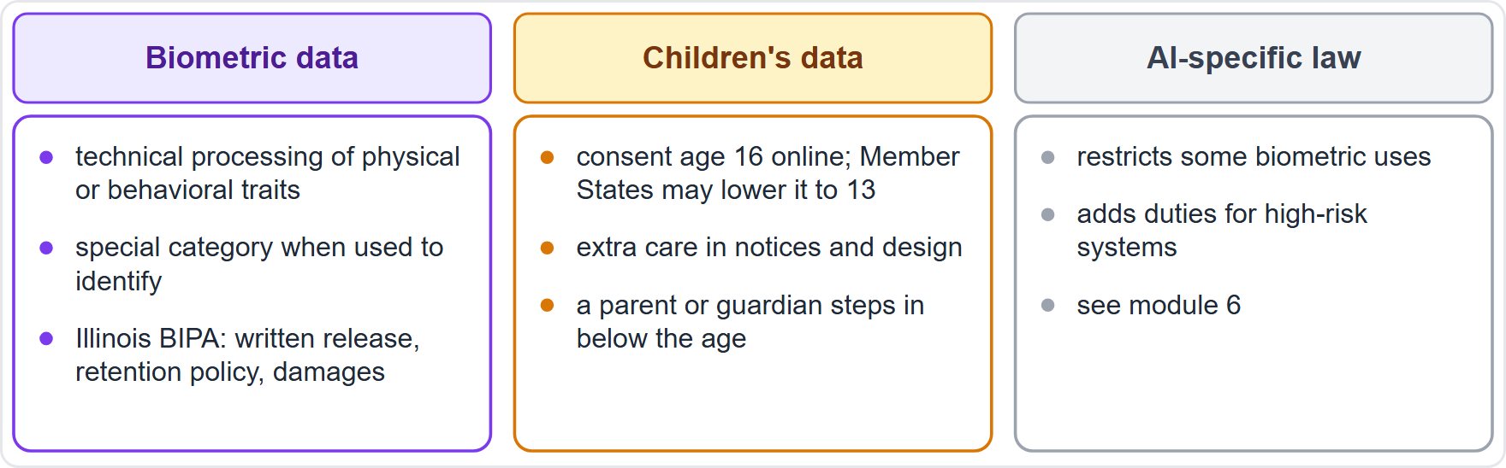
Biometrics, Children and Other High-Risk Data
BEYOND THE BOK
Part 2
Biometric data result from technical processing of physical, physiological or behavioral traits and allow or confirm unique identification (Article 4(14)); used to identify, they are special-category data
Illinois BIPA (Biometric Information Privacy Act): informed written release before collection, a published retention and destruction policy, and damages of USD 1,000 or USD 5,000 per violation type (secondary sources)
Children: where consent is the basis for online services, the age is 16, which Member States may lower to 13 (Article 8)
AI-specific law adds rules for some biometric uses (module 6)
EXAM TIP Biometric data are sensitive when used to identify a person; a face scan for unlocking or matching is the typical case.
AIGP Exam Prep Masterclass | Certified AI Governance Professional
Module 4: Privacy Laws Applied to AI
20 / 27
Notes:
This is a beyond-the-Body-of-Knowledge slide. Biometric data result from technical processing of physical, physiological or behavioral traits and allow or confirm unique identification, in Article four, point fourteen. Used to identify, they are special-category data. The Illinois biometric privacy act requires informed written release before collection, a published retention and destruction policy, and damages of one thousand or five thousand dollars; those details come from secondary sources. For children, where consent is the basis for online services, the age is sixteen, which Member States may lower to thirteen, under Article eight. Module six covers AI-specific rules. Exam tip: biometric data are sensitive when used to identify.

Slide 21
Module Recap
Part 2
1
Notice, basis, purpose
2
Minimization and design
3
Controller duties
assess (DPIA), contract processors, secure transfers, answer rights, control automated decisions, notify breaches, keep records
tell people about AI use; pick and document a lawful basis; check compatibility before reuse
the least data, built in from the start and by default; privacy-enhancing techniques
4
Sensitive data
5
Roles
prohibited unless an exception applies; what data reveal counts; biometrics, children and inferences need extra care
controller, processor and joint controller follow who decides purposes and means
AIGP Exam Prep Masterclass | Certified AI Governance Professional
Module 4: Privacy Laws Applied to AI
21 / 27
Notes:
Let us recap. Tell people about A I use, pick and document a lawful basis, and check compatibility before reuse. Use the least data, built in from the start and by default, with privacy-enhancing techniques. As controller: assess with a D P I A, contract processors, secure transfers, answer rights, control automated decisions, notify breaches and keep records. Sensitive data is prohibited unless an exception applies, and what data reveal counts. And controller, processor and joint controller follow who decides purposes and means.

Slide 22
Practice Question 1
Part 2
Q1
Helios wants to use past applicants' data to train a better screening model. The data were collected only to process each application. Under the GDPR, which question should be answered first?
A
Whether the vendor's marketing material says that the applicant data are fully anonymized
B
Whether training is compatible with the purpose of collection, and which lawful basis supports it
C
Whether the training data can be moved to a lower-cost cloud region without a contract change
D
Whether the applicants have received an annual reminder email about the company's recruiting policy
AIGP Exam Prep Masterclass | Certified AI Governance Professional
Module 4: Privacy Laws Applied to AI
22 / 27
Notes:
Question one. Helios wants to use past applicants' data to train a better screening model. The data were collected only to process each application. Under the G D P R, which question should be answered first? The four options are on the screen. [PAUSE 12] The answer is B. Reusing data for a new purpose needs a compatibility check, or a new lawful basis, and the controller must document it.

Slide 23
Practice Question 2
Part 2
Q2
Which TWO measures best serve data minimization and privacy by design in a screening model? (Select TWO.)
A
Remove input fields that are not needed for the stated purpose of the model
B
Collect the broadest set of applicant data points in case it improves accuracy later
C
Pseudonymize the training data and limit who can access it and for how long
D
Keep the application data for as long as models might need to be retrained in the future
E
Publish the full training dataset online to demonstrate openness to the public
AIGP Exam Prep Masterclass | Certified AI Governance Professional
Module 4: Privacy Laws Applied to AI
23 / 27
Notes:
Question two. Which two measures best serve data minimization and privacy by design in a screening model? Select two. The five options are on the screen. [PAUSE 15] The answers are A and C. Minimization limits data to what the purpose needs, and measures such as pseudonymization with access and retention limits support it. Collecting everything, keeping data indefinitely, and publishing the dataset work against it.

Slide 24
Practice Question 3
Part 2
Q3
Helios plans to send EU applicants' data to Veridex's servers in the United States. Which statement is correct?
A
No transfer mechanism is needed, because Veridex acts as a processor for Helios
B
A note in the privacy notice is enough, because applicants have not objected to the transfer
C
A transfer mechanism is needed only if the data contain special categories of personal data
D
A transfer mechanism is needed, such as an adequacy decision or appropriate safeguards
AIGP Exam Prep Masterclass | Certified AI Governance Professional
Module 4: Privacy Laws Applied to AI
24 / 27
Notes:
Question three. Helios plans to send E U applicants' data to Veridex's servers in the United States. Which statement is correct? The four options are on the screen. [PAUSE 12] The answer is D. A transfer to a third country needs an adequacy decision or appropriate safeguards, such as standard data protection clauses, whether the recipient is a controller or a processor.

Slide 25
Practice Question 4
Part 2
Q4
An EU job applicant is rejected automatically by a score, with no human review. The applicant asks the company for a copy of their data, a correction of a wrong employment date, and an explanation of how the score was reached. Which THREE rights are engaged? (Select THREE.)
A
The right to erasure of the data held in the application file
B
The right of access, including a copy of the personal data
C
The right to portability of the application data to another employer
D
The right to rectification of the inaccurate employment date
E
The right to meaningful information about the logic of the automated decision
AIGP Exam Prep Masterclass | Certified AI Governance Professional
Module 4: Privacy Laws Applied to AI
25 / 27
Notes:
Question four. An E U job applicant is rejected automatically by a score, with no human review. The applicant asks for a copy of their data, a correction of a wrong employment date, and an explanation of how the score was reached. Which three rights are engaged? Select three. The five options are on the screen. [PAUSE 15] The answers are B, D and E. Access, rectification, and meaningful information about the logic of an automated decision. Nothing asks for erasure or portability.

Slide 26
Practice Question 5
Part 2
Q5
A model infers an applicant's health condition from a video interview and uses it in scoring. How does the GDPR treat the inferred information?
A
It is not personal data, because the applicant did not provide it to the company
B
It is ordinary personal data, because an inference is a statistical guess
C
It is special-category data if it reveals health, so Article 9 conditions apply
D
It may be used, because legitimate interests cover scoring decisions
AIGP Exam Prep Masterclass | Certified AI Governance Professional
Module 4: Privacy Laws Applied to AI
26 / 27
Notes:
Question five. A model infers an applicant's health condition from a video interview and uses it in scoring. How does the G D P R treat the inferred information? The four options are on the screen. [PAUSE 12] The answer is C. Data that reveal a sensitive characteristic, such as health, fall under the special categories even when inferred, so a prohibition applies unless an Article nine exception is met.

Slide 27
Answers at a Glance
Part 2
Question | Answer | Why
Q1 | B | Compatibility and lawful basis come first
Q2 | A, C | Fewer fields; pseudonymization with access and retention limits
Q3 | D | A transfer needs adequacy or safeguards
Q4 | B, D, E | Access, rectification, logic of the decision
Q5 | C | Inferred health data are special-category data
AIGP Exam Prep Masterclass | Certified AI Governance Professional
Module 4: Privacy Laws Applied to AI
27 / 27
Notes:
Here are all five answers. Question one: B. Question two: A and C. Question three: D. Question four: B, D and E. Question five: C. That completes Module four. Next, Module five covers other existing laws applied to A I: intellectual property, nondiscrimination, consumer protection and product liability.

