Slide 1
Module 5: Other Existing Laws Applied to AI
Intellectual property, nondiscrimination, consumer protection and product liability
Domain II · Competency B · Indicators II.B.1 to II.B.4
AIGP Exam Prep Masterclass
Module 5 · Part 1
Notes:
Welcome to Module five: Other Existing Laws Applied to A I. Competency B of domain two asks how laws that were not written for A I still apply to it. Four areas matter: intellectual property, nondiscrimination, consumer protection, and product liability. Several of the points here are still developing, so watch for the verify-live tags.

Slide 2
What You Will Learn
Part 1
Explain how intellectual property law limits what data AI may train on, and who owns outputs
Explain how nondiscrimination law reaches hiring, credit, housing and insurance AI
Explain how consumer-protection law treats unfair and deceptive AI claims and practices
Explain how product-liability law treats AI defects, including the new EU rules
AIGP Exam Prep Masterclass | Certified AI Governance Professional
Module 5: Other Existing Laws Applied to AI
2 / 27
Notes:
By the end of this module you will be able to do four things. Explain how intellectual property law limits what data A I may train on, and who owns outputs. Explain how nondiscrimination law reaches hiring, credit, housing and insurance. Explain how consumer protection law treats unfair and deceptive A I claims. And explain how product liability law treats A I defects, including the new E U rules.

Slide 3
Case Check-In: Training Data, Hiring Results and a Marketing Claim
Part 1
CASE CHECK-IN · Helios
Helios's support assistant learned from help-center articles, some written by third parties
The hiring tool selects one group of applicants at a clearly lower rate than another
Marketing wants to call the assistant always accurate; it once gave a customer a refund window that does not exist
Jonas Weber, Head of Legal and Privacy, asks which laws beyond privacy are now in play
AIGP Exam Prep Masterclass | Certified AI Governance Professional
Module 5: Other Existing Laws Applied to AI
3 / 27
Notes:
At Helios, three things happen at once. The support assistant learned from help-center articles, some written by third parties. The hiring tool selects one group of applicants at a clearly lower rate than another. And marketing wants to call the assistant always accurate, although it once gave a customer a refund window that does not exist. Jonas Weber, Head of Legal and Privacy, asks which laws beyond privacy are now in play.

Slide 4
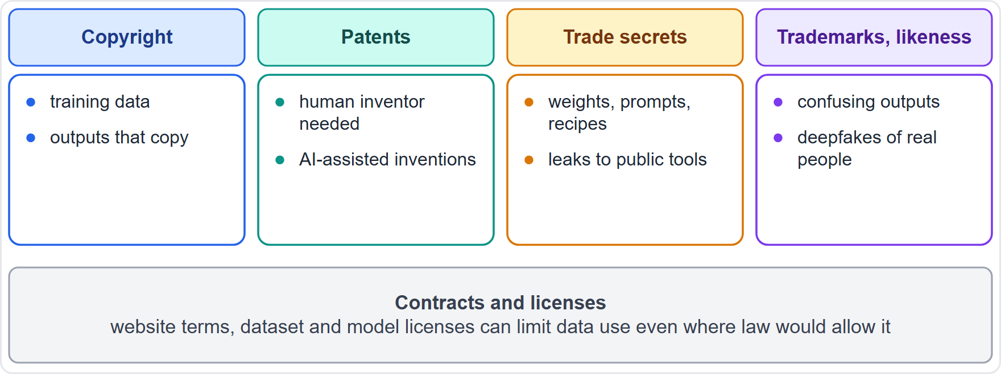
How Intellectual Property Law Meets AI
Part 1
Copyright: protects creative works, so it bears on training data and on outputs that copy
Patents: protect inventions; courts and offices have required a human inventor
Trade secrets and confidentiality: protect model weights, prompts and data; leaks to public tools destroy secrecy
Trademarks and likeness: protect names, logos and personal identity against confusing or deceptive AI outputs
Contracts and licenses (website terms, dataset and model licenses) can limit data use even where law would allow it
EXAM TIP For an IP question, first name the right being used (copyright, trade secret, license), then ask whether use is allowed.
AIGP Exam Prep Masterclass | Certified AI Governance Professional
Module 5: Other Existing Laws Applied to AI
4 / 27
Notes:
Intellectual property law meets A I at several points. Copyright protects creative works, so it bears on training data and on outputs that copy. Patents protect inventions, and courts and offices have required a human inventor. Trade secrets and confidentiality protect model weights, prompts and data, and leaks to public tools destroy secrecy. Trademarks and likeness protect names, logos and personal identity. And contracts and licenses can limit data use even where law would allow it. Exam tip: first name the right being used, then ask whether use is allowed.

Slide 5
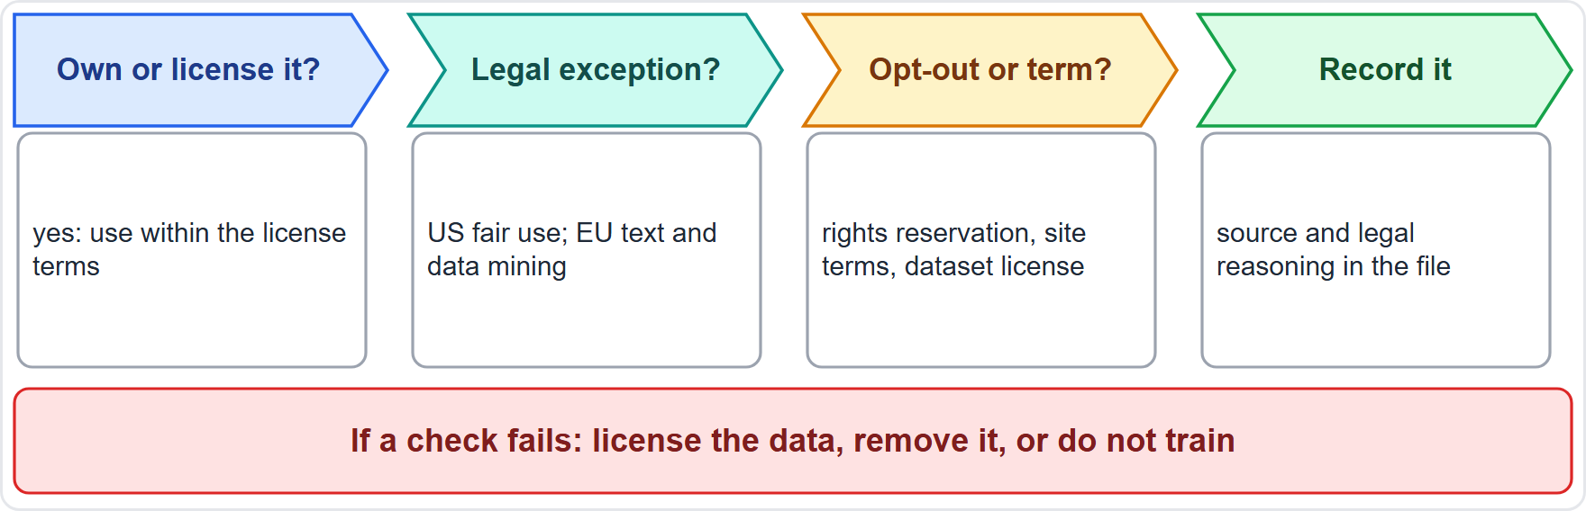
Training Data: Copyright, Mining Exceptions and Opt-Outs
BEYOND THE BOK
Part 1
US: fair use, decided case by case on four factors: purpose and character, nature of the work, amount used, effect on the market (17 U.S.C. 107)
EU: text and data mining exceptions exist, but a rightsholder can reserve its rights
General-purpose model providers need a copyright policy that honors reservations (AI Act Article 53(1)(c)) and a public training-content summary (Article 53(1)(d))
Website terms, licenses and scraping rules can limit use even where an exception exists
Governance: license where needed, record sources and reasoning, honor opt-outs
EXAM TIP Public availability is not permission: a question about scraped data asks for a license, an exception, or both, and for records.
AIGP Exam Prep Masterclass | Certified AI Governance Professional
Module 5: Other Existing Laws Applied to AI
5 / 27
Notes:
This is a beyond-the-Body-of-Knowledge slide. In the U S, copyright allows fair use, decided case by case on four factors: purpose and character of the use, nature of the work, amount used, and effect on the market. In the E U, there are exceptions for text and data mining, but a rightsholder can reserve its rights. Providers of general-purpose models must have a copyright policy that honors such reservations, and must publish a sufficiently detailed summary of training content, under Article fifty-three. Website terms and dataset licenses can restrict use even where an exception exists. Exam tip: public availability is not permission.

Slide 6
Outputs: Who Owns What AI Makes?
BEYOND THE BOK · VERIFY LIVE
Part 1
Copyright needs human authorship: purely AI-generated material is not protected, while human-written parts and creative selection, arrangement or editing can be
The US Copyright Office released its report on copyrightability on 29 January 2025; prompts alone were not enough for authorship
Patents: an AI cannot be the inventor; humans who contribute to an invention can be
Infringing outputs: a model can reproduce protected text or images, so the user or the company may face a claim
Contracts decide the rest: vendor terms say who owns outputs and whether the vendor indemnifies for infringement claims
As of 27 October 2026: courts and offices are still refining these rules; check current authority
EXAM TIP If no human contributed creative expression, there may be no copyright to own; the contract still allocates use and risk.
AIGP Exam Prep Masterclass | Certified AI Governance Professional
Module 5: Other Existing Laws Applied to AI
6 / 27
Notes:
This is a beyond-the-Body-of-Knowledge slide, tagged verify live. Copyright needs human authorship. Purely A I-generated material is not protected, while human-written parts and creative selection, arrangement or editing can be. The U S Copyright Office released its report on copyrightability on the twenty-ninth of January, twenty twenty-five, and said prompts alone were not enough. An A I cannot be a patent inventor. Outputs can also infringe, so the user or company may face a claim. Contracts decide the rest: who owns outputs, and who indemnifies. As of the twenty-seventh of October, twenty twenty-six, these rules are still being refined.

Slide 7
Licenses, Trade Secrets and Confidentiality
BEYOND THE BOK
Part 1
Area | What to watch in AI
Open-source licenses | permissive licenses allow wide reuse; copyleft licenses can require sharing derived code on the same terms
Model licenses | open weights are not always open source; use restrictions, attribution and field-of-use limits
Dataset licenses | permitted purposes (research only, non-commercial) and attribution duties
Trade secrets | model weights, prompts and training recipes; reasonable secrecy measures are required
Confidential data | staff pasting client or personal data into public tools can breach contract and destroy secrecy
Helios: an approved-tools list, license review for every model and dataset, and a rule against pasting confidential data into unapproved tools
EXAM TIP Read the license: open weights do not mean unrestricted commercial use.
AIGP Exam Prep Masterclass | Certified AI Governance Professional
Module 5: Other Existing Laws Applied to AI
7 / 27
Notes:
This is a beyond-the-Body-of-Knowledge slide. Open-source licenses: permissive ones allow wide reuse, while copyleft ones can require sharing derived code on the same terms. Model licenses: open weights are not always open source, and use restrictions are common. Dataset licenses limit purposes, such as research only. Trade secrets cover weights, prompts and training recipes, and need reasonable secrecy measures. Staff pasting client or personal data into public tools can breach contracts and destroy secrecy. At Helios, that means an approved-tools list and license review for every model and dataset. Exam tip: read the license.

Slide 8
Where the Courts Stand
BEYOND THE BOK · DATES · VERIFY LIVE
Part 1
Matter | Point to know
Thomson Reuters v. Ross (Third Circuit, 29 September 2026) | first federal appellate decision on fair use in AI training; the tool was not generative; the court did not hold training is always infringing
Bartz v. Anthropic (settled for USD 1.5 billion, approved 20 July 2026) | training on lawfully acquired books was held fair use; keeping a library of pirated copies was not
Overall | no controlling appellate ruling on generative AI training; outcomes depend on the facts, the source of the data and market harm
As of 27 October 2026: these cases are fast-moving and rest on secondary reports; treat them as illustrations, not settled law
EXAM TIP The safe answer is that fair use is fact-specific: where data came from and what harm the use does to the market both matter.
AIGP Exam Prep Masterclass | Certified AI Governance Professional
Module 5: Other Existing Laws Applied to AI
8 / 27
Notes:
This is a beyond-the-Body-of-Knowledge slide, tagged dates and verify live. On the twenty-ninth of September, twenty twenty-six, the Third Circuit affirmed the ruling against Ross in Thomson Reuters. It is the first federal appellate decision on fair use in A I training, but the tool was not generative, and the court did not hold that training is always infringing. In Bartz against Anthropic, training on lawfully acquired books was held fair use, keeping pirated copies was not, and the case settled for one point five billion dollars. Overall, there is no controlling appellate ruling on generative training. Exam tip: fair use is fact-specific.

Slide 9
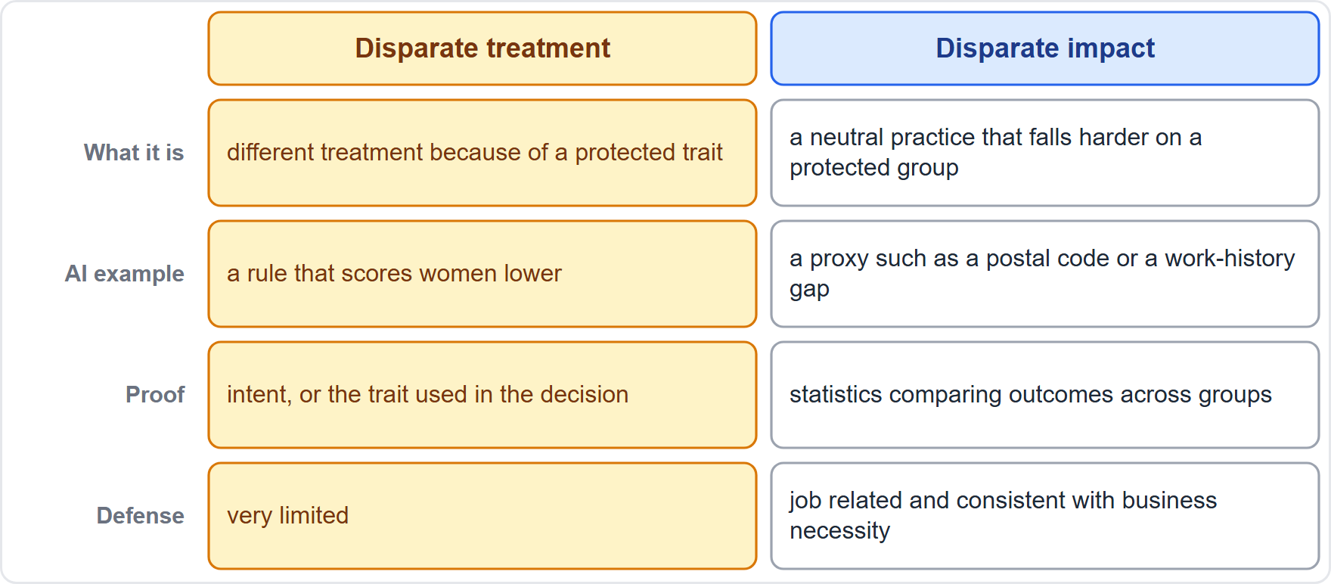
Two Theories of Discrimination
Part 1
Disparate treatment: treating people differently because of a protected characteristic, such as race, color, religion, sex or national origin (Title VII)
Disparate impact: a neutral practice that falls harder on a protected group; unlawful if it is not job related and consistent with business necessity, or if a less discriminatory alternative exists
In AI, proxies (a postal code, a gap in work history) can cause impact without using the characteristic
Laws also cover age (Age Discrimination in Employment Act, ADEA) and disability (Americans with Disabilities Act, ADA)
EXAM TIP If the tool never sees the protected characteristic but the results differ, think disparate impact.
AIGP Exam Prep Masterclass | Certified AI Governance Professional
Module 5: Other Existing Laws Applied to AI
9 / 27
Notes:
Discrimination law has two main theories. Disparate treatment means treating people differently because of a protected characteristic, such as race, color, religion, sex or national origin, under Title VII. Disparate impact means a neutral practice that falls harder on a protected group. It is unlawful if it is not job related and consistent with business necessity, or if a less discriminatory alternative exists. In A I, proxies such as a postal code can cause impact without using the characteristic. Age and disability are covered too. Exam tip: if the tool never sees the characteristic but results differ, think disparate impact.

Slide 10
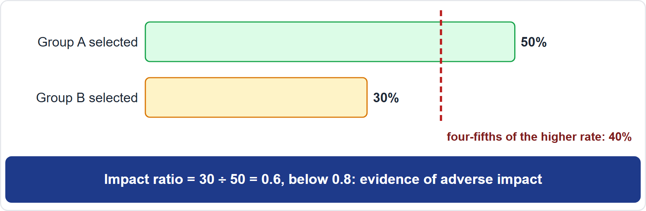
Measuring Adverse Impact: The Four-Fifths Rule
Part 1
Selection rate: the share of a group's applicants who are selected
Impact ratio: the lower group's rate divided by the highest group's rate
A ratio below four-fifths (80%) is generally treated by federal agencies as evidence of adverse impact (29 CFR 1607.4(D), the Code of Federal Regulations)
It is a rule of thumb, not a safe harbor: smaller gaps can still be unlawful, and larger ones may not be
Example: 50% against 30% gives 0.6; 40 of 100 against 36 of 100 gives 0.9
EXAM TIP Compute the lower rate over the higher rate; a result under 0.8 flags review, a result above does not clear the tool.
AIGP Exam Prep Masterclass | Certified AI Governance Professional
Module 5: Other Existing Laws Applied to AI
10 / 27
Notes:
How do you measure adverse impact? Selection rate is the share of a group's applicants who are selected. The impact ratio is the lower group's rate divided by the highest group's rate. A ratio below four-fifths, or eighty percent, is generally treated by federal agencies as evidence of adverse impact, under the Uniform Guidelines. It is a rule of thumb, not a safe harbor. For example, fifty percent against thirty percent gives zero point six. Forty of one hundred against thirty-six of one hundred gives zero point nine. Exam tip: compute lower over higher.

Slide 11
Employment: Screening Tools and the Vendor's Role
VERIFY LIVE
Part 1
Employers answer for the tools they use to screen, rank or reject applicants
Vendors can be drawn in: in Mobley v. Workday, a US court let claims proceed on the theory that an AI hiring vendor can act as an agent of its employer customers
On 16 May 2025 the court allowed an age-discrimination collective to start
Disability: tools that screen out disabled applicants, or fail to offer reasonable accommodation, raise ADA risk
Age: tools that learn from past hires can copy age patterns (ADEA)
Governance: test for adverse impact before and after launch, keep human review, ask the vendor for validation evidence, document the job-relatedness of each criterion
As of 27 October 2026: the case was still pending; check its status
EXAM TIP Buying a screening tool does not move the employer's responsibility for its effects.
AIGP Exam Prep Masterclass | Certified AI Governance Professional
Module 5: Other Existing Laws Applied to AI
11 / 27
Notes:
Employers answer for the tools they use to screen, rank or reject applicants. Vendors can be drawn in. In Mobley against Workday, a U S court let claims proceed on the theory that an A I hiring vendor can act as an agent of its employer customers. On the sixteenth of May, twenty twenty-five, the court allowed an age-discrimination collective to start. Tools that screen out disabled applicants raise A D A risk. Governance means testing for adverse impact before and after launch, keeping human review, and asking vendors for validation evidence. As of the twenty-seventh of October, twenty twenty-six, the case was still pending.

Slide 12
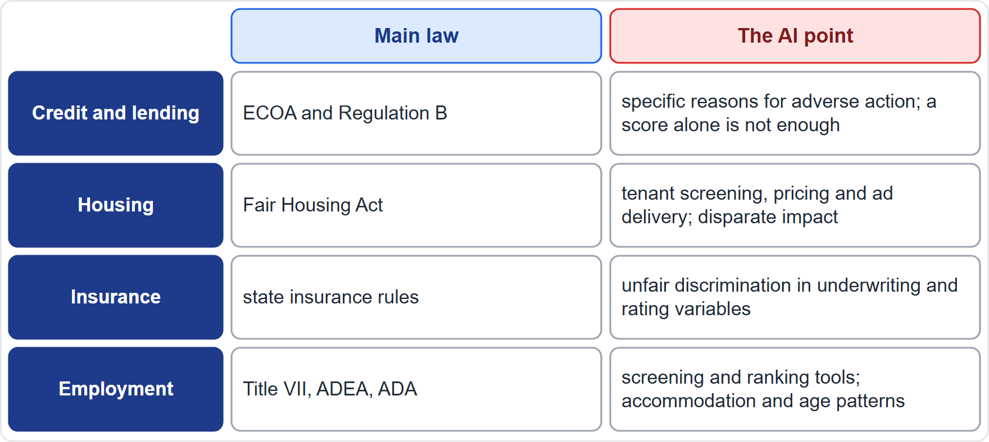
Credit, Lending, Housing and Insurance
Part 1
Credit and lending: ECOA and Regulation B require notice of action within 30 days of a completed application, with specific principal reasons; saying only that the applicant failed a credit score is insufficient (12 CFR 1002.9)
Housing: the Fair Housing Act covers tenant screening, pricing and ad delivery, including disparate impact
Insurance: state regulators police unfair discrimination in underwriting and rating variables
Credit reports: accuracy and adverse-action duties apply to scoring built on consumer reports (Fair Credit Reporting Act, FCRA)
A complex model does not excuse the duty to give specific reasons
EXAM TIP For credit AI, the question is often whether the adverse-action notice gives specific reasons.
AIGP Exam Prep Masterclass | Certified AI Governance Professional
Module 5: Other Existing Laws Applied to AI
12 / 27
Notes:
Credit and lending: the Equal Credit Opportunity Act and Regulation B require notice of action within thirty days of a completed application, with specific principal reasons. Saying only that the applicant failed a credit score is insufficient. Housing: the Fair Housing Act covers tenant screening, pricing and ad delivery, including disparate impact. Insurance: state regulators police unfair discrimination in underwriting and rating variables. Credit reports: accuracy and adverse-action duties apply under the Fair Credit Reporting Act. A complex model does not excuse specific reasons. Exam tip: for credit A I, look for specific reasons.

Slide 13
Nondiscrimination Beyond the US, and Managing the Risk
BEYOND THE BOK
Part 2
EU equality law bans direct and indirect discrimination by race, employment and gender, and in access to goods and services; indirect discrimination is the EU's term for a neutral practice with a disparate effect
The GDPR requires fair processing, and the AI Act asks high-risk providers to examine data for bias (module 6)
A governance routine: define the groups and the metric, test before launch, retest after changes, mitigate, document, and keep human review
Vendors: require bias-test evidence, ask what groups were tested, and reserve audit rights
EXAM TIP Indirect discrimination in the EU and disparate impact in the US describe the same idea.
AIGP Exam Prep Masterclass | Certified AI Governance Professional
Module 5: Other Existing Laws Applied to AI
13 / 27
Notes:
This is a beyond-the-Body-of-Knowledge slide. E U equality law bans direct and indirect discrimination by race, in employment, by gender, and in access to goods and services. Indirect discrimination is the E U term for a neutral practice with a disparate effect. The G D P R requires fair processing, and the A I Act asks high-risk providers to examine data for bias. A governance routine: define the groups and the metric, test before launch, retest after changes, mitigate, document, and keep human review. Exam tip: indirect discrimination and disparate impact describe the same idea.

Slide 14
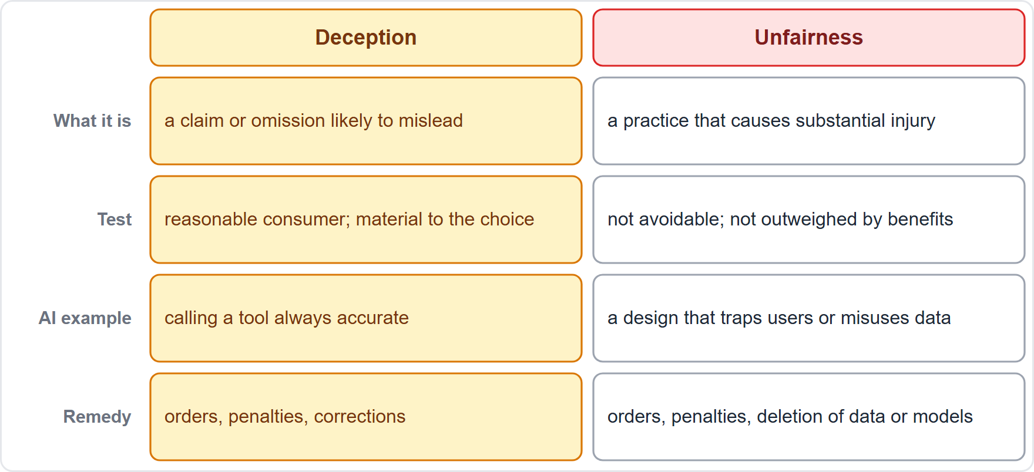
Unfair and Deceptive Practices: Section 5 and State Laws
Part 2
Section 5 of the FTC Act makes unfair or deceptive acts or practices in commerce unlawful (15 U.S.C. 45(a)(1)); states have similar laws
Deception: a claim or omission likely to mislead reasonable consumers about something material
Unfairness: a practice that causes or is likely to cause substantial injury that consumers cannot reasonably avoid and that is not outweighed by benefits (15 U.S.C. 45(n))
Remedies can include orders, penalties and deletion of data or models built on improperly obtained data
The EU has unfair-commercial-practices law with the same aims
EXAM TIP Deception is about what you said; unfairness is about what you did.
AIGP Exam Prep Masterclass | Certified AI Governance Professional
Module 5: Other Existing Laws Applied to AI
14 / 27
Notes:
Now consumer protection. Section five of the Federal Trade Commission Act makes unfair or deceptive acts or practices in commerce unlawful, and states have similar laws. Deception is a claim or omission likely to mislead reasonable consumers about something material. Unfairness is a practice that causes or is likely to cause substantial injury that consumers cannot reasonably avoid, and that is not outweighed by benefits. Remedies can include orders, penalties, and deletion of data or models built on improperly obtained data. Exam tip: deception is about what you said. Unfairness is about what you did.

Slide 15
AI Washing and Claims About AI
BEYOND THE BOK · VERIFY LIVE
Part 2
AI washing: claiming a product uses or is powered by AI when it does not, or overstating what it can do
Capability claims such as accurate, unbiased, human-level or safe need substantiation before they are made
The FTC launched Operation AI Comply in September 2024 and has continued case-by-case enforcement against deceptive AI claims
Fake reviews, undisclosed bots and invented endorsements produced with AI are deceptive too
Helios: the claim that the assistant is always accurate cannot be substantiated, so it should be dropped or qualified
As of 27 October 2026: enforcement priorities shift; the principle does not
EXAM TIP If a marketing claim about AI cannot be backed by evidence, the legal risk is deception, whatever the technology.
AIGP Exam Prep Masterclass | Certified AI Governance Professional
Module 5: Other Existing Laws Applied to AI
15 / 27
Notes:
This is a beyond-the-Body-of-Knowledge slide, tagged verify live. A I washing means claiming a product uses or is powered by A I when it does not, or overstating what it can do. Claims such as accurate, unbiased, human-level or safe need substantiation before they are made. The F T C launched Operation A I Comply in September, twenty twenty-four, and enforces case by case. Fake reviews, undisclosed bots and invented endorsements are deceptive too. At Helios, the claim that the assistant is always accurate cannot be substantiated. Exam tip: an unsupported claim about A I is deception.

Slide 16
Chatbots, Dark Patterns and Data Practices
Part 2
Chatbots: presenting a bot as a human, or hiding that a person is talking to AI, can mislead
Dark patterns: interface designs that steer or trap users, such as hidden cancellation, can be unfair or deceptive
Data practices: promising privacy or security and then using data to train models is a broken promise
Wrong outputs: if a customer relies on a wrong answer, the company's statements and disclaimers matter
Controls: disclose AI use, test claims, keep records of substantiation, give human escalation, and review marketing for AI statements
EXAM TIP Disclosure does not cure a harmful design, and a disclaimer does not cure a false claim.
AIGP Exam Prep Masterclass | Certified AI Governance Professional
Module 5: Other Existing Laws Applied to AI
16 / 27
Notes:
More consumer risks. Presenting a bot as a human, or hiding that a person is talking to A I, can mislead. Dark patterns are interface designs that steer or trap users, such as hidden cancellation, and can be unfair or deceptive. Promising privacy or security and then using data to train models is a broken promise. If a customer relies on a wrong answer, the company's statements and disclaimers matter. Controls: disclose A I use, test claims, keep substantiation records, give human escalation, and review marketing. Exam tip: a disclaimer does not cure a false claim.

Slide 17
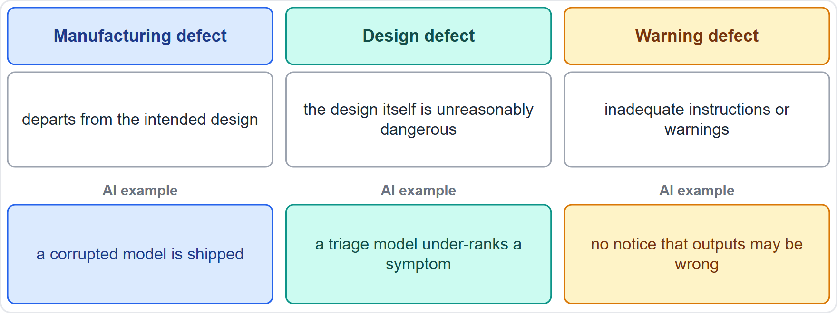
Product Liability Basics: Three Kinds of Defect
Part 2
Strict liability for defective products can apply without proof of fault in many jurisdictions
Manufacturing defect: the product departs from its intended design
Design defect: the design itself is unreasonably dangerous
Failure to warn: inadequate instructions or warnings about risks
Claims can also rest on negligence and on contract warranties
Whether software is a product has been unsettled in US courts; the EU has settled it by statute
EXAM TIP Match the facts to the defect type: departs from design, bad design, or missing warning.
AIGP Exam Prep Masterclass | Certified AI Governance Professional
Module 5: Other Existing Laws Applied to AI
17 / 27
Notes:
Now product liability. Strict liability for defective products can apply without proof of fault in many jurisdictions. There are three classic defects. A manufacturing defect: the product departs from its intended design. A design defect: the design itself is unreasonably dangerous. A failure to warn: inadequate instructions or warnings about risks. Claims can also rest on negligence and contract warranties. Whether software is a product has been unsettled in U S courts, and the E U has settled it by statute. Exam tip: match the facts to the defect type.

Slide 18
AI Examples of Each Defect
Part 2
Defect | AI example
Manufacturing | a pipeline error ships a corrupted model that behaves differently from the tested one
Design | a triage model is built so that it systematically under-ranks a symptom
Warning | no instructions on the tool's limits, or no warning that outputs may be wrong
Who answers: the manufacturer or provider, and sometimes suppliers and deployers
Updates and learning matter: a system can become defective after release
Evidence is hard to get; documentation, logs and testing records are the defense
EXAM TIP Documentation helps both ways: it proves due care, and its absence suggests a design or warning failure.
AIGP Exam Prep Masterclass | Certified AI Governance Professional
Module 5: Other Existing Laws Applied to AI
18 / 27
Notes:
Here are A I examples. Manufacturing: a pipeline error ships a corrupted model that behaves differently from the tested one. Design: a triage model is built so that it systematically under-ranks a symptom. Warning: no instructions on the tool's limits, or no warning that outputs may be wrong. The manufacturer or provider answers, and sometimes suppliers and deployers. Updates and learning matter, because a system can become defective after release. Documentation, logs and testing records are the defense. Exam tip: documentation proves due care.

Slide 19
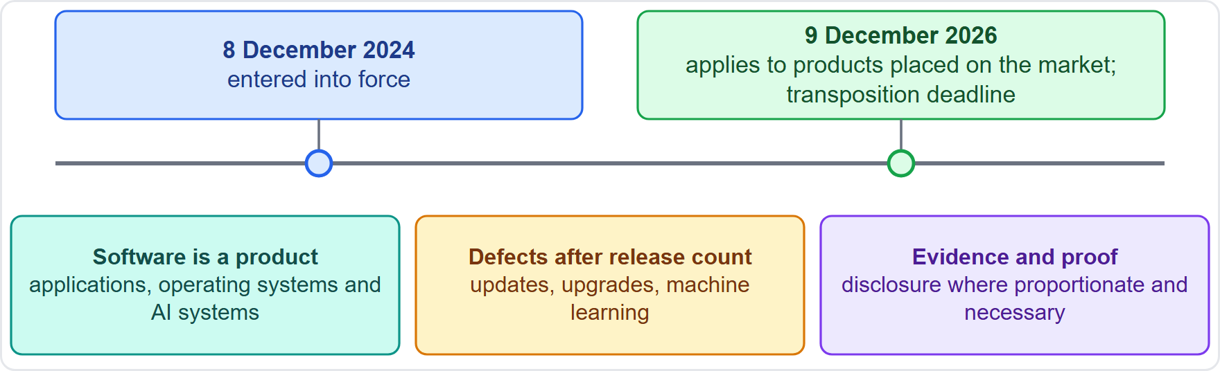
The New EU Product Liability Directive
BEYOND THE BOK · DATES · VERIFY LIVE
Part 2
Entered into force on 8 December 2024; applies to products placed on the market from 9 December 2026, which is also the transposition deadline
All types of software are covered, including AI systems
Manufacturers can be liable for defects at release and those that arise through updates, upgrades or machine learning
A product is defective if it lacks the safety a person is entitled to expect
Disclosure of evidence can be requested where proportionate and necessary, which eases the claimant's burden of proof
As of 27 October 2026: Member States are still transposing; check national laws
EXAM TIP The Directive makes software, including AI, a product for liability, and the producer's duty continues through updates.
AIGP Exam Prep Masterclass | Certified AI Governance Professional
Module 5: Other Existing Laws Applied to AI
19 / 27
Notes:
This is a beyond-the-Body-of-Knowledge slide, tagged dates and verify live. The new Product Liability Directive entered into force on the eighth of December, twenty twenty-four. It applies to products placed on the market from the ninth of December, twenty twenty-six, which is also the transposition deadline. All types of software are covered, including A I systems. Manufacturers can be liable for defects at release and for those that arise through updates, upgrades or machine learning. A product is defective if it lacks the safety a person is entitled to expect. Evidence can be requested. As of the twenty-seventh of October, twenty twenty-six, Member States are still transposing.

Slide 20
Liability Beyond Defects: The Withdrawn AI Liability Proposal
BEYOND THE BOK · DATES
Part 2
The Commission proposed an AI Liability Directive on 28 September 2022 to ease claims for harm caused by AI
It withdrew the proposal, announcing it on 11 February 2025, citing no foreseeable agreement
Liability for AI harm now runs through the Product Liability Directive, national negligence and contract law, and sector rules
Contracts allocate risk between vendors and customers: warranties, indemnities, liability caps and insurance (module 12)
Governance: keep testing and monitoring records, give clear warnings, and review vendor terms and insurance
EXAM TIP Do not assume a dedicated AI liability law: liability follows product, negligence and contract rules, plus the AI Act's duties.
AIGP Exam Prep Masterclass | Certified AI Governance Professional
Module 5: Other Existing Laws Applied to AI
20 / 27
Notes:
This is a beyond-the-Body-of-Knowledge slide, tagged dates. The Commission proposed an A I Liability Directive on the twenty-eighth of September, twenty twenty-two, to ease claims for harm caused by A I. It withdrew the proposal, announcing it on the eleventh of February, twenty twenty-five, citing no foreseeable agreement. Liability now runs through the Product Liability Directive, national negligence and contract law, and sector rules. Contracts allocate risk: warranties, indemnities, caps and insurance. Exam tip: do not assume a dedicated A I liability law.

Slide 21
Module Recap
Part 2
1
IP
2
Nondiscrimination
check the right to use data (license, exception, opt-out); human authorship for outputs; licenses, trade secrets and confidentiality
disparate treatment and disparate impact; the four-fifths rule of thumb; employment, credit, housing, insurance; the vendor does not carry the employer's duty
3
Consumer protection
4
Product liability
deception and unfairness; substantiate AI claims; disclose bots
manufacturing, design and warning defects; EU rules cover software and updates
AIGP Exam Prep Masterclass | Certified AI Governance Professional
Module 5: Other Existing Laws Applied to AI
21 / 27
Notes:
Let us recap. Intellectual property: check the right to use data, through a license, an exception or an opt-out; human authorship for outputs; licenses, trade secrets and confidentiality. Nondiscrimination: disparate treatment and disparate impact; the four-fifths rule of thumb; employment, credit, housing and insurance; the vendor does not carry the employer's duty. Consumer protection: deception and unfairness; substantiate A I claims. Product liability: manufacturing, design and warning defects, and the E U rules that cover software and updates.

Slide 22
Practice Question 1
Part 2
Q1
A company plans to train a model on text scraped from public websites. Which TWO steps best manage copyright and data-use risk? (Select TWO.)
A
Check whether the sites reserve rights against mining or restrict reuse in their terms
B
Assume that publicly accessible content may be used for training and needs no review
C
Rely on a documented legal basis, such as a license or exception, and keep source records
D
Remove copyright notices from the scraped text before it is used for training the model
E
Train first and review the sources after the model has been released to the public
AIGP Exam Prep Masterclass | Certified AI Governance Professional
Module 5: Other Existing Laws Applied to AI
22 / 27
Notes:
Question one. A company plans to train a model on text scraped from public websites. Which two steps best manage copyright and data-use risk? Select two. The five options are on the screen. [PAUSE 15] The answers are A and C. Rights reservations and site terms can restrict use, and the company needs a documented basis, with records of sources. Public availability is not permission, and reviewing after release is too late.

Slide 23
Practice Question 2
Part 2
Q2
A screening tool never uses race or sex as an input, yet it rejects a much larger share of one group. Which theory of discrimination most directly applies?
A
Disparate treatment, because a difference in outcomes shows that people were treated differently on purpose
B
Disparate impact, because a neutral practice has a disproportionate effect that may not be justified
C
Neither theory, because discrimination law applies only when a protected attribute is an input
D
Fraud, because the tool hides how it reaches its decisions from the people it screens
AIGP Exam Prep Masterclass | Certified AI Governance Professional
Module 5: Other Existing Laws Applied to AI
23 / 27
Notes:
Question two. A screening tool never uses race or sex as an input, yet it rejects a much larger share of one group. Which theory of discrimination most directly applies? The four options are on the screen. [PAUSE 12] The answer is B. A neutral practice that falls harder on a protected group is disparate impact, and the employer must show the practice is job related and consistent with business necessity.

Slide 24
Practice Question 3
Part 2
Q3
A screening tool selects 40 of 100 male applicants and 36 of 100 female applicants. What does the four-fifths rule of thumb indicate?
A
The ratio is 0.9, so the rule does not flag adverse impact, though that is not a safe harbor
B
The ratio is 0.9, so the tool is proven lawful and needs no further testing for bias
C
The ratio is 0.4, so the rule flags adverse impact and the tool must be withdrawn from use by the company
D
The ratio is 1.1, so the rule flags adverse impact against the male applicants as a group of people
AIGP Exam Prep Masterclass | Certified AI Governance Professional
Module 5: Other Existing Laws Applied to AI
24 / 27
Notes:
Question three. A screening tool selects forty of one hundred male applicants and thirty-six of one hundred female applicants. What does the four-fifths rule of thumb indicate? The four options are on the screen. [PAUSE 12] The answer is A. Thirty-six percent divided by forty percent is zero point nine, above zero point eight, so the rule does not flag adverse impact. But it is not a safe harbor, and testing continues.

Slide 25
Practice Question 4
Part 2
Q4
Helios wants to advertise its customer assistant as always accurate, although it has given wrong answers. Which area of law most directly makes the claim a risk?
A
Copyright law, because the assistant's answers may resemble the help-center articles it learned from
B
Title VII, because the claim could affect how applicants view the company as an employer
C
Consumer-protection law on unfair or deceptive practices, because the claim cannot be substantiated
D
Product-liability law, because the advertisement itself is a defect in the assistant's design
AIGP Exam Prep Masterclass | Certified AI Governance Professional
Module 5: Other Existing Laws Applied to AI
25 / 27
Notes:
Question four. Helios wants to advertise its customer assistant as always accurate, although it has given wrong answers. Which area of law most directly makes the claim a risk? The four options are on the screen. [PAUSE 12] The answer is C. A capability claim that cannot be backed by evidence is a deceptive practice under consumer protection law. The other areas are not engaged by the advertising claim itself.

Slide 26
Practice Question 5
Part 2
Q5
An AI triage tool is built so that it systematically ranks a serious symptom below less serious ones, and patients are harmed. Which kind of product defect does this most closely resemble?
A
A manufacturing defect, because the tool departs from the design its builders intended and tested
B
A design defect, because the way the product was designed makes it unreasonably dangerous to use
C
A failure to warn, because the tool did not tell the users that it was designed by software engineers
D
No defect, because the tool is software and its ranking was learned from data rather than designed
AIGP Exam Prep Masterclass | Certified AI Governance Professional
Module 5: Other Existing Laws Applied to AI
26 / 27
Notes:
Question five. An A I triage tool is built so that it systematically ranks a serious symptom below less serious ones, and patients are harmed. Which kind of product defect does this most closely resemble? The four options are on the screen. [PAUSE 12] The answer is B. When the design itself is unreasonably dangerous, the defect is one of design. And the new E U rules expressly cover software, including A I.

Slide 27
Answers at a Glance
Part 2
Question | Answer | Why
Q1 | A, C | Check reserved rights and terms; document a legal basis and sources
Q2 | B | Neutral practice, disproportionate effect: disparate impact
Q3 | A | Ratio 0.9 is above four-fifths, but not a safe harbor
Q4 | C | An unsubstantiated claim is a deceptive practice
Q5 | B | A dangerous design is a design defect
AIGP Exam Prep Masterclass | Certified AI Governance Professional
Module 5: Other Existing Laws Applied to AI
27 / 27
Notes:
Here are all five answers. Question one: A and C. Question two: B. Question three: A. Question four: C. Question five: B. That completes Module five. Next, Module six covers AI-specific laws: the E U A I Act and beyond.

