Slide 1
Module 6: AI-Specific Laws
The EU AI Act in depth, then South Korea, the US and other approaches
Domain II · Competency C · Indicators II.C.1 to II.C.6
AIGP Exam Prep Masterclass
Module 6 · Part 1
Notes:
Welcome to Module six: A I-Specific Laws. This is the largest module, because competency C of domain two is the heaviest part of the legal domain. We start with the E U A I Act in depth: scope, risk classes, requirements, roles, enforcement and timeline. Then we compare South Korea, the United States and other approaches.

Slide 2
What You Will Learn
Part 1
Place a system in the right risk class and say what each class means
List the requirements for high-risk systems and the duties that come with them
Explain human oversight, transparency and quality management
Explain the extra rules for general-purpose AI models
Explain enforcement and penalties, and how duties differ by role
Compare the South Korean, US and other approaches
AIGP Exam Prep Masterclass | Certified AI Governance Professional
Module 6: AI-Specific Laws: the EU AI Act and Beyond
2 / 45
Notes:
By the end of this module you will be able to do six things. Place a system in the right risk class, and say what each class means. List the requirements for high-risk systems and the duties that come with them. Explain human oversight, transparency and quality management. Explain the extra rules for general-purpose A I models. Explain enforcement, penalties and duties by role. And compare the South Korean, U S and other approaches.

Slide 3
Case Check-In: Which Helios System Is Regulated, and How?
Part 1
CASE CHECK-IN · Helios
The hiring tool screens EU applicants; Veridex also offers emotion analysis of the video interview
The customer assistant chats with EU customers on a Corvid Labs general-purpose model
Helios also hires in New York City, Illinois and Colorado and serves customers in South Korea
Jonas Weber asks: which class, which duties, which role, and what is the penalty if we get it wrong?
AIGP Exam Prep Masterclass | Certified AI Governance Professional
Module 6: AI-Specific Laws: the EU AI Act and Beyond
3 / 45
Notes:
At Helios, the hiring tool screens applicants in the E U, and Veridex also offers emotion analysis of the video interview. The customer assistant chats with E U customers, on a general-purpose model from Corvid Labs. Helios also hires in New York City, Illinois and Colorado, and serves customers in South Korea. Jonas Weber asks: which class, which duties, which role, and what is the penalty if we get it wrong?

Slide 4
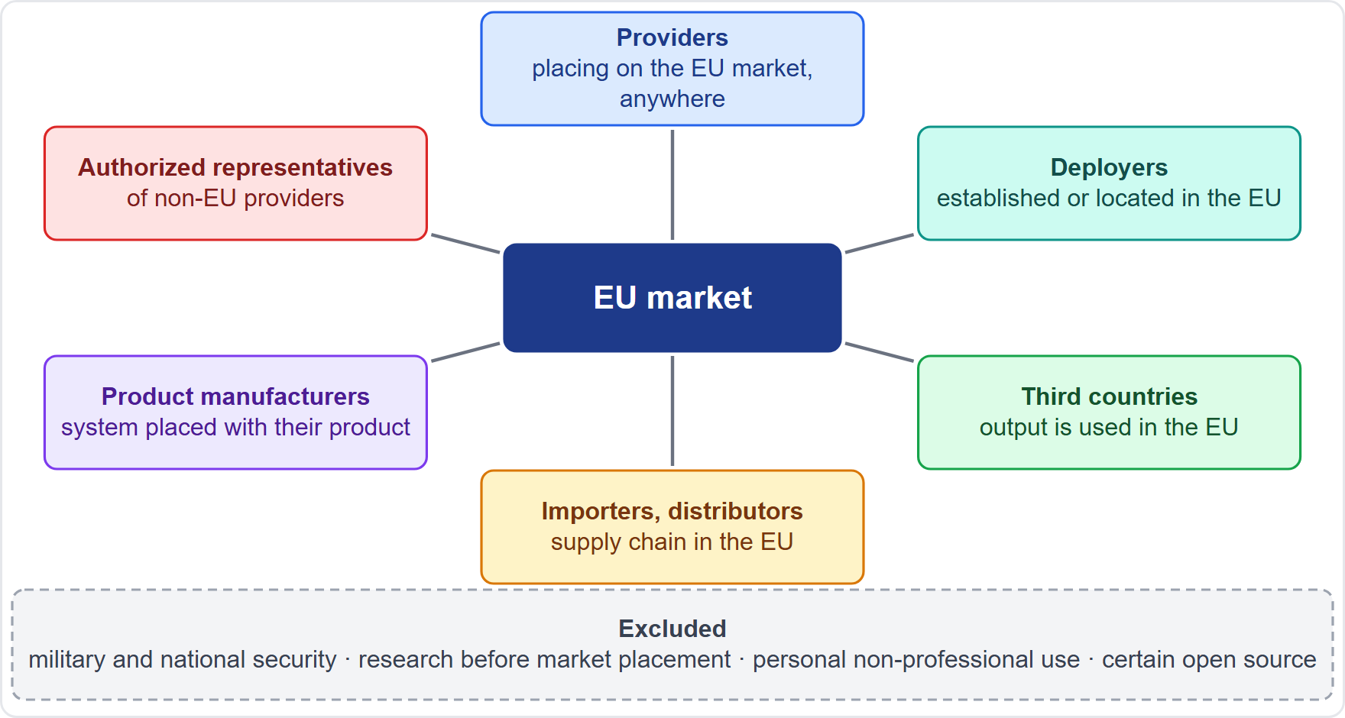
The EU AI Act at a Glance: Reach and Scope
BEYOND THE BOK
Part 1
The AI Act is the EU's risk-based regulation: the higher the risk, the heavier the duty
It applies to providers that place systems or general-purpose models on the EU market wherever they are based (Article 2)
And to deployers in the EU, and to third-country providers and deployers when the output is used in the EU
Also importers, distributors, product manufacturers, authorized representatives and affected persons in the EU
Excluded: military, defense and national security; research before market placement; purely personal non-professional use; certain open-source systems
EXAM TIP Location of the provider does not matter; use in the EU does.
AIGP Exam Prep Masterclass | Certified AI Governance Professional
Module 6: AI-Specific Laws: the EU AI Act and Beyond
4 / 45
Notes:
This is a beyond-the-Body-of-Knowledge slide. The A I Act is a risk-based law: the higher the risk, the heavier the duty. Under Article two, it applies to providers that place systems or general-purpose models on the E U market, wherever they are based. It applies to deployers in the E U, and to third-country providers and deployers when the output is used in the E U. It also covers importers, distributors, product manufacturers, authorized representatives and affected persons. Excluded are military, defense and national security, research before market placement, personal non-professional use, and certain open-source systems. Exam tip: use in the E U matters, not location.

Slide 5
Key Definitions That Decide Scope
BEYOND THE BOK
Part 1
Term (Article 3) | Why it matters
AI system (1) | the machine-based system that infers outputs (module 1)
Provider (3) / Deployer (4) | who develops and places on the market, and who uses under its authority
Placing on the market (9) | the first making available on the Union market
Putting into service (11) | supply for first use to the deployer, or for own use
General-purpose AI model (63) | a model with significant generality, integrable in many systems
Intended purpose (set by the provider) drives classification: the same model can be minimal risk in one use and high-risk in another
A substantial modification can trigger new assessment and can change the role (Article 25)
EXAM TIP Classification follows the use, not the technology.
AIGP Exam Prep Masterclass | Certified AI Governance Professional
Module 6: AI-Specific Laws: the EU AI Act and Beyond
5 / 45
Notes:
This is a beyond-the-Body-of-Knowledge slide. Article three holds the definitions that decide scope. An A I system infers outputs from input, as we saw in module one. The provider develops and places on the market; the deployer uses under its authority. Placing on the market is the first making available on the Union market. Putting into service is supply for first use to the deployer, or for own use. A general-purpose model shows significant generality. The intended purpose drives classification, and a substantial modification can change duties and roles. Exam tip: classification follows the use, not the technology.

Slide 6
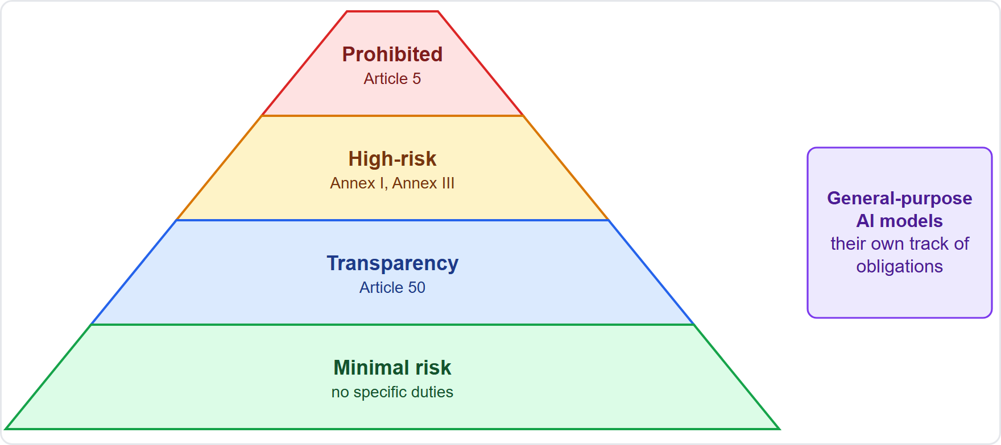
The Four Risk Classes
Part 1
Unacceptable risk: practices that are banned (Article 5)
High risk: allowed, but under strict requirements; two routes, Annex I (product safety) and Annex III (listed uses)
Limited risk: transparency duties, such as telling people they talk to AI (Article 50)
Minimal risk: no specific duties; voluntary codes
General-purpose AI models have their own track of obligations
EXAM TIP Name the class first; the duties follow from it.
AIGP Exam Prep Masterclass | Certified AI Governance Professional
Module 6: AI-Specific Laws: the EU AI Act and Beyond
6 / 45
Notes:
The Act has four risk classes. Unacceptable risk: practices that are banned, in Article five. High risk: allowed, but under strict requirements, through two routes, Annex one for product safety and Annex three for listed uses. Limited risk: transparency duties, such as telling people they talk to A I, in Article fifty. Minimal risk: no specific duties. General-purpose A I models have their own track of obligations. Exam tip: name the class first. The duties follow from it.

Slide 7
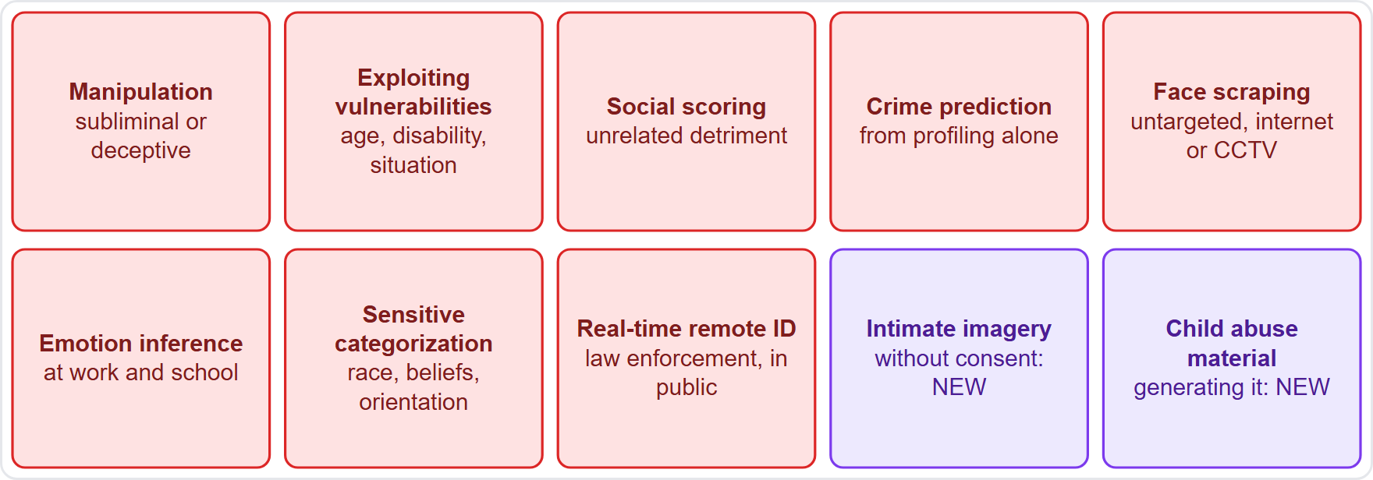
Prohibited Practices
DATES
Part 1
Manipulation and exploiting vulnerabilities (age, disability, social or economic situation)
Social scoring; crime prediction based solely on profiling
Face databases from untargeted scraping (internet or closed-circuit television, CCTV)
Emotion inference at work and in education, except for medical or safety reasons
Sensitive biometric categorization; real-time remote biometric identification for law enforcement, with limits
New: non-consensual intimate imagery and child sexual abuse material, from 2 December 2026; the older bans since 2 February 2025
EXAM TIP Emotion recognition is banned at work and school but allowed for medical or safety reasons; elsewhere it is high-risk.
AIGP Exam Prep Masterclass | Certified AI Governance Professional
Module 6: AI-Specific Laws: the EU AI Act and Beyond
7 / 45
Notes:
This slide is tagged dates. Article five bans these practices. Manipulation through subliminal or deceptive techniques causing significant harm. Exploiting vulnerabilities of age, disability or social or economic situation. Social scoring. Crime prediction based solely on profiling. Building face databases by untargeted scraping. Inferring emotions in the workplace and in education, except for medical or safety reasons. Biometric categorization of sensitive traits. And real-time remote biometric identification for law enforcement, unless strictly necessary. The new bans on non-consensual intimate imagery and child sexual abuse material apply from the second of December, twenty twenty-six. The older bans apply since the second of February, twenty twenty-five.

Slide 8
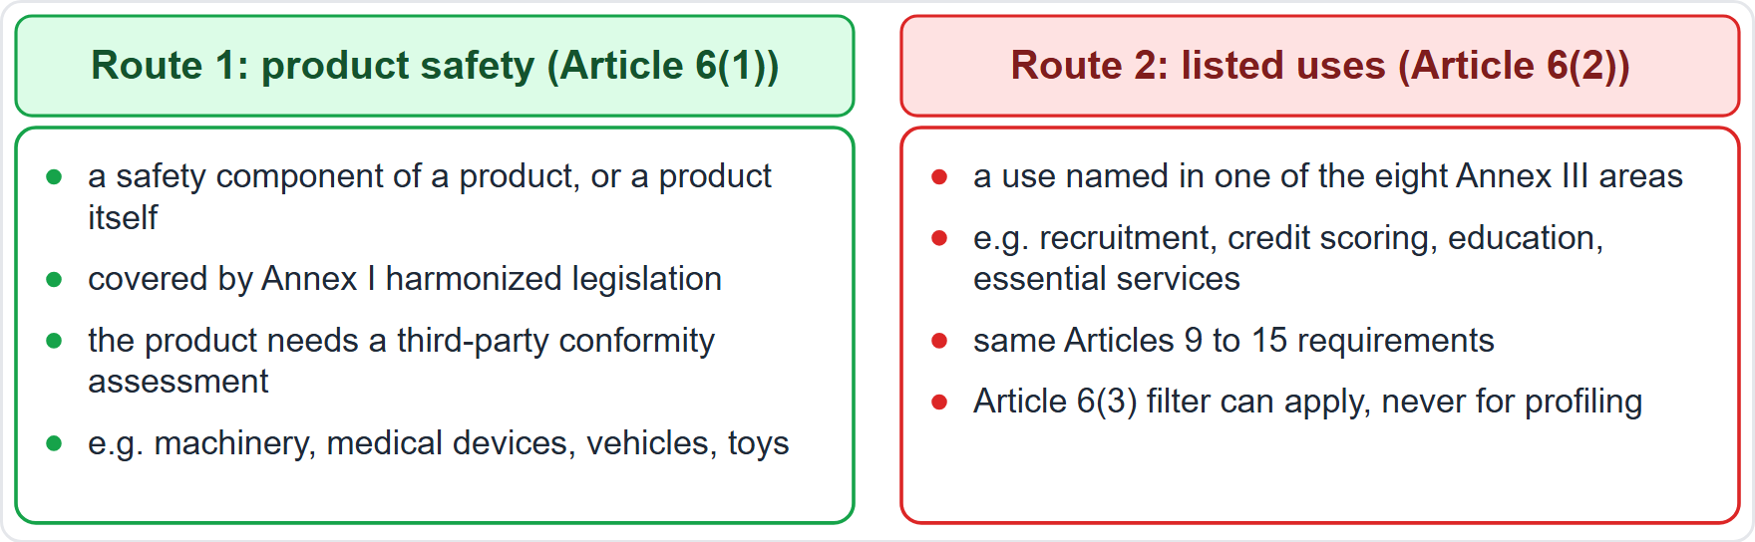
High-Risk, Route One: Product Safety (Annex I)
Part 1
Route 1 (Article 6(1)): the system is a safety component of a product, or a product itself, under Annex I harmonized legislation, and that product needs a third-party conformity assessment
Typical: machinery, medical devices, vehicles, toys and similar regulated products
Route 2 (Article 6(2)): the system's use is listed in Annex III
Both routes lead to the same requirements (Articles 9 to 15), with different assessment procedures
EXAM TIP Product-safety AI (a medical device component) and listed-use AI (hiring) are both high-risk, by different doors.
AIGP Exam Prep Masterclass | Certified AI Governance Professional
Module 6: AI-Specific Laws: the EU AI Act and Beyond
8 / 45
Notes:
Route one to high risk is product safety. Under Article six, paragraph one, a system is high-risk when it is a safety component of a product, or a product itself, covered by Annex one harmonized legislation, and that product needs a third-party conformity assessment. Typical examples are machinery, medical devices, vehicles and toys. Route two, in Article six, paragraph two, is a use listed in Annex three. Both routes lead to the same requirements, with different assessment procedures. Exam tip: a medical-device component and a hiring tool are both high-risk, through different doors.

Slide 9
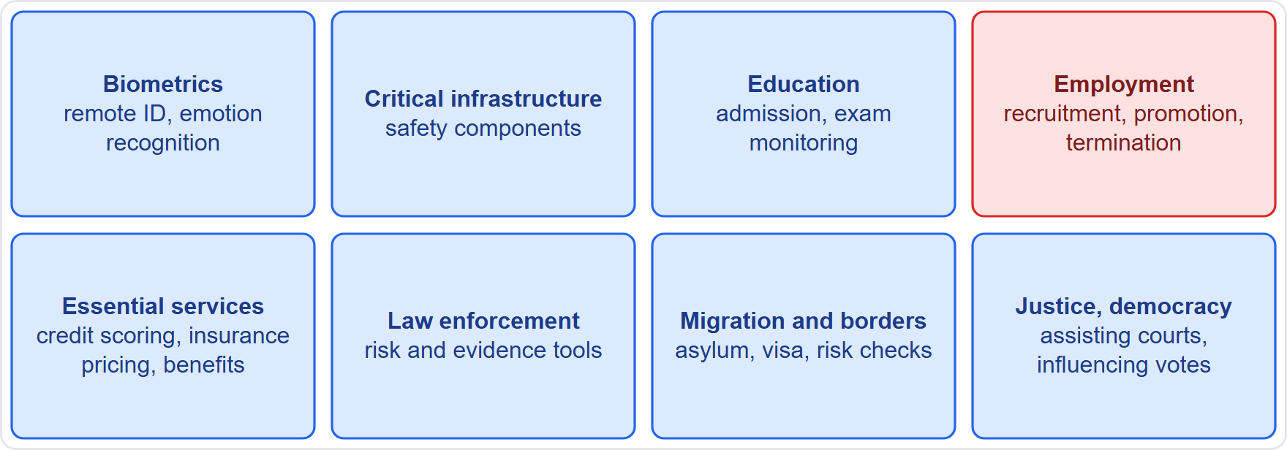
High-Risk, Route Two: The Annex III Areas
BEYOND THE BOK
Part 1
Biometrics (remote identification, categorization, emotion recognition)
Critical infrastructure safety components
Education: admission, assessing learning, monitoring tests
Employment: recruitment and selection (screening, evaluating candidates) and decisions on promotion, termination, task allocation and monitoring
Essential services: public benefits, credit scoring, life and health insurance pricing, emergency triage
Law enforcement, migration, asylum and border control, justice and democratic processes
EXAM TIP Hiring and credit-scoring systems are high-risk by listing; fraud detection is carved out of the credit item.
AIGP Exam Prep Masterclass | Certified AI Governance Professional
Module 6: AI-Specific Laws: the EU AI Act and Beyond
9 / 45
Notes:
This is a beyond-the-Body-of-Knowledge slide. Annex three lists eight areas. Biometrics, including remote identification, categorization and emotion recognition. Critical infrastructure safety components. Education: admission, assessing learning and monitoring tests. Employment: recruitment and selection, and decisions on promotion, termination, task allocation and monitoring. Essential services: public benefits, credit scoring, life and health insurance pricing, and emergency triage. Law enforcement. Migration, asylum and border control. And justice and democratic processes. Exam tip: hiring and credit scoring are high-risk by listing. Fraud detection is carved out of credit.

Slide 10
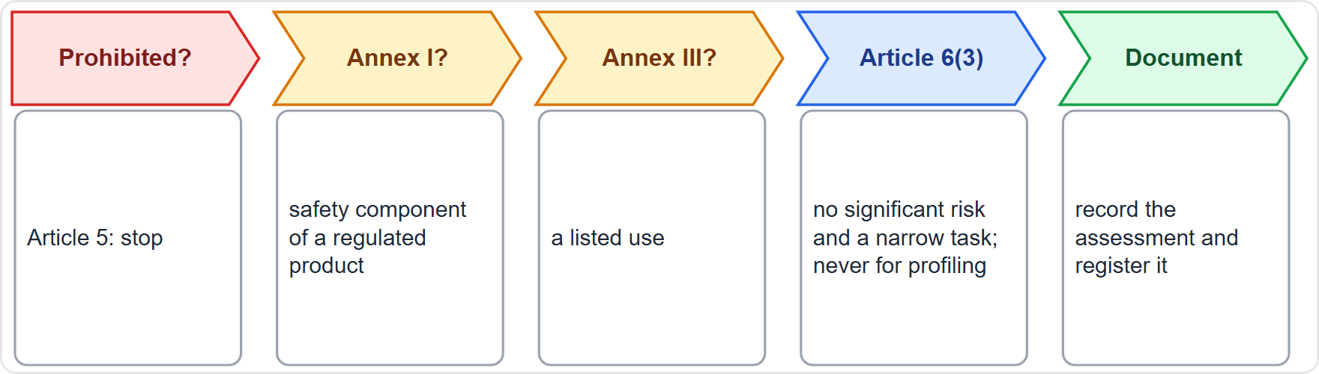
Is It High-Risk? The Article 6(3) Filter
BEYOND THE BOK
Part 1
Step 1: is the practice prohibited? Stop.
Step 2: is it a safety component of an Annex I product? High-risk.
Step 3: is the use listed in Annex III? High-risk.
Step 4 (Article 6(3)): not high-risk only if it poses no significant risk of harm and fits one of four cases
The four cases: a narrow procedural task, improving a completed human activity, detecting patterns without replacing human assessment, or a preparatory task
But a system that performs profiling of natural persons is always high-risk
A provider that decides a listed system is not high-risk must document the assessment and register it (Article 6(4))
EXAM TIP Profiling people on an Annex III use cannot be argued out of high-risk.
AIGP Exam Prep Masterclass | Certified AI Governance Professional
Module 6: AI-Specific Laws: the EU AI Act and Beyond
10 / 45
Notes:
This is a beyond-the-Body-of-Knowledge slide. Walk four steps. One: is the practice prohibited? Then stop. Two: is it a safety component of an Annex one product? Then high-risk. Three: is the use listed in Annex three? Then high-risk. Four, the filter in Article six, paragraph three. A listed system is not high-risk only if it poses no significant risk of harm and fits one of four cases: a narrow procedural task, improving a completed human activity, detecting patterns without replacing human assessment, or a preparatory task. But a system that performs profiling of natural persons is always high-risk. A provider that decides otherwise must document and register that assessment.

Slide 11
Limited and Minimal Risk, and General-Purpose Models
Part 1
Limited risk: systems that interact with people, generate synthetic content or infer emotions carry transparency duties (Article 50, slide 22)
Minimal risk: most AI, such as spam filters; no specific duties, only voluntary codes
General-purpose AI models are a separate track: obligations fall on the model provider (slides 24 to 26)
A general-purpose model placed in a high-risk use makes the system high-risk, with the system's provider carrying those duties
The same company can be minimal-risk in one product and high-risk in another
EXAM TIP A chatbot is limited risk for transparency, and becomes high-risk only if its use is on a high-risk list.
AIGP Exam Prep Masterclass | Certified AI Governance Professional
Module 6: AI-Specific Laws: the EU AI Act and Beyond
11 / 45
Notes:
Limited risk covers systems that interact with people, generate synthetic content, or infer emotions: they carry transparency duties under Article fifty. Minimal risk is most A I, such as spam filters, with no specific duties beyond voluntary codes. General-purpose models are a separate track, with obligations on the model provider. A general-purpose model placed in a high-risk use makes the system high-risk, and the system's provider carries those duties. Exam tip: a chatbot is limited risk for transparency, and becomes high-risk only if its use is on a high-risk list.

Slide 12
Applying the Classes to Helios
Part 1
Helios system | Class | Why
Hiring tool (screens and ranks applicants) | High-risk | Annex III employment: recruitment and selection; profiling, so no Article 6(3) escape
Emotion analysis of the video interview | Prohibited in the EU workplace | Article 5 bans inferring emotions at work, except medical or safety reasons
Customer assistant (chat) | Limited risk | transparency: tell customers it is AI (Article 50)
Corvid Labs model underneath | General-purpose model | its provider has its own duties; Helios is its deployer
Result: Helios switches off emotion analysis for EU use and prepares for high-risk duties for the hiring tool
EXAM TIP Walk the path in order: prohibited, high-risk, transparency, minimal.
AIGP Exam Prep Masterclass | Certified AI Governance Professional
Module 6: AI-Specific Laws: the EU AI Act and Beyond
12 / 45
Notes:
Now apply the classes to Helios. The hiring tool is high-risk: Annex three employment covers recruitment and selection, and it profiles people, so there is no Article six paragraph three escape. The emotion analysis of the video interview is prohibited in the E U workplace, unless used for medical or safety reasons. The customer assistant is limited risk: customers must be told it is A I. The Corvid Labs model underneath is a general-purpose model, whose provider has its own duties. Helios switches off emotion analysis in the E U, and prepares for high-risk duties. Exam tip: walk the path in order.

Slide 13
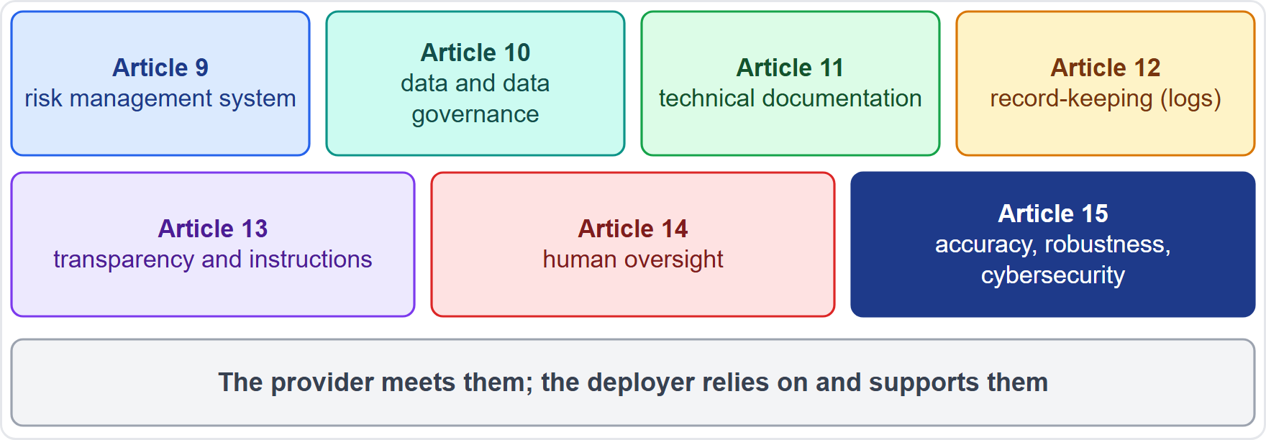
The High-Risk Requirements at a Glance
Part 2
Article 9 risk management system
Article 10 data and data governance
Article 11 technical documentation
Article 12 record-keeping (logs)
Article 13 transparency and instructions for use
Article 14 human oversight
Article 15 accuracy, robustness and cybersecurity
The provider must meet them; the deployer relies on and supports them
EXAM TIP Learn the seven by their job: manage risk, govern data, document, log, tell, oversee, secure.
AIGP Exam Prep Masterclass | Certified AI Governance Professional
Module 6: AI-Specific Laws: the EU AI Act and Beyond
13 / 45
Notes:
High-risk systems must meet seven requirements, in Articles nine to fifteen. Article nine: a risk management system. Article ten: data and data governance. Article eleven: technical documentation. Article twelve: record-keeping, or logs. Article thirteen: transparency and instructions for use. Article fourteen: human oversight. Article fifteen: accuracy, robustness and cybersecurity. The provider must meet them, and the deployer relies on and supports them. Exam tip: learn the seven by their job: manage risk, govern data, document, log, tell, oversee, secure.

Slide 14
Risk Management System (Article 9)
Part 2
A continuous, iterative process planned and run through the whole life cycle
Identify and analyze known and reasonably foreseeable risks to health, safety and fundamental rights
Estimate and evaluate them, including from foreseeable misuse and post-market data
Adopt targeted measures and judge residual risk acceptable: design it out first, then mitigate, then inform and train
Test against predefined metrics before market placement
Consider persons under 18 and other vulnerable groups
EXAM TIP Risk management is a living process, not a one-time assessment before launch.
AIGP Exam Prep Masterclass | Certified AI Governance Professional
Module 6: AI-Specific Laws: the EU AI Act and Beyond
14 / 45
Notes:
Article nine requires a risk management system. It is a continuous, iterative process, planned and run through the whole life cycle. Identify and analyze known and reasonably foreseeable risks to health, safety and fundamental rights. Estimate and evaluate them, including from foreseeable misuse and post-market data. Adopt targeted measures and judge residual risk acceptable: design it out first, then mitigate, then inform and train. Test against predefined metrics before market placement. And consider persons under eighteen and other vulnerable groups. Exam tip: it is a living process, not a one-time assessment.

Slide 15
Data and Data Governance (Article 10)
BEYOND THE BOK · VERIFY LIVE
Part 2
Governance covers design choices, data origin and collection, preparation (annotation, cleaning), assumptions, availability and suitability
Examine possible biases that could harm health, safety or fundamental rights or lead to prohibited discrimination, and take measures to detect, prevent and mitigate them
Datasets should be relevant, sufficiently representative, free of errors as far as possible and complete
The Digital Omnibus added Article 4a: special-category data may be processed exceptionally for bias detection and correction, only where strictly necessary and under strict conditions (no other data suffice, strong security, no transfer, deletion afterwards, records)
As of 27 October 2026: this rule is new; check the consolidated text
EXAM TIP Bias examination is a legal duty for high-risk data, and the exception for sensitive data is narrow and recorded.
AIGP Exam Prep Masterclass | Certified AI Governance Professional
Module 6: AI-Specific Laws: the EU AI Act and Beyond
15 / 45
Notes:
This is a beyond-the-Body-of-Knowledge slide, tagged verify live. Data governance under Article ten covers design choices, data origin and collection, preparation such as annotation and cleaning, assumptions, and availability and suitability. Providers must examine possible biases that could harm health, safety or fundamental rights, or lead to prohibited discrimination, and take measures to detect, prevent and mitigate them. Datasets should be relevant, sufficiently representative, free of errors as far as possible, and complete. The Digital Omnibus added Article four A: special-category data may be processed exceptionally for bias detection and correction, only where strictly necessary and under strict conditions. As of the twenty-seventh of October, twenty twenty-six, this rule is new.

Slide 16
Technical Documentation and Record-Keeping (Articles 11 and 12)
Part 2
Technical documentation is drawn up before placing on the market, kept up to date, and shows compliance; it has the minimum elements of Annex IV
SMEs may use a simplified form
A post-market monitoring plan is part of that documentation (slide 20)
Logs: the system must automatically record events over its lifetime, to identify risk situations, to support post-market monitoring and to let deployers monitor operation
Remote biometric identification logs add time of use, database checked, matched input and the people who verified
EXAM TIP Documentation is for authorities and assessors; logs are for tracing what the system did.
AIGP Exam Prep Masterclass | Certified AI Governance Professional
Module 6: AI-Specific Laws: the EU AI Act and Beyond
16 / 45
Notes:
Technical documentation is drawn up before placing on the market, kept up to date, and shows compliance. It has the minimum elements of Annex four. Small and medium enterprises may use a simplified form. A post-market monitoring plan is part of that documentation. Under Article twelve, the system must automatically record events over its lifetime, to identify risk situations, to support post-market monitoring, and to let deployers monitor operation. Remote biometric identification logs add the time of use, the database checked, the matched input, and who verified. Exam tip: documentation is for assessors. Logs trace what the system did.

Slide 17
Transparency to Deployers and Accuracy, Robustness, Cybersecurity (Articles 13 and 15)
Part 2
Instructions for use must state the provider's identity, the system's capabilities and limits, pre-determined changes, human oversight measures, resources and lifetime, and log collection (Article 13)
Accuracy: declare the levels and metrics in the instructions
Robustness: resilient to errors, faults and inconsistencies; reduce feedback loops where the system keeps learning
Cybersecurity: resist attempts to alter use or output, including data poisoning, model poisoning, adversarial examples and confidentiality attacks
EXAM TIP Transparency here means information for the deployer to use the system properly; notices to the public are in Article 50.
AIGP Exam Prep Masterclass | Certified AI Governance Professional
Module 6: AI-Specific Laws: the EU AI Act and Beyond
17 / 45
Notes:
Article thirteen requires instructions for use stating the provider's identity, the system's capabilities and limits, pre-determined changes, human oversight measures, resources and lifetime, and log collection. Article fifteen then sets accuracy, robustness and cybersecurity. Accuracy levels and metrics are declared in the instructions. Robustness means resilience to errors, faults and inconsistencies, and reducing feedback loops where the system keeps learning. Cybersecurity means resisting attempts to alter use or output, including data poisoning, model poisoning, adversarial examples and confidentiality attacks. Exam tip: transparency here is information for the deployer. Notices to the public sit in Article fifty.

Slide 18
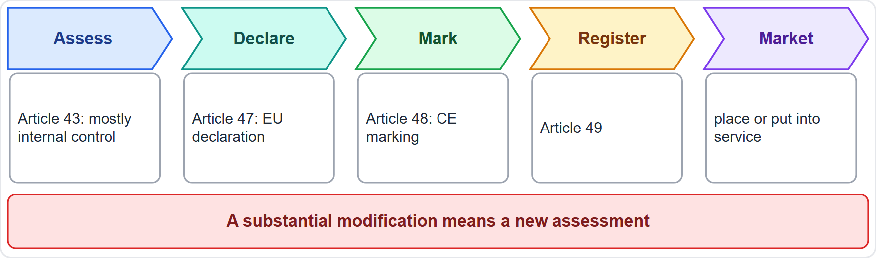
Conformity Assessment, Declaration, CE Marking and Registration
Part 2
Conformity assessment (Article 43): for most Annex III uses, internal control by the provider; for biometrics, internal control or a notified body, depending on standards; Annex I products follow the sectoral procedure
The provider draws up the EU declaration of conformity (Article 47) and affixes the CE marking (Article 48)
The system is registered (Article 49) before use
A substantial modification needs a new assessment; changes pre-determined for a learning system are not substantial
EXAM TIP Providers of listed-use high-risk systems mostly self-assess; a notified body is the exception.
AIGP Exam Prep Masterclass | Certified AI Governance Professional
Module 6: AI-Specific Laws: the EU AI Act and Beyond
18 / 45
Notes:
Before a high-risk system goes to market, the provider completes conformity assessment under Article forty-three. For most Annex three uses, that is internal control by the provider. For biometrics, it is internal control or a notified body, depending on standards. Annex one products follow the sectoral procedure. The provider draws up the E U declaration of conformity under Article forty-seven, affixes the C E marking under Article forty-eight, and registers the system under Article forty-nine. A substantial modification needs a new assessment, but changes pre-determined for a learning system are not substantial. Exam tip: mostly self-assessment.

Slide 19
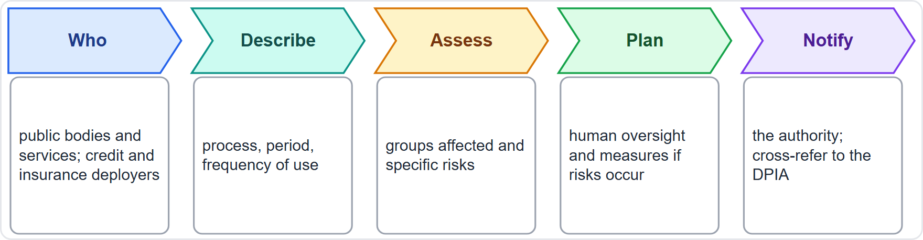
Fundamental Rights Impact Assessment (Article 27)
Part 2
Who: deployers that are public bodies or private entities providing public services, and deployers of credit-scoring and life and health insurance systems (Annex III points 5(b) and 5(c)); not for critical infrastructure systems
When: before first use; update if elements change
Content: the process, period and frequency of use, groups affected, specific risks of harm, human oversight, and measures if risks materialize, including complaint mechanisms
Notify the market surveillance authority; cross-refer to a GDPR DPIA where one exists
EXAM TIP A deployer's FRIA complements the provider's risk management; a DPIA can supply parts of it.
AIGP Exam Prep Masterclass | Certified AI Governance Professional
Module 6: AI-Specific Laws: the EU AI Act and Beyond
19 / 45
Notes:
Article twenty-seven requires a fundamental rights impact assessment from certain deployers. Who: public bodies, private entities providing public services, and deployers of credit-scoring and life and health insurance systems, but not for critical infrastructure systems. When: before first use, updated if elements change. Content: the process, the period and frequency of use, the groups affected, the specific risks of harm, human oversight, and measures if risks materialize, including complaint mechanisms. The deployer notifies the market surveillance authority, and may cross-refer to a G D P R data protection impact assessment. Exam tip: it complements the provider's risk management.

Slide 20
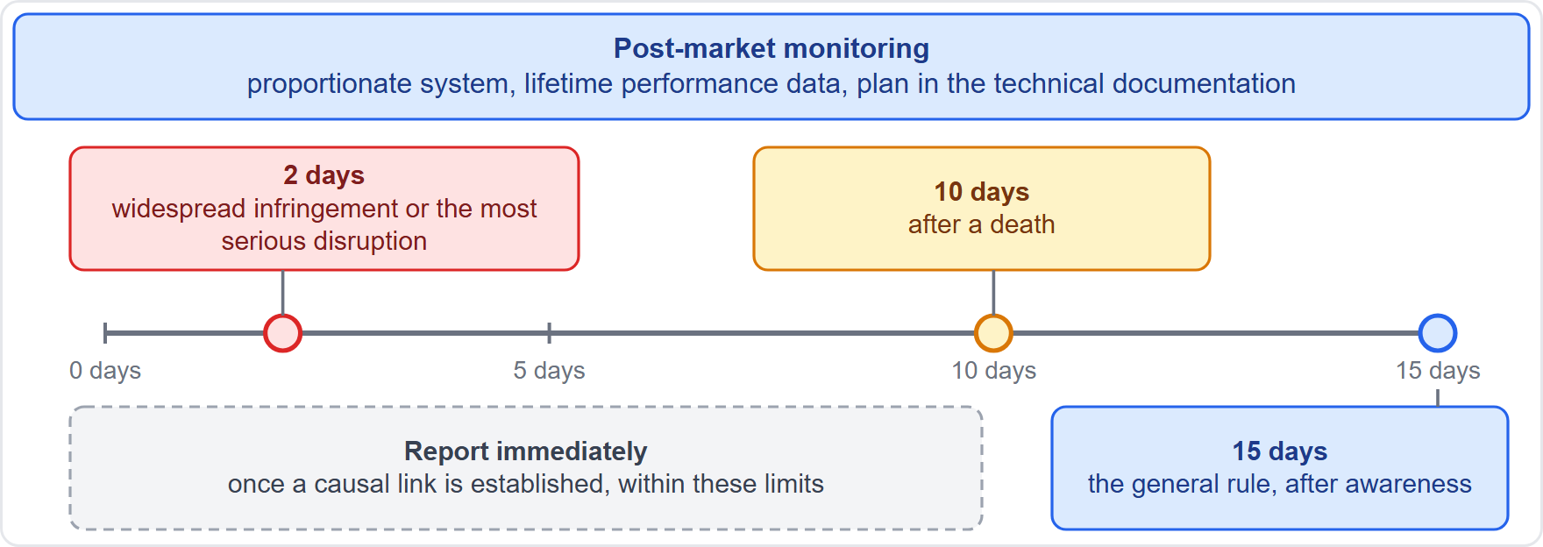
Post-Market Monitoring and Serious Incident Reporting (Articles 72 and 73)
Part 2
Post-market monitoring (Article 72): a system proportionate to the technology and risks that collects and analyzes performance data over the system's lifetime; the plan belongs to the technical documentation
Serious incidents (Article 73): report immediately after a causal link is established, and in any event not later than 15 days after awareness
Not later than 2 days for a widespread infringement or the most serious disruptions; not later than 10 days after a death
Deployers tell the provider and the authorities when they suspect a risk or a serious incident (Article 26)
EXAM TIP Remember the order of urgency: 2 days, 10 days, 15 days.
AIGP Exam Prep Masterclass | Certified AI Governance Professional
Module 6: AI-Specific Laws: the EU AI Act and Beyond
20 / 45
Notes:
Under Article seventy-two, providers run a post-market monitoring system, proportionate to the technology and risks, that collects and analyzes performance data over the system's lifetime. The plan belongs to the technical documentation. Under Article seventy-three, a serious incident is reported immediately after a causal link is established, and in any event not later than fifteen days after awareness. For a widespread infringement or the most serious disruptions, the limit is two days. After a death, it is ten days. Deployers tell the provider and authorities when they suspect a risk or a serious incident. Exam tip: two days, ten days, fifteen days.

Slide 21
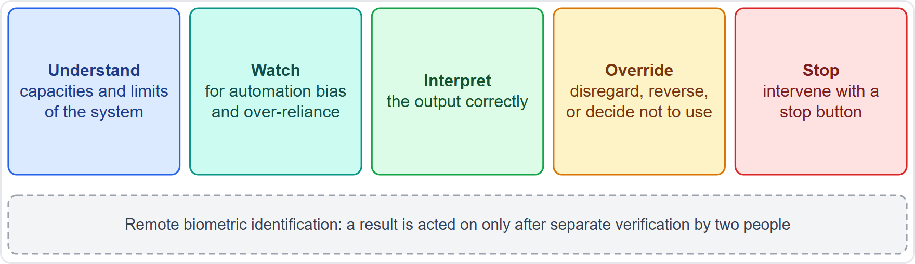
Human Oversight (Article 14)
Part 2
The aim is to prevent or minimize risks to health, safety and fundamental rights, including from foreseeable misuse
Overseers must be able to: understand the system's capacities and limits; stay aware of automation bias; interpret output correctly; override or disregard output or decide not to use it; stop the system
For remote biometric identification, a result is acted on only after separate verification by two people
The provider designs the measures in; the deployer assigns competent, trained people with authority (Article 26)
EXAM TIP Oversight must be effective: a person who cannot understand, override or stop the system is not oversight.
AIGP Exam Prep Masterclass | Certified AI Governance Professional
Module 6: AI-Specific Laws: the EU AI Act and Beyond
21 / 45
Notes:
Human oversight under Article fourteen aims to prevent or minimize risks to health, safety and fundamental rights, including from foreseeable misuse. Overseers must be able to understand the system's capacities and limits; stay aware of automation bias; interpret output correctly; override or disregard output, or decide not to use the system; and stop it. For remote biometric identification, a result is acted on only after separate verification by two people. The provider designs the measures in, and the deployer assigns competent, trained people with authority. Exam tip: oversight must be effective, not nominal.

Slide 22
Transparency and Notification Duties (Article 50)
Part 2
Situation | Duty | On
System interacts directly with people | design it so people know they are dealing with AI, unless obvious | provider
System generates synthetic audio, image, video or text | mark outputs in a machine-readable format | provider
Emotion recognition or biometric categorization | inform the exposed people | deployer
Deepfakes and AI text published to inform the public | disclose it is artificial (editorial-control exceptions) | deployer
Information is given clearly, at the latest at first interaction or exposure
Also: deployers of high-risk systems inform people subject to decisions (Article 26) and workers' representatives before workplace use
EXAM TIP Telling a customer they are chatting with AI is the provider's design duty, unless it is obvious.
AIGP Exam Prep Masterclass | Certified AI Governance Professional
Module 6: AI-Specific Laws: the EU AI Act and Beyond
22 / 45
Notes:
Article fifty sets four transparency duties. When a system interacts directly with people, the provider designs it so people know they are dealing with A I, unless it is obvious. When a system generates synthetic audio, image, video or text, the provider marks outputs in a machine-readable format. For emotion recognition or biometric categorization, the deployer informs the exposed people. For deepfakes and A I text published to inform the public, the deployer discloses that it is artificial, with editorial-control exceptions. Information is given clearly, at the latest at first interaction. Exam tip: telling customers they chat with A I is the provider's design duty.

Slide 23
Quality Management System (Article 17)
Part 2
A documented system of policies, procedures and instructions that keeps the provider compliant
Covers a compliance strategy, design and development controls, testing and validation, technical specifications, data management, risk management, post-market monitoring, serious incident reporting, communication with authorities, record-keeping, resource management and accountability
Applied proportionately to the provider's size, with consideration for SMEs
It is the provider's management layer over everything in Articles 9 to 15
EXAM TIP The QMS ties the requirements into one managed system; it does not replace any of them.
AIGP Exam Prep Masterclass | Certified AI Governance Professional
Module 6: AI-Specific Laws: the EU AI Act and Beyond
23 / 45
Notes:
Article seventeen requires a quality management system: a documented system of policies, procedures and instructions that keeps the provider compliant. It covers a compliance strategy, design and development controls, testing and validation, technical specifications, data management, risk management, post-market monitoring, serious incident reporting, communication with authorities, record-keeping, resource management and accountability. It is applied proportionately to the provider's size, with consideration for small and medium enterprises. Exam tip: the quality system ties the requirements together. It does not replace any of them.

Slide 24
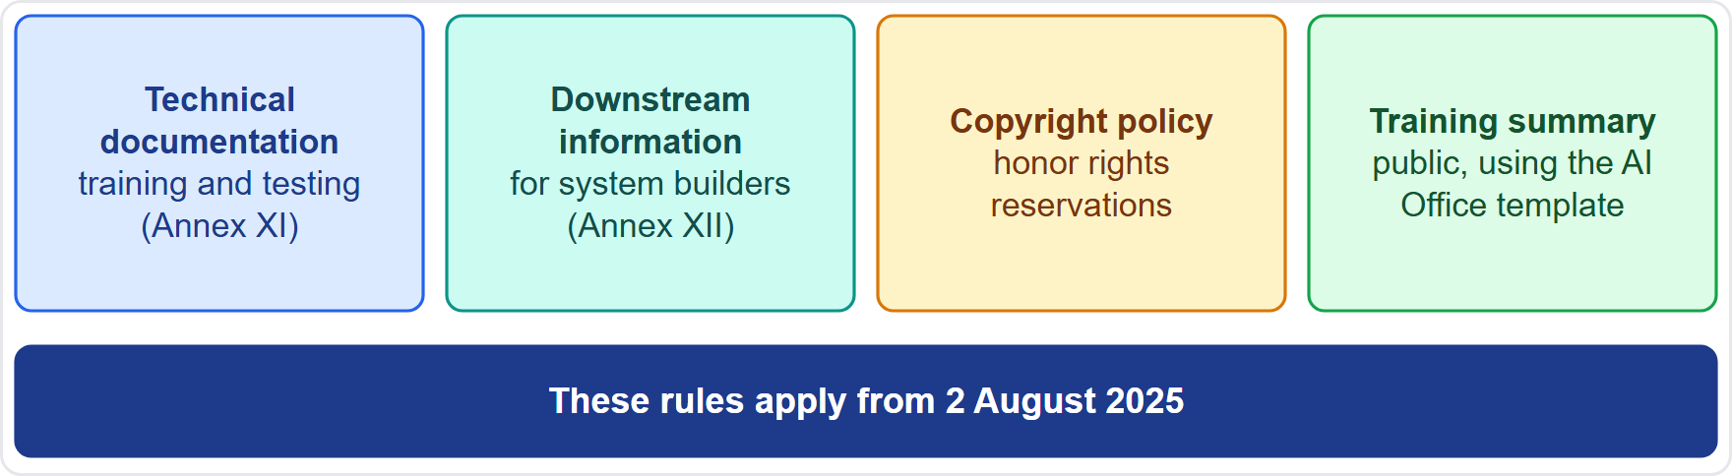
General-Purpose AI Models: Obligations of All Providers
DATES
Part 2
Technical documentation of the model, including training and testing (Annex XI)
Information and documentation for downstream providers who build it into systems (Annex XII), protecting IP and trade secrets
A copyright policy that honors rights reservations
A public summary of training content using the AI Office template (Article 53)
These rules apply from 2 August 2025
EXAM TIP These four duties apply to every general-purpose model; systemic-risk models add more.
AIGP Exam Prep Masterclass | Certified AI Governance Professional
Module 6: AI-Specific Laws: the EU AI Act and Beyond
24 / 45
Notes:
This slide is tagged dates. Every provider of a general-purpose model has four duties under Article fifty-three. Keep technical documentation of the model, including training and testing, under Annex eleven. Provide information and documentation for downstream providers who build the model into systems, under Annex twelve, while protecting intellectual property and trade secrets. Put in place a copyright policy that honors rights reservations. And publish a summary of training content, using the A I Office template. These rules apply from the second of August, twenty twenty-five. Exam tip: these four apply to every model.

Slide 25
Models With Systemic Risk (Articles 51 and 55)
BEYOND THE BOK
Part 2
A model has systemic risk if it has high-impact capabilities
It is presumed when training used more than 10^25 floating point operations, or the Commission so decides (Article 51)
Extra duties (Article 55): evaluate the model including adversarial testing; assess and mitigate systemic risks at EU level; track and report serious incidents to the AI Office; ensure cybersecurity
Helios: Corvid Labs, not Helios, carries the model-level duties; Helios, as a deployer, asks for the model documentation
EXAM TIP The compute threshold gives a presumption, not the only route to systemic-risk status.
AIGP Exam Prep Masterclass | Certified AI Governance Professional
Module 6: AI-Specific Laws: the EU AI Act and Beyond
25 / 45
Notes:
This is a beyond-the-Body-of-Knowledge slide. A model has systemic risk if it has high-impact capabilities. That is presumed when training used more than ten to the power of twenty-five floating point operations, or when the Commission so decides, under Article fifty-one. Article fifty-five adds duties: evaluate the model, including adversarial testing; assess and mitigate systemic risks at E U level; track and report serious incidents to the A I Office; and ensure cybersecurity. At Helios, Corvid Labs carries these model-level duties, and Helios asks for the model documentation. Exam tip: the compute threshold gives a presumption.

Slide 26
Codes of Practice, Open Source and the Provider Chain
DATES
Part 2
The AI Office encourages codes of practice covering the model duties; they were due by 2 May 2025
If a code is not finalized by 2 August 2025 or is inadequate, the Commission may set common rules by implementing act
Providers can show compliance through a code, harmonized standards, or other adequate means
Free and open-source models get relief from some duties, but not from the copyright policy and training summary, and not if they carry systemic risk
Downstream providers rely on the model provider's information to meet their own duties
EXAM TIP A code of practice is a route to showing compliance, not a replacement for the duties.
AIGP Exam Prep Masterclass | Certified AI Governance Professional
Module 6: AI-Specific Laws: the EU AI Act and Beyond
26 / 45
Notes:
This slide is tagged dates. The A I Office encourages codes of practice for the model duties, which were due by the second of May, twenty twenty-five. If a code is not finalized by the second of August, twenty twenty-five, or is inadequate, the Commission may set common rules by implementing act. Providers can show compliance through a code, harmonized standards, or other adequate means. Free and open-source models get relief from some duties, but not from the copyright policy and training summary, and not if they carry systemic risk. Downstream providers rely on the model provider's information. Exam tip: a code is a route to show compliance.

Slide 27
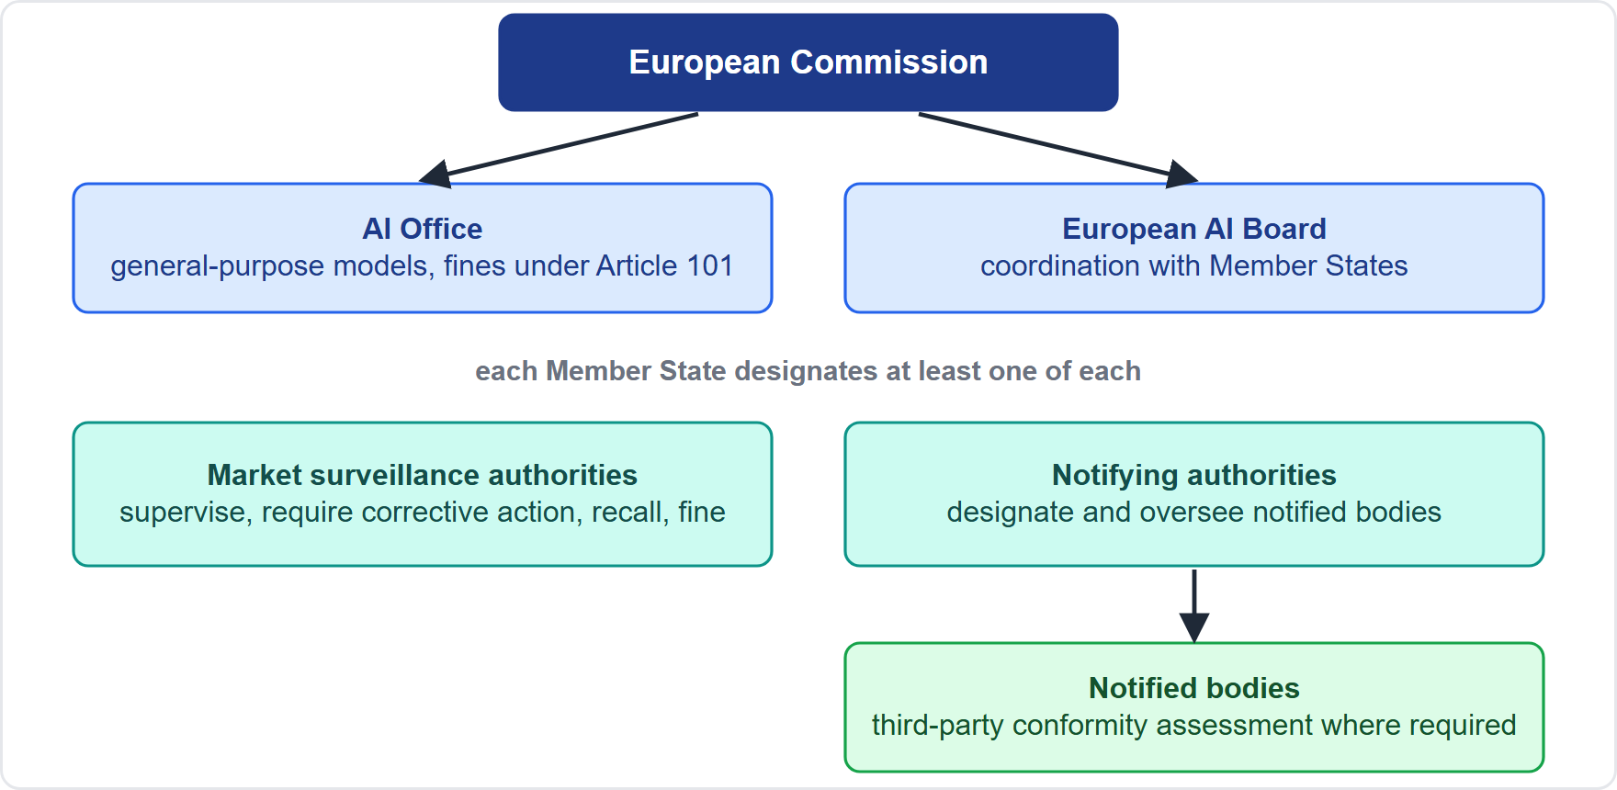
Governance and Who Enforces
Part 2
European level: the AI Office (in the Commission) oversees general-purpose models; the AI Board helps coordinate
National level: each Member State designates at least one market surveillance authority and one notifying authority, acting independently
Notified bodies perform third-party conformity assessment where required
Market surveillance authorities can require corrective action, withdraw or recall systems and impose fines
The European Data Protection Supervisor supervises EU institutions
EXAM TIP General-purpose model enforcement is European; most system enforcement is national.
AIGP Exam Prep Masterclass | Certified AI Governance Professional
Module 6: AI-Specific Laws: the EU AI Act and Beyond
27 / 45
Notes:
At European level, the A I Office, inside the Commission, oversees general-purpose models, and the A I Board helps coordinate. At national level, each Member State designates at least one market surveillance authority and one notifying authority, acting independently. Notified bodies perform third-party conformity assessment where required. Market surveillance authorities can require corrective action, withdraw or recall systems, and impose fines. The European Data Protection Supervisor supervises E U institutions. Exam tip: general-purpose model enforcement is European. Most system enforcement is national.

Slide 28
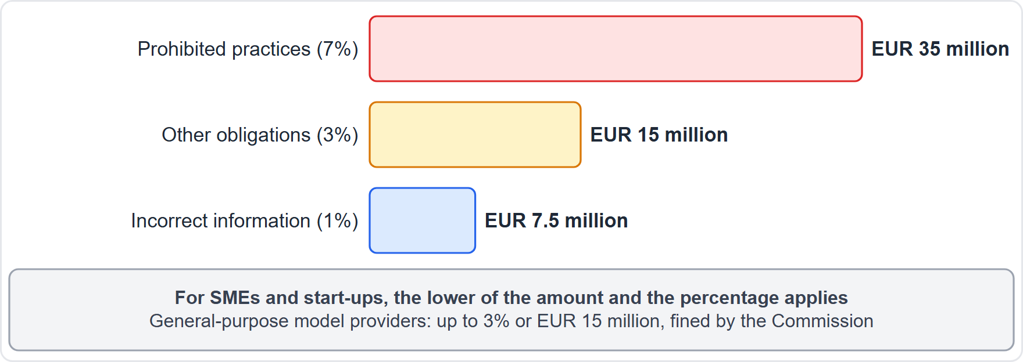
Penalties
Part 2
Prohibited practices (Article 5): up to EUR 35 million or 7% of worldwide annual turnover, whichever is higher
Most other obligations (providers, importers, distributors, deployers, authorized representatives, notified bodies, transparency): up to EUR 15 million or 3%
Incorrect, incomplete or misleading information to authorities: up to EUR 7.5 million or 1%
SMEs and start-ups: the lower of the amount or the percentage
General-purpose model providers (Article 101): up to 3% or EUR 15 million, imposed by the Commission
EXAM TIP Whichever is higher for large companies, whichever is lower for SMEs; do not confuse the GDPR's 20 million and 4%.
AIGP Exam Prep Masterclass | Certified AI Governance Professional
Module 6: AI-Specific Laws: the EU AI Act and Beyond
28 / 45
Notes:
The Act has three fine tiers. For prohibited practices under Article five: up to thirty-five million euros or seven percent of worldwide annual turnover, whichever is higher. For most other obligations, covering providers, importers, distributors, deployers, authorized representatives, notified bodies and transparency: up to fifteen million euros or three percent. For incorrect, incomplete or misleading information to authorities: up to seven and a half million euros or one percent. For small and medium enterprises and start-ups, the lower applies. General-purpose model providers face up to three percent or fifteen million euros, from the Commission. Exam tip: do not confuse the G D P R's twenty million and four percent.

Slide 29
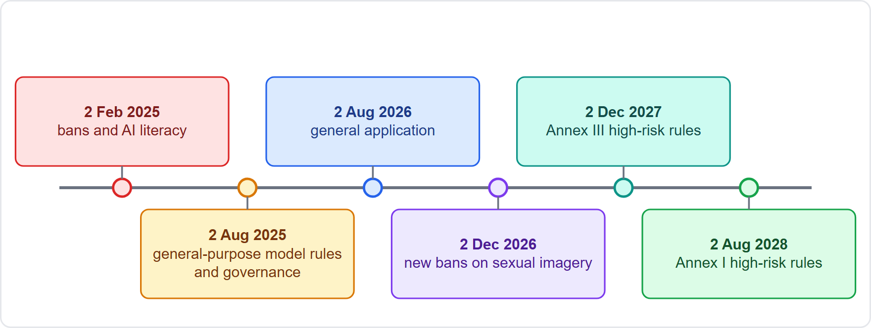
The Timeline
DATES · VERIFY LIVE
Part 2
2 February 2025: prohibitions and the AI literacy duty
2 August 2025: general-purpose model rules, governance and most penalties provisions
2 August 2026: the Act applies generally, including transparency duties
2 December 2026: the new bans on sexual imagery apply
2 December 2027: Annex III high-risk rules; 2 August 2028: Annex I product-safety high-risk rules (as amended; earlier dates were sooner)
As of 27 October 2026: consolidated text dated 27 July 2026; check for further changes
EXAM TIP Know the order: bans first, then general-purpose models, then general application, then high-risk.
AIGP Exam Prep Masterclass | Certified AI Governance Professional
Module 6: AI-Specific Laws: the EU AI Act and Beyond
29 / 45
Notes:
This slide is tagged dates and verify live. On the second of February, twenty twenty-five, the prohibitions and the A I literacy duty began to apply. On the second of August, twenty twenty-five, the general-purpose model rules, the governance provisions and most penalties provisions followed. On the second of August, twenty twenty-six, the Act applies generally, including transparency duties. On the second of December, twenty twenty-six, the new bans on sexual imagery apply. The Annex three high-risk rules now apply from the second of December, twenty twenty-seven, and the Annex one rules from the second of August, twenty twenty-eight, as amended. As of the twenty-seventh of October, twenty twenty-six, check for further changes.

Slide 30
Duties by Role: Providers, Importers, Distributors, Authorized Representatives
Part 3
Role | Main duties
Provider (Article 16) | meet the requirements, quality management system, documentation and logs, conformity assessment, declaration, CE marking, registration, corrective action
Importer (Article 23) | verify conformity, documentation, marking and instructions before placing on the market; keep key documents for 10 years; do not place non-conforming systems
Distributor | check marking, documentation and instructions; stop if non-conforming; keep storage safe
Authorized representative (Article 22) | acts for a non-EU provider under a written mandate
Each role has its own checks; none can rely on another's word alone
EXAM TIP The importer and distributor are gatekeepers: they verify before they supply.
AIGP Exam Prep Masterclass | Certified AI Governance Professional
Module 6: AI-Specific Laws: the EU AI Act and Beyond
30 / 45
Notes:
Now duties by role. The provider, under Article sixteen, meets the requirements, runs a quality management system, keeps documentation and logs, completes conformity assessment, draws up the declaration, affixes the C E marking, registers the system, and takes corrective action. The importer, under Article twenty-three, verifies conformity, documentation, marking and instructions before placing on the market, and keeps key documents for ten years. The distributor checks marking, documentation and instructions, and stops if non-conforming. The authorized representative acts for a non-E U provider under a written mandate. Exam tip: importers and distributors verify before they supply.

Slide 31
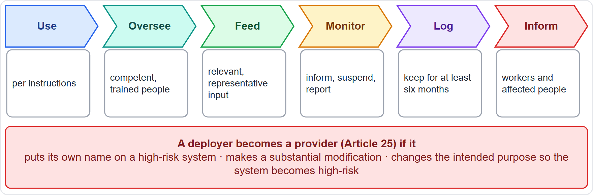
Deployer Duties and When a Role Changes
Part 3
Use per instructions and assign human oversight to people with competence, training and authority (Article 26)
Ensure input data under your control are relevant and sufficiently representative
Monitor, tell the provider, suspend use where there is a risk, and report serious incidents (the provider first, then the authorities)
Keep logs for at least six months; inform workers' representatives and affected workers before workplace use, and inform people subject to decisions
A deployer becomes a provider if it puts its name on a high-risk system, makes a substantial modification, or changes the intended purpose so that it becomes high-risk (Article 25)
Helios: as deployer of the hiring tool, it must do all of the above
EXAM TIP Rebranding or repurposing a high-risk system moves provider duties onto you.
AIGP Exam Prep Masterclass | Certified AI Governance Professional
Module 6: AI-Specific Laws: the EU AI Act and Beyond
31 / 45
Notes:
Deployers have their own duties under Article twenty-six. Use the system per its instructions, and assign human oversight to people with competence, training and authority. Ensure input data under your control are relevant and sufficiently representative. Monitor, tell the provider, suspend use where there is a risk, and report serious incidents, the provider first and then the authorities. Keep logs for at least six months. Inform workers' representatives and affected workers before workplace use, and inform people subject to decisions. And under Article twenty-five, a deployer becomes a provider if it puts its name on a high-risk system, makes a substantial modification, or changes the intended purpose so it becomes high-risk. Exam tip: rebranding or repurposing moves provider duties onto you.

Slide 32
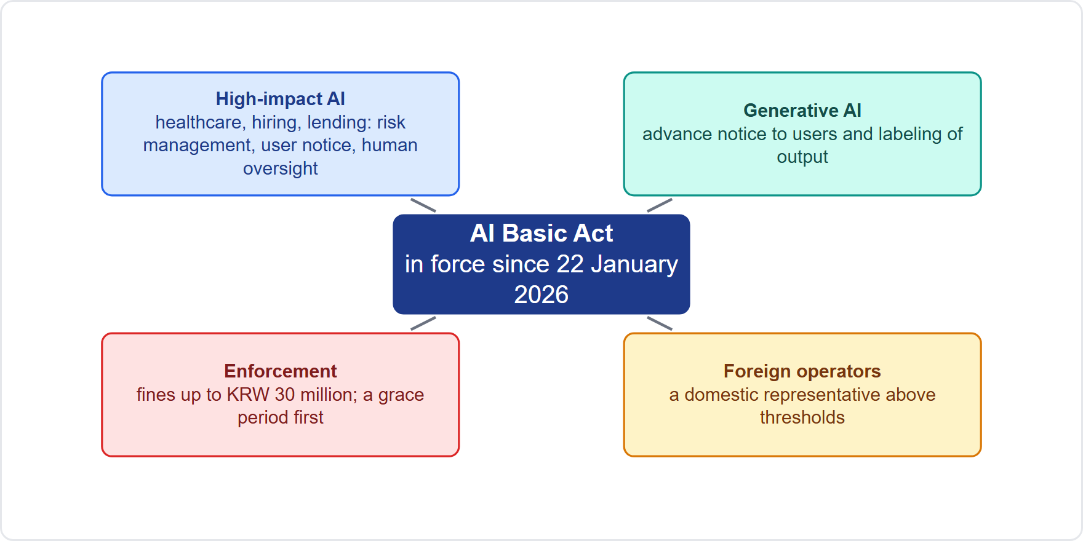
South Korea: The AI Basic Act
VERIFY LIVE
Part 3
In force from 22 January 2026 (secondary sources)
High-impact AI in areas such as healthcare, hiring and lending: risk management, user notice and human oversight duties
Generative AI: advance notice to users and labeling of generated output
Foreign operators above set thresholds appoint a domestic representative
Fines up to KRW 30 million, with a grace period of at least a year announced before fines
As of 27 October 2026: details rest on secondary reports; check the official text
EXAM TIP Korea resembles the EU in risk focus and in generative-AI notice and labeling, with lighter penalties.
AIGP Exam Prep Masterclass | Certified AI Governance Professional
Module 6: AI-Specific Laws: the EU AI Act and Beyond
32 / 45
Notes:
This slide is tagged verify live, because these details rest on secondary sources. South Korea's A I Basic Act has been in force since the twenty-second of January, twenty twenty-six. It focuses on high-impact A I, in areas such as healthcare, hiring and lending, with duties for risk management, user notice and human oversight. For generative A I, it requires advance notice to users and labeling of generated output. Foreign operators above set thresholds appoint a domestic representative. Fines reach thirty million won, and a grace period of at least a year was announced. Exam tip: Korea resembles the E U in risk focus, with lighter penalties.

Slide 33
The US Federal Position
VERIFY LIVE
Part 3
There is no comprehensive federal AI statute; agencies apply existing laws: the FTC on deception and unfairness, the Equal Employment Opportunity Commission (EEOC) on employment, the Consumer Financial Protection Bureau (CFPB) on credit, and others
Federal policy has moved toward removing barriers and uniform national rules
Executive Order 14365 (11 December 2025) directed a federal challenge to state AI laws; a Justice Department AI litigation task force was formalized on 9 January 2026
On 20 March 2026 the White House released non-binding recommendations for a national framework that would preempt state laws
As of 27 October 2026: no federal statute preempts state AI laws, so state and local laws still bind private companies
EXAM TIP In the US, the answer to which law applies is usually existing federal law plus state and local AI-specific rules.
AIGP Exam Prep Masterclass | Certified AI Governance Professional
Module 6: AI-Specific Laws: the EU AI Act and Beyond
33 / 45
Notes:
This slide is tagged verify live. The United States has no comprehensive federal A I statute. Agencies apply existing laws: the F T C on deception and unfairness, the Equal Employment Opportunity Commission on employment, the Consumer Financial Protection Bureau on credit, and others. Federal policy has moved toward removing barriers and uniform national rules. Executive Order fourteen thousand three hundred sixty-five, of the eleventh of December, twenty twenty-five, directed a federal challenge to state A I laws, and a Justice Department task force was formalized on the ninth of January, twenty twenty-six. On the twentieth of March, twenty twenty-six, the White House released non-binding recommendations to preempt state laws. As of the twenty-seventh of October, twenty twenty-six, no federal statute preempts them.

Slide 34
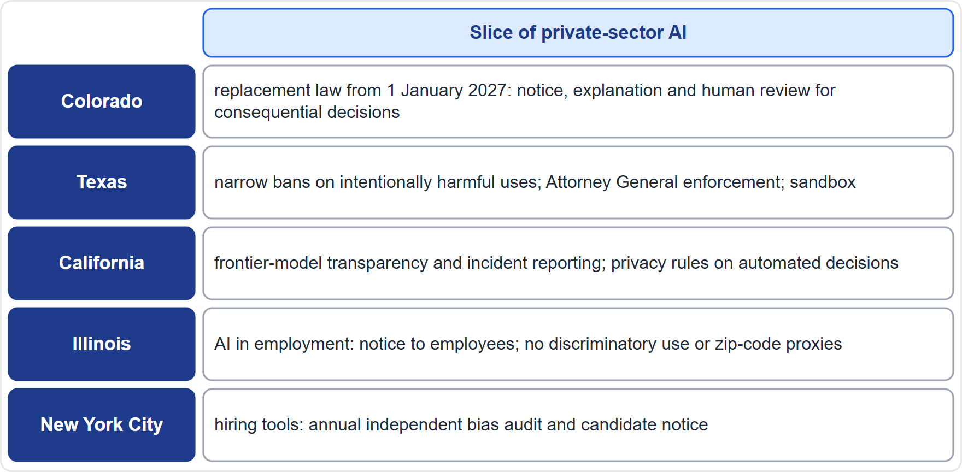
US State and Local AI Laws
VERIFY LIVE
Part 3
Colorado: the 2024 AI Act was repealed and replaced by Senate Bill (SB) 26-189, signed 14 May 2026, effective 1 January 2027: consumer notice, explanations of adverse decisions, human review
Texas (House Bill, HB, 149): a narrow ban on intentionally harmful uses, with a notice-and-cure period and a sandbox
California: SB 53 frontier-model transparency and incident reporting (effective 1 January 2026); automated decision-making privacy rules
Illinois (HB 3773): employers notify employees of AI in employment decisions; no discriminatory use
New York City (Local Law 144): annual independent bias audit and candidate notice for hiring tools
As of 27 October 2026: these statuses rest on secondary reports; check each statute
EXAM TIP For Helios's hiring in New York City and Illinois, the audit of an automated employment decision tool (AEDT) and the notice duty are the two to remember.
AIGP Exam Prep Masterclass | Certified AI Governance Professional
Module 6: AI-Specific Laws: the EU AI Act and Beyond
34 / 45
Notes:
This slide is tagged verify live. Colorado's twenty twenty-four A I Act was delayed to the thirtieth of June, twenty twenty-six, then repealed and replaced by Senate Bill twenty-six dash one eighty-nine, signed on the fourteenth of May. It takes effect on the first of January, twenty twenty-seven: consumer notice, explanations of adverse decisions and human review. Texas has a narrow ban on intentionally harmful uses, with Attorney General enforcement and a sandbox. California has frontier-model transparency and incident reporting, effective the first of January, twenty twenty-six, plus privacy rules on automated decision-making. Illinois requires notice of A I in employment decisions. New York City requires an annual independent bias audit and candidate notice for hiring tools.

Slide 35
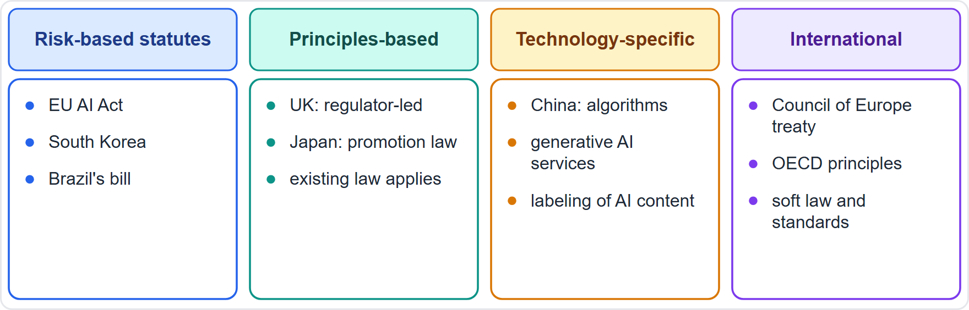
Other Jurisdictions: Approaches Compared
BEYOND THE BOK · VERIFY LIVE
Part 3
Risk-based statutes: the EU AI Act, South Korea, and Brazil's bill
Principles-based, regulator-led: the UK, with no general AI statute, and Japan's promotion-oriented law, leaning on cooperation and existing law
Technology-specific rules: China regulates algorithms, generative AI services and the labeling of AI-generated content
International instruments: the Council of Europe Framework Convention on AI, the first binding AI treaty (opened 5 September 2024), and the OECD principles
As of 27 October 2026: these regimes are evolving, so the course teaches them as approaches
EXAM TIP Questions on other jurisdictions ask for the approach, not article numbers.
AIGP Exam Prep Masterclass | Certified AI Governance Professional
Module 6: AI-Specific Laws: the EU AI Act and Beyond
35 / 45
Notes:
This is a beyond-the-Body-of-Knowledge slide, tagged verify live. The Study Guide says the credential covers other jurisdictions, so know the approaches. Risk-based statutes: the E U A I Act, South Korea, and Brazil's bill. Principles-based, regulator-led: the U K, with no general A I statute, and Japan's promotion-oriented law, leaning on cooperation and existing law. Technology-specific rules: China regulates algorithms, generative A I services and the labeling of A I-generated content. International instruments: the Council of Europe Framework Convention on A I, the first binding A I treaty, opened on the fifth of September, twenty twenty-four, and the O E C D principles. Exam tip: expect approaches, not article numbers.

Slide 36
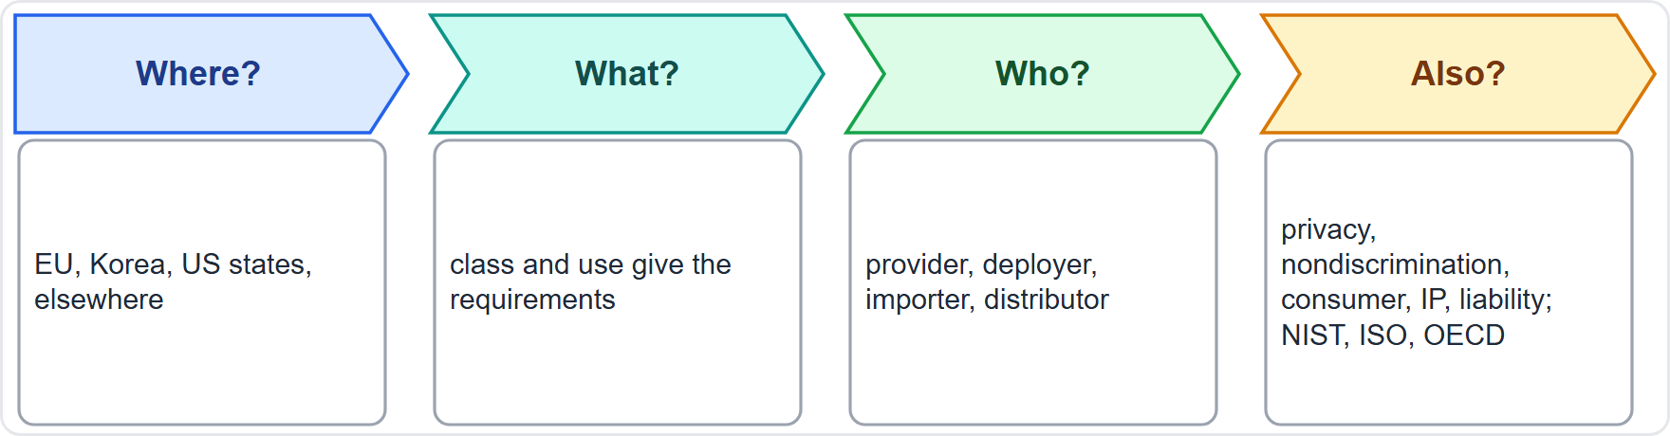
Which Instrument Applies? A Decision Aid
Part 3
Where is the system used and who is affected? That selects the jurisdictions
What does it do? That gives the class and the requirements
Who are you in the chain? That gives your duties
Which existing laws also apply (privacy, nondiscrimination, consumer protection, IP, liability) and which framework organizes the work (module 7)
Helios example: EU AI Act for the hiring tool and assistant; New York City and Illinois rules; GDPR; nondiscrimination law; Korea for its Korean customers
EXAM TIP AI-specific laws sit on top of existing laws; they do not replace them.
AIGP Exam Prep Masterclass | Certified AI Governance Professional
Module 6: AI-Specific Laws: the EU AI Act and Beyond
36 / 45
Notes:
Here is a decision aid. First, where is the system used, and who is affected? That selects the jurisdictions. Second, what does it do? That gives the class and the requirements. Third, who are you in the chain? That gives your duties. Fourth, which existing laws also apply, such as privacy, nondiscrimination, consumer protection, I P and liability, and which framework organizes the work, which is module seven. For Helios: the E U A I Act for the hiring tool and assistant, New York City and Illinois rules, the G D P R, nondiscrimination law, and Korea for its Korean customers. Exam tip: A I-specific laws sit on top of existing laws.

Slide 37
Module Recap
Part 3
1
Classes
2
High-risk
3
Oversight, transparency, QMS
prohibited, high-risk (Annex I and Annex III), transparency, minimal; general-purpose models on their own track
Articles 9 to 15 requirements, conformity assessment, registration, FRIA, post-market monitoring, incident reports (15, 10 and 2 days)
effective human oversight; tell people they deal with AI; a documented quality system
4
GPAI
5
Penalties
6
Beyond the EU
four duties for all; systemic-risk models add evaluations, risk mitigation, incident reporting and cybersecurity
EUR 35 million or 7%; EUR 15 million or 3%; EUR 7.5 million or 1%; roles carry different duties
Korea, US federal and state laws, and other approaches
AIGP Exam Prep Masterclass | Certified AI Governance Professional
Module 6: AI-Specific Laws: the EU AI Act and Beyond
37 / 45
Notes:
Let us recap. The classes: prohibited, high-risk through Annex one and Annex three, transparency, and minimal, with general-purpose models on their own track. High-risk means the Article nine to fifteen requirements, conformity assessment, registration, the rights assessment, post-market monitoring, and incident reports at fifteen, ten and two days. Oversight must be effective, people must be told they deal with A I, and a quality system ties it together. General-purpose models have four duties for all and more for systemic risk. Fines reach thirty-five million euros or seven percent, fifteen million or three, and seven and a half million or one. And roles carry different duties.

Slide 38
Practice Question 1
Part 3
Q1
Helios's hiring tool screens and ranks job applicants in the EU. How does the AI Act classify it?
A
As a prohibited practice, because all AI used in recruitment is banned in the Union under Article 5
B
As high-risk, because recruitment is an Annex III area and the tool profiles people
C
As limited risk, because the main duty is to tell applicants that they are interacting with AI
D
As minimal risk, because a recruiter makes the final decision about each applicant
AIGP Exam Prep Masterclass | Certified AI Governance Professional
Module 6: AI-Specific Laws: the EU AI Act and Beyond
38 / 45
Notes:
Question one. Helios's hiring tool screens and ranks job applicants in the E U. How does the A I Act classify it? The four options are on the screen. [PAUSE 12] The answer is B. Employment, including recruitment and selection, is an Annex three area, and a system that profiles people cannot use the Article six, paragraph three exception. Recruitment A I is not banned, and a human decision does not make it minimal.

Slide 39
Practice Question 2
Part 3
Q2
Which TWO practices are prohibited under Article 5 of the AI Act? (Select TWO.)
A
Inferring employees' emotions in the workplace, except for medical or safety reasons
B
Using a spam filter to sort a company's incoming email into folders and a junk folder
C
Scoring applicants for a bank loan with a model that estimates their creditworthiness
D
Building a facial recognition database by untargeted scraping of internet or CCTV images
E
Showing a notice that a customer is chatting with an AI system before the chat starts
AIGP Exam Prep Masterclass | Certified AI Governance Professional
Module 6: AI-Specific Laws: the EU AI Act and Beyond
39 / 45
Notes:
Question two. Which two practices are prohibited under Article five of the A I Act? Select two. The five options are on the screen. [PAUSE 15] The answers are A and D. Workplace emotion inference, except for medical or safety reasons, and untargeted facial scraping are banned. A spam filter is minimal risk, credit scoring is a high-risk use, and a chatbot notice is a transparency duty that the Act requires.

Slide 40
Practice Question 3
Part 3
Q3
A provider of a high-risk system must run a continuous, iterative process throughout the system's life cycle to identify and reduce foreseeable risks. Which requirement is this?
A
The data governance requirement in Article 10, which concerns the quality of training data
B
The human oversight requirement in Article 14, which concerns the people who monitor the system
C
The risk management system in Article 9, which runs throughout the life cycle of the system
D
The record-keeping requirement in Article 12, which concerns automatic logs of system events
AIGP Exam Prep Masterclass | Certified AI Governance Professional
Module 6: AI-Specific Laws: the EU AI Act and Beyond
40 / 45
Notes:
Question three. A provider of a high-risk system must run a continuous, iterative process throughout the system's life cycle to identify and reduce foreseeable risks. Which requirement is this? The four options are on the screen. [PAUSE 12] The answer is C. Article nine requires a risk management system that is a continuous iterative process, planned and run throughout the entire life cycle.

Slide 41
Practice Question 4
Part 3
Q4
Helios's customer assistant chats directly with EU customers and is not used for any high-risk purpose. Which duty most directly applies?
A
Registering the assistant in the EU database of high-risk systems before it is used
B
Carrying out a fundamental rights impact assessment before the first customer chat
C
Obtaining a conformity assessment from a notified body before offering the assistant
D
Making sure customers are informed that they are interacting with an AI system
AIGP Exam Prep Masterclass | Certified AI Governance Professional
Module 6: AI-Specific Laws: the EU AI Act and Beyond
41 / 45
Notes:
Question four. Helios's customer assistant chats directly with E U customers and is not used for any high-risk purpose. Which duty most directly applies? The four options are on the screen. [PAUSE 12] The answer is D. A system that interacts directly with people carries a transparency duty under Article fifty: people must be told they are dealing with A I, unless it is obvious. The other options belong to high-risk systems.

Slide 42
Practice Question 5
Part 3
Q5
Corvid Labs trains a general-purpose model using more than 10^25 floating point operations. What follows under the AI Act?
A
The model is exempt from the Act, because the Act regulates AI systems and not models
B
The model is presumed to have systemic risk, so its provider takes on extra duties
C
The model must be withdrawn from the EU market until a notified body has certified it for use
D
The model becomes a prohibited practice, because training at that scale is banned in the Union
AIGP Exam Prep Masterclass | Certified AI Governance Professional
Module 6: AI-Specific Laws: the EU AI Act and Beyond
42 / 45
Notes:
Question five. Corvid Labs trains a general-purpose model using more than ten to the power of twenty-five floating point operations. What follows under the A I Act? The four options are on the screen. [PAUSE 12] The answer is B. Training above that threshold creates a presumption of systemic risk, which adds duties such as evaluation with adversarial testing, risk mitigation, incident reporting and cybersecurity.

Slide 43
Practice Question 6
Part 3
Q6
What is the maximum fine for using a prohibited AI practice under the AI Act?
A
EUR 7.5 million or 1% of worldwide annual turnover, whichever is higher
B
EUR 15 million or 3% of worldwide annual turnover, whichever is higher
C
EUR 35 million or 7% of worldwide annual turnover, whichever is higher
D
EUR 20 million or 4% of worldwide annual turnover, whichever is higher
AIGP Exam Prep Masterclass | Certified AI Governance Professional
Module 6: AI-Specific Laws: the EU AI Act and Beyond
43 / 45
Notes:
Question six. What is the maximum fine for using a prohibited A I practice under the A I Act? The four options are on the screen. [PAUSE 12] The answer is C: thirty-five million euros or seven percent of worldwide annual turnover, whichever is higher. The lower tiers cover other obligations and incorrect information, and twenty million euros and four percent belongs to the G D P R.

Slide 44
Practice Question 7
Part 3
Q7
Helios deploys the Veridex hiring tool, which is a high-risk system. Which TWO duties fall on Helios as the deployer? (Select TWO.)
A
Drawing up the EU declaration of conformity and affixing the CE marking to the tool itself
B
Using the tool as instructed and assigning competent, trained people to oversee it
C
Running the quality management system that covers the tool's design and development work
D
Registering the tool as the provider and keeping its technical documentation up to date
E
Informing workers' representatives and affected people that the tool is in use
AIGP Exam Prep Masterclass | Certified AI Governance Professional
Module 6: AI-Specific Laws: the EU AI Act and Beyond
44 / 45
Notes:
Question seven. Helios deploys the Veridex hiring tool, which is a high-risk system. Which two duties fall on Helios as the deployer? Select two. The five options are on the screen. [PAUSE 15] The answers are B and E. Deployers use the system as instructed, assign competent oversight, and inform workers' representatives and affected people. The declaration, marking, quality system, registration and documentation are provider duties.

Slide 45
Answers at a Glance
Part 3
Question | Answer | Why
Q1 | B | Annex III employment, with profiling
Q2 | A, D | Workplace emotion inference and face scraping are banned
Q3 | C | Article 9 risk management system
Q4 | D | Article 50: tell people they interact with AI
Q5 | B | Over the compute threshold: presumed systemic risk
Q6 | C | EUR 35 million or 7%
Q7 | B, E | Use as instructed, oversight, and informing people
AIGP Exam Prep Masterclass | Certified AI Governance Professional
Module 6: AI-Specific Laws: the EU AI Act and Beyond
45 / 45
Notes:
Here are all seven answers. Question one: B. Question two: A and D. Question three: C. Question four: D. Question five: B. Question six: C. Question seven: B and E. That completes Module six. Next, Module seven covers standards and frameworks: the O E C D principles, the N I S T A I Risk Management Framework, and the I S O standards.

